Slide 1
Analysis of PaaS & SaaS Interoperability through Azure, OpenShift and AWS
Javedali Shaikh (16212373) | Sanjay Singh (16211668) | Kevin Shortall (16213216)
07/12/2017

Slide 2
Agenda
Goals
Key points for Azure, Red Hat OpenShift and AWS
Challenges Faced
Comparison
Conclusion

Slide 3
Goals
Exploring PaaS (website hosting/deploying and storage)
Cloud Interoperability using SaaS
Migration of ASP.NET based website from one cloud to another (Interoperability)
Scalability - Auto Scaling

Slide 4
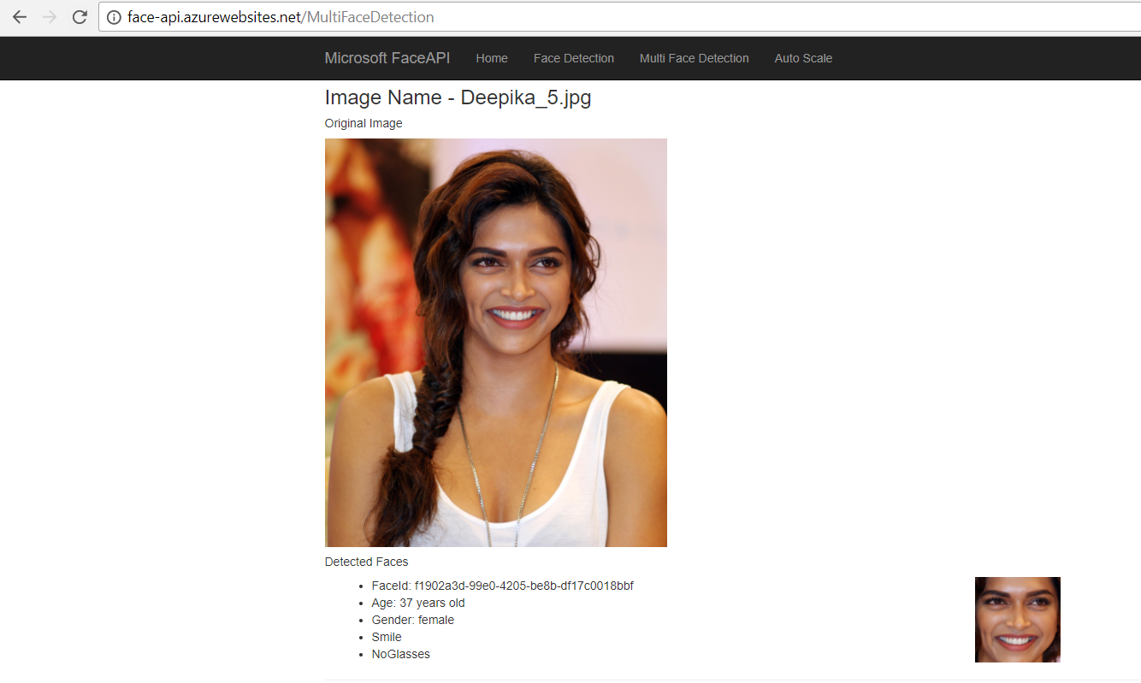
Website
ASP.NET MVC 4.5
Face Detection using Azure Face API
Storage for images
http://face-api.azurewebsites.net/MultiFaceDetection

Slide 5
Tools Used
Visual Studio 2015, 2017
Azure, AWS and OpenShift portal
Click2Cloud for OpenShift

Slide 6
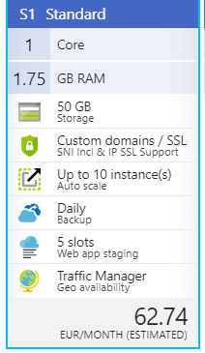
Microsoft Azure - Key Points - 1
Free trial - 12 months - $ 200 credit
App Service (Web APPs) to host website
Storage created in WEU with geo replication
REST APIs to access storage,
easy for developers

Slide 7
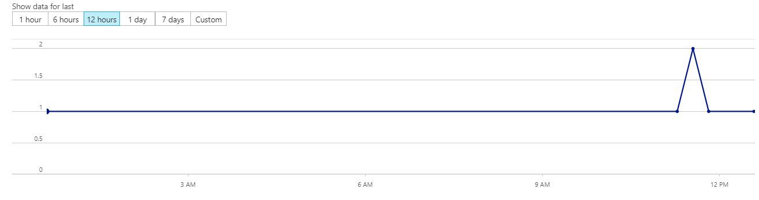
Microsoft Azure - Key Points - 2
Auto Scale configured on metric (CPU > 70)

Slide 8
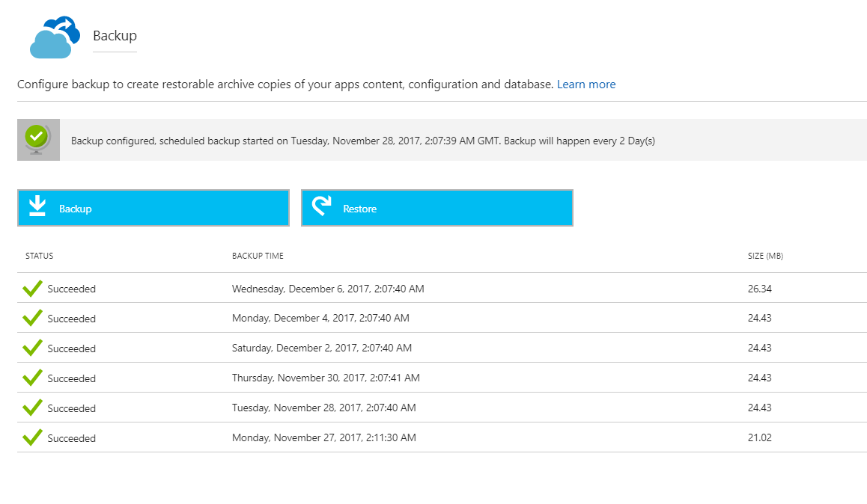
Microsoft Azure - Key Points - 3
Back up every 2 days

Slide 9
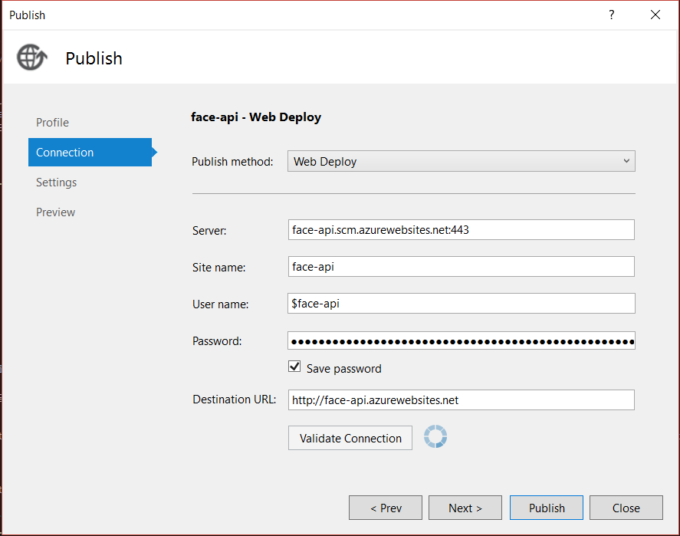
Microsoft Azure - Key Points - 4
Deploying via Visual Studio

Slide 10
Microsoft Azure - advantages
PaaS - website hosting and deployment is super easy for ASP
Variety of storage options - Blob, File, Table, SQl etc.
Easy to use and very good portal UI/UX
Great support for developers specially from .NET community

Slide 11
Microsoft Azure - challenges
Blob storage not getting created for half day in free trial
REST API header issue for authentication
Documentation is plenty but can still be better (examples)
Can be cheap or provide some cheaper options for start ups

Slide 12
OpenShift
Want to test interoperability between Linux based cloud and .Net based application.
Red Hat open source auto scaling Platform as a Service
Allows developers to quickly develop, build, deploy & manage containerised services and application in a cloud environment.
Also, OpenShift user can access additional storage volume types, including cloud-platform storage from AWS(s3) Google

Slide 13
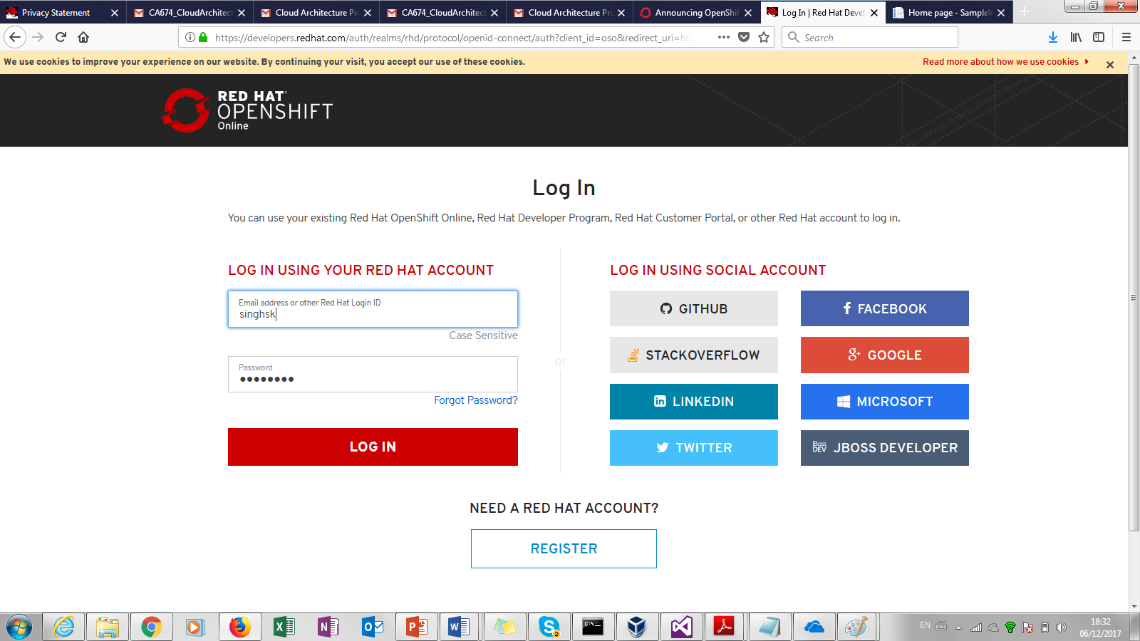
OpenShift Web portal

Slide 14
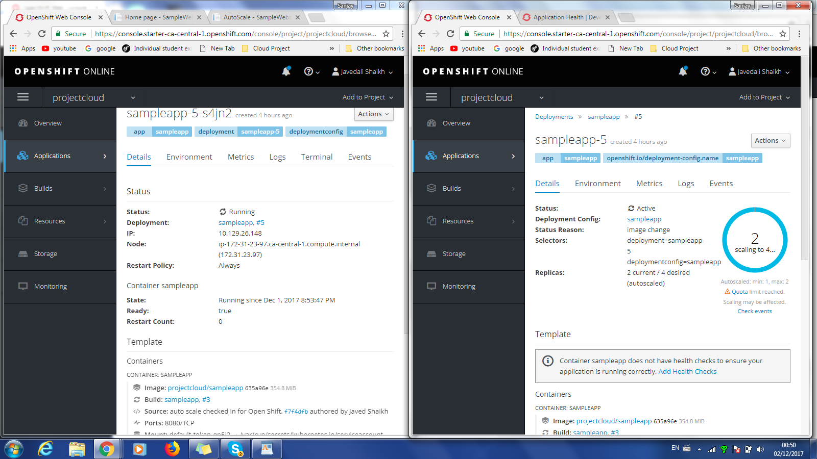
OpenShift Auto scaling

Slide 15
OpenShift- advantages
Open source container based virtualization tool.
OpenShift supports latest .Net frameworks (Core).
Enterprise-grade, container-based platform with no vendor lock-in
OpenShift platform is very scalable, flexible and easy to understand.

Slide 16
OpenShift- challenges
ASP.Net MVC 4.5 framework is not supported.
Its support is lacking in options, especially when it comes to on-demand service.
Less documentation, FAQ and walkthrough
Troubleshooting is difficult.
Difficult to find email address and contact details

Slide 17
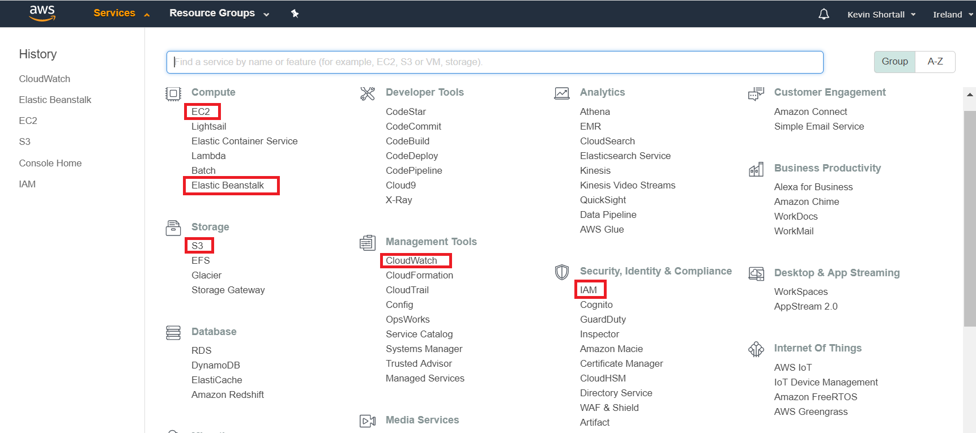
Amazon AWS - Portal

Slide 18
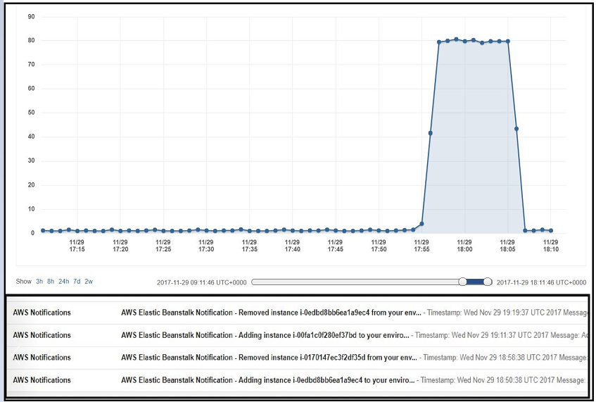
Amazon AWS - Autoscaling

Slide 19
Amazon AWS- advantages
Interoperability - excellent options as market leader
Documentation - plentiful (but can require some AWS knowledge)
Free Tier - allows new user to experience AWS
Configurations - easy and intuitive to change/experiment
Monitoring - user-friendly interface
Visual Studio toolkit - makes deployment easier

Slide 20
Amazon AWS- challenges
User Permissions - must access Remote Desktop in AWS to allow modify rights for C:\inetpub folder to fully deploy app
Documentation - often older GUI versions used in documentation

Slide 21
Comparison Table
(Weight 0-5, Score 0-5)
 | Weight | Azure | OpenShift | AWS
Creating an Account / Installation | 2 | 4 | 4 | 4
Documentation & Community | 3 | 4 | 2 | 3.5
Management Portal | 3 | 5 | 3 | 3.5
Storage | 4 | 5 | 2.5 | 4
Deploying Applications | 3 | 5 | 3 | 3.5
Interoperability | 4 | 5 | 2.5 | 5
Costs & Free Plans | 4 | 3 | 3 | 4
Configurations | 3 | 4.5 | 3 | 5
Backup resources | 3 | 4.5 | 2.5 | 5
Scalability | 5 | 5 | 3 | 5
Ease of Use/User-Friendliness | 3 | 4.5 | 2 | 3
Monitoring | 3 | 4 | 3 | 4.5
Security | N/A | N/A | N/A | N/A
Total Score | 200 | 179.5 | 110.5 | 169

Slide 22
Conclusion - 1
Studied, implemented and evaluated PaaS and Saas aspects of all 3 clouds
Learned that in open source world things are not straightforward, things are not as user friendly as compared to its giant peers
AWS the market leader truly deserves its position, as it showed great support even for .NET

Slide 23
Conclusion - 2
Azure is relatively new compared to AWS but still offers variety of products and services. It can still do better with costing
OpenShift is good enough to try out sample projects, but to scale the application to real world it lacks experience and resource

Slide 24
Video Location
Blog Location
AWS - https://github.com/javedsha/CA674-CloudProject/blob/master/CA674_Screencast_KevinShortall_AWS.mp4
OpenShift - https://github.com/javedsha/CA674-CloudProject/blob/master/OpenShift.mp4
Azure - https://drive.google.com/open?id=17nz5m69cF5fOJk7B2Zy3l3brawdaxwFf
https://github.com/javedsha/CA674-CloudProject/blob/master/Blog.docx

Slide 25
Thank You! Questions?

