Slide 1
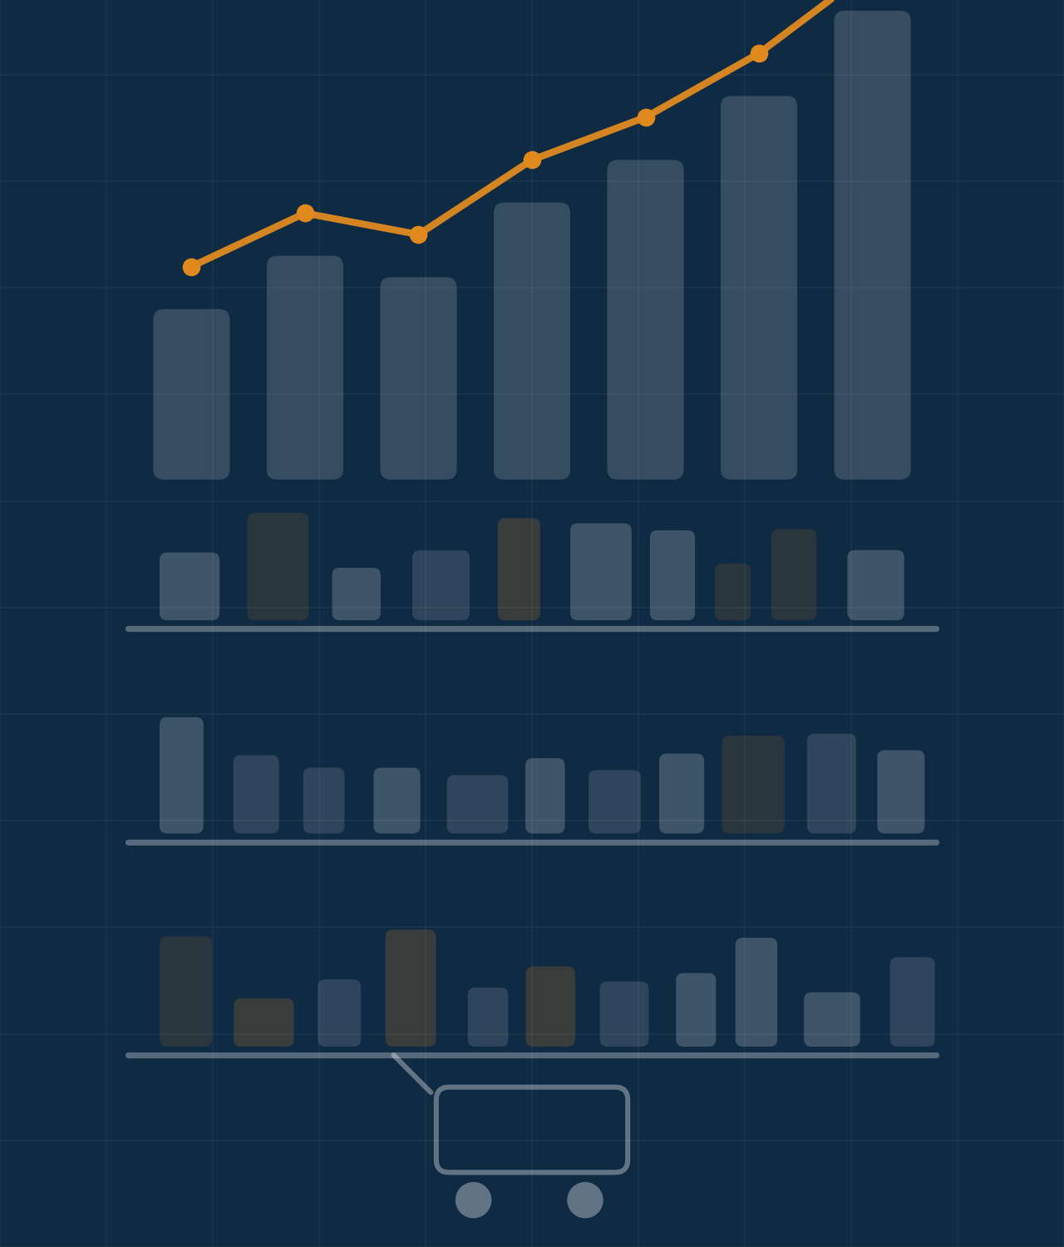
CALIBO AI ACADEMY · PHASE 1 · MINI USE CASE 01
CATEGORY
INTELLIGENCE
Retail Product Performance EDA
GROUP 12
Geetha Javeed Vikas Ashok
Retail / E-commerce | Python · Pandas · NumPy · Matplotlib · Seaborn
Notes:
Good morning. We are Group 12, and our mini use case is Category Intelligence — a retail product performance EDA. We analysed six months of transaction data from a 12-store regional retail chain in Andhra Pradesh, built entirely in Python with Pandas, NumPy, Matplotlib and Seaborn. Over the next ten slides we will walk you through the business problem, what the data showed us, and the position we would take into a supplier review. Every number you will see is calculated directly from the dataset — nothing is estimated.

Slide 2




THE SITUATION
Business Context
A regional retail chain
12 stores across six Andhra Pradesh cities — Vijayawada, Guntur, Rajahmundry, Tirupati, Nellore and Kakinada.
Five product categories
Electronics, Apparel, Grocery, Home & Kitchen and Personal Care — 25 products in total, five per category.
Six months of transactions
107,836 transaction records covering 1 January to 30 June 2026, worth ₹45.98 Cr in revenue.
A decision waiting to be made
The Category Manager has a quarterly supplier review next week, where each category argues for shelf space and promotional investment.
12 Stores
→
5 Categories
→
6 Months
→
Supplier Review
GROUP 12 · Category Intelligence
Notes:
This is a regional chain — twelve stores, six cities, five categories, twenty-five products. What matters is the timing: the Category Manager has a supplier review next week, and every supplier will walk in arguing that their category deserves more shelf space and more promotional money. She needs her own evidence, not theirs. We have six months of transaction data — 107,836 rows, January to June 2026, ₹45.98 crore of revenue — and that file is our single source of truth. The whole analysis is built to send her into that meeting with a position she can defend.

Slide 3




THE BUSINESS QUESTION
What Are We Trying to Answer?
Based on six months of transaction data, which categories and products are driving performance, where are declines occurring, and what should the Category Manager prioritise for the supplier review?
01
02
03
04
05
Category Revenue Trends
Top & Bottom Products
Discount Effectiveness
Day & Month Patterns
Category Recommendation
Month-on-month revenue for all five categories
The two best and two weakest products in each category
Whether discount spend is buying incremental volume
When demand actually occurs across the week and the half-year
One defensible position for the supplier review
GROUP 12 · Category Intelligence
Notes:
Everything we built answers one question, and it is a decision question, not a data question: what should the Category Manager prioritise going into the supplier review? We broke it into five objectives. First, which categories are growing or declining month on month. Second, which products inside each category carry it and which drag. Third, whether the discounts the chain funds are actually generating volume. Fourth, when demand naturally occurs, so promotions can be timed rather than guessed. And fifth, pulling all of that into a single recommendation. Those five objectives map directly onto the next eight slides.

Slide 4


THE FRAMEWORK
CBIM Problem Canvas
From Retail Business Problem to Data-Driven Decision
Situation
01
Complication
02
Business Question
03
A retail chain with 12 stores, 5 categories and 25 products, tracked across 6 months of transactions ahead of the supplier review.
Category and product performance shifts over time — some grow while others decline, and discounts may lift sales without lifting revenue.
Which categories and products are performing well, which need attention, and are discounts really helping ahead of the supplier review?
SSOT
04
Success Definition
05
Primary Stakeholder
06
MUC01_Retail_Sales_Dataset.csv — transaction-level data on dates, stores, categories, products, units, prices, revenue and discounts.
Spot the strongest and weakest categories and products, understand discount and timing effects, and turn it into clear, data-backed actions.
Category Manager — responsible for category performance, supplier reviews, product decisions, shelf space and promotional investment.
GROUP 12 · Category Intelligence

Slide 5
DATASET & DATA QUALITY
Understanding the Data
107,836
10
5
25
₹45.98 Cr
Transactions
Columns
Categories
Products
Total Revenue
0 null values
Dataset Structure
Every one of the ten columns is complete — no imputation was needed.
Transaction ID
Date
0 duplicate transaction IDs
No double-counted sales; no rows were dropped.
Store
City
Jan 1 – Jun 30, 2026
Category
Product
All 181 days present — a continuous six-month window.
Units Sold
Unit Price
Discounts top out at 20%
The brief describes a 0–30% range; the file contains only 0, 5, 10, 15 and 20%.
Revenue
Discount %
GROUP 12 · Category Intelligence
Notes:
Before trusting any finding we audited the file. 107,836 transactions, ten columns, five categories, twenty-five products, ₹45.98 crore of revenue. Critically for a supplier meeting: zero nulls and zero duplicate transaction IDs, so nothing needed cleaning and nothing is double counted. All 181 days are present. One honest flag — the assignment brief describes discounts running to 30%, but the actual file only contains 0, 5, 10, 15 and 20%. We analysed what is there and reported the higher bracket as empty rather than inventing numbers for it.

Slide 6
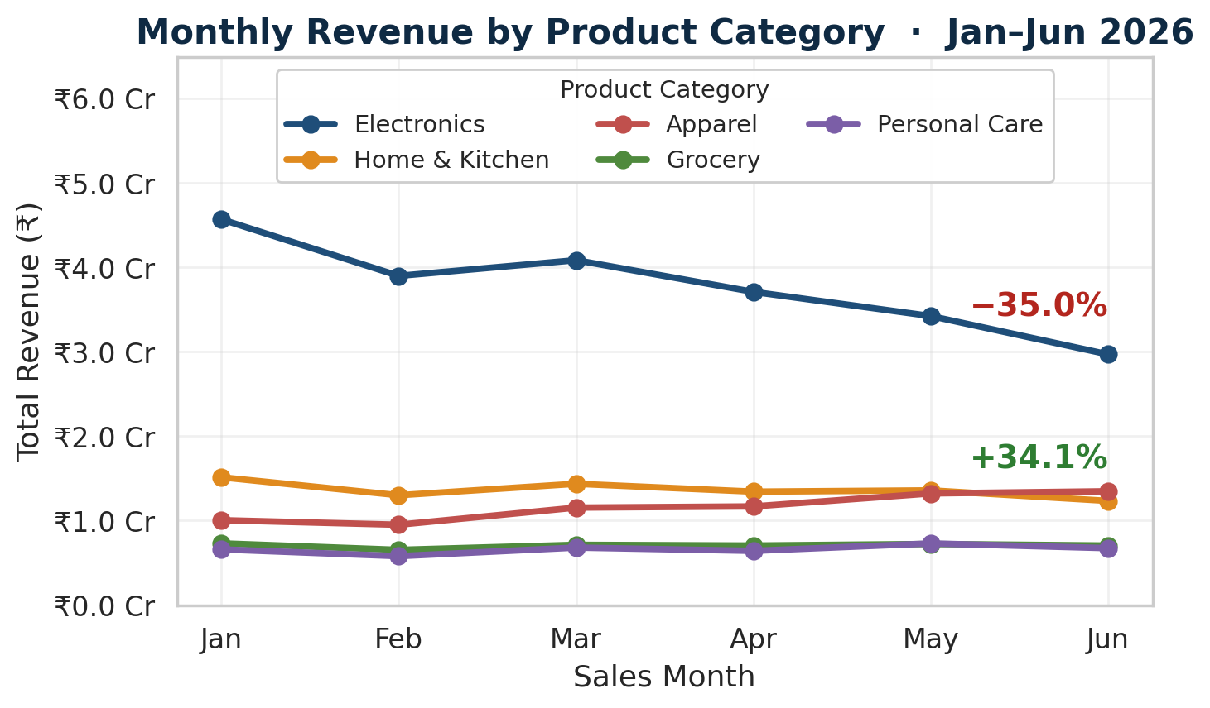
STEP 6.2 · THE MOST IMPORTANT CHART
Category Revenue Trend — January to June 2026
Steepest decline: Electronics
₹4.57 Cr → ₹2.97 Cr. Down 35.02% — a ₹1.60 Cr loss, larger than the chain's entire ₹1.55 Cr decline.
Strongest growth: Apparel
₹1.00 Cr → ₹1.35 Cr, up 34.10%, rising in every month except February.
Most consistent: Grocery
Coefficient of variation of just 3.87% across the six months — steady, but flat at −3.55%.
GROUP 12 · Category Intelligence
Notes:
This is the chart the Category Manager opens the meeting with. Five categories, six months, one pair of axes. Electronics — the dark blue line at the top — falls from ₹4.57 crore in January to ₹2.97 crore in June: down 35 percent, a loss of ₹1.60 crore. That is larger than the chain's entire decline of ₹1.55 crore, which means growth elsewhere absorbed the difference. Apparel is that growth, up 34.1 percent, and you can see it overtake Home & Kitchen in June. Grocery is the flat green line — the most consistent category at under 4 percent variation. We calculated all three of those rankings rather than reading them off the chart.

Slide 7



FROM DATA SIGNAL TO BUSINESS SIGNAL
What Does the Trend Mean for the Business?
Apparel
+34.10%
Growing against a declining chain — the strongest evidence-based case for more shelf space and promotional funding.
₹1.00 Cr → ₹1.35 Cr
Personal Care
+2.18%
Broadly stable. Hold current space; no case for extra investment either way.
₹65.9 L → ₹67.4 L
Grocery
−3.55%
The steadiest category in the chain. Its value is footfall and stability, not growth — protect it, do not promote it.
₹73.1 L → ₹70.5 L
Home & Kitchen
−18.49%
A real slide, overtaken by Apparel in June. Worth a question in the review, but not the headline.
₹1.51 Cr → ₹1.23 Cr
Electronics
−35.02%
Half the chain's revenue on a falling trajectory. The supplier is asking us to fund a declining asset.
₹4.57 Cr → ₹2.97 Cr
GROUP 12 · Category Intelligence
Notes:
The same trend, translated into what it means for the review. Apparel is the only category growing while the chain declines 18 percent — that is a genuine share gain, and it is the one category with an evidence-based case for more space. Personal Care and Grocery are stable; Grocery in particular is the footfall base, so its job is consistency, not growth. Home & Kitchen is down 18.5 percent and was overtaken by Apparel in June. And Electronics, at minus 35 percent, is the headline: it is half the chain's revenue and it is falling, which means the supplier is effectively asking us to keep funding a declining asset.

Slide 8

STEP 6.3 · TOP 2 AND BOTTOM 2 BY CATEGORY
Product-Level Performance
Category
Top 2 Products
Bottom 2 Products
Weakest as % of best
Electronics
Headphones ₹4.77 Cr · Laptop ₹4.66 Cr
Smart TV ₹4.19 Cr · Tablet ₹4.47 Cr
87.8%
Home & Kitchen
Mixer Grinder ₹1.69 Cr · Storage Box ₹1.67 Cr
Water Bottle ₹1.58 Cr · Pressure Cooker ₹1.61 Cr
93.6%
Apparel
Saree ₹1.42 Cr · T-Shirt ₹1.41 Cr
Kurta ₹1.36 Cr · Formal Shirt ₹1.37 Cr
96.1%
Grocery
Rice (5kg) ₹85.62 L · Dal (1kg) ₹84.88 L
Sugar (1kg) ₹83.78 L · Oil (1L) ₹84.32 L
97.8%
Personal Care
Shampoo ₹81.68 L · Body Lotion ₹81.07 L
Sunscreen ₹75.94 L · Toothpaste ₹77.69 L
93.0%
No category has a dead product — the weakest line still earns 88–98% of the strongest. This is a category problem, not a delisting decision, so the challenge is Electronics as a whole. The dataset has no supplier column, so we name the category and products, not a supplier.
GROUP 12 · Category Intelligence
Notes:
We expected to find a dead product to delist. We did not. Look at the right-hand column: in Grocery the weakest product still earns 97.8 percent of the strongest, in Apparel 96.1 percent. Even in Electronics, where the rupee gap is biggest at ₹58 lakh, Smart TV still does 87.8 percent of Headphones. That changes the recommendation entirely — there is no single SKU to blame, so the conversation has to be about the Electronics category as a whole. One important caveat: this dataset has no supplier column, so we deliberately refer to categories and products, never to a named supplier.

Slide 9
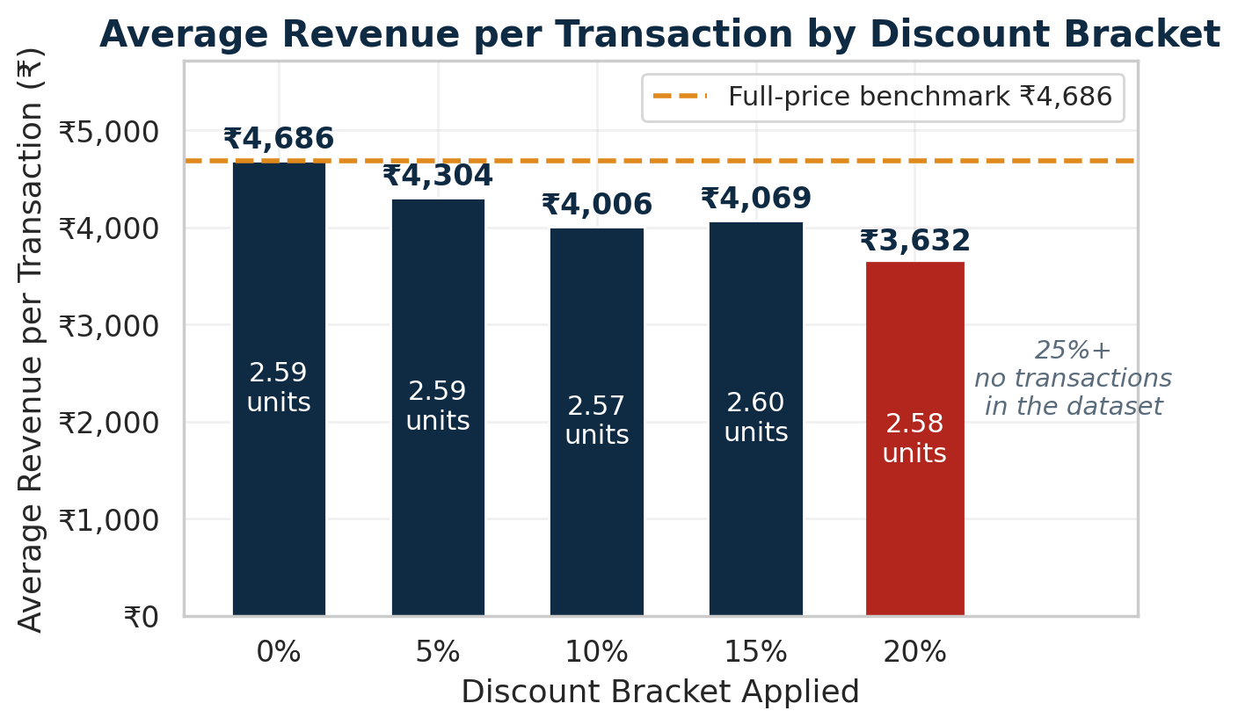

STEP 6.4 · DISCOUNT EFFECTIVENESS
Are Discounts Driving More Revenue?
Our position: discounts are not working
Revenue per transaction falls 22.5% from ₹4,685.65 at full price to ₹3,631.73 at 20% off, while average units sold stays flat at 2.57–2.60 in every bracket and every category.
66.6%
of transactions carry a discount — 71,803 of 107,836
₹3.56 Cr
gap between list value and realised revenue over six months
0
transactions in the 25%+ bracket — reported empty, not estimated
Limitation: the dataset holds revenue after discount but no cost, COGS or margin column. We can show the discount is not buying volume; we cannot measure the margin it destroys.
GROUP 12 · Category Intelligence
Notes:
Here is the finding we would put in front of every supplier. As the discount deepens, average revenue per transaction falls steadily — ₹4,686 at full price down to ₹3,632 at 20 percent off, a 22.5 percent drop. But look at the white numbers inside the bars: average units sold barely moves, 2.57 to 2.60 across every bracket, and it stays flat inside every individual category too, so this is not a category-mix illusion. Two-thirds of all transactions carry a discount, and the gap between list value and realised revenue is ₹3.56 crore. Note the last bar — there are no transactions above 20 percent in this dataset, so we report that bracket as empty rather than inventing it. And the honest limit: with no cost column, we can prove discounts are not buying volume, but we cannot measure margin.

Slide 10
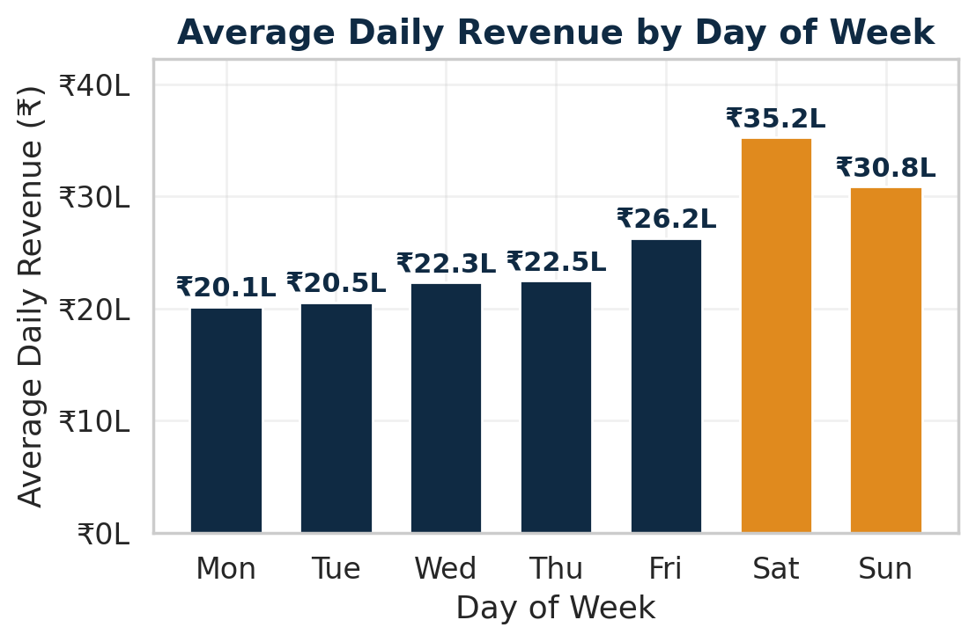
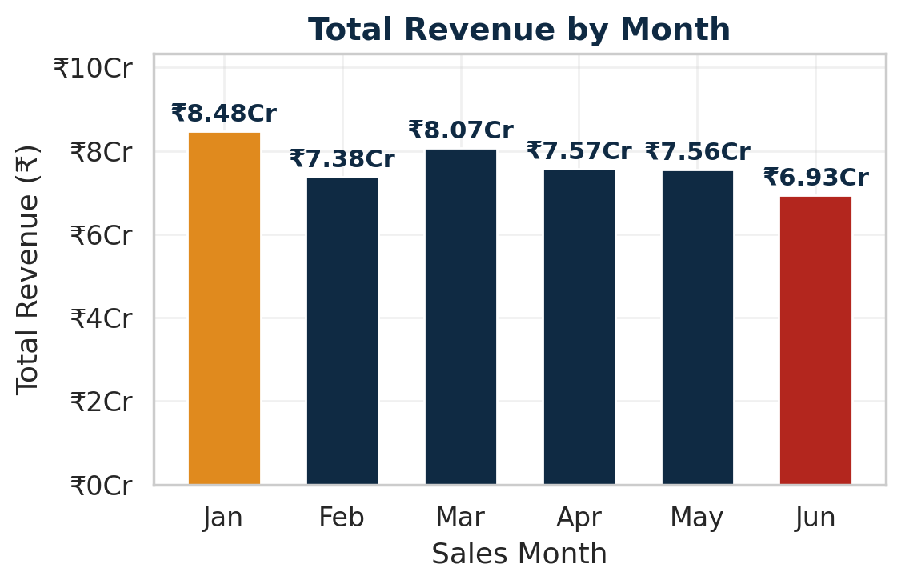
STEP 6.5 · TIMING PATTERNS
When Does the Business Sell the Most?
BEST DAY
WORST DAY
BEST MONTH
WORST MONTH
Saturday
Monday
January
June
₹35.24 L average
₹20.12 L average
₹8.48 Cr
₹6.93 Cr
Saturday earns 1.75× a Monday and the average weekend day runs 48.0% ahead of the average weekday — so promotional weight belongs Friday to Sunday, where demand already exists, rather than being spent trying to manufacture a Monday that has never performed.
GROUP 12 · Category Intelligence
Notes:
Two timing questions: which day, and which month. On the left, the chain is heavily weekend-loaded — Saturday averages ₹35.2 lakh against Monday's ₹20.1 lakh. That is 1.75 times, and the average weekend day runs 48 percent ahead of the average weekday. On the right, January was the best month at ₹8.48 crore and June the worst at ₹6.93 crore, with no recovery month in between. For promotional timing the implication is simple: push Friday to Sunday where demand already exists. And because we have just shown discounts do not move units, the lever for the weak Monday-to-Thursday window should be availability and in-store execution, not deeper markdowns.

Slide 11
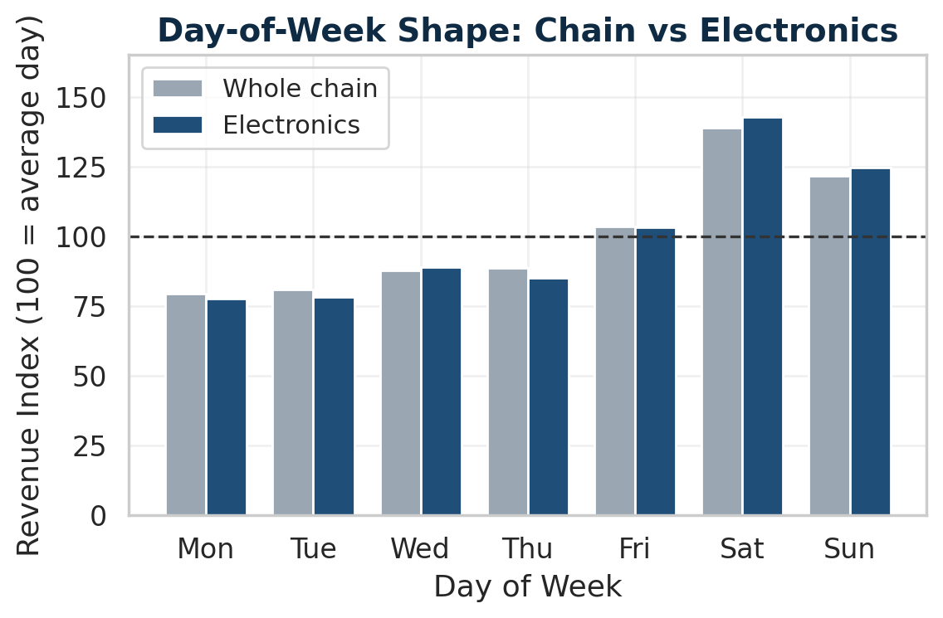
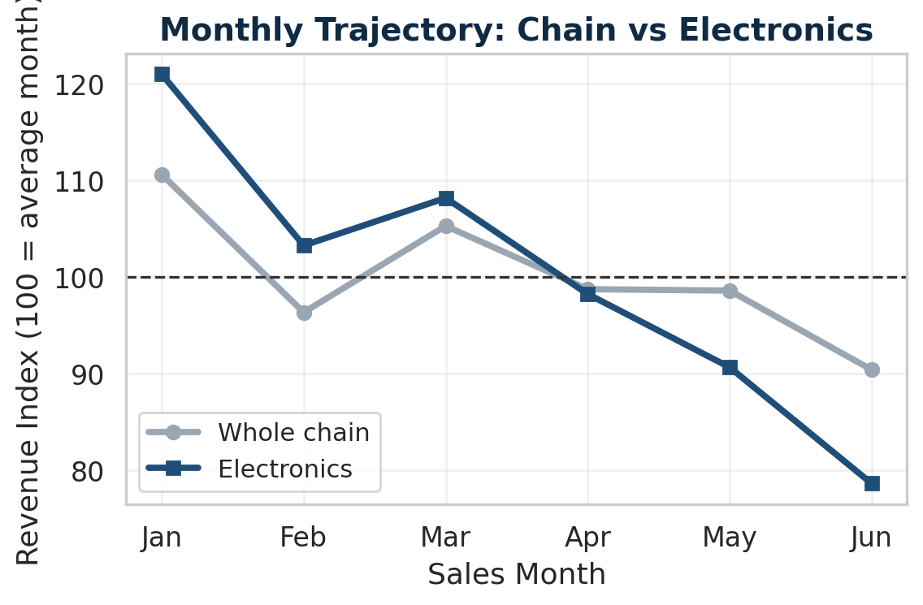
THE SINGLE MOST INTERESTING CATEGORY
Category Deep Dive — Electronics vs the Chain
Electronics is 49.3% of chain revenue (₹22.65 Cr) and the steepest decliner — so it both drives the chain pattern and distorts it.
Day of week: follows the chain, amplified
Month on month: behaves very differently
Same Saturday peak and Monday trough, only steeper — index 142.8 vs the chain's 138.8 on Saturday, 77.6 vs 79.3 on Monday.
The chain falls 18.3% Jan–Jun; Electronics falls 35.02% and diverges from March onward. It is not riding a slowdown — it is causing most of one.
GROUP 12 · Category Intelligence
Notes:
We picked Electronics as the most interesting category because it is 49.3 percent of chain revenue and the steepest decliner. Both charts index each series against its own average, so they are directly comparable despite the size difference. On the left, day of week: Electronics follows the chain's shape but amplifies it — Saturday 142.8 against the chain's 138.8, Monday 77.6 against 79.3. Same rhythm, sharper. On the right, the monthly picture is completely different: the chain falls 18.3 percent while Electronics falls 35, and the two lines separate from March onward. So Electronics is not suffering a general chain slowdown — it is causing most of it. That is the distinction that changes the supplier conversation.

Slide 12


THE RECOMMENDATION
Category Manager Briefing
01 INCREASE INVESTMENT
02 CHALLENGE
Apparel
Electronics — ₹22.65 Cr
Up 34.10% — ₹1.00 Cr to ₹1.35 Cr — rising in every month but February while the chain fell 18.3%. It is winning share against the trend. Fund it by redirecting Electronics' promotional budget, not with new spend.
49.3% of chain revenue, down 35.02% (₹4.57 Cr → ₹2.97 Cr, a ₹1.60 Cr loss). All five products fell, led by Mobile Phone at −57.1% (₹98.03 L → ₹42.10 L). Footfall, not price: 790 → 526 transactions a month at an unchanged unit price.
03 DISCOUNT DISCUSSION
04 BEFORE FINAL DECISION
Test the ladder down
Product-level cost data
Revenue per transaction falls from ₹4,685.65 to ₹3,631.73 (−22.5%) while units stay flat at 2.57–2.60. Propose withdrawing the 15% and 20% brackets in a subset of stores for one quarter and measuring the volume response.
Revenue here is after discount and there is no cost or margin column, so margin impact is inferred, never measured. Without it, a shelf-space call on revenue alone could favour the category contributing least profit per rupee of space.
All figures calculated from MUC01_Retail_Sales_Dataset.csv · 107,836 transactions
Notes:
This is what we would actually say walking into the supplier review. One: back Apparel — it is the only category growing, up 34 percent while the chain fell 18, and we would fund it by moving Electronics' promotional budget rather than asking for new money. Two: challenge Electronics — ₹22.65 crore, half the business, down 35 percent, with every product falling and Mobile Phone collapsing 57 percent. Crucially it is a footfall problem, not a pricing problem: transactions fell from 790 to 526 a month at an unchanged unit price, so the supplier owes us an explanation and a recovery plan. Three: raise the discount ladder — 22 percent less revenue per transaction for no extra units — and test withdrawing the deepest brackets. Four: before the final shelf-space decision we want product-level cost data, because without it we can show discounts are not driving volume but we cannot quantify margin.

Slide 13

THANK YOU
GROUP 12
Category Intelligence — Retail Product Performance EDA
Calibo AI Academy · Phase 1 — Mini Use Case 01 · Path 2, KLU Batch
Notes:
Thank you. To summarise in one line: back Apparel, challenge Electronics with the ₹1.60 crore decline, test the discount ladder down, and get cost data before the final shelf-space call. We are happy to take questions on any part of the analysis or the notebook.

