Slide 1

      Department of Electronics and Communication Engineering
      LOW POWER 3-BIT ENCODER DESIGN USING MEMRISTOR
Presented by:
Sd. Javeed 19711A04A9
M. N. Rohith 19711A0473
M. Venkata Subbaiah 19711A0470
SK. Masthan 19711A04A1
Under the guidance of
Mr. C. Leela Mohan , Asst Professor

Slide 2
ABSTRACT:
Digital logic gate design using memristors is an alternative to current IC designs. This will be one of the future computer architectures. Fabrication of MRL gates is straightforward because the memristor can be designed on top of the polysilicon gate of the NMOS transistor. The density of transistors on a chip will increase. The proposed 3-bit encoder design using MRL consumes little power compared to the CMOS design. This device is used to model various combinatorial logic circuits and this paper is mainly aimed at designing and analysing 3-bit encoders with various logic using LT-Spice.

Slide 3
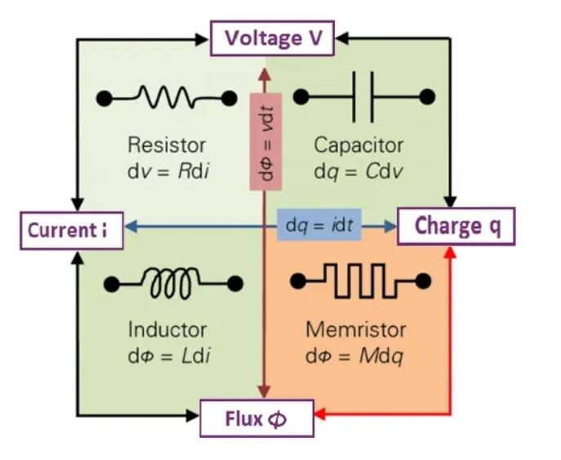
What is Memrister..?

Slide 4
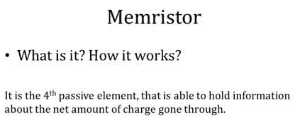
When the current flows in one direction the resistance increases, in contrast when the current flows in the opposite direction the resistance decreases.

Slide 5
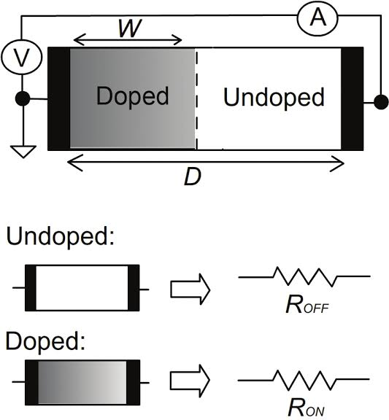

Slide 6
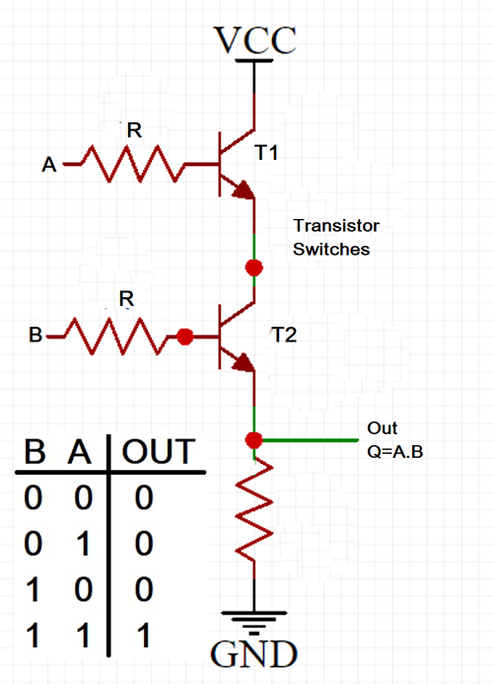
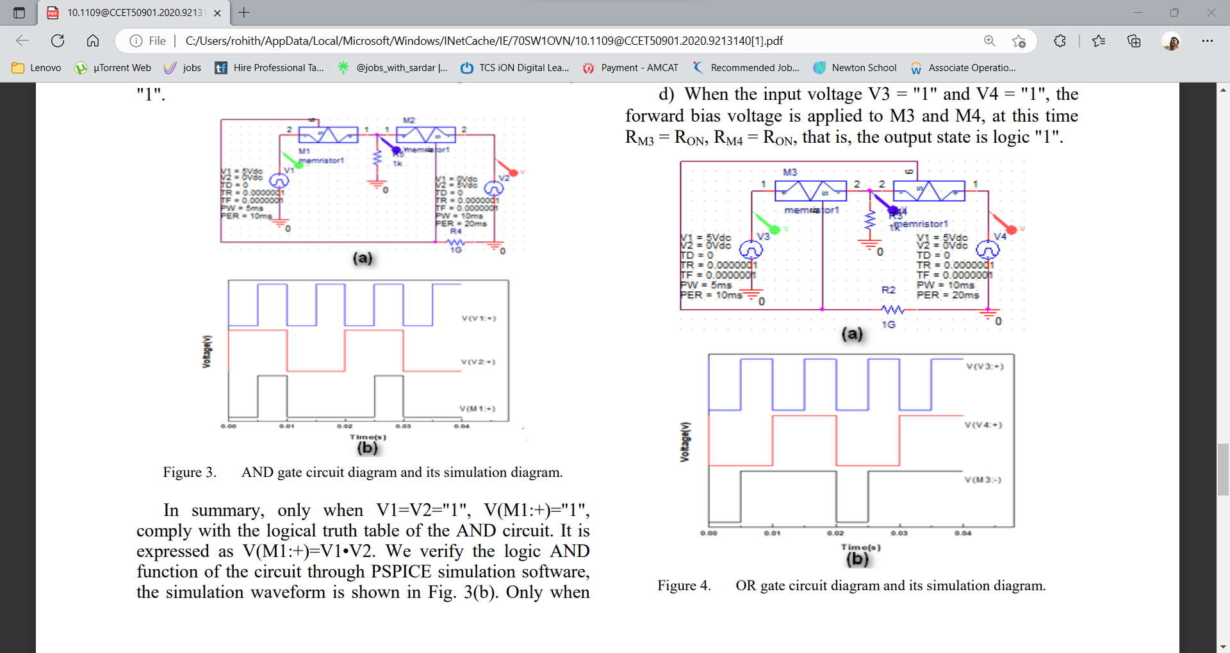
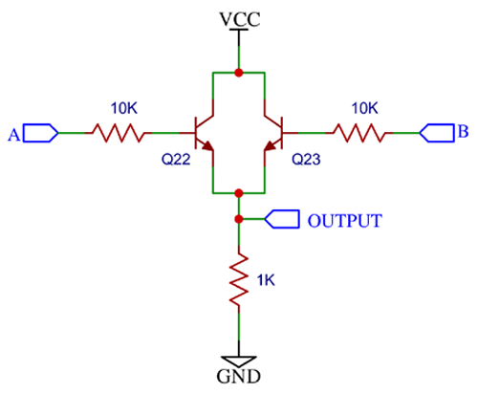
ENCODERS USING TRANSISTORS VERSUS MEMRISTER:

Slide 7


