Slide 1

Department of Electronics and Communication Engineering
LOW POWER MEMRISTOR-BASED 3-BIT ENCODER DESIGN
Under the guidance of
Mr. C. Leela Mohan , Associate Professor
PROJECT ASSOCIATES
Sd. Javeed 19711A04A9
M. N. Rohith 19711A0473
M. Venkata Subbaiah 19711A0470
SK. Masthan 19711A04A1

Slide 2
ABSTRACT
ABSTRACT
LITERATURE SURVEY
EXSISTING METHOS
PROPOSED METHOD
RESULTS
CONCLUSION

Slide 3
ABSTRACT
The power consumption is a very critical parameter in electronic digital circuits. In this project, power dissipation is reduced in digital circuits using memristors. The use of memristors in the design of digital logic gates presents an alternative approach to current integrated circuit (IC) design and is a promising development in computing architecture. The manufacturing process for memristor-based gates is straightforward, as memristors can be designed on top of the polysilicon gate of NMOS transistors. This can lead to an increase in transistor density on a chip. Additionally, lower power consumption is achieved by tweaking the memristor's Ron, Roff, and Rint values. The memristor-based design can be utilised to model various combinational logic circuits, and the primary objective of this project is to analyse and design a 3-bit encoder with different logics using LTspice software.

Slide 4
Literature Survey
In 2010, D.B. Strukov, and his team from Information and Quantum Science Laboratory published an article on hybrid CMOS/memristor circuits. The article provides a brief review of recent work on these circuits, which combine the high functionality of CMOS subsystems with the high density of nanoscale thin film resistance switching devices. Simulation and initial experimental results demonstrate that CMOS/memristor circuits outperform conventional VLSI paradigm in several important applications.
In 2012, Shahar and his team from the Electrical Department of TIT, Israel, published an article on MRL (Memristor Ratioed Logic), a hybrid CMOS-memristive logic family. The article discusses how memristive devices are used for OR and AND logic gates in the MRL family, with CMOS inverters added for a complete logic structure and signal restoration. The article includes a case study of an eight-bit full adder and discusses related design considerations

Slide 5
INTRODUCTION
In recent years, the need for energy-efficient computing systems has grown significantly, and low-power memristor-based circuits have emerged as a promising solution. Memristors, which are resistive devices that can remember the last current that flowed through them, have shown great potential for use in analog and digital circuits due to their non-volatile and low-power characteristics. In this context, the design of a low-power memristor-based encoder is of particular interest, as encoders are essential components in many communication and control systems. In this paper, we propose a novel approach for designing a low-power memristor-based encoder, which utilizes the unique properties of memristors to achieve high efficiency and reliability. We present the design principles and simulation results, demonstrating the effectiveness of our approach in achieving low power consumption while maintaining high accuracy and speed.

Slide 6
EXSISTING METHOD
Low power VLSI design has become a critical area of research due to the increasing demand for energy-efficient and portable devices.
The conventional VLSI design techniques have been focused on achieving high performance, while power consumption has been considered as a secondary objective.
However, with the emergence of battery-operated devices, low power design has become a crucial factor in determining the success of a product.

Slide 7
CMOS
The term CMOS stands for “Complementary Metal Oxide Semiconductor”
This is one of the most popular technology in the computer chip design industry and it is broadly used today to form integrated circuits in numerous and varied applications.
Today’s computer memories, CPUs, and cell phones make use of this technology due to several key advantages. This technology makes use of both P channel and N channel semiconductor devices

Slide 8
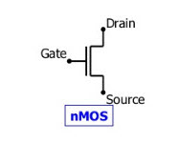
NMOS
NMOS is built on a p-type substrate with n-type source and drain diffused on it.
In NMOS, the majority of carriers are electrons.
The NMOS will conduct when the gate receives a strong voltage. Similar to this, NMOS won't conduct when the gate receives a low voltage
NMOS Transistor

Slide 9
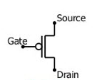
PMOS
P- channel MOSFET consists of P-type Source and Drain diffused on an N-type substrate.
The majority of carriers are holes.
When a high voltage is applied to the gate, the PMOS will not conduct.
When a low voltage is applied to the gate, the PMOS will conduct.
PMOS

Slide 10
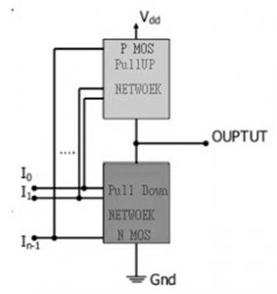
CMOS WORKING
if both a p-type and n-type transistor have their gates connected to the same input, the p-type MOSFET will be ON when the n-type MOSFET is OFF, and vice-versa
CMOS Using Pull Down And Pull Up

Slide 11
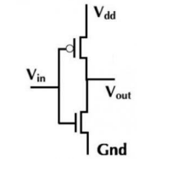
CMOS NOT GATE
The inverter circuit consists of PMOS and NMOS FET
when a low-level voltage is applied to the inverter, the NMOS switched OFF and PMOS switched ON, pulling the circuit up to Vdd.
CMOS Inverter

Slide 12
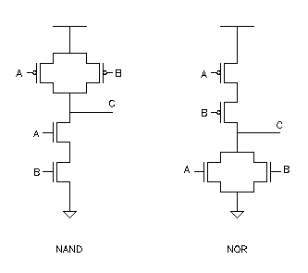
CMOS NAND GATE
A NAND gate places two n-channel transistors in series to ground and two p-channel transistors in parallel connected to +V. Only when both inputs are logic 1, the output goes to logic 0
CMOS NAND Gate

Slide 13
CMOS NOR GATE
The output voltage of the CMOS NOR2 gate will attain a logic-low voltage of V=0 and a logic- high voltage of VR = VDD.
CMOS NOR Gate

Slide 14
Pseudo NMOS
Pseudo-NMOS Logic: Pseudo—NMOS logic uses only one PMOS device as a pull-up device for a multi- transistor N—Logic block. Therefore, the required number of transistors for an Ninput gate is an N+1 transistor.CMOS has high noise immunity. NMOS has comparatively low noise immunity. The CMOS is used to design various types of digital logic circuits, microprocessors, microcontrollers, memories, etc. NMOS is used to design several types of digital logic circuits such as microprocessors & memory chips

Slide 15
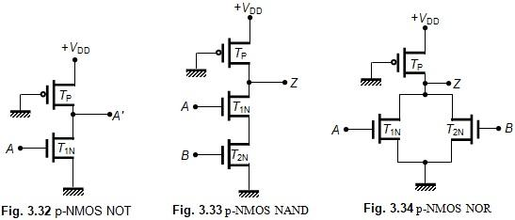
Pseudo NMOS logic gates

Slide 16
PROPOSED METHOD
MRL – Memristor Ratioed Logic
Memristor ratioed logic is a design approach that combines CMOS technology and memristors to create logic gates with several advantages over traditional CMOS designs.
MRL enables easy fabrication of memristors on top of the CMOS polysilicon layer, which reduces the design's area and the number of transistors required.

Slide 17
MRL - CHARACTERISTICS
Memristor Ratioed Logic (MRL) is a design approach that combines CMOS technology with memristors to create logic gates with several distinct characteristics. Some of the key characteristics of MRL are
● Reduced Power Consumption
● Faster Operation
● Reduced Area
● Fewer Transistors

Slide 18
MRL AS LOGIC GATES
An interesting method for integrating memristive devices with standard CMOS logic is using memristive devices as computational elements, OR and AND
The memristive devices are utilised solely for logic computation and not for storing a logical state.

Slide 19
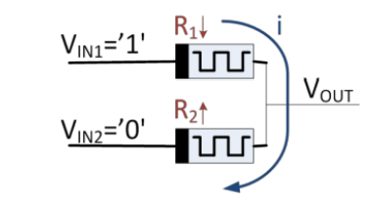
MEMRISTIVE OR GATE
An OR logic gate, when VIN1 = '1' and VIN2 = '0'. The current flows from VIN1 to VIN2 and the resistance of the memristive devices changes for the OR logic gates
MEMRISTIVE OR GATE

Slide 20
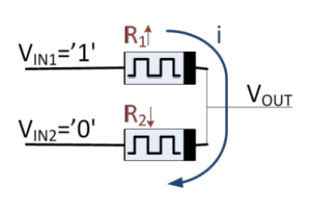
MEMRISTIVE AND GATE
An AND logic gate, when VIN1 = '1' and VIN2 = '0'. The current flows from VIN1 to VIN2 and the resistance of the memristive devices changes for the AND logic gates
MEMRISTIVE AND GATE

Slide 21
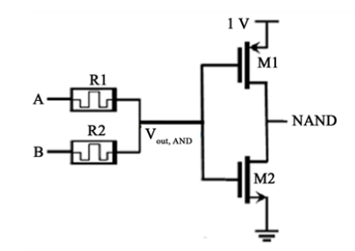
MEMRISTIVE NAND GATE
The NAND gate has two parallel PMOS transistors and two series NMOS transistors.
The AND gate is connected to the inverter.
Memristive NAND Gate

Slide 22
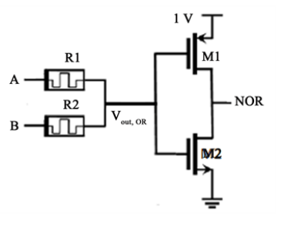
MEMRISTIVE NOR GATE
The NOR gate has two series PMOS transistors and two parallel NMOS transistors
The OR gate is connected to the inverter
Memristive NOR Gate

Slide 23
Required Software
LT – Spice
it is Analog Devices high performance circuit simulation program, which allows to draft, probe, and analyze the performance of your circuit design. LT- spice contains an integrated schematic editor, waveform viewer, and advanced features that are easy to use once you learn some basic commands

Slide 24
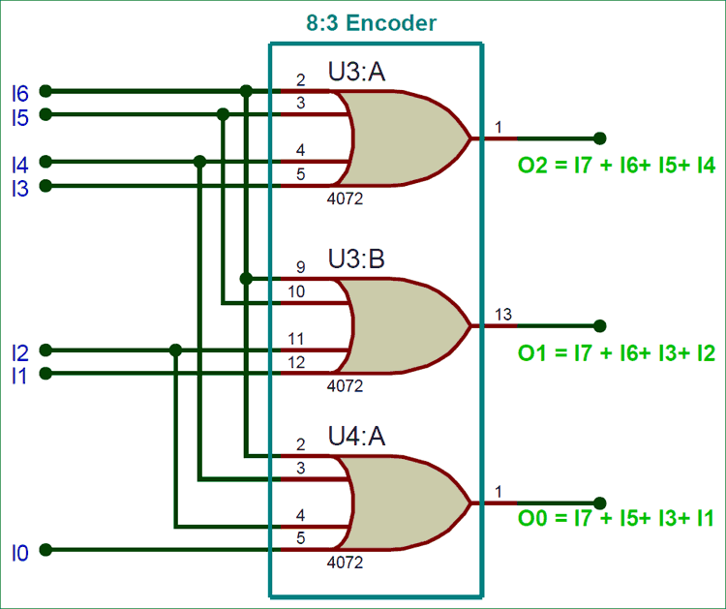
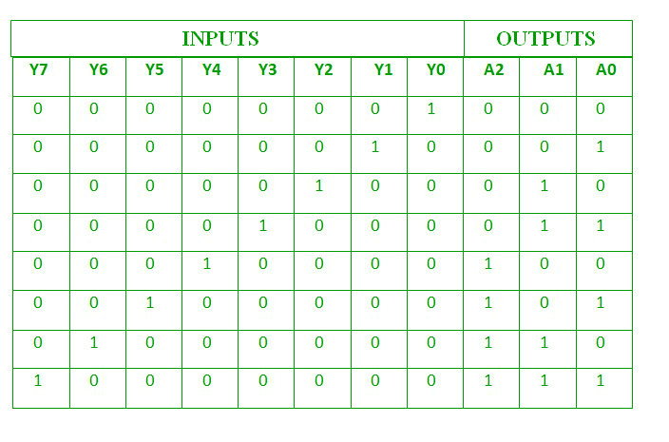
IMPLEMEMTATION:
ENCODER USING LOGIC GATES

Slide 25
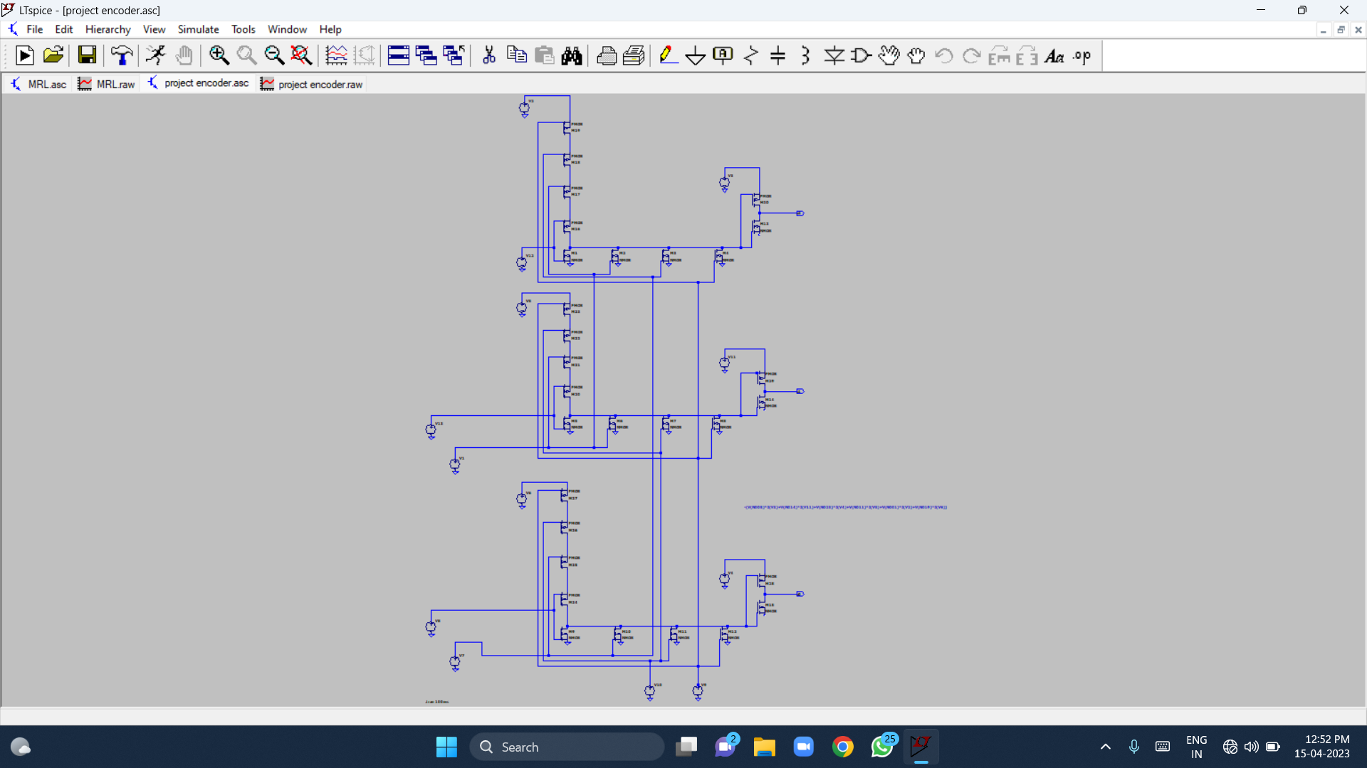
Design using cmos

Slide 26
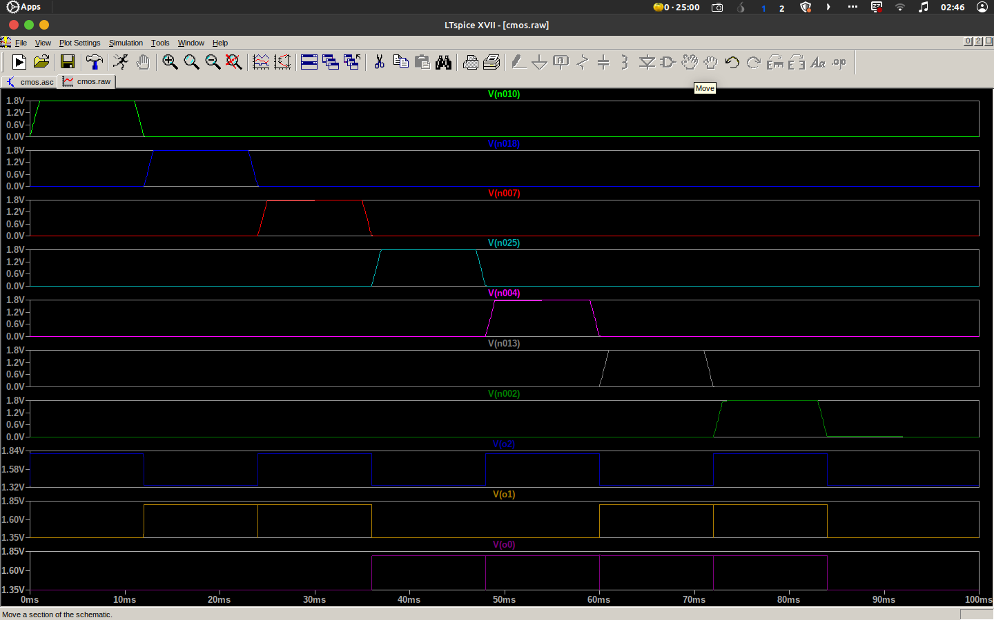
Output of Encoder using CMOS

Slide 27
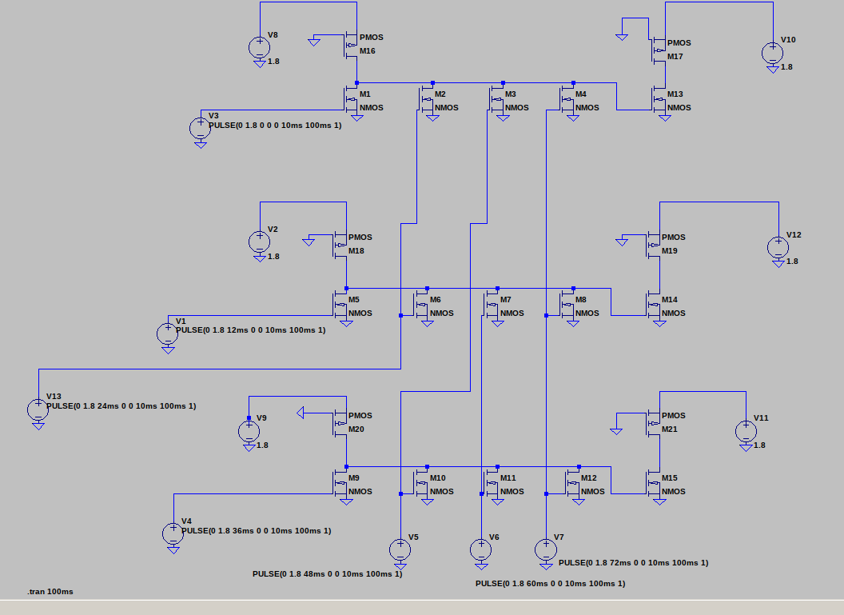
Design using Pseudo NMOS

Slide 28
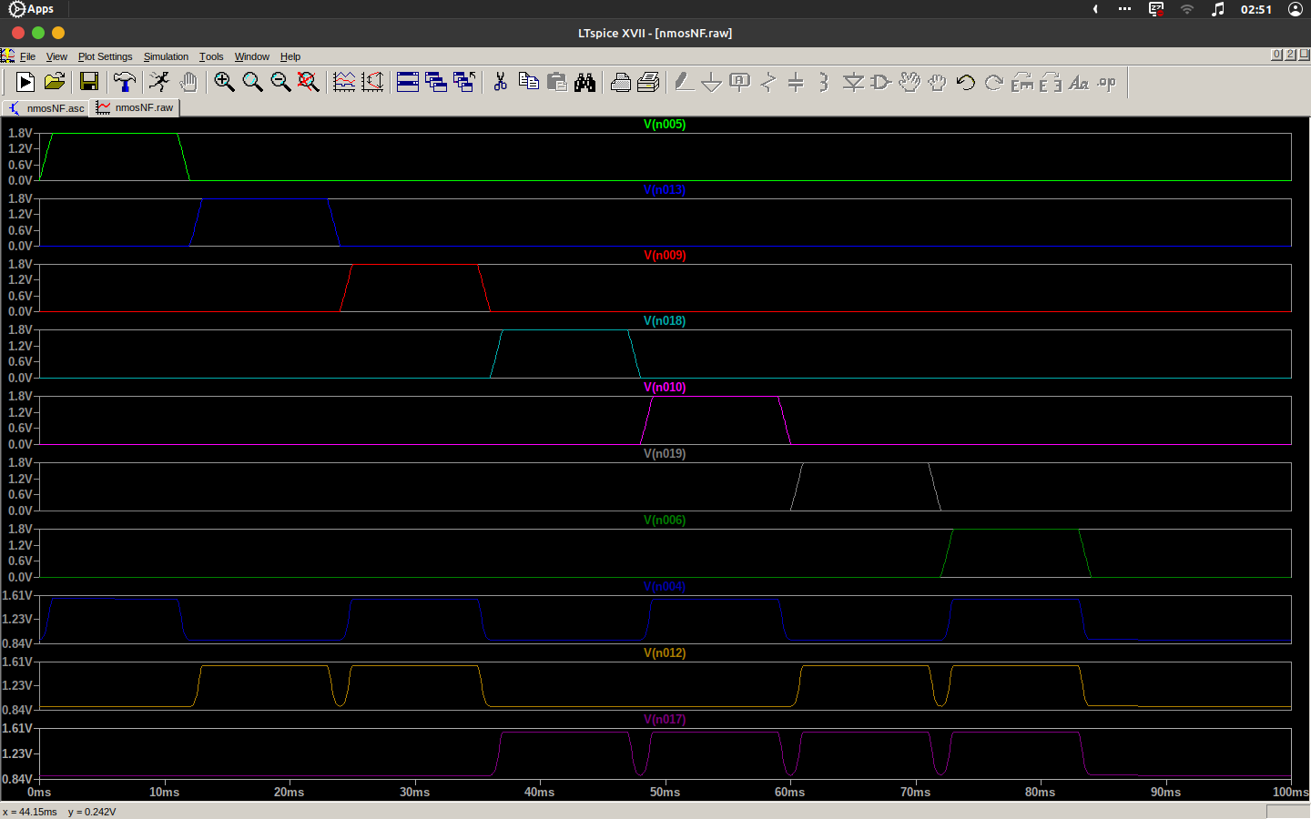
Output of Encoder using PNMOS

Slide 29
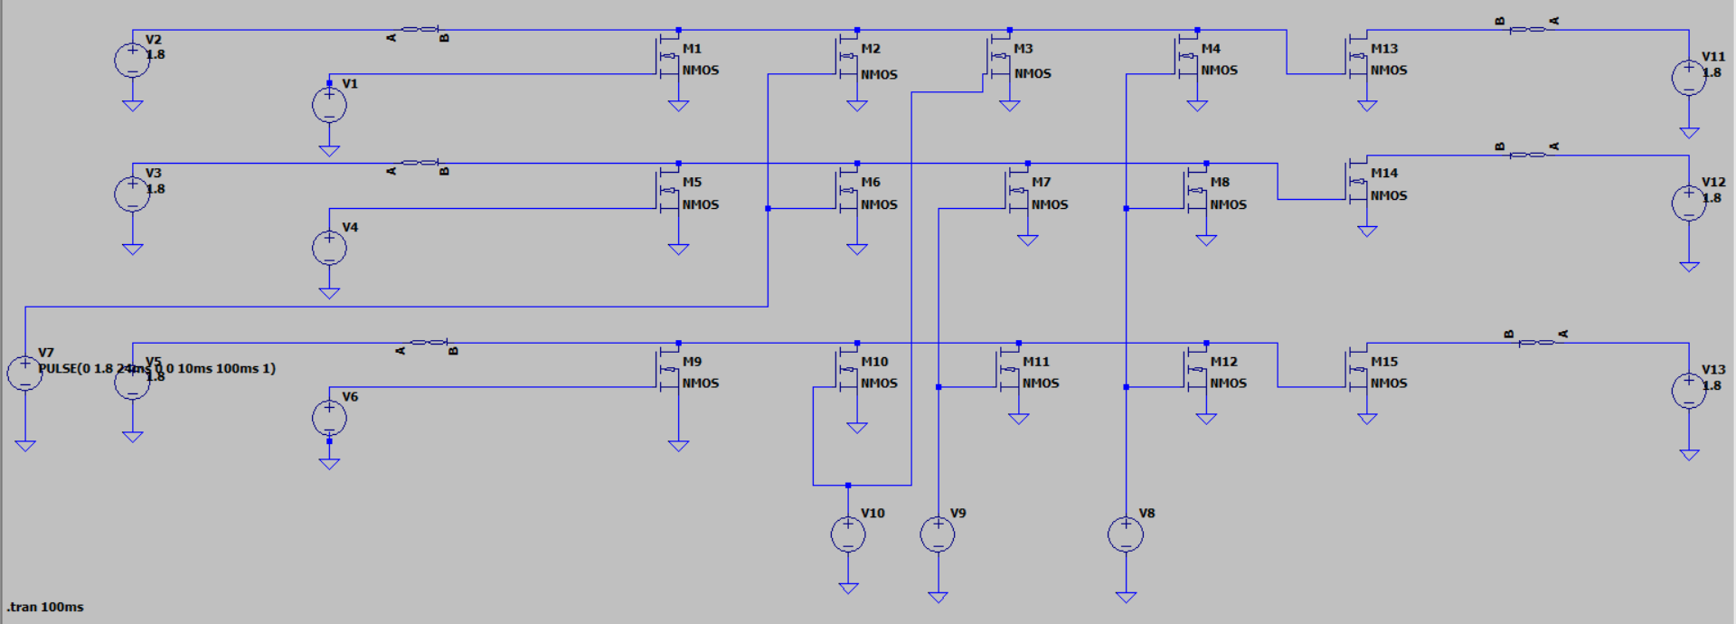
Design using MRL

Slide 30
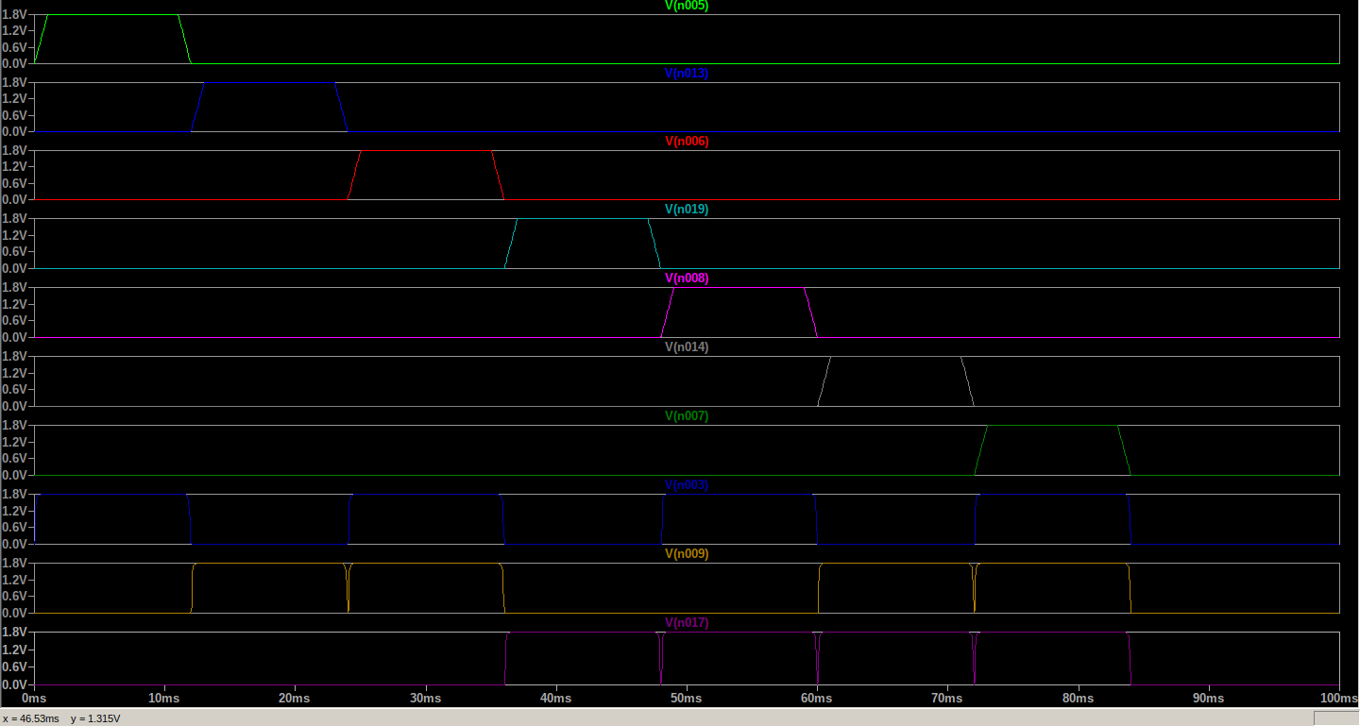
Output of encoder using MRL

Slide 31
Results
The use of memristor-based logic design in encoder design is a promising approach to achieving energy-efficient and compact circuit designs.9666966081
Logic used for designing | Number of transistors used | Average Power Dissipated
CMOS | 30(15 NMOS + 15 PMOS) | 890.27 nW
Pseudo NMOS | 21(15 NMOS + 6 PMOS) | 150.77 µW
MRL | 15(15 NMOS + 0 PMOS) | 486.7 nW

Slide 32
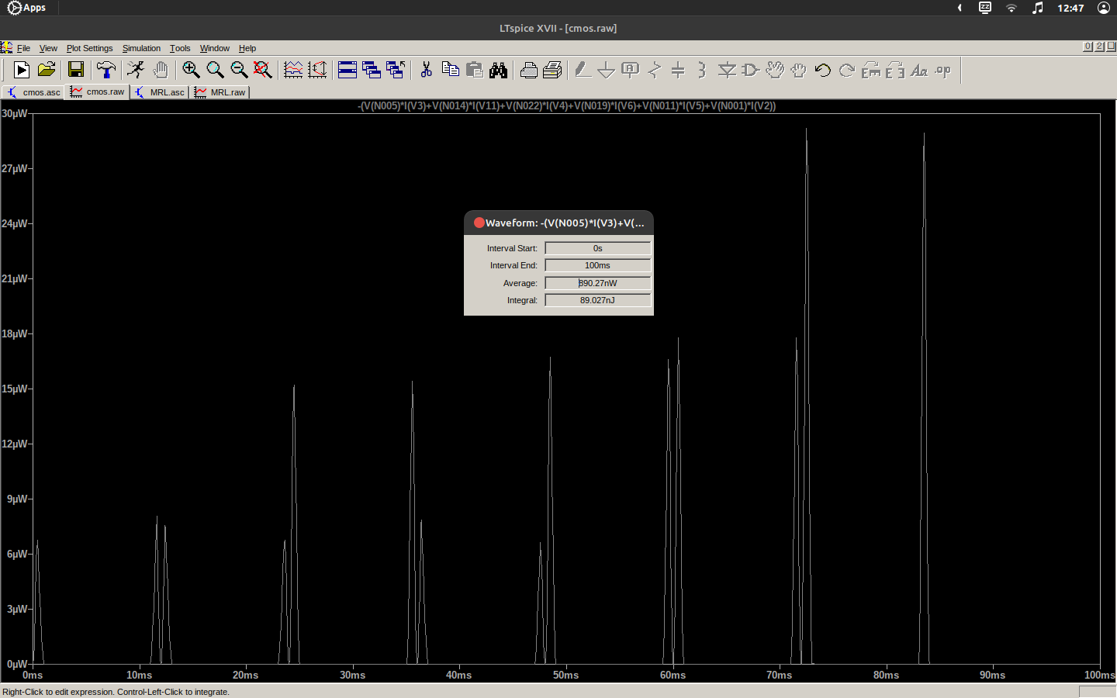
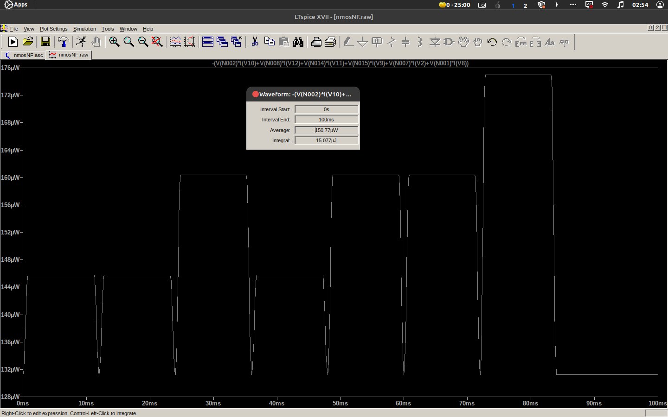
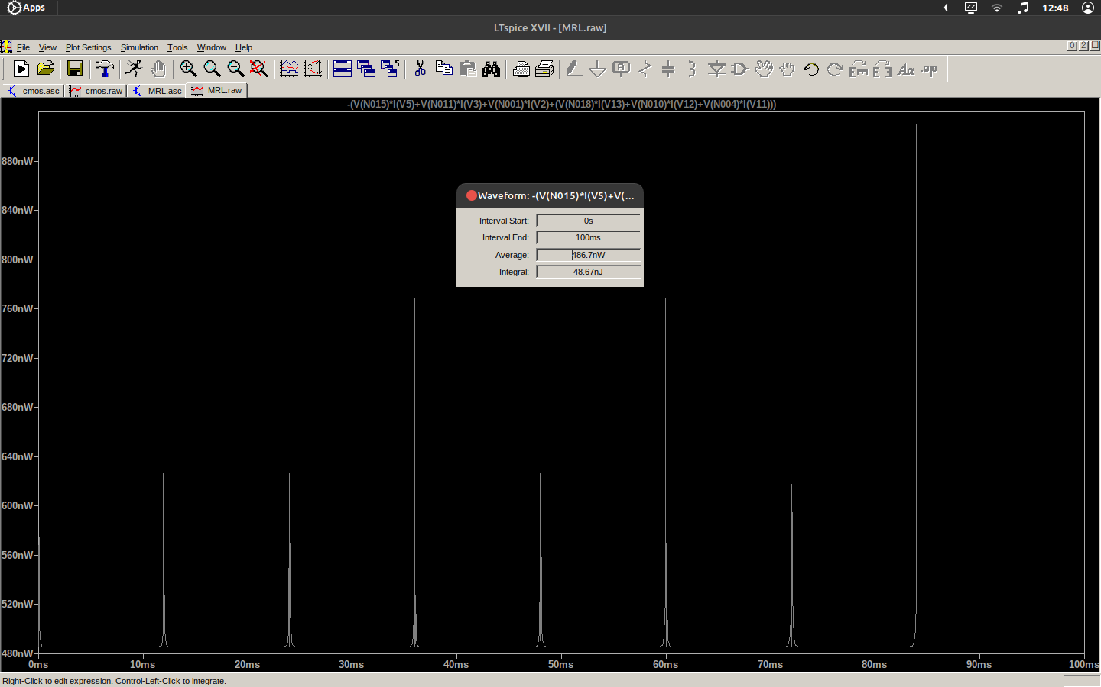
Average power dissipation
CMOS PNMOS MRL

Slide 33
CONCLUSION
The utilisation of memristor-based logic design in encoder design has been found to be more effective in terms of power and area compared to traditional CMOS logic and Pseudo NMOS logic. Despite the persistent trade-off between power, area, and speed in circuit design, the memristor-based logic design technique has been observed to require fewer transistors, making it a more efficient approach to digital circuit design.

Slide 34
References
[1] Suri Shanmukh, Sompalli RohitKumar, Paluru Hemaprasad, and R.Sakthivel, “Low Power 3-Bit Encoder Design using Memristor,” 2022 2nd International Conference on Intelligent Technologies (CONIT) Karnataka, India. June 24-26, 2022
[2] S. Smaili and Y. Massoud, “Analytic modeling of memristor variability for robust
memristor systems designs,” in 2014 IEEE International Symposium on Circuits and
Systems (ISCAS). IEEE, 2014, pp. 794–797.
[3] S. Kvatinsky, G. Satat, N. Wald, E. G. Friedman, A. Kolodny, and U. C. Weiser,
“Memristor-based material implication (imply) logic: Design principles and
methodologies,” IEEE Transactions on Very Large Scale Integration (VLSI) Systems,
vol. 22, no. 10, pp. 2054–2066, 2013.

Slide 35


