Slide 1

Department of Electronics and Communication Engineering
LOW POWER 3-BIT ENCODER DESIGN USING MEMRISTOR
Presented by:
Sd. Javeed 19711A04A9
M. N. Rohith 19711A0473
M. Venkata Subbaiah 19711A0470
SK. Masthan 19711A04A1
Under the guidance of
Mr. C. Leela Mohan , Assoc. Professor

Slide 2
ABSTRACT
Digital logic gate design using memristors is an alternative to current IC designs. This will be one of the future computer architectures. Fabrication of MRL gates is straightforward because the memristor can be designed on top of the polysilicon gate of the NMOS transistor. The density of transistors on a chip will increase. The proposed 3-bit encoder design using MRL consumes little power compared to the CMOS design. This device is used to model various combinatorial logic circuits and this paper is mainly aimed at designing and analysing 3-bit encoders with various logic using LT-Spice.
Memristors, short for memory resistors, are a type of passive two-terminal electronic component that can remember the amount of electric charge that has flowed through it. They were first theorized in 1971 but were not physically demonstrated until 2008. Memristors have the unique ability to alter their resistance based on the history of current flow and have the potential to revolutionize the way computer memory is stored and processed.

Slide 3
LITERATURE SURVEY
In 2010, D.B. Strukov, and his team from Information and Quantum Science Laboratory published an article on hybrid CMOS/memristor circuits. The article provides a brief review of recent work on these circuits, which combine the high functionality of CMOS subsystems with the high density of nanoscale thin film resistance switching devices. Simulation and initial experimental results demonstrate that CMOS/memristor circuits outperform conventional VLSI paradigm in several important applications.
In 2012, Shahar and his team from the Electrical Department of TIT, Israel, published an article on MRL (Memristor Ratioed Logic), a hybrid CMOS-memristive logic family. The article discusses how memristive devices are used for OR and AND logic gates in the MRL family, with CMOS inverters added for a complete logic structure and signal restoration. The article includes a case study of an eight-bit full adder and discusses related design considerations

Slide 4
CONT’D
In 2019 paper published paper on “MRL — Memristor Ratioed Logic“ by Sarojini Mandal discusses the potential of memristors as a promising alternative device for computational logic and memory implementations. The paper emphasizes the basic properties of memristors and describes different digital circuits designed for logic operations and DSP applications using a hybrid CMOS-memristor based approach. The paper also presents the design methodologies and circuit parameters used in the study, as well as the results of transient response simulations in Cadence 180nm technology.
In 2017, Anuradha Singh published a paper on designing an area-efficient and high-speed full adder using memristor technology. The design uses only 15 NMOS transistors and 15 memristors, and provides better results in terms of area utilization, speed, and power efficiency compared to a conventional CMOS full adder circuit with 28 transistors. The adder was simulated in LT SPICE and found to have a simplified architecture with improved performance.

Slide 5
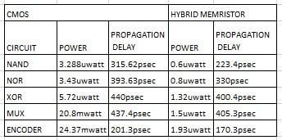
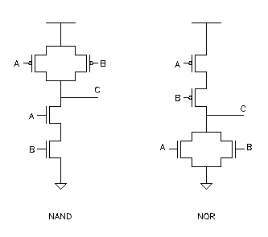
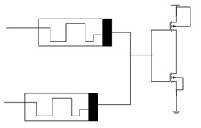
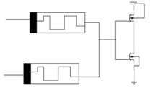
WORK IN PROGRESS
Memristive CMOS NAND & NOR logic

Slide 6
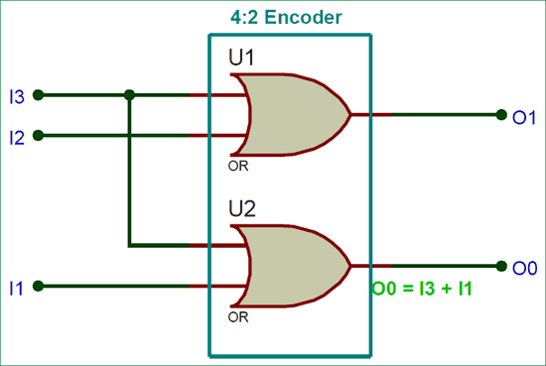
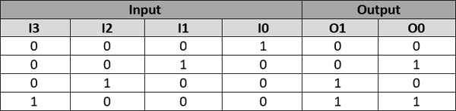
ENCODER USING LOGIC GATES

Slide 7
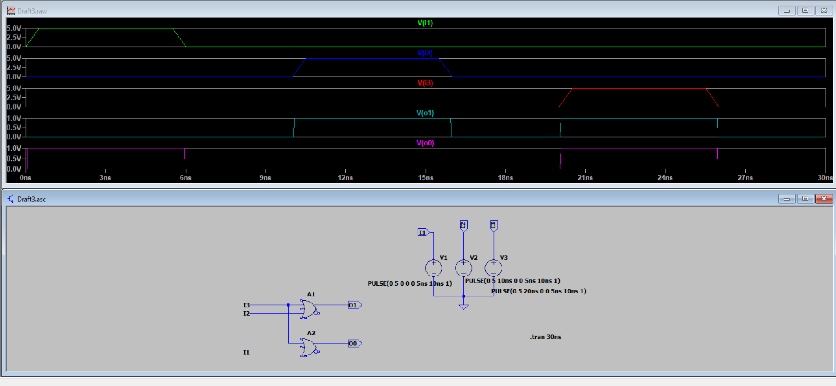
2-BIT ENCODER USING LOGIC GATES

Slide 8
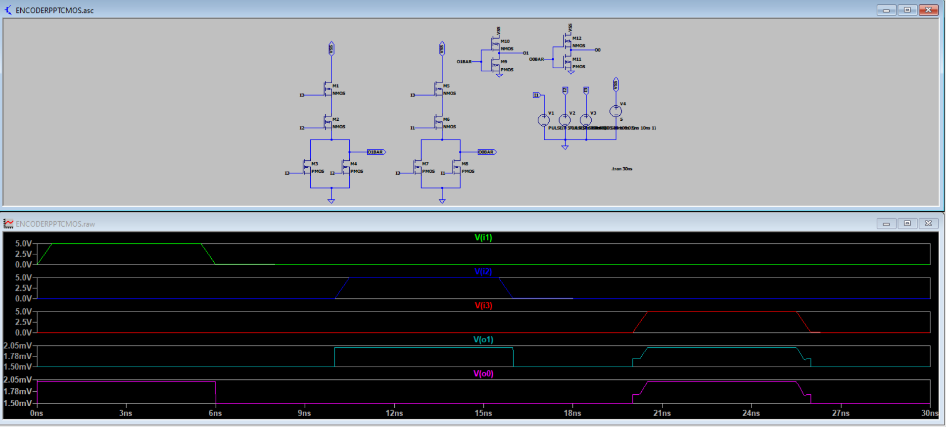
2-BIT ENCODER USING CMOS

Slide 9
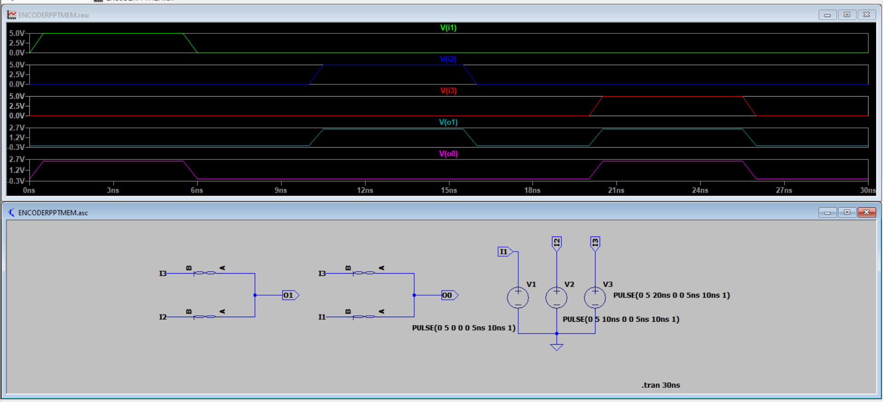
2-BIT ENCODER USING MEMRISTOR

Slide 10
RESULTS AND DISCUSSIONS
We designed 2 bit encoder using the Logic gates, CMOS logic and memristor using a generic, efficient and analytically simple memristor model.

Slide 11


