Slide 1

Department of Electronics and Communication Engineering
LOW POWER 3-BIT ENCODER DESIGN USING MEMRISTOR
Presented by:
Sd. Javeed 19711A04A9
M. N. Rohith 19711A0473
M. Venkata Subbaiah 19711A0470
SK. Masthan 19711A04A1
Under the guidance of
Mr. C. Leela Mohan , Assoc. Professor

Slide 2
contents
ABSTRACT
INTRODUCTION
IMPLEMENTATION
RESULTS

Slide 3
ABSTRACT
Digital logic gate design using memristors is an alternative to current IC designs. This will be one of the future computer architectures. Fabrication of MRL gates is straightforward because the memristor can be designed on top of the polysilicon gate of the NMOS transistor. The density of transistors on a chip will increase. The proposed 3-bit encoder design using MRL consumes little power compared to the CMOS design. This device is used to model various combinational logic circuits and this paper is mainly aimed at designing and analysing 3-bit encoders with various logic using LTSpice.
Memristors, short for memory resistors, are a type of passive two-terminal electronic component that can remember the amount of electric charge that has flowed through it. They were first theorized in 1971 but were not physically demonstrated until 2008. Memristors have the unique ability to alter their resistance based on the history of current flow and have the potential to revolutionize the way computer memory is stored and processed.

Slide 4
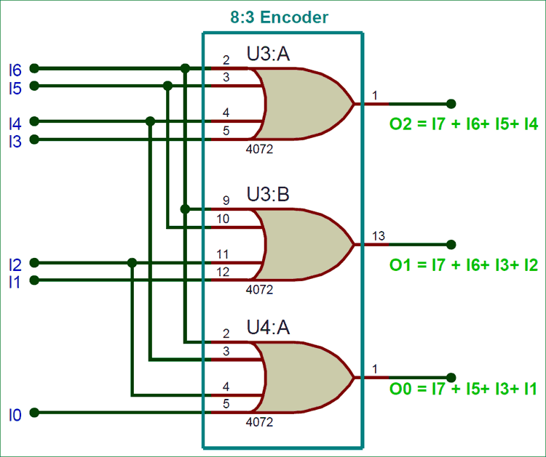
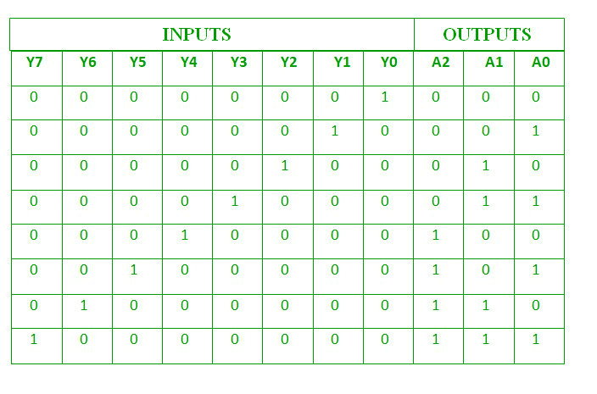
IMPLEMEMTATION:
ENCODER USING LOGIC GATES

Slide 5
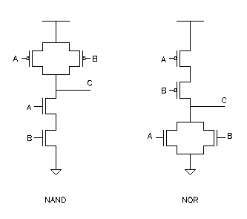
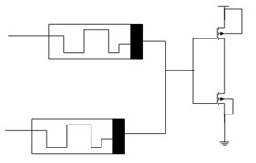
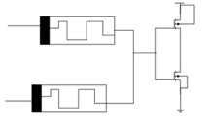
MRL
Memristive CMOS NAND & NOR logic

Slide 6
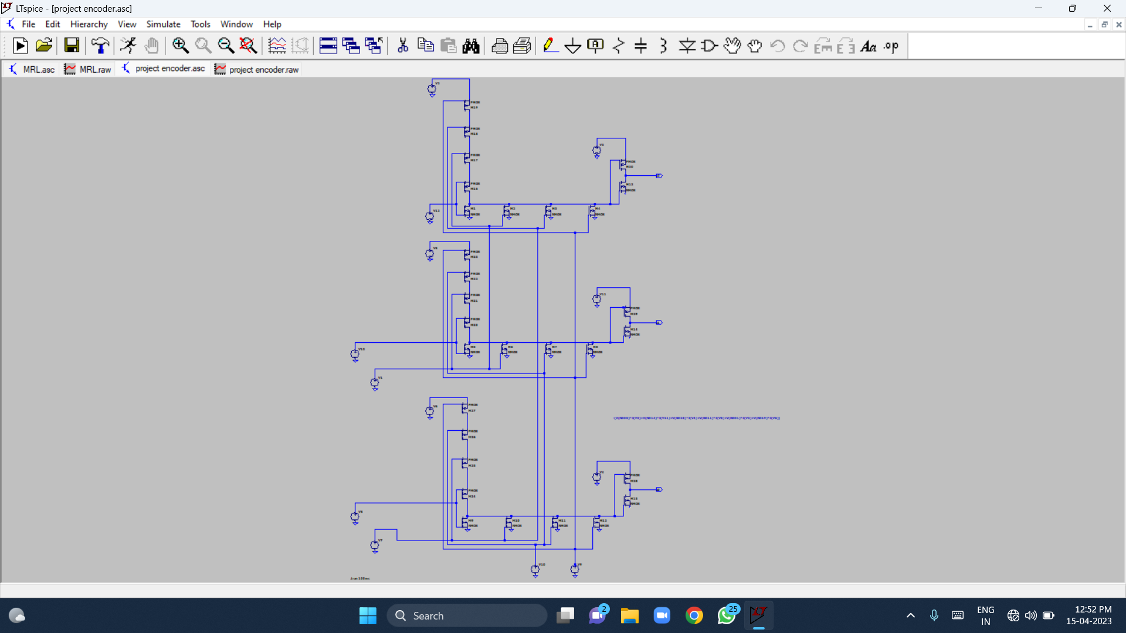
Design using cmos

Slide 7
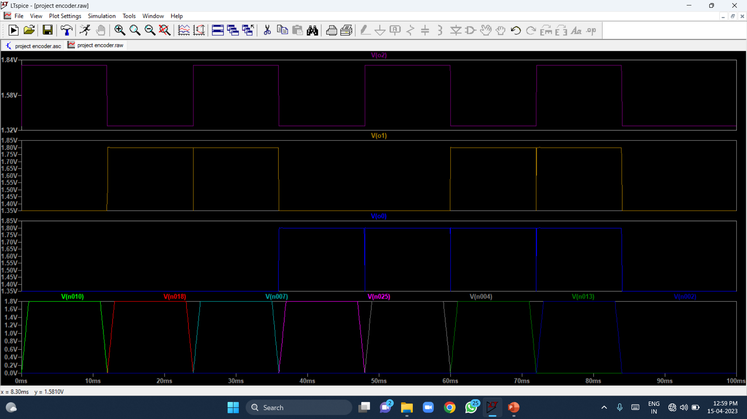

Slide 8
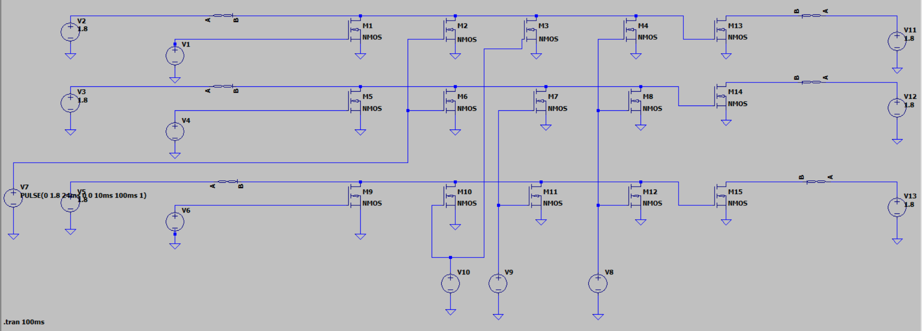
Design using MRL

Slide 9
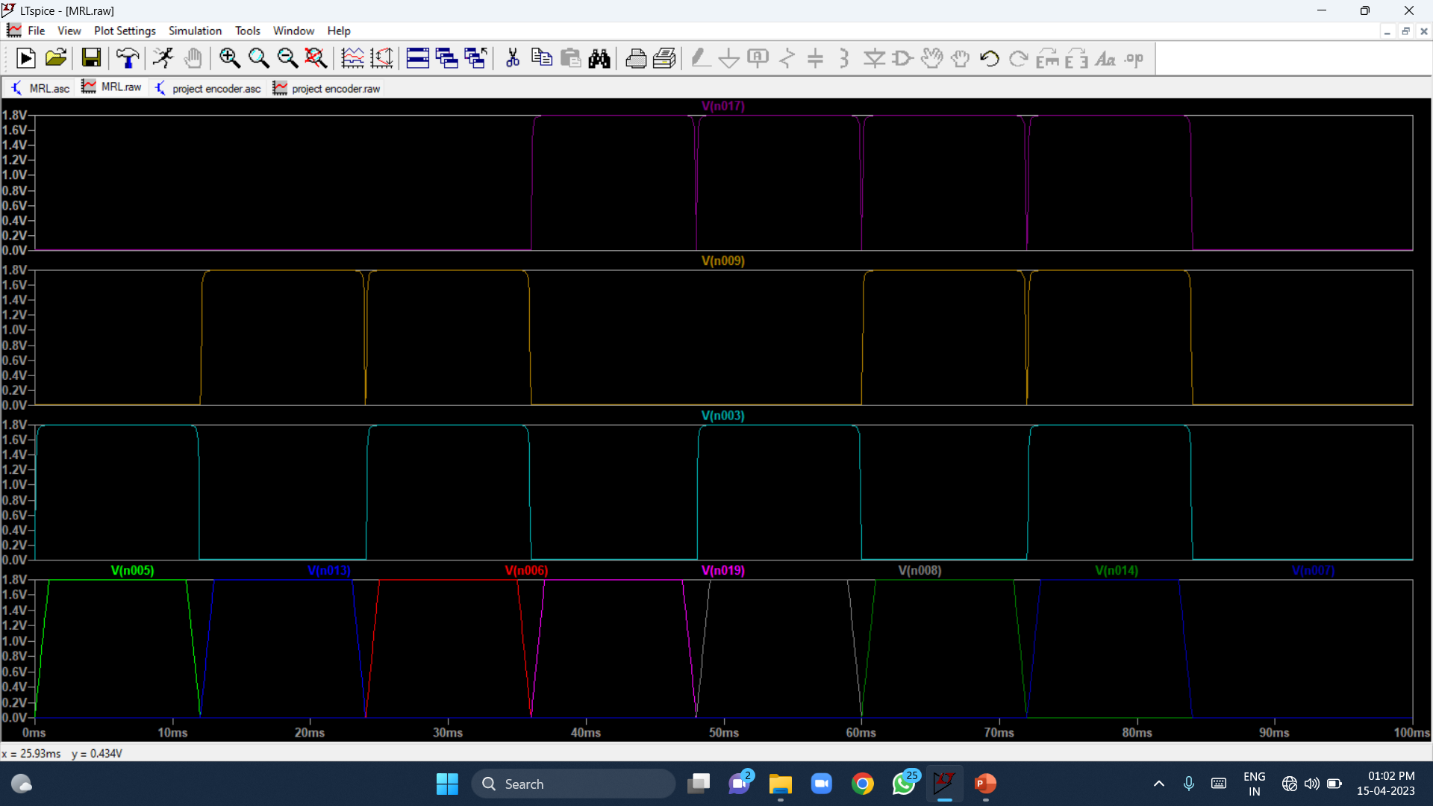

Slide 10
Results
Logic used for designing | Number of transistors used
CMOS | 30(15 NMOS + 15 PMOS)
MRL | 15(15 NMOS + 0 PMOS)

Slide 11
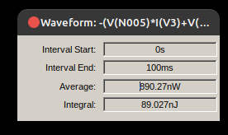
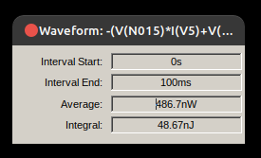
Average power dissipation
CMOS MRL

Slide 12


