Slide 1

SHELL SCRIPT
Java Full Stack Program

Slide 2
Shell Script
What is Shell Script?
A shell script is a computer program written in shell programming language. Shell scripts are executed by a shell interpreter and are used to automate tasks in the Unix-based operating systems, such as Linux and macOS.
A shell script typically consists of a series of shell commands, each on a separate line, that are executed in sequence. The commands can be simple operations, such as copying or moving a file, or more complex operations, such as installing software or setting up a network.
Java Full Stack Program

Slide 3
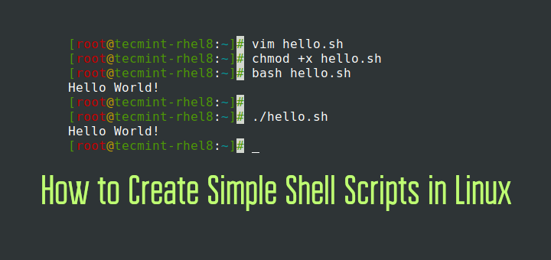
Steps to Writing a Shell Script:
Write a script file using vi:
The first line identifies the file as a bash script. (#!/bin/bash)
Comments begin with a # and end at the end of the line.
Write a script file using vi:
give the user (and others, if (s)he wishes)
permission to execute it.
chmod +x filename
Run from local dir
./filename
Run with a trace – echo commands after expansion
bash –x ./filename
Java Full Stack Program

Slide 4
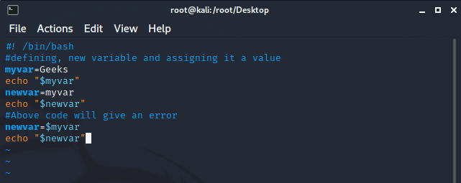
Variables
Variables in shell scripting are used to store values that can be used later in the script.
Steps to Create a Variable
Create a variable
Variablename=value (no spaces, no $)
read variablename (no $)
Access a variable's value
$variablename
Set a variable
Variablename=value (no spaces, no $ before variablename)
Java Full Stack Program

Slide 5
Variable Scope & Processes
Variables are shared only with their own process, unless exported
x=Hi – define x in current process
sh – launch a new process
echo $x – cannot see x from parent process
x=bye
<ctrl d> -- exit new process
echo $x -- see x in old process did not change
demoShare – cannot see x
. demoShare – run with dot space runs in current shell
export x – exports the variable to make available to its children
demoShare – now it can see x
Java Full Stack Program

Slide 6
Positional Parameter
Positional Parameter | What It References
$0 | References the name of the script
$# | Holds the value of the number of positional parameters
$* | Lists all of the positional parameters
$@ | Means the same as $@, except when enclosed in double quotes
"$*" | Expands to a single argument (e.g., "$1 $2 $3")
"$@" | Expands to separate arguments (e.g., "$1" "$2" "$3")
$1 .. ${10} | References individual positional parameters
set | Command to reset the script arguments
Java Full Stack Program

Slide 7
Environment Variables
Think of the shell as any other program that you write. Your program maintains information about its current state. Since the shell's main job is to act as a liaison between the kernel and the user, it maintains information about the computing environment. The environment variables hold this information.
Environmental variables are values that are stored in the operating system and can be used by various programs and applications. They provide a way to store information that can be easily accessed and used by multiple programs and scripts, without having to hard-code the values into the program itself.
Java Full Stack Program

Slide 8
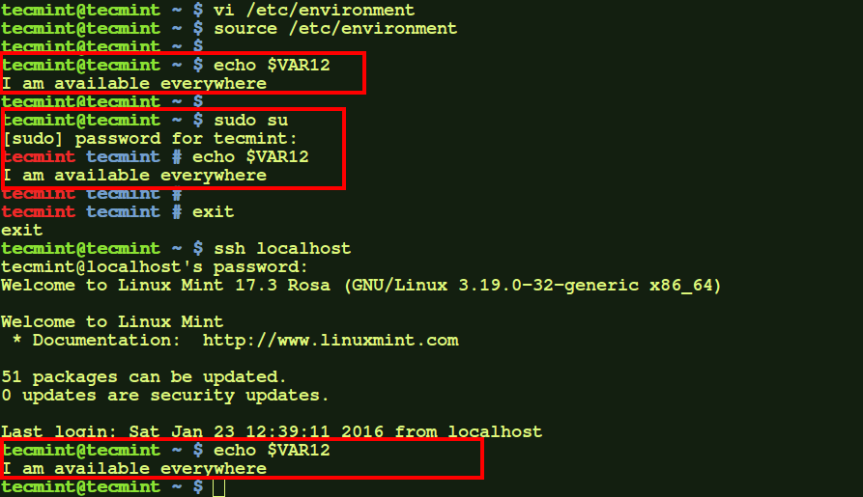
Environment Variables
Java Full Stack Program

Slide 9
Important Environment Variables
HOME - your home directory.
USER and LOGNAME - your login ID.
HOSTNAME - the name of the host computer.
PWD - the current working directory.
MAIL - where your mail is located.
PATH - a list of directories in which to look for executable commands.
Certain applications and commands may communicate with the shell and reference the environment variables that it maintains.
For example, it seems that frm and nfrm seem not to work if $MAIL is not defined. frm and nfrm are commands to list the contents of your inbox without logging into pine.
Java Full Stack Program

Slide 10
Introduction to ~/bin
bin directories
Program files or commands, also called binary executable files and script files, are kept in various places throughout the system.
Usually these binary files are stored in bin (short for binary) directories throughout the system.
If you take a look at the paths are stored in your $PATH environment variable, you will notice that many of these directories end in .../bin.
Your ~/bin directory
You may also notice that your path may contain a bin directory that is listed as being in your home directory (/afs/umbc.edu/users/u/s/username/home/bin).
This is where you can store your own compiled programs or scripts that you would like to be able to run from anywhere on the system.
Java Full Stack Program

Slide 11
Introducing tcsh
Currently, the default shell on UMBC’s GL system is tcsh.
tcsh is short for Turbo C SHell.
Customizing your tcsh shell
The UNIX@UMBC guide linked from the course web page has a pretty good section on customizing your tcsh shell.
The .cshrc file
tcsh looks for a configuration file at startup time called "~/.cshrc"
I recommend backing up a copy of your account configuration files before modifying them (such as "cp .cshrc .cshrc.bak").
Changes to your configuration file do not effect the system immediately after you save the file.
You might just be able to issue the command source ~/.cshrc to make the changes take effect.
You may need to logout and log back in for these changes to take effect.
Java Full Stack Program

Slide 12
Control Statements
Without control statements, execution within a shell scripts flows from one statement to the next in succession.
Control statements control the flow of execution in a programming language
The three most common types of control statements:
conditionals: if/then/else, case, ...
loop statements: while, for, until, do, ...
branch statements: subroutine calls (good), goto (bad)
Java Full Stack Program

Slide 13
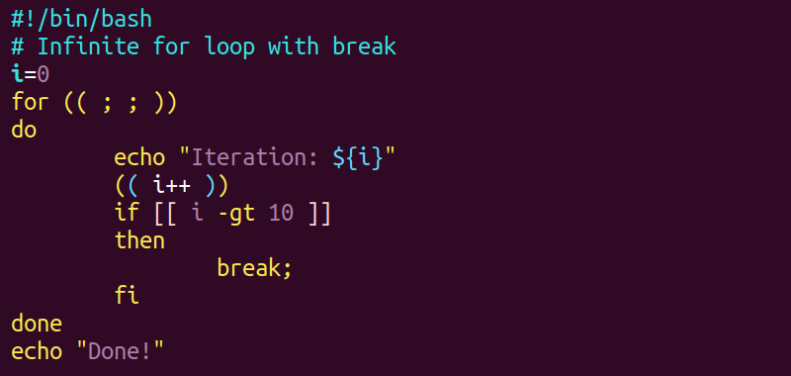
for Loops
for loops allow the repetition of a command for a specific set of values
Syntax:
for var in value1 value2 ...
do
command_set
done
command_set is executed with each value of var (value1, value2, ...) in sequence
Java Full Stack Program

Slide 14
Conditionals
Conditionals are used to “test” something.
In Java or C, they test whether a Boolean variable is true or false.
In a Bourne shell script, the only thing you can test is whether or not a command is “successful”
Every well behaved command returns back a return code.
0 if it was successful
Non-zero if it was unsuccessful (actually 1..255)
We will see later that this is different from true/false conditions in C.
Java Full Stack Program

Slide 15
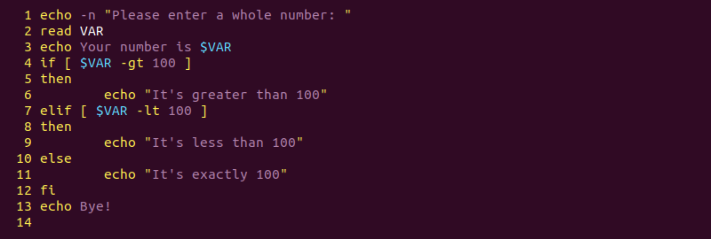
The if Statement
Simple form:
if decision_command_1
then
command_set_1
fi
Example:
if grep unix myfile >/dev/null
then
echo "It's there"
fi
Java Full Stack Program

Slide 16
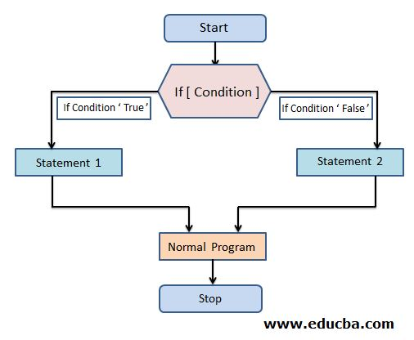
If and else
Simple form
if grep "UNIX" myfile >/dev/null
Then
echo UNIX occurs in myfile
Else
echo No!
echo UNIX does not occur in myfile
fi
Java Full Stack Program

Slide 17
if and elif
Simple form
if grep "UNIX" myfile >/dev/null
Then
echo "UNIX occurs in file"
elif grep "DOS" myfile >/dev/null
Then
echo "Unix does not occur, but DOS does"
Else
echo "Nobody is there"
fi
Java Full Stack Program

Slide 18
Use of Semicolons
Instead of being on separate lines, statements can be separated by a semicolon (;)
For example:
if grep "UNIX" myfile; then echo "Got it"; fi
This actually works anywhere in the shell.
% cwd=`pwd`; cd $HOME; ls; cd $cwd
Java Full Stack Program

Slide 19
Use of Colon
Sometimes it is useful to have a command which does “nothing”.
The : (colon) command in Unix does nothing
#!/bin/sh
if grep unix myfile
then
:
else
echo "Sorry, unix was not found"
fi
Java Full Stack Program

Slide 20
The test Command – File Tests
test –f file does file exist and is not a directory?
test -d file does file exist and is a directory?
test –x file does file exist and is executable?
test –s file does file exist and is longer than 0 bytes?
#!/bin/sh
count=0
for i in *; do
if test –x $i; then
count=`expr $count + 1`
fi
done
echo Total of $count files executable.
Java Full Stack Program

Slide 21
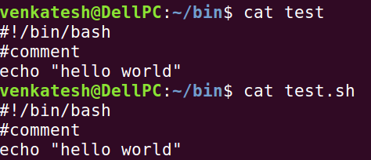
The test Command – String Tests
test –z string is string of length 0?
test string1 = string2 does string1 equal string2?
test string1 != string2 not equal?
Example:
if test -z $REMOTEHOST
then
:
else
DISPLAY="$REMOTEHOST:0"
export DISPLAY
fi
Java Full Stack Program

Slide 22
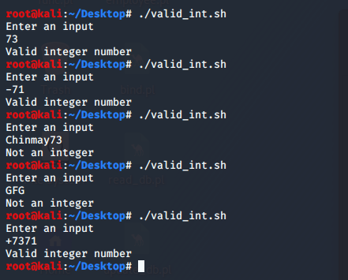
The test Command – Integer Tests
Integers can also be compared:
Use -eq, -ne, -lt, -le, -gt, -ge
For example:
#!/bin/sh
smallest=10000
for i in 5 8 19 8 7 3; do
if test $i -lt $smallest; then
smallest=$i
fi
done
echo $smallest
Java Full Stack Program

Slide 23
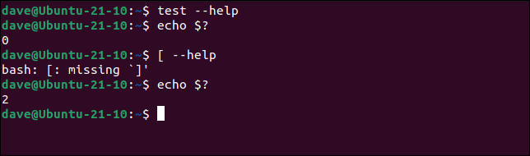
Use of [ ]
The test program has an alias as [ ]
Each bracket must be surrounded by spaces!
This is supposed to be a bit easier to read.
For example:
#!/bin/sh
smallest=10000
for i in 5 8 19 8 7 3; do
if [ $i -lt $smallest ] ; then
smallest=$i
fi
done
echo $smallest
Java Full Stack Program

Slide 24
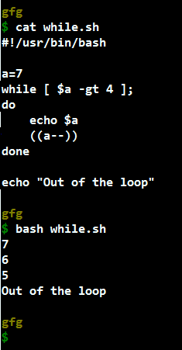
The while Loop
While loops repeat statements as long as the next Unix command is successful.
For example:
#!/bin/sh
i=1
sum=0
while [ $i -le 100 ]; do
sum=`expr $sum + $i`
i=`expr $i + 1`
done
echo The sum is $sum.
Java Full Stack Program

Slide 25
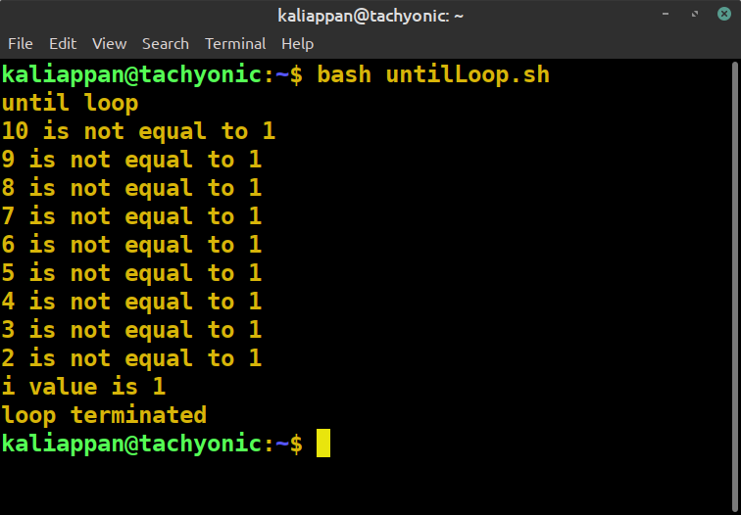
The until Loop
Until loops repeat statements until the next Unix command is successful.
For example:
#!/bin/sh
x=1
until [ $x -gt 3 ]; do
echo x = $x
x=`expr $x + 1`
done
Java Full Stack Program

Slide 26
Command Line Arguments (1)
Shell scripts would not be very useful if we could not pass arguments to them on the command line
Shell script arguments are “numbered” from left to right
$1 - first argument after command
$2 - second argument after command
... up to $9
They are called “positional parameters”.
Java Full Stack Program

Slide 27
Command Line Arguments (2)
Example: get a particular line of a file
Write a command with the format:
getlineno linenumber filename
#!/bin/sh
head -$1 $2 | tail -1
Other variables related to arguments:
$0 name of the command running
$* All the arguments (even if there are more than 9)
$# the number of arguments
Java Full Stack Program

Slide 28
Command Line Arguments (3)
Example: print the oldest files in a directory
#! /bin/sh
# oldest -- examine the oldest parts of a directory
HOWMANY=$1
shift
ls -lt $* | tail +2 | tail $HOWMANY
The shift command shifts all the arguments to the left
$1 = $2, $2 =$3, $3 = $4, ...
$1 is lost (but we have saved it in $HOWMANY)
The value of $# is changed ($# - 1)
useful when there are more than 9 arguments
The “tail +2” command removes the first line.
Java Full Stack Program

Slide 29
More on Bourne Shell Variables (1)
There are three basic types of variables in a shell script:
Positional variables ...
$1, $2, $3, ..., $9
Keyword variables ...
Like $PATH, $HOWMANY, and anything else we may define.
Special variables ...
Java Full Stack Program

Slide 30
More on Bourne Shell Variables (2)
Special variables:
$*, $# -- all the arguments, the number of the arguments
$$ -- the process id of the current shell
$? -- return value of last foreground process to finish
-- more on this one later
There are others you can find out about with man sh
Java Full Stack Program

Slide 31
THANK YOU
Java Full Stack Program

