Slide 1
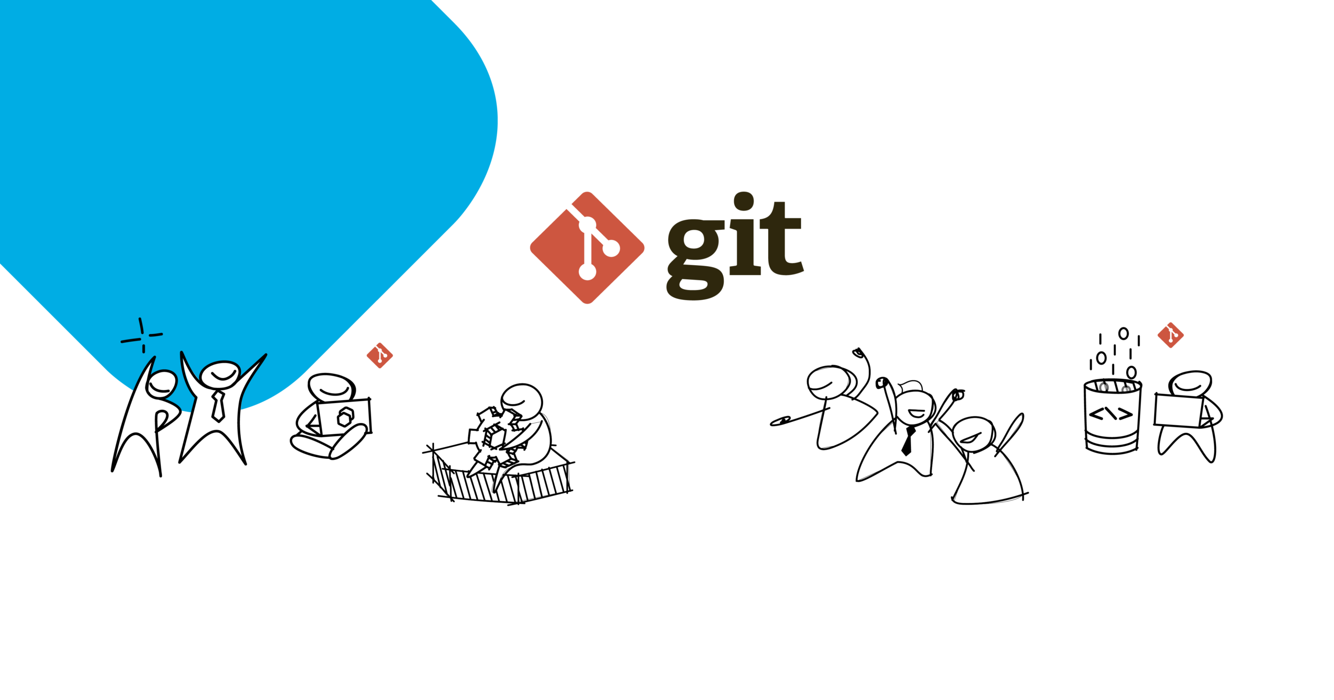

Slide 2
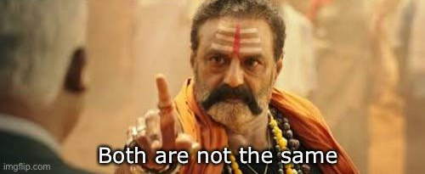
Git
Git is a distributed version control system designed for tracking changes in source code during software development.
Developed by Linus Torvalds in 2005, initially to manage the Linux kernel development.
Used to work collaboratively over a team , track code changes.
Git vs Github
Git: The version control system itself, installed locally on a developer's machine.
GitHub: A web-based platform built around Git, providing a hosting service for Git repositories and additional collaboration features.
Git manages the versioning of code, while GitHub adds features like issue tracking, pull requests, project management tools, and team collaboration.

Slide 3
Git - Setup
Download Git for free from the following website: https://www.git-scm.com/
For Windows : Download Git Bash
After installation , Configure Git
Open a terminal/command prompt.
Set your username and email:
git config --global user.name "Your Name"
git config --global user.email your.email@example.com
Make a directory>Project folder then Initialize git by git init – creates a new repository

Slide 4
Basic Git Commands
git init: - Initializes a new Git repository in the current directory.
git add: - Adds changes in the working directory to the staging area, preparing them for the next commit.
git commit: - Records changes to the repository, creating a snapshot of the staged changes.
git push: - Uploads local repository content to a remote repository, usually hosted on a service like GitHub.
git pull: - Fetches changes from a remote repository and merges them into the local repository.
git clone: - Creates a local copy of a remote repository.
git branch: -Lists, creates, or deletes branches within the repository.
git merge: - Combines changes from one branch into another.
git checkout: -Switches branches or restores working tree files to a specific state.
git status: - Displays the current state of the working directory and the staging area

Slide 5
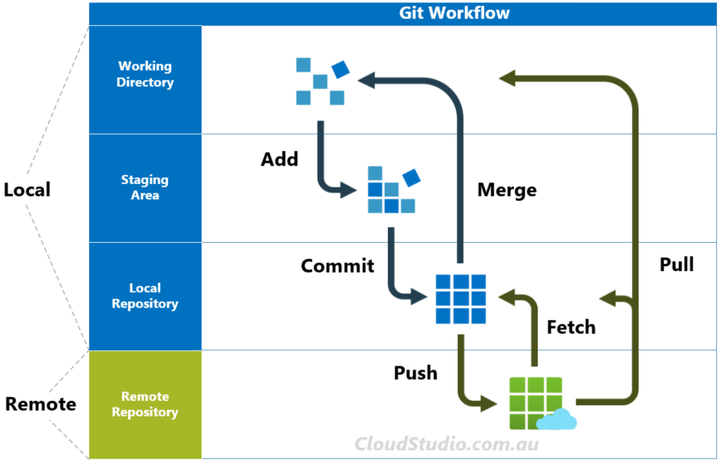
Git Workflow

Slide 6
Git Branching
In Git, a branch is a new/separate version of the main repository.
a lightweight movable pointer to a commit. When you create a branch, you're essentially creating a new line of development that diverges from the main codebase (often referred to as the "master" branch).
Isolation: Branches allow developers to work on new features, bug fixes, or experiments without affecting the main codebase until the changes are ready to be merged.
Parallel Development: Multiple developers can work on different features simultaneously by creating separate branches, which can then be merged back into the main codebase when complete.
git branch new-feature - Create a Branch: Use the git branch command to create a new branch based on the current state of the repository.
git checkout new-feature - Switch Branches: Use the git checkout command to switch between branches.

Slide 7
Relationship between Pull Requests and Merge Conflicts:
Pull requests (PRs) and merge conflicts are both related to the process of integrating changes from one branch into another in a Git repository, typically when collaborating on a project with multiple developers.
A pull request is a feature provided by Git hosting platforms like GitHub, GitLab, and Bitbucket, enabling developers to propose changes to a repository and request them to be reviewed and merged into another branch (often the main branch) by project maintainers or collaborators.
Merge conflicts occur when Git is unable to automatically merge changes from different branches or commits due to Developers must resolve any merge conflicts before the pull request can be merged successfully.
Pull request review tools provided by Git hosting platforms often facilitate conflict resolution by highlighting conflicting changes and providing tools for comparing and resolving conflicts.

Slide 8
GitHub
GitHub Account
Go to GitHub and sign up for an account Create a Repository on GitHub
Now that you have made a GitHub account, sign in, and create a new Repo
Public (if you want the repo to be viewable for anyone) or
Private (if you want to choose who should be able to view the repo).
Either way, you will be able to choose who can contribute to the repo.
Then click "Create repository".
Since we have already set up a local Git repo, we are going to push that to GitHub.
git remote add origin URL specifies that you are adding a remote repository, with the specified URL, as an origin to your local Git repo. Now we are going to push our master branch to the origin url, and set it as the default remote branch.

Slide 9
GitHub Pull , Push , Branch
When working as a team on a project, it is important that everyone stays up to date.
Any time you start working on a project, you should get the most recent changes to your local copy.
With Git, you can do that with pull - It is used to pull all changes from a remote repository into the branch you are working on.
pull is a combination of
Fetch - gets all the change history of a tracked branch/repo and Merge - combines the current branch, with a specified branch.
git commit -a -m “commit mesage“
Git push branch
On GitHub, access your repository and click the "master" branch button.There you can create a new Branch.
After the branch gets active , Start working on an existing file in this branch.

Slide 10
GitHub Pull , Push , Branch
continue working on our new branch created on local
Ensure your code is up-to-date , if not pull branch , and then we can see our branch on GitHub.
use the -a option to see all local and remote branches –
git branch –a
git branch –r : remote branches
Create a new local branch, and push that to GitHub- git checkout -b newBranch
Check git status – we can see modified , but not added staging area.
git add – to add it to staging area , git commit –m to save changes and then git push - from our local Git repository, to GitHub, where everyone can see the changes

Slide 11
GitHub Merge and Pull Request
In GitHub, we can now see the changes and merge them into the master branch if we approve it.
If you click the "Compare & pull request", you can go through the changes made and new files added.
If the changes look good, you can go forward, creating a pull request.
A pull request is how you propose changes. Get someone to review your changes or pull your contribution and merge it into their branch.
The pull request will record the changes, which means you can go through them later to figure out the changes made.
you can delete the now unused branch by clicking "Delete branch".

Slide 12
Git GitHub Fork
A fork is a copy of a repository. This is useful when you want to contribute to someone else's project or start your own project based on theirs.
fork is not a command in Git, but something offered in GitHub and other repository hosts.
Now we have our own fork, but only on GitHub. We also want a clone on our local Git to keep working on it.
A clone is a full copy of a repository, including all logging and versions of files. – git clone URL
we have a full copy of a repository, whose origin we are not allowed to make changes to.
git remote add myrepoName URL - add a new remote repository named myrepoName to your local Git repository.
Git remote –v lists all remote repos connected to your local repo.

Slide 13
Online Git Repositories
GitHub: Largest and most popular Git repository hosting platform with robust collaboration features.
GitLab: Web-based Git repository manager with integrated CI/CD pipelines and project management tools.
Bitbucket: Supports Git and Mercurial repositories with integration to other Atlassian products like Jira.
Azure Repos: Microsoft's Git repository hosting service with seamless integration to Azure Pipelines.
AWS CodeCommit: Fully managed Git hosting service provided by Amazon Web Services (AWS).
SourceForge: Open-source platform offering Git repository hosting along with project management tools.
Google Cloud Source Repositories: Scalable and private Git repository hosting integrated with Google Cloud Platform (GCP) services.
Codeberg: Non-profit Git hosting platform focused on privacy and user freedom.
Gitea: Lightweight and easy-to-use self-hosted Git service written in Go.
GitKraken Glo Boards: Kanban-style project management integrated with Git repositories by GitKraken.

Slide 14


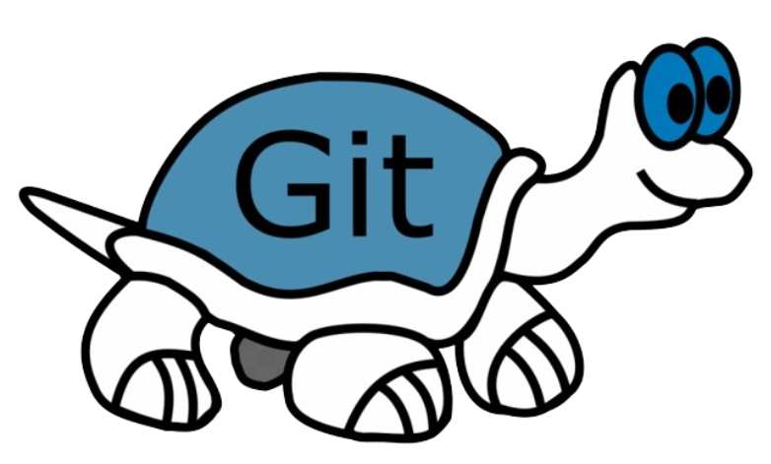

Git
Guess the Logo

