Slide 1
Patient-Reported Medication Experience Analytics
Using Apache Spark for EDA, Structured Streaming, and MLlib Classification
Jessica Ballard | ITCS 6190 Final Project

Slide 2
Project Objective
Analyze patient-reported medication experiences from Druglib.com reviews.
Identify satisfaction patterns across drugs, conditions, effectiveness, and side effects.
Predict whether a review reflects a positive or negative medication experience.
ITCS 6190 | Patient-Reported Medication Experience Analytics

Slide 3
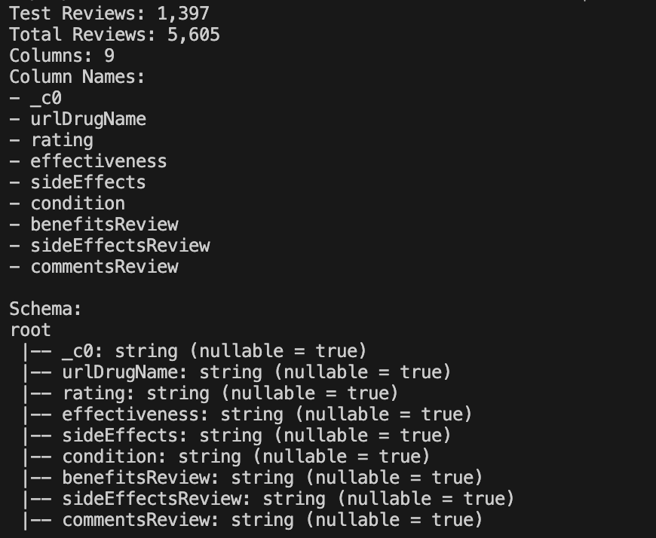
Dataset
Source: UCI Drug Review Dataset (Druglib.com).
Files: drugLibTrain_raw.tsv and drugLibTest_raw.tsv.
Key fields:
drug name
condition
rating
effectiveness
side effects
review text
ITCS 6190 | Patient-Reported Medication Experience Analytics

Slide 4
Pipeline Overview
Ingestion
Cleaning
EDA
Streaming
MLlib
Results
Each script produces reproducible outputs used by later pipeline stages.
Final execution is designed to run through a single shell script.
ITCS 6190 | Patient-Reported Medication Experience Analytics

Slide 5
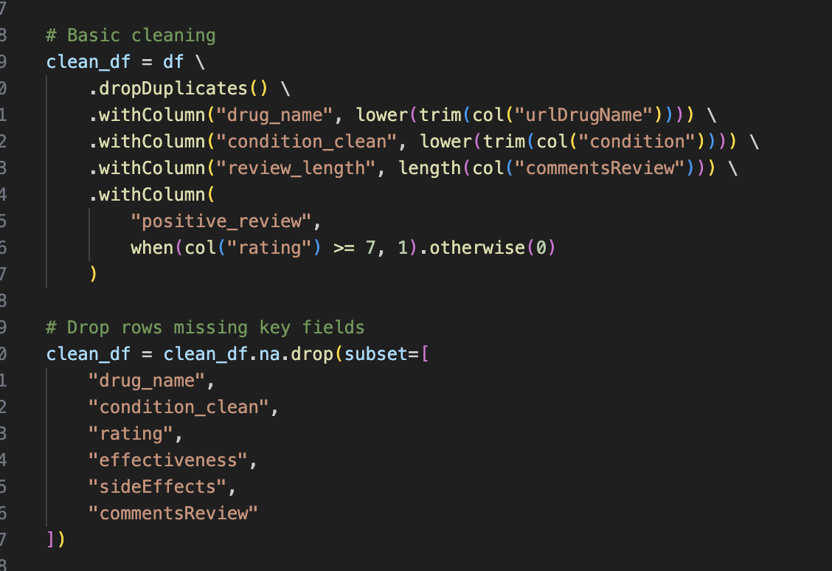
Data Cleaning & Feature Engineering
Data Cleaning Steps
• Combined training and test datasets
• Removed duplicate records
• Removed rows with missing critical fields
• Standardized medication and condition values
• Saved cleaned dataset as Parquet for efficient Spark processing
Feature Engineering
• review_length
- Number of characters in each review
• positive_review
- Binary target variable
- 1 = rating ≥ threshold
- 0 = otherwise
• condition_clean
- Standardized medical condition field
Why These Steps Matter
Improved data quality and consistency
Reduced noise from duplicate and incomplete records
Created features for exploratory analysis and machine learning
Prepared data for Structured Streaming and MLlib classification
ITCS 6190 | Patient-Reported Medication Experience Analytics

Slide 6
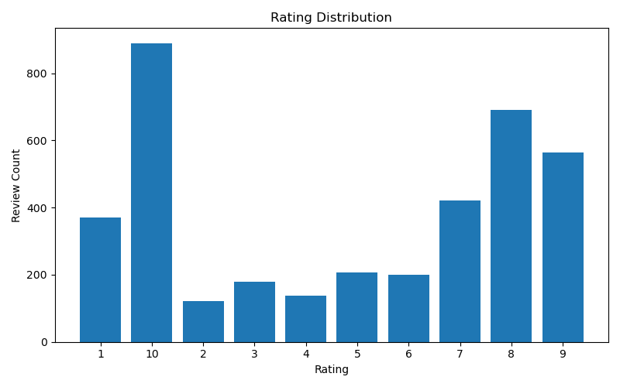
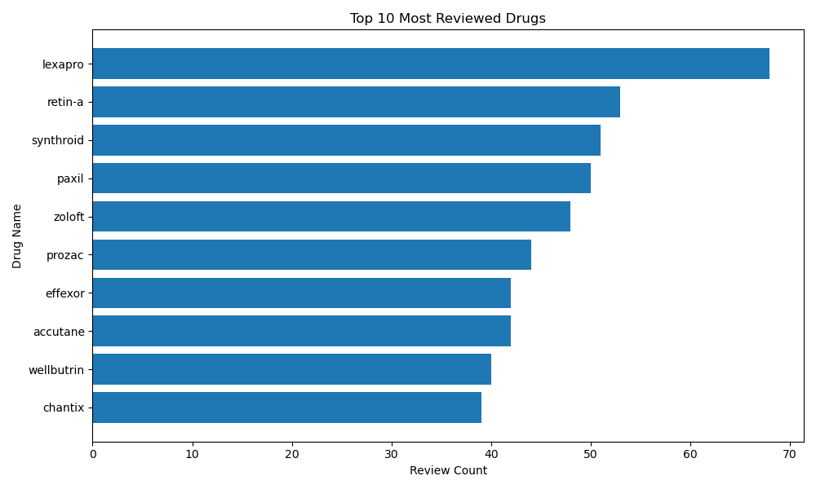
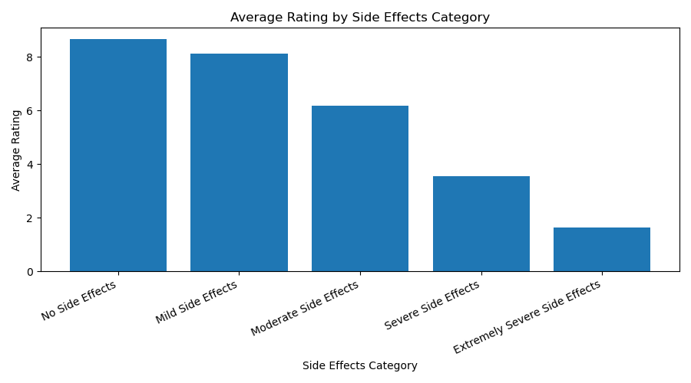
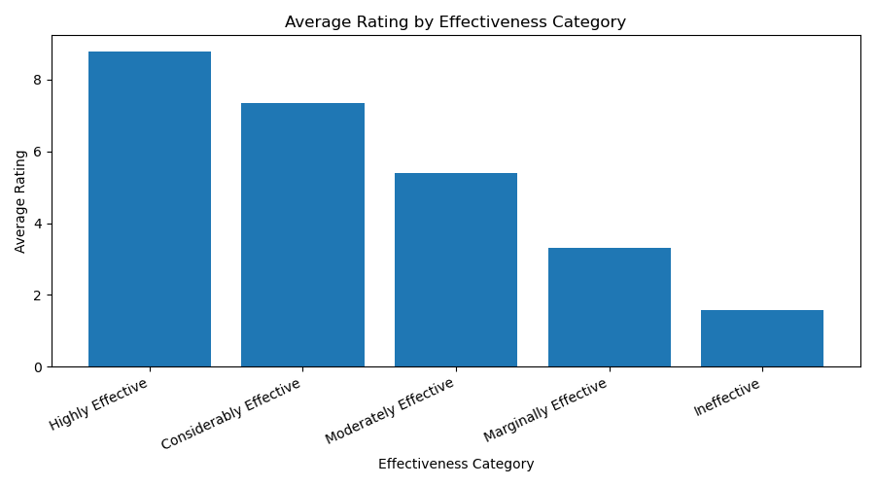
EDA Results
Performed exploratory data analysis (EDA) using Spark DataFrames to examine rating trends, review frequency by drug, and relationships between ratings, effectiveness, and side effects.
The results provided insights into patient sentiment and informed subsequent streaming and machine learning analyses.
ITCS 6190 | Patient-Reported Medication Experience Analytics

Slide 7
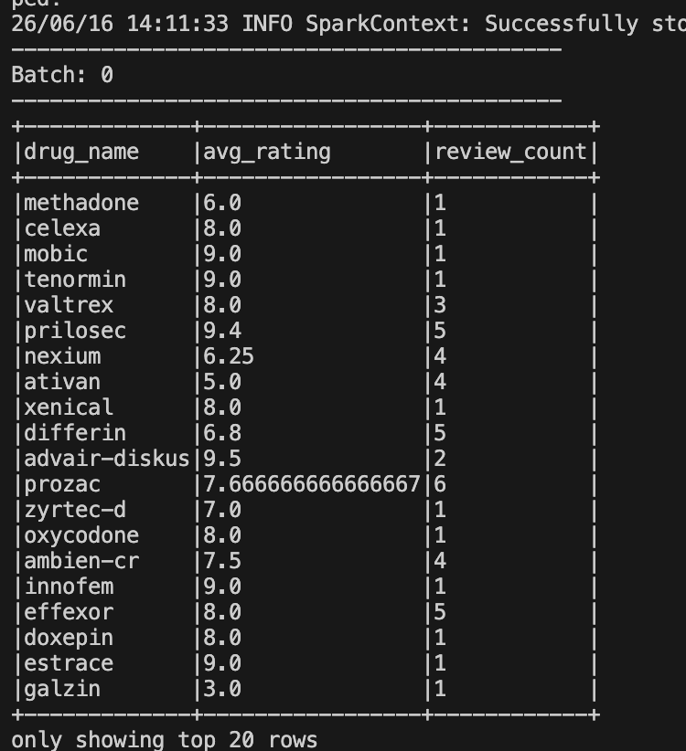
Structured Streaming
The Structured Streaming pipeline simulates incoming medication review records by reading small batches of historical review data. As new records arrive, Spark automatically updates average satisfaction metrics for each medication.
Streaming Implementation
The cleaned medication review dataset was split into multiple small CSV batches using a batch generation script. Spark Structured Streaming continuously monitored the input folder and processed each batch as if new review records were arriving in real time.
Batch 0 is the first micro-batch processed by Spark Structured Streaming. It contains the initial set of review records that were read from the simulated streaming input folder.
Example Output
prilosec | 9.4 | 5
This indicates that Spark processed 5 reviews for Prilosec and calculated an average satisfaction rating of 9.4.
Why Use Streaming?
In a real healthcare or pharmaceutical environment, medication reviews may be submitted continuously. Structured Streaming enables satisfaction metrics to be updated in near real time rather than waiting for a full batch-processing job.
Key Outcome
The streaming job successfully demonstrates how Apache Spark can process incoming review data and continuously update medication satisfaction metrics as new records become available.
ITCS 6190 | Patient-Reported Medication Experience Analytics

Slide 8
MLlib Classification Model
Goal
Predict whether a patient-reported medication review reflects a positive or negative medication experience.
Target Variable
positive review
• 1 = Positive Review
• 0 = Negative Review
Features Used
• Effectiveness rating
• Side-effect category
• Medical condition
• Review length
Why This Matters
This model demonstrates how patient experience outcomes can be predicted from medication review characteristics using Apache Spark MLlib.
Categorical Features
StringIndexer
VectorAssembler
Logistic Regression
Prediction
ITCS 6190 | Patient-Reported Medication Experience Analytics

Slide 9
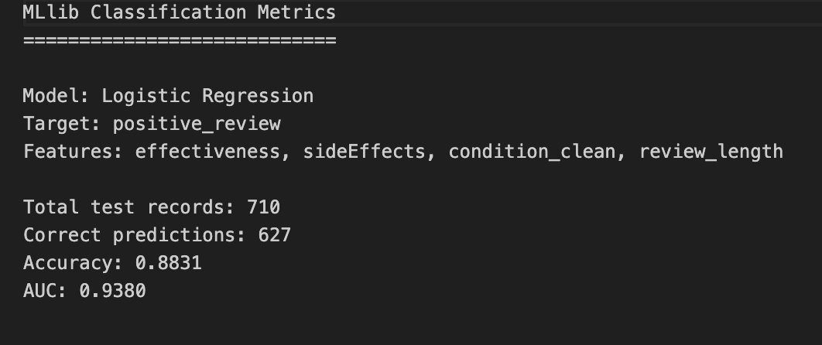
Model Results
Accuracy
88.3%
AUC
0.938
The model was effective at separating positive and negative patient experiences. It achieved 88.3% accuracy, correctly classifying 627 out of 710 test reviews, and an AUC of 0.938, indicating excellent ability to distinguish between positive and negative outcomes.
These results suggest that review characteristics such as effectiveness, side effects, medical condition, and review length are strong predictors of overall patient satisfaction.
ITCS 6190 | Patient-Reported Medication Experience Analytics

Slide 10
Limitations & Future Improvements
Patient-reported reviews may include bias or inconsistent reporting.
Streaming is simulated using batch files rather than a live source.
Current model uses structured fields only; future work could add NLP features from review text.
Additional model comparison and tuning could improve prediction quality.
ITCS 6190 | Patient-Reported Medication Experience Analytics

