Slide 1

Notes:
In this unit we will move away from machine learning for a bit and instead talk about images and videos. Why images and videos? Image and video processing is actually very common in machine learning applications. Can you think of any examples of images or video processing in machine learning? Some ideas include: * Facial recognition * Classification * Converting video to a textual description (story) * Analyzing video for suspicious movements * Disease detection in medical images * Crop yield estimates based on aerial photos of fields The list goes on and on. There are many applications of image and video processing in machine learnings.

Slide 2

Notes:
Let's think for a second. What is an image actually? You likely know that an image is a grid of pixels. And each pixel represents a single color point in the image. But how is that pixel encoded?

Slide 3
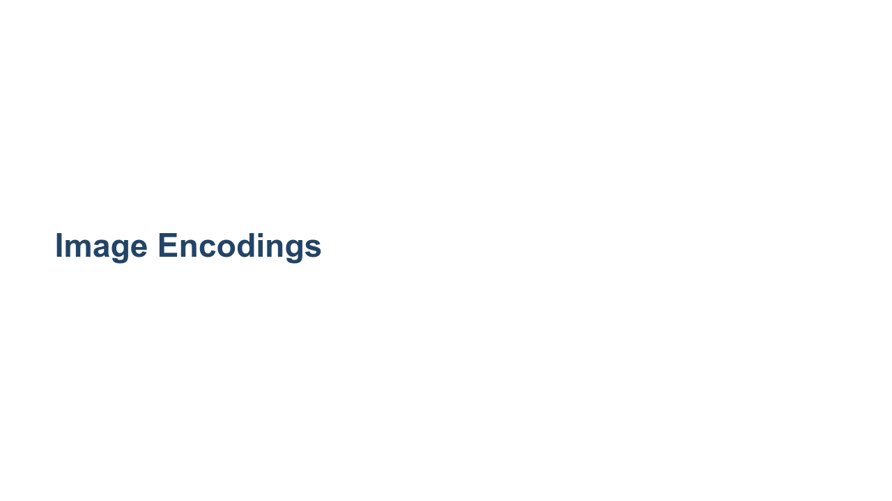
Notes:
Not all pixels are encoded in the same way. There are actually quite a few different encodings for images.

Slide 4
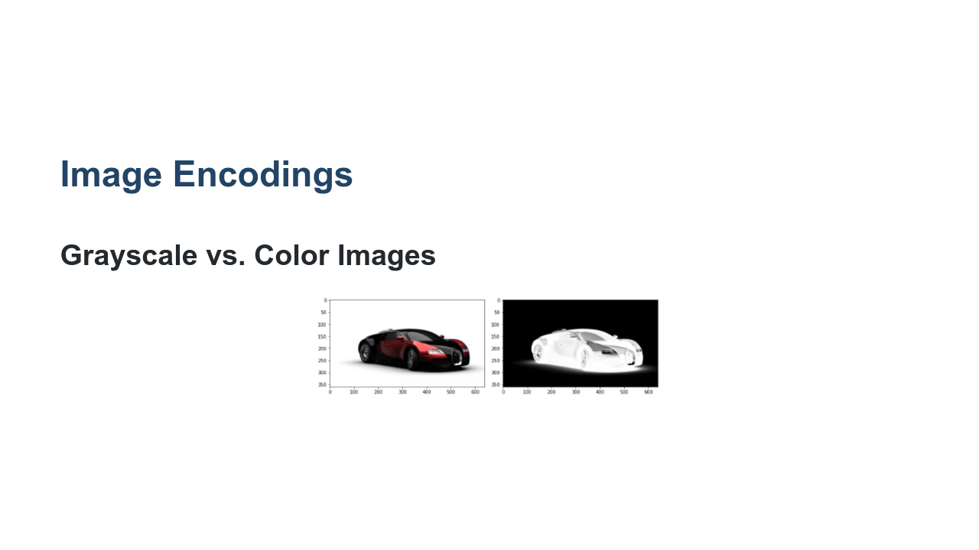
Notes:
One of the first distinctions to be made is if the image is made up pixels on a "gray scale" or if the image is made from a larger spectrum of colors. In this example you can see that the image on the left has many colors, including some reds while the image on the right is limited to black, white, and the grays in between. What does this mean for the encoding? * Image name: res/color-vs-gray.png * Repo link: https://github.com/google/applied-machine-learning-intensive/tree/master/content/04_classification/06_images_and_video/res/color-vs-gray.png * Source https://pixabay.com/illustrations/car-sports-car-racing-car-speed-49278/ by Author Lipetkd / Felipe Lima https://pixabay.com/users/lipetkd-4592/ under License https://pixabay.com/service/license/.

Slide 5
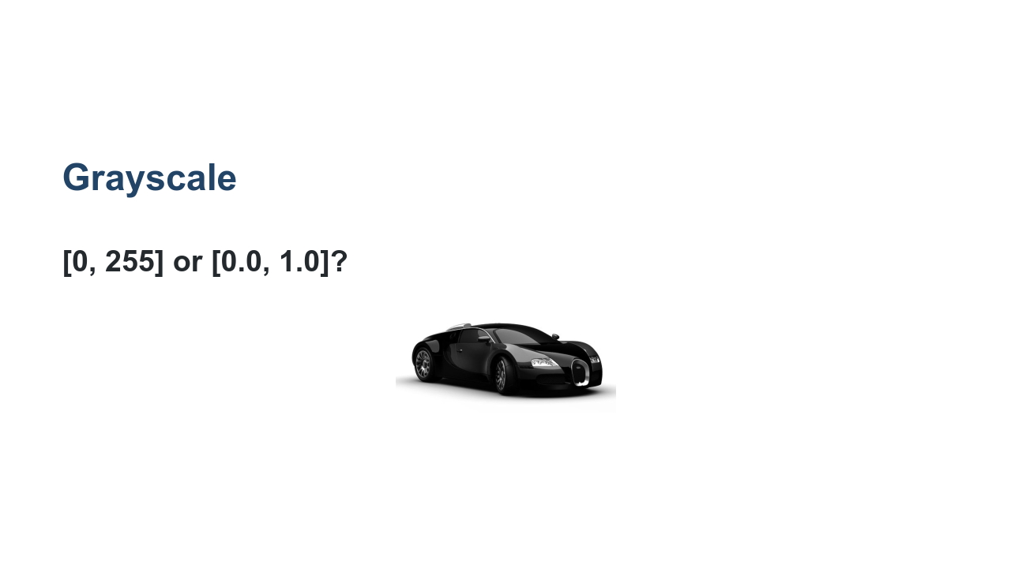
Notes:
We'll start with the simplest format, grayscale. Grayscale images have a single numeric value representing each pixel in the image. But what are those numbers? Typically they range from 0 to 255 if they are integers or 0.0 to 1.0 if they are floating point values. Even with grayscale images, it is important to know the range of values for the input pixels. If the pixels range from 0.0 to 1.0 then many models will be able to more easily train on the images. If the values are integers between 0 and 255, then it is typically a good idea to divide the values by 255.0 in order to bring them into the 0.0 to 1.0 range that neural networks in order to help the models learn more quickly. * Image name: res/grayscale.png * Repo link: https://github.com/google/applied-machine-learning-intensive/tree/master/content/04_classification/06_images_and_video/res/grayscale.png * Source https://pixabay.com/illustrations/car-sports-car-racing-car-speed-49278/ by Author Lipetkd / Felipe Lima https://pixabay.com/users/lipetkd-4592/ under License https://pixabay.com/service/license/.

Slide 6
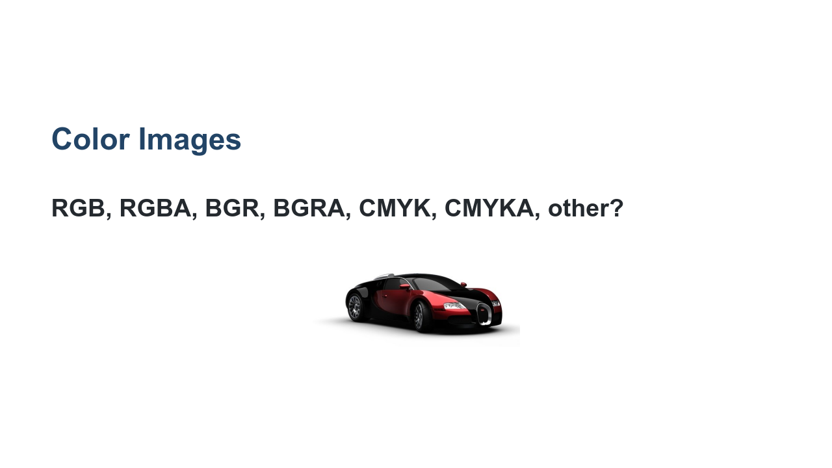
Notes:
Grayscale images typically are one of the two encodings that we mentioned. It is of course important to know which encoding your images are in since a model expects inputs to be on the same scale. However, converting between [0.0, 1.0] and [0, 255] is fairly trivial. Color images introduce an entirely new level of encoding complexity. There are scores of encodings for color images. One of the more common ones that you might have seen is RGB. RGB stands for "red", "green", "blue". With these three colors you can make scores of other colors. With RGB encoding a value, typically between 0 and 255 (though sometimes between 0.0 and 1.0), you can combine the colors to create a rainbow of possibility. With RGB you have three numeric values for each pixel. This triples the size of your inputs! But that is not all. There is RGBA, which takes our red, green, and blue and adds an "alpha" channel which represents the opacity of the pixel. Opacity? Typically when we think of an image, we think about only seeing that image. But what if we put an image under the image we were looking at? If there were no opacity, then we'd only see the topmost image. If there is opacity (think transparency) then we would see a little bit of the underlying image too. The alpha channel, also typically between 0 and 255 or 0.0 and 1.0, manages how "see-through" our pixel is. But why RGB? Why not BRG or GBR or any other ordering? It turns out that there are other orderings, one of the more common being BGR. This was a common encoding in early digital cameras for hardware reasons that aren't relevant to our topic. Just know that color order can change, and you need to make sure that your inputs for training and predicting have the same encodings. Of course, this begs the question. Are reds, greens, blues, and maybe alphas the only way to encode color? Of course not! There are other schemes such as CMYK, which stands for cyan, magenta, yellow, and black. Encodings aren't complicated individually, but the number and variety of image encodings can be difficult to work with. Know your inputs! * Image name: res/color.png * Repo link: https://github.com/google/applied-machine-learning-intensive/tree/master/content/04_classification/06_images_and_video/res/color.png * Source https://pixabay.com/illustrations/car-sports-car-racing-car-speed-49278/ by Author Lipetkd / Felipe Lima https://pixabay.com/users/lipetkd-4592/ under License https://pixabay.com/service/license/.

Slide 7
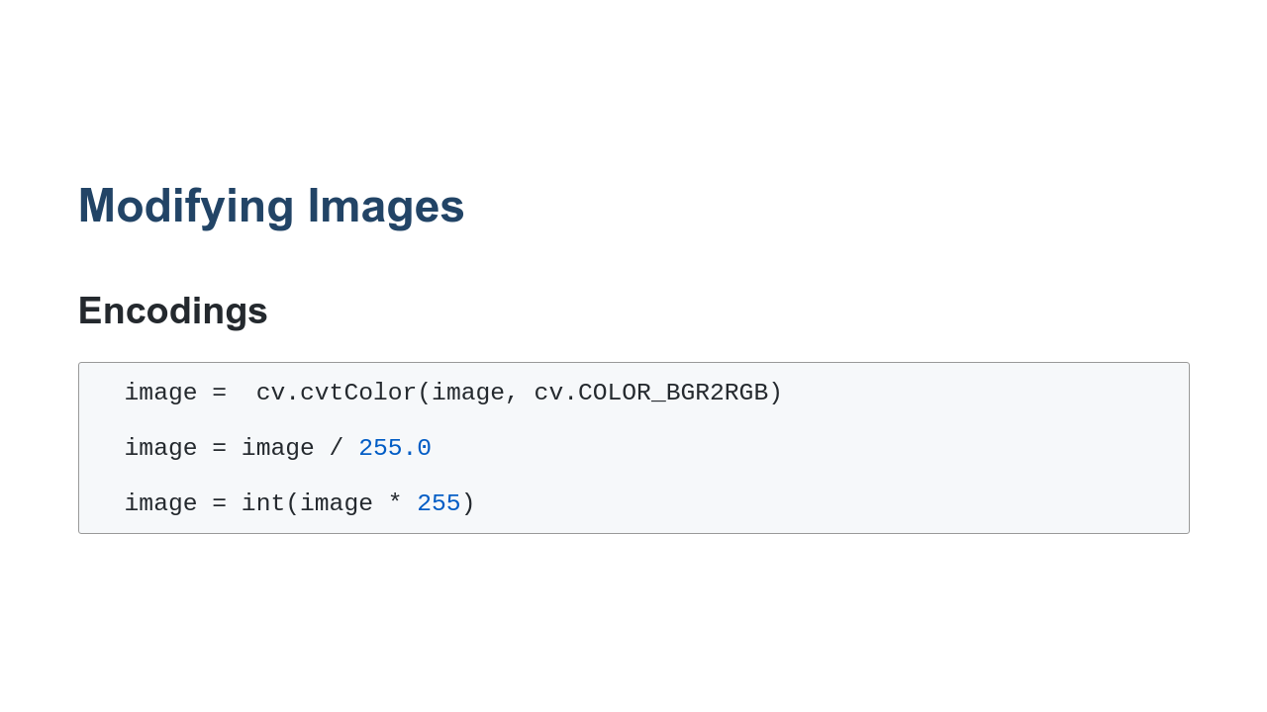
Notes:
We talked about image encodings and how it is important to feed your model images encoded in the same way. In order to do this you have a few options. If you are converting encodings, you can use the OpenCV `cvtColor` function to to the conversion for you. If you are scaling the encodings you can use simple Python expressions with NumPy arrays.

Slide 8
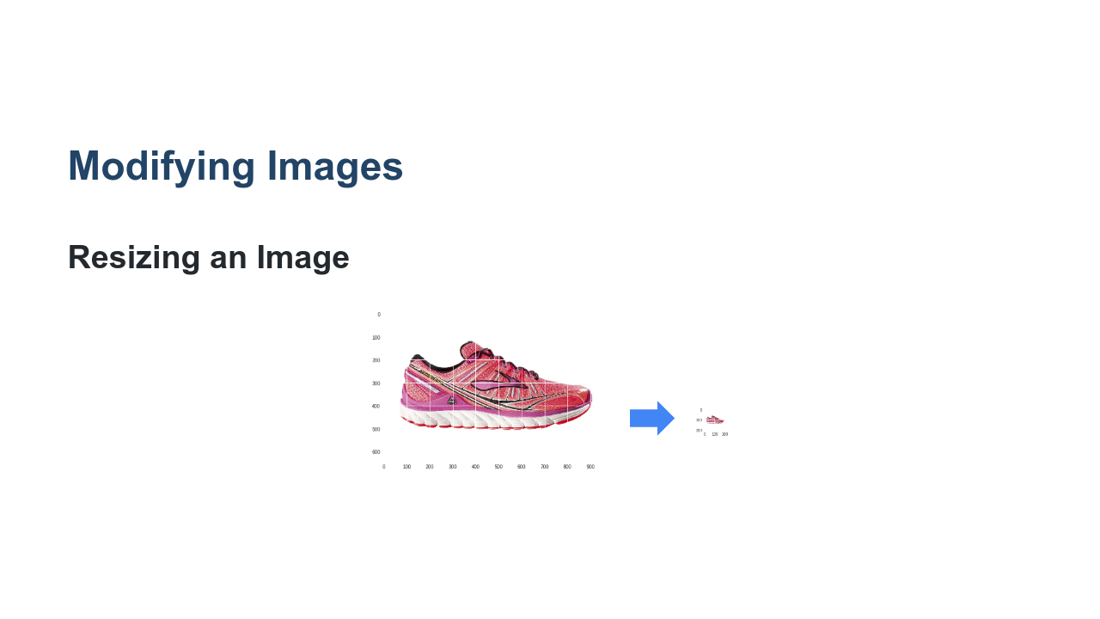
Notes:
But what about scaling/resizing an image? Some models have a scaling layer as an early step, but not all do. Also, you may want more control of your image when you scale it. In the example in this slide we simply scaled the image down to a size that presumptively the model expects. We could have also padded it into a proportional square or rectangle before resizing. * Image name: res/resize.png * Repo link: https://github.com/google/applied-machine-learning-intensive/tree/master/content/04_classification/06_images_and_video/res/resize.png * Source https://pixabay.com/photos/running-shoe-shoe-brooks-371624/ by Author Stux https://pixabay.com/users/stux-12364/ under License https://pixabay.com/service/license/.

Slide 9
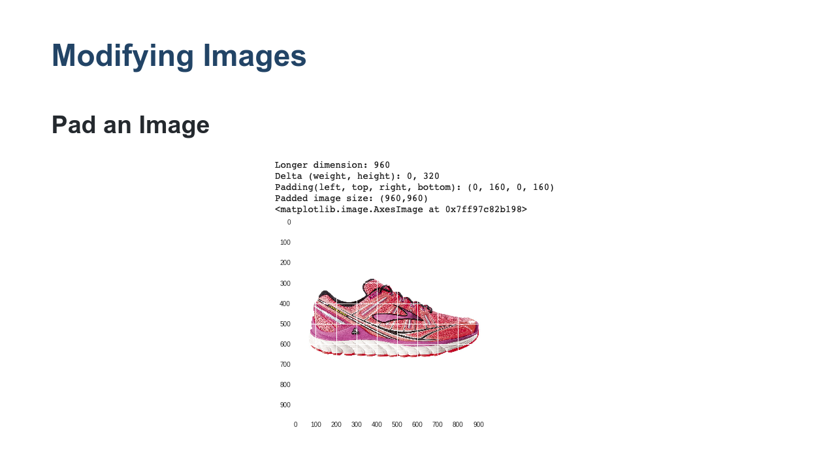
Notes:
But you don't always just want to blindly resize an image. That might distort it. In some cases you'll want to pad an image with whatever the background color is and then resize it in order to avoid distorting the image. To do this, you must find the number of pixels to add to the height of the image and divide those pixels across the top and bottom of the image. You must do the same for the left and right of the image. * Image name: res/pad.png * Repo link: https://github.com/google/applied-machine-learning-intensive/tree/master/content/04_classification/06_images_and_video/res/pad.png * Source https://pixabay.com/photos/running-shoe-shoe-brooks-371624/ by Author Stux https://pixabay.com/users/stux-12364/ under License https://pixabay.com/service/license/.

Slide 10
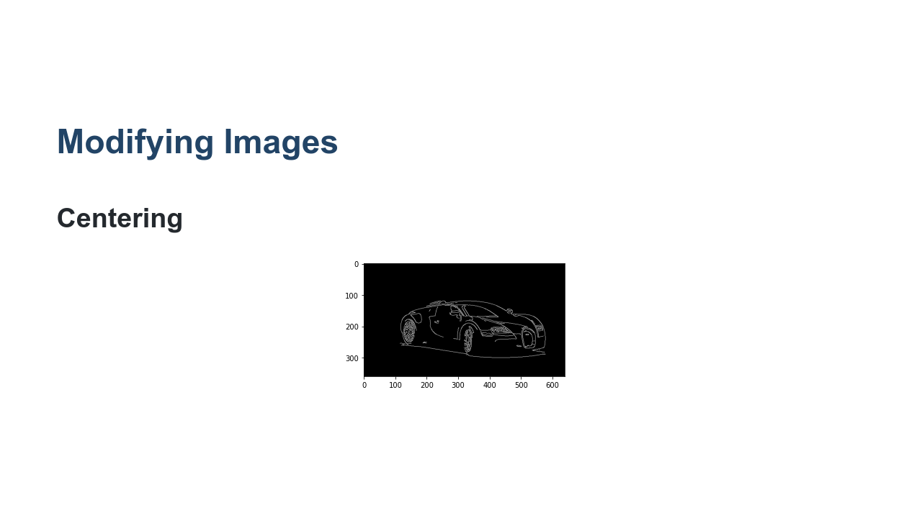
Notes:
If we have images with a predictable solid background, we can actually perform more complex processing and try to find the center of the focal object. Using algorithms like the Canny algorithm, we can find the key strokes and make our image, hone in on them, and find the center of our image. We can then pad around that. * Image name: res/lines.png * Repo link: https://github.com/google/applied-machine-learning-intensive/tree/master/content/04_classification/06_images_and_video/res/lines.png * Source https://pixabay.com/illustrations/car-sports-car-racing-car-speed-49278/ by Author Lipetkd / Felipe Lima https://pixabay.com/users/lipetkd-4592/ under License https://pixabay.com/service/license/.

Slide 11
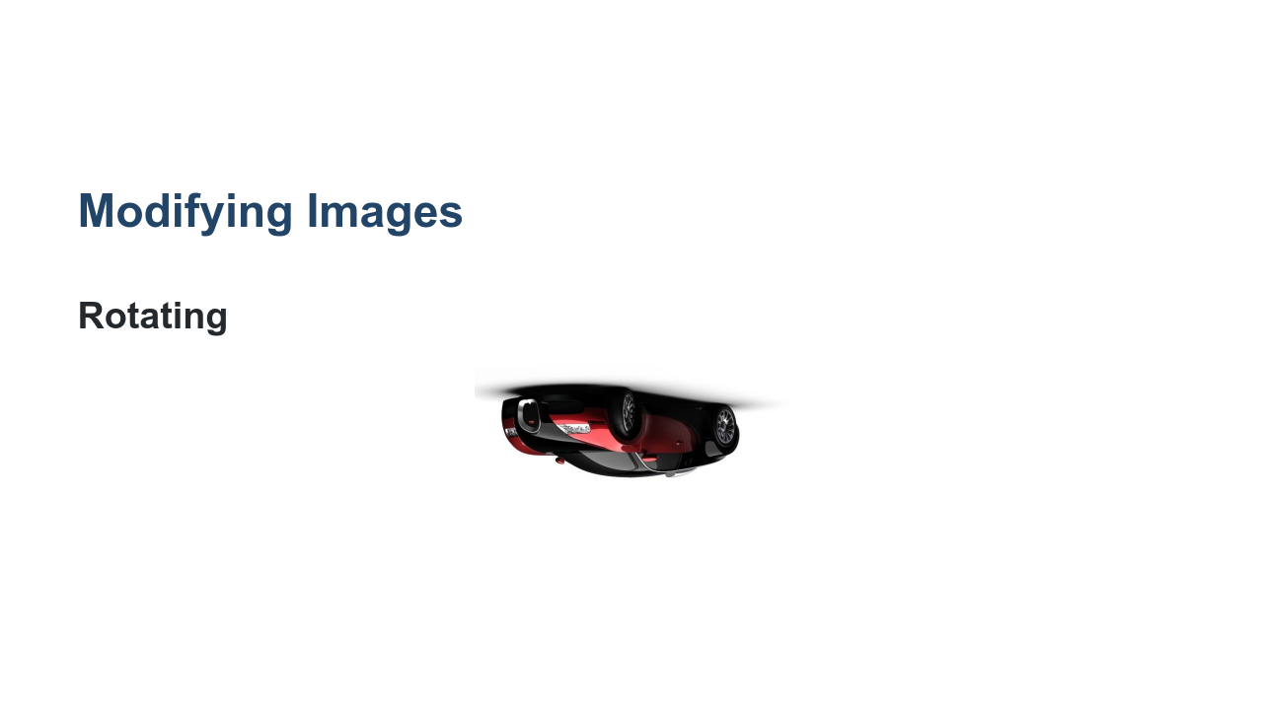
Notes:
Other image manipulation tricks involve rotations. You can augment an image by spinning it around. * Image name: res/upside-down-color.png * Repo link: https://github.com/google/applied-machine-learning-intensive/tree/master/content/04_classification/06_images_and_video/res/upside-down-color.png * Source https://pixabay.com/illustrations/car-sports-car-racing-car-speed-49278/ by Author Lipetkd / Felipe Lima https://pixabay.com/users/lipetkd-4592/ under License https://pixabay.com/service/license/.

Slide 12
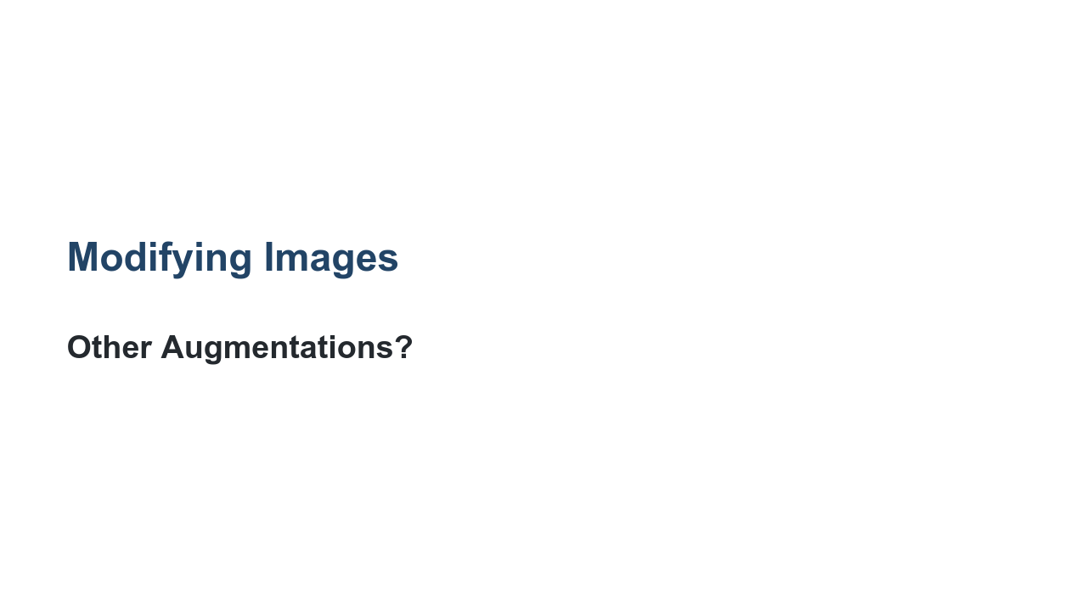
Notes:
What are some other image augmentations that you can think of? Some others include: * 'cutting': where images of the same class are spliced together to increase the size of the training data set. * 'drop out': where portions of training images are removed during training. * Generating fake data based from a model that is then used to train another model. There are many more strategies and none are right for every model. You have to experiment.

Slide 13

Notes:
This section also talks about video. We are going to greatly simplify video. If you think about a video feed, it has images, it has sound, it might have captions and other optional features. For our case in this course, video will simply be a series of images and we will treat it as such. Much of the video we watch is 30 "frames per second" (fps) or 60 fps. Think of each of these frames as a still image. Now think about how much changes between frames in 1/30th of a second? Well, it depends on what type of video you are processing. Are you watching the spray from a sneeze? Are you watching ice melt? Video might simply be a "series of images" for our purposes, but you still need to consider what you are modelling.

Slide 14

Notes:
It is time for you to practice working with images and video. This unit is a bit different because there are three labs to do. Two perform images processing. One with PIL (Pillow) and the other with OpenCV. We then do a video processing lab where we open a video and extract frames. This all leads to a project where we will take a video and classify items in the video. Have fun!

