Slide 1

Notes:
Welcome to Intermediate Pandas. At this point in the course you should be familiar with Pandas Series and DataFrame objects. If these words are unfamiliar to you, you probably want to go back and revisit the Introduction to Pandas unit.

Slide 2
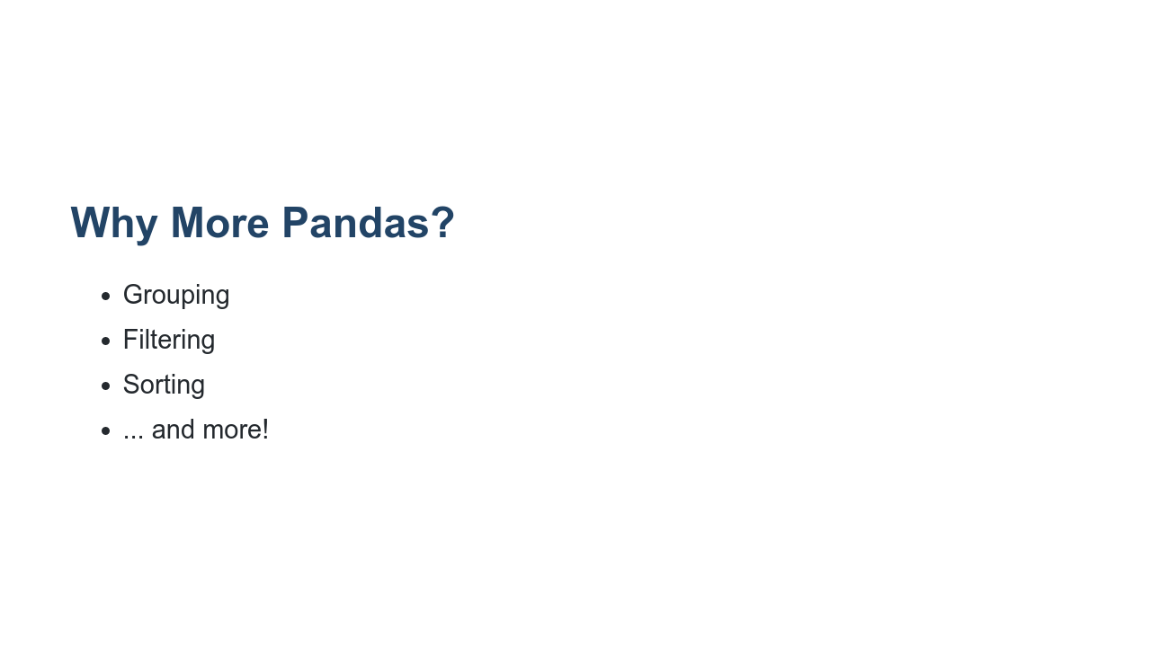
Notes:
You might be asking, "Why more Pandas? I'm ready to do some data science!" Well, it turns out that quite a bit of the work in data science and machine learning involves getting quality data ready to feed into our models. Pandas is a toolkit you'll regularly see used for this part of the data science pipeline. In this unit we will take a closer look at DataFrames. We will learn more ways to explore the data in a DataFrame. This includes merging, grouping, filtering, sorting, and more!

Slide 3
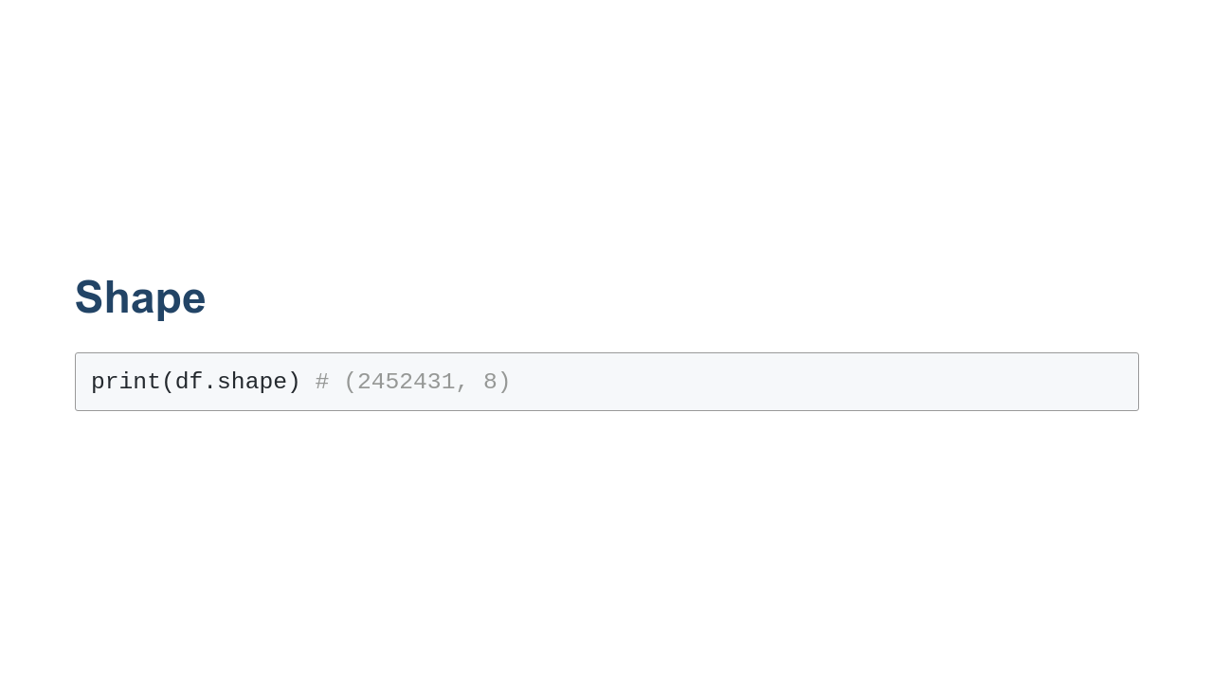
Notes:
First, we will explore a few more ways to get information about a DataFrame. One of the most basic is the `.shape` property of a DataFrame. What is shape? Shape is a property of a DataFrame that lets you know the number of rows and columns in the DataFrame. Returns a tuple with dimensions of DataFrame. Specifically, (# rows, # columns). If you know about NumPy, then you may recall that NumPy has a `.shape` attribute on NumPy arrays. Pandas `.shape` has the same functionality. The primary difference is that NumPy supports n-dimensional matrices where n can be greater than two, while Pandas' DataFrame objects typically just have two dimensions: rows and columns.

Slide 4
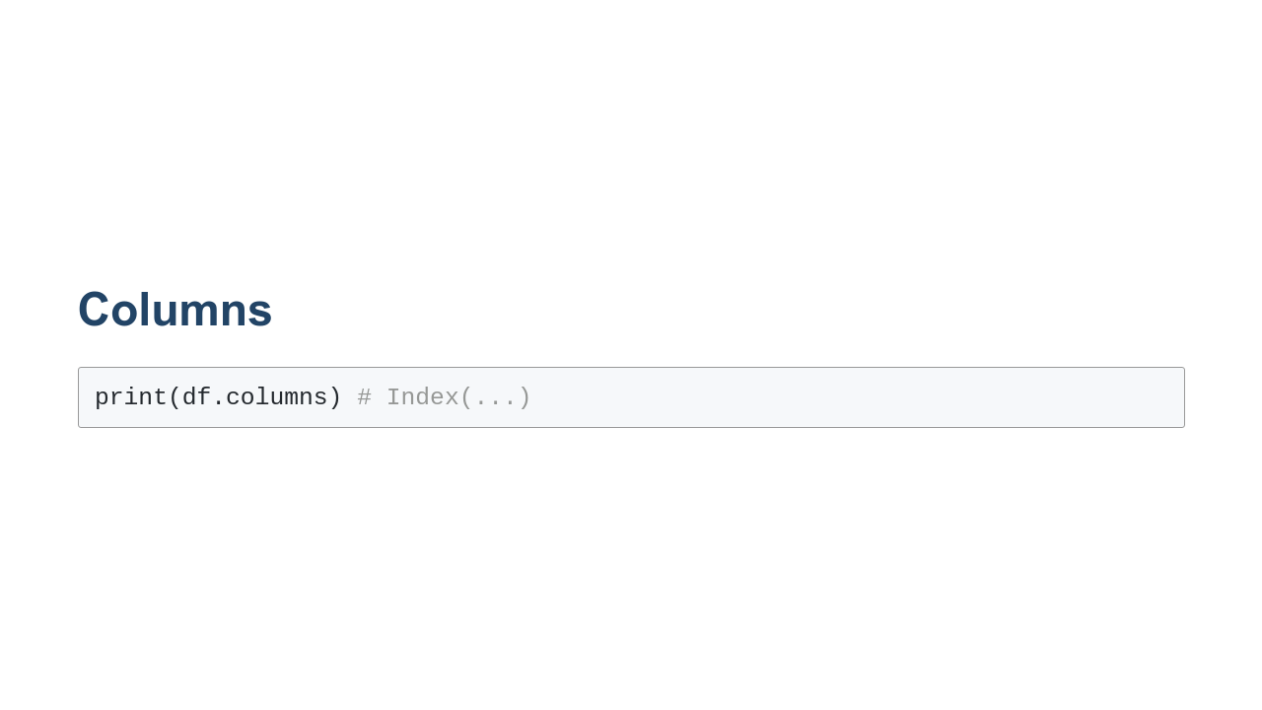
Notes:
DataFrames are typically thought of as tabular structures containing rows and columns. Rows are often indexed by number (but not always), while columns typically have meaningful names like, 'Games Played' or 'Square Meters.' Monotonically increasing numbers are easy enough to iterate over, but arbitrarily-named columns are a different story. Sometimes it is useful to know all of the names of the columns in a DataFrame. To get this information you can use the `.columns` property of the DataFrame. This returns an `Index` object that allows you to iterate over all of the column names of the DataFrame in left-to-right order. `Index` is a Pandas object, but it is also a Python iterable. This allows you to loop over the columns' names, extract them into a list, or perform any other iterable operation supported by Python.

Slide 5
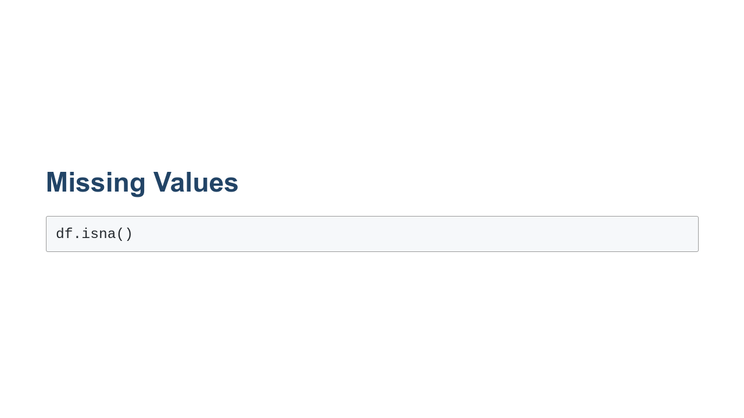
Notes:
It is common to find instances of missing data in datasets. Pandas provides the `.isna()` utility to help you find missing data. `.isna()` examines the data in a DataFrame and returns a DataFrame containing boolean values: True if the data is missing and False if the data is present. You can use this to find missing data that you can then act upon to clean your dataset. At this point we won't worry about specific missing data mitigation measures. Instead, we'll address them in examples throughout the course.

Slide 6
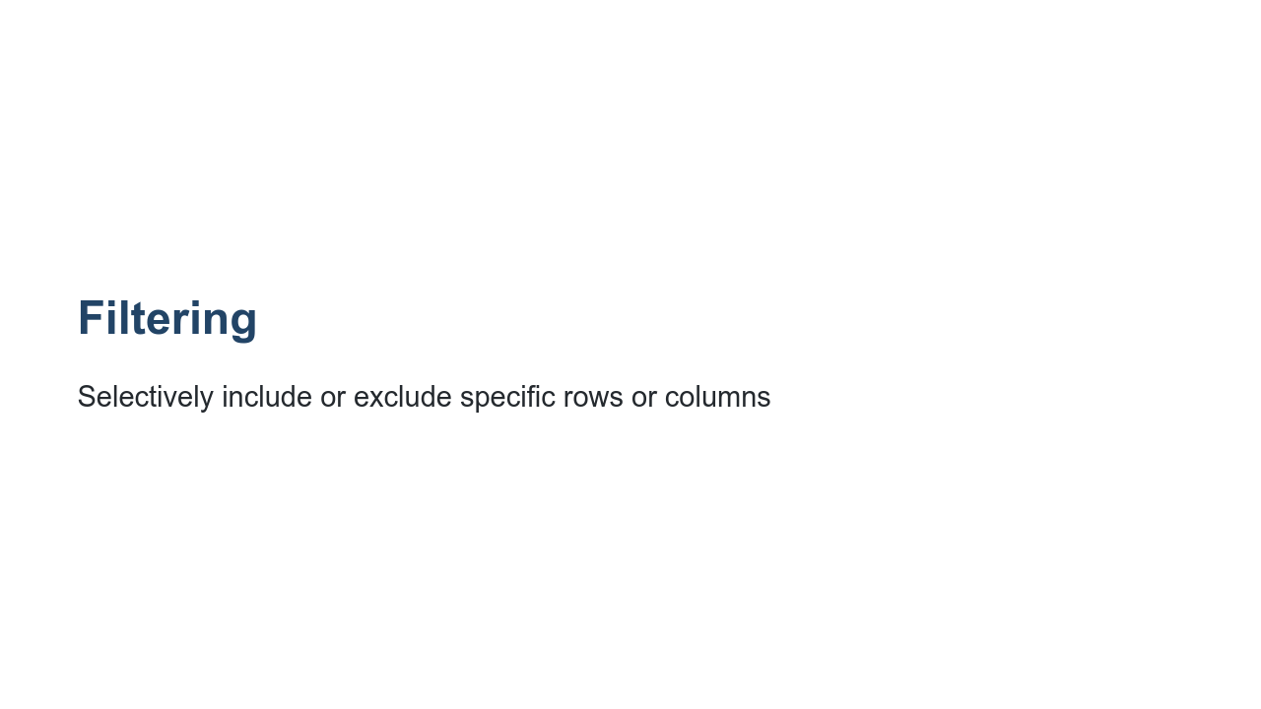
Notes:
Filtering is a powerful operation that allows us to selectively include or exclude specific rows or columns. Let's start by taking a look at row filtering.

Slide 7
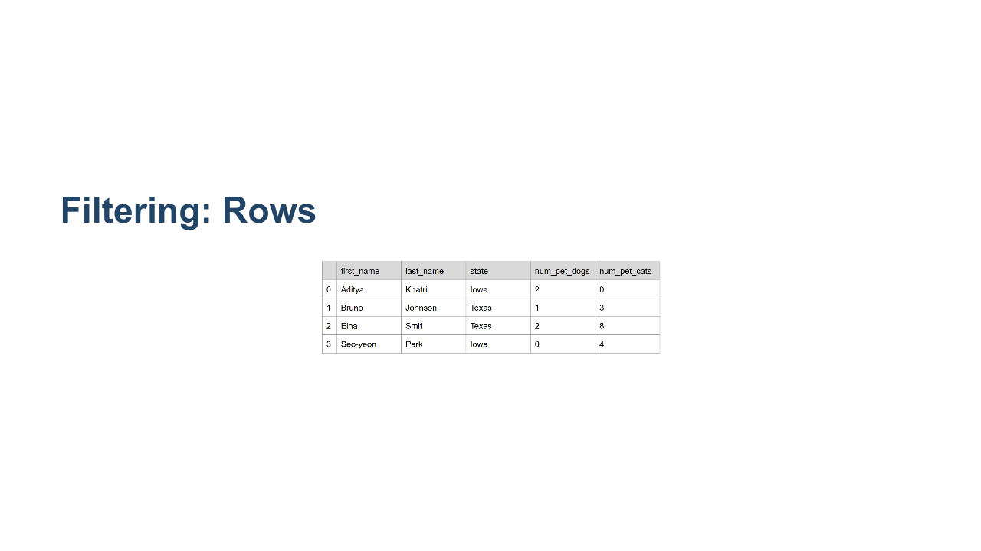
Notes:
In this slide we see data from a DataFrame. The DataFrame has four rows and five columns, so df.shape would return (4,5). Let's say that we would like to find people with more than two dogs. How would we do that? * Image name: res/table_for_row_filter.png * Repo link: https://github.com/google/applied-machine-learning-intensive/tree/master/content/02_data/02_intermediate_pandas/res/table_for_row_filter.png * Source https://github.com/google/applied-machine-learning-intensive/tree/master/content/02_data/02_intermediate_pandas/res/table_for_row_filter.png by Author Google LLC under License Copyright [2020] Google LLC.

Slide 8
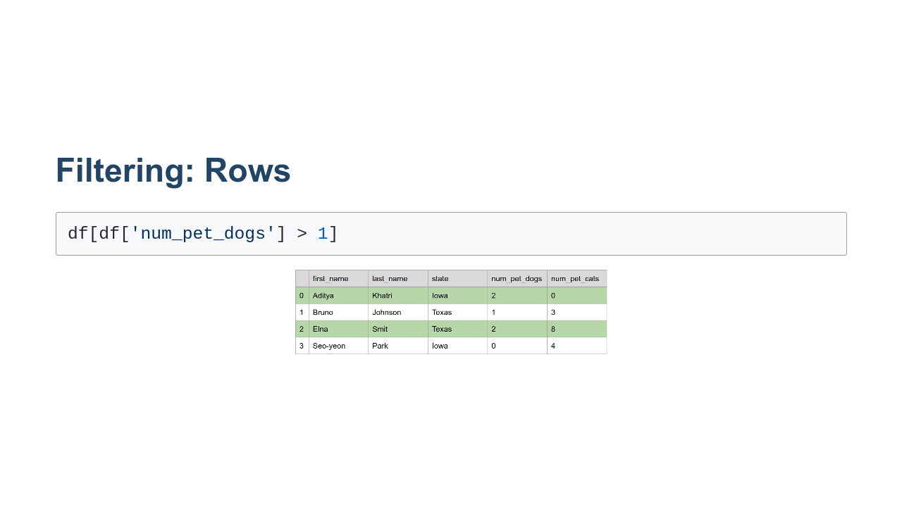
Notes:
Here we have put the expression `df['num_pet_dogs'] > 1` inside another selector for `df`. The inner-expression creates a "boolean index," which is an index that is the same length as the DataFrame (in this case the length is 4), where an entry is True if num_pet_dogs > 1. For this specific example,`df['num_pet_dogs'] > 1` returns an index with entries True, False, True, False. Then we take df[boolean index], and this selects the rows for which the boolean value is True. Note that a DataFrame is returned. You may want to assign this to a new variable to work with it further. This filtering is not done in place and does not modify the original DataFrame, df. * Image name: res/table_more_than_two_dogs.png * Repo link: https://github.com/google/applied-machine-learning-intensive/tree/master/content/02_data/02_intermediate_pandas/res/table_more_than_two_dogs.png * Source https://github.com/google/applied-machine-learning-intensive/tree/master/content/02_data/02_intermediate_pandas/res/table_more_than_two_dogs.png by Author Google LLC under License Copyright [2020] Google LLC.

Slide 9
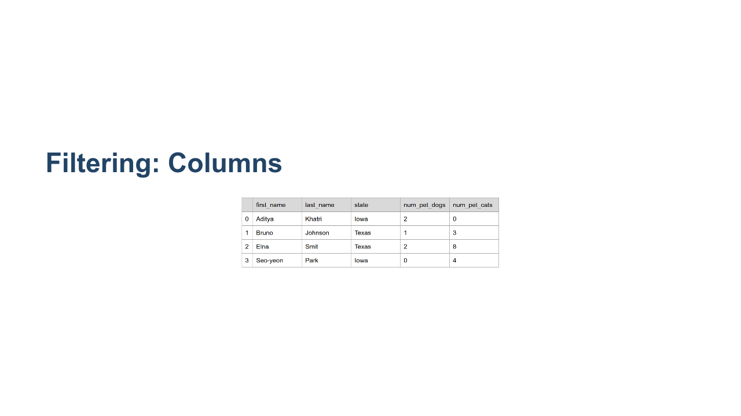
Notes:
It is also possible to filter out columns of data. In the pictured DataFrame there are pieces of personally identifiable information that could be used to locate someone. If we wanted to make the data a little more anonymous, we could filter out the 'last_name' and 'state' columns. How would we do that? * Image name: res/table_for_column_filter.png * Repo link: https://github.com/google/applied-machine-learning-intensive/tree/master/content/02_data/02_intermediate_pandas/res/table_for_column_filter.png * Source https://github.com/google/applied-machine-learning-intensive/tree/master/content/02_data/02_intermediate_pandas/res/table_for_column_filter.png by Author Google LLC under License Copyright [2020] Google LLC.

Slide 10
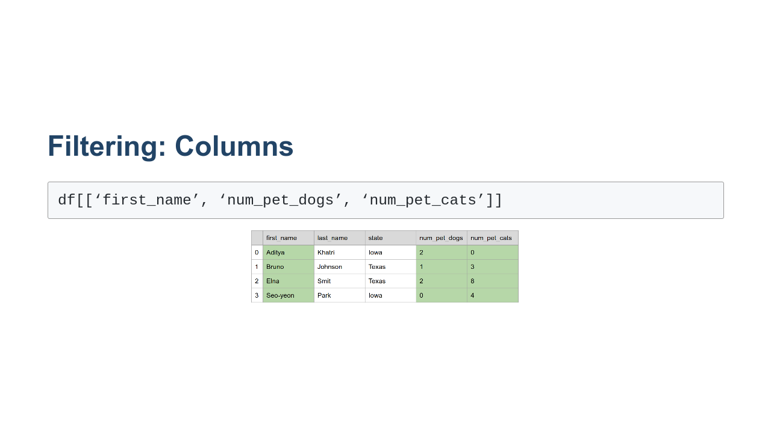
Notes:
To filter by columns, we can also use the DataFrame selector. Instead of passing in a boolean index, we pass in a list of strings that match the column names that we want to keep. * Image name: res/table_less_pii.png * Repo link: https://github.com/google/applied-machine-learning-intensive/tree/master/content/02_data/02_intermediate_pandas/res/table_less_pii.png * Source https://github.com/google/applied-machine-learning-intensive/tree/master/content/02_data/02_intermediate_pandas/res/table_less_pii.png by Author Google LLC under License Copyright [2020] Google LLC.

Slide 11
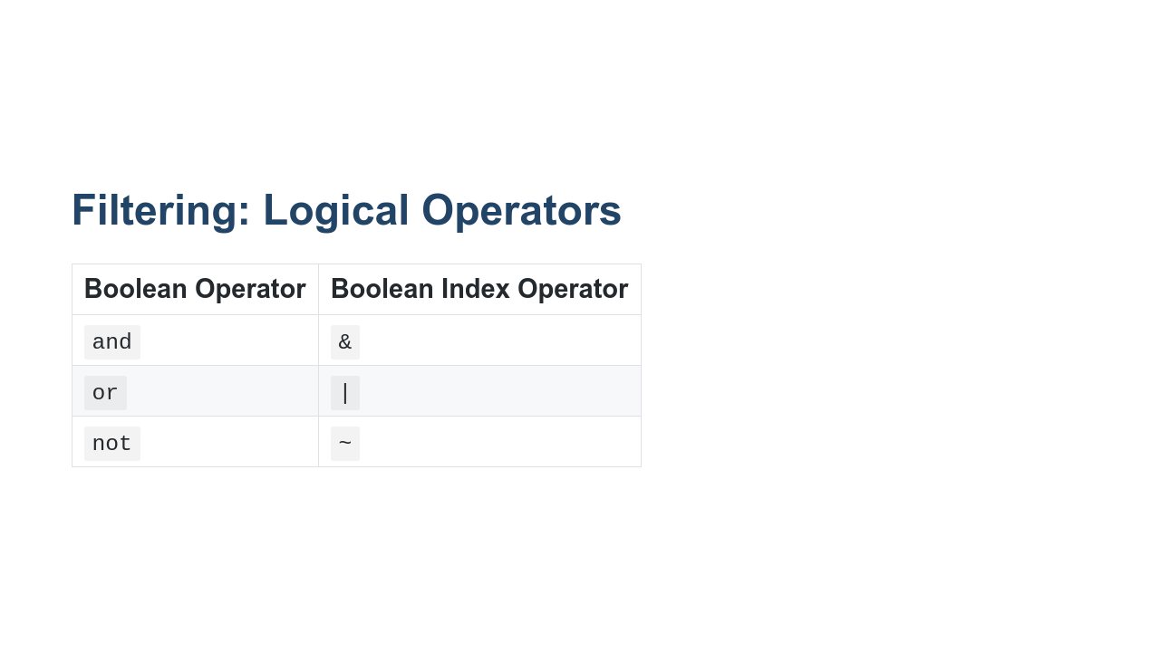
Notes:
You are likely familiar with the boolean operators `and`, `or`, and `not` found in standard Python. You can use the operators to make expressions like: ```python price > 70 and weight < 5 ``` You can do similar things with Pandas boolean indices; however, you can't use the standard `and`, `or`, and `not` operators. Instead, you must use the more terse `&`, `|`, and `~`. You might recognize these as the bitwise boolean operators. Pandas has overridden these operators to be logical boolean operators for boolean indices.

Slide 12
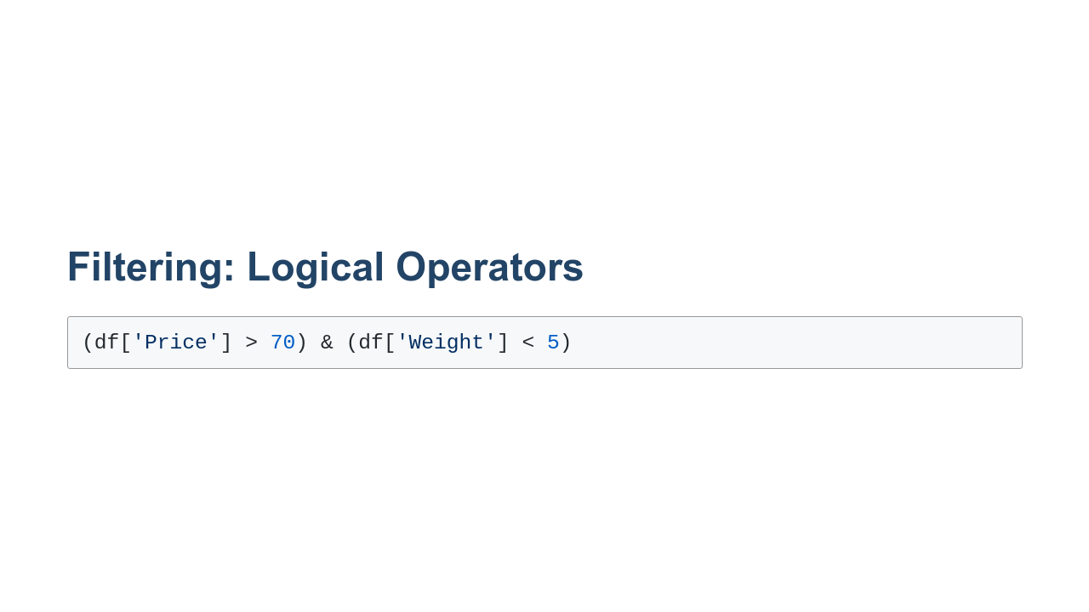
Notes:
Here you can see logical operators in action. We are looking at the 'Price' column of a DataFrame object and creating a boolean index that is `True` when the price is greater than 70. We are also creating a boolean index that is `True` when the weight is less than 5. The `&` operator is then used to combine these indices into a single index. You might notice that we put parentheses around each boolean expression. This is because the precedence for `&`, `|`, and `~` is higher than `>` and `<` so we must add parenthesis to ensure that the `>` and `<` happen first.

Slide 13
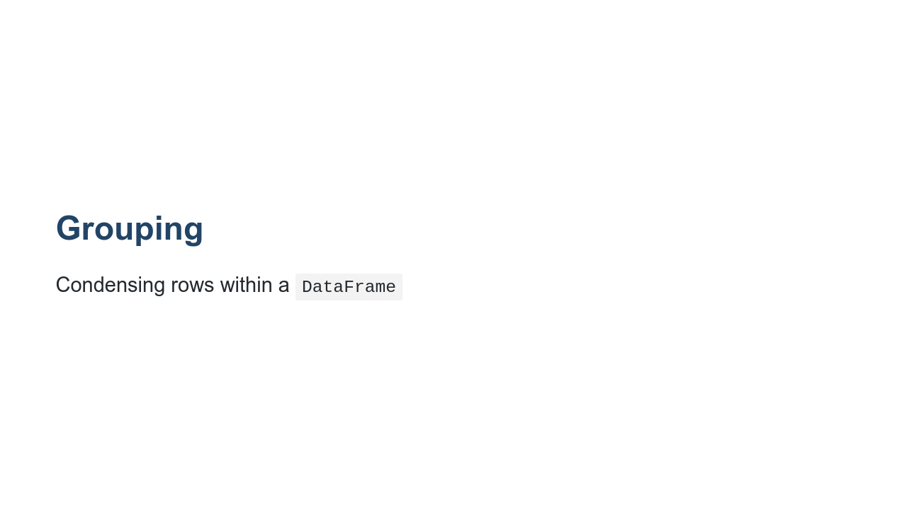
Notes:
Often you can gather insights about the data in a `DataFrame` by condensing many rows into one. This is called "grouping." Let's start by looking at an example using renderings of tables.

Slide 14
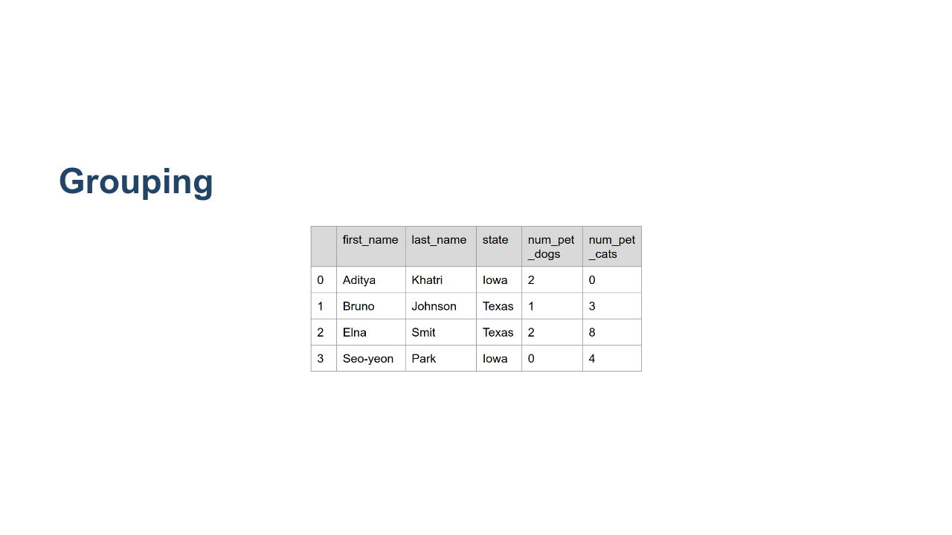
Notes:
Here we have a `DataFrame` that contains pet owner data at an individual level. Say we want to know which state has the most cats and dogs per pet owner. To do that we can **group** our rows by state and find the mean count of cats and dogs per owner per state. How would we do that? * Image name: res/table_to_group.png * Repo link: https://github.com/google/applied-machine-learning-intensive/tree/master/content/02_data/02_intermediate_pandas/res/table_to_group.png * Source https://github.com/google/applied-machine-learning-intensive/tree/master/content/02_data/02_intermediate_pandas/res/table_to_group.png by Author Google LLC under License Copyright [2020] Google LLC.

Slide 15
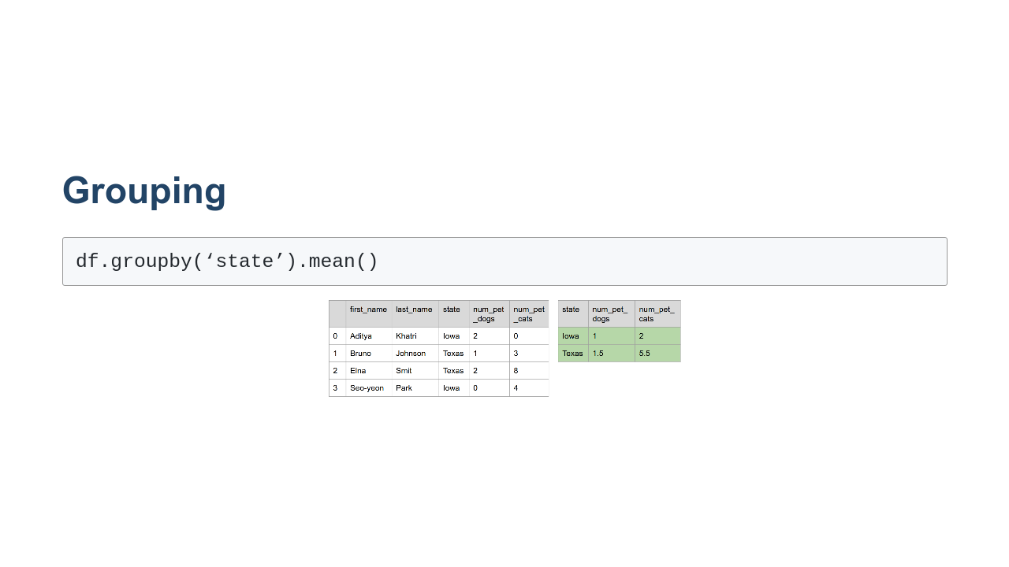
Notes:
The `DataFrame` object has a method called `groupby()` that allows us to group data by the column name or names passed to it. In this case we grouped by 'state' and then calculated the mean. From the results we can see that Texas is the clear winner on 'pets per pet owner.' There are many other statistics that we can gather when grouping data in a `DataFrame`. These include min, max, count, standard deviation, and more. * Image name: res/table_grouped.png * Repo link: https://github.com/google/applied-machine-learning-intensive/tree/master/content/02_data/02_intermediate_pandas/res/table_grouped.png * Source https://github.com/google/applied-machine-learning-intensive/tree/master/content/02_data/02_intermediate_pandas/res/table_grouped.png by Author Google LLC under License Copyright [2020] Google LLC.

Slide 16
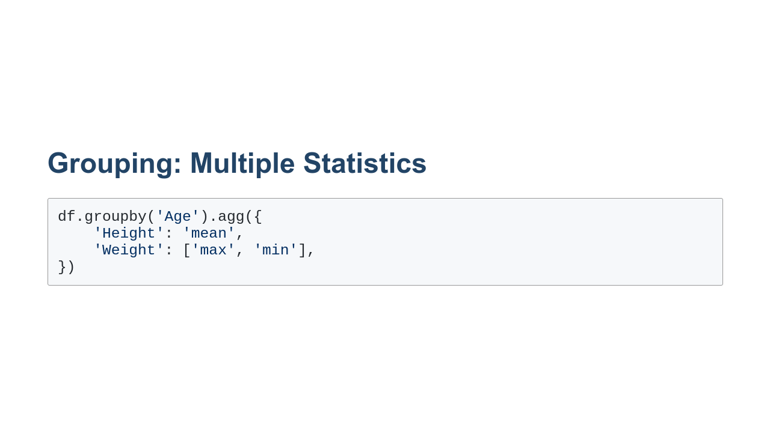
Notes:
In the example we saw earlier, we calculated the mean for every numeric column in a `DataFrame`. Often you'll want different statistics for different columns, or even multiple statistics for some columns. Here you can see that we are grouping by 'Age' and calculating different statistics for the 'Height' and 'Weight' columns. We are doing this by passing a dictionary of aggregation requests to the `agg()` function.

Slide 17

Notes:
So far we have worked with individual `DataFrame` objects. Often the data that we will work with will be stored in multiple sources. In these cases it is often useful to **merge** the data in order to process it. In order to merge data, a common **key** must exist between the `DataFrame` objects to be merged. By default, Pandas considers matching column names to be matching keys. Let's look at an example.

Slide 18
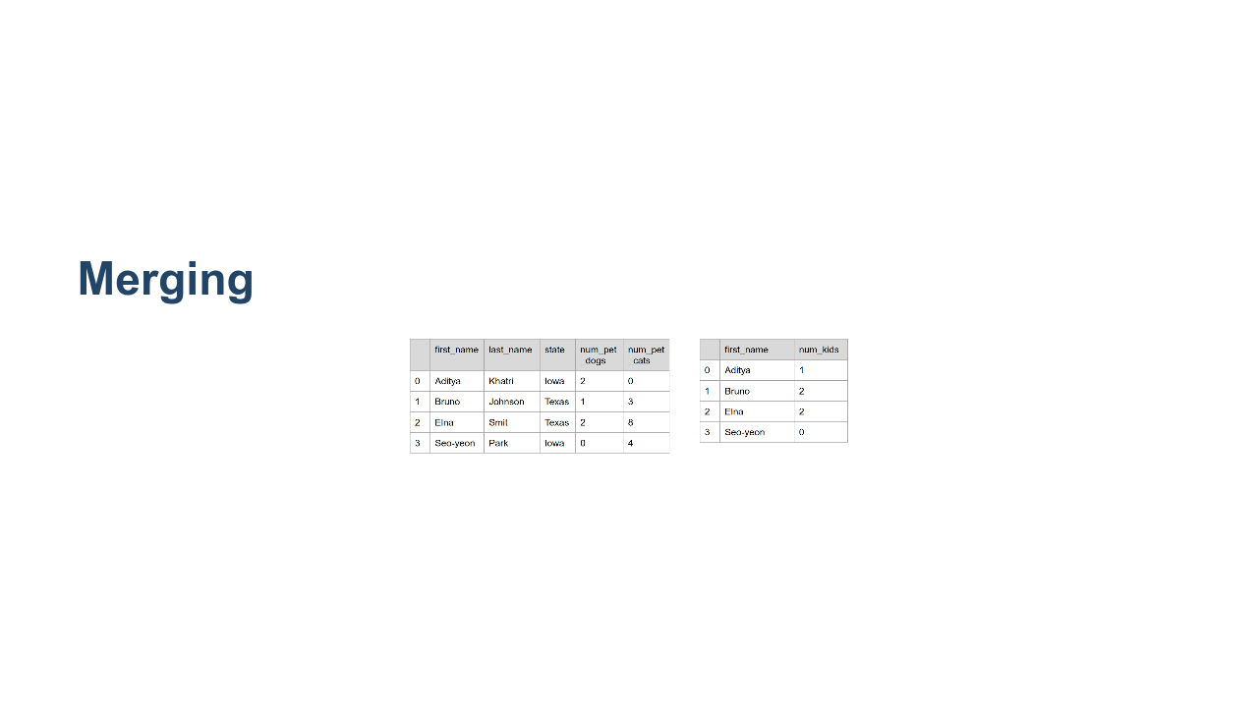
Notes:
Here is an illustration of two `DataFrame` objects that we'd like to merge. One contains the name, state, and pet data that we are familiar with. The other contains first names and a count of the number of children that each person has. You can see that 'first_name' is the common column between the two tables. Let's see how Pandas would merge these tables. * Image name: res/tables_to_merge.png * Repo link: https://github.com/google/applied-machine-learning-intensive/tree/master/content/02_data/02_intermediate_pandas/res/tables_to_merge.png * Source https://github.com/google/applied-machine-learning-intensive/tree/master/content/02_data/02_intermediate_pandas/res/tables_to_merge.png by Author Google LLC under License Copyright [2020] Google LLC.

Slide 19
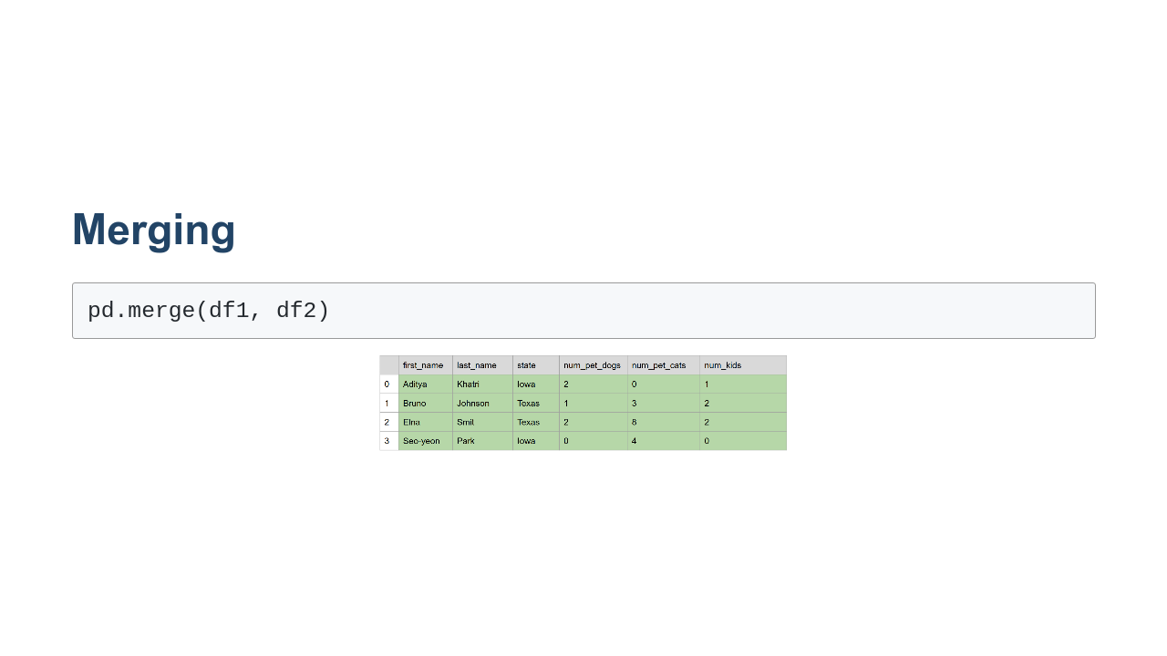
Notes:
Here we can see the call to `merge()`. It accepts two `DataFrame` objects and merges them on common column names. In this case, 'first_name'. * Image name: res/tables_merged.png * Repo link: https://github.com/google/applied-machine-learning-intensive/tree/master/content/02_data/02_intermediate_pandas/res/tables_merged.png * Source https://github.com/google/applied-machine-learning-intensive/tree/master/content/02_data/02_intermediate_pandas/res/tables_merged.png by Author Google LLC under License Copyright [2020] Google LLC.

Slide 20
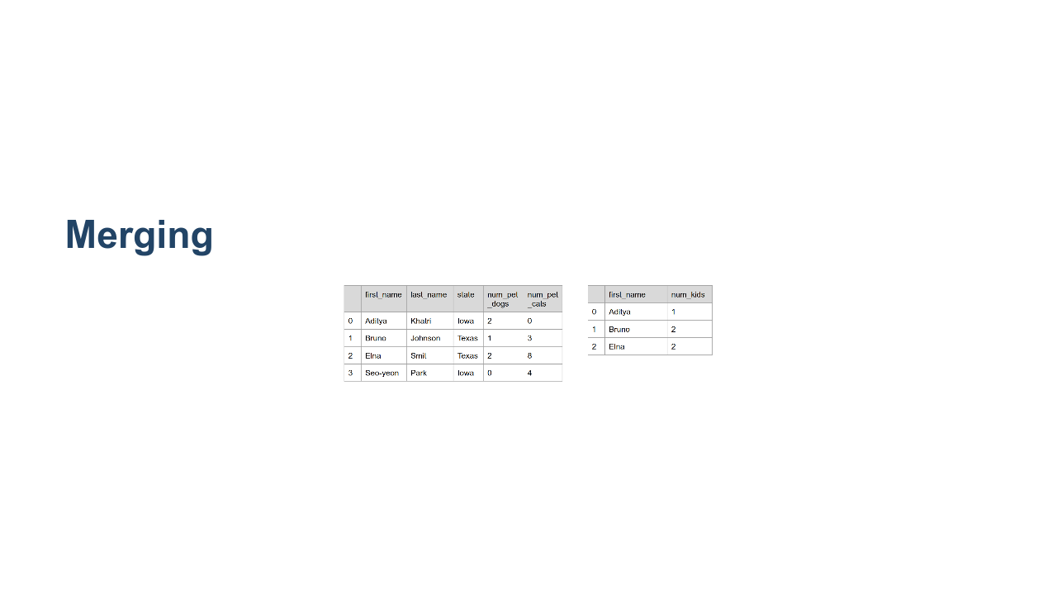
Notes:
What about this case? We have four rows in one table and three in the other. 'Seo-yeon' is missing from the table that counts children. If you remember from our previous slide, Seo-yeon had a zero-count of children. It is common for rows with zero values to be missing from tables. Any guesses on what happens? * Image name: res/tables_to_merge_uneven.png * Repo link: https://github.com/google/applied-machine-learning-intensive/tree/master/content/02_data/02_intermediate_pandas/res/tables_to_merge_uneven.png * Source https://github.com/google/applied-machine-learning-intensive/tree/master/content/02_data/02_intermediate_pandas/res/tables_to_merge_uneven.png by Author Google LLC under License Copyright [2020] Google LLC.

Slide 21
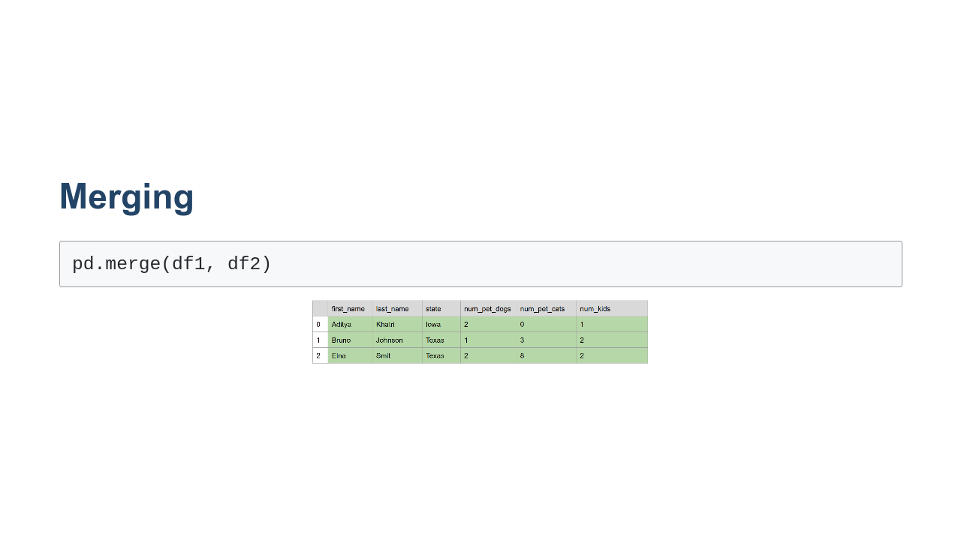
Notes:
In this case we completely lost the record of Seo-yeon! Since Pandas couldn't find a match, it didn't include the datapoint. This is standard join functionality. There are ways to get around this, though. * Image name: res/tables_merged_uneven.png * Repo link: https://github.com/google/applied-machine-learning-intensive/tree/master/content/02_data/02_intermediate_pandas/res/tables_merged_uneven.png * Source https://github.com/google/applied-machine-learning-intensive/tree/master/content/02_data/02_intermediate_pandas/res/tables_merged_uneven.png by Author Google LLC under License Copyright [2020] Google LLC.

Slide 22
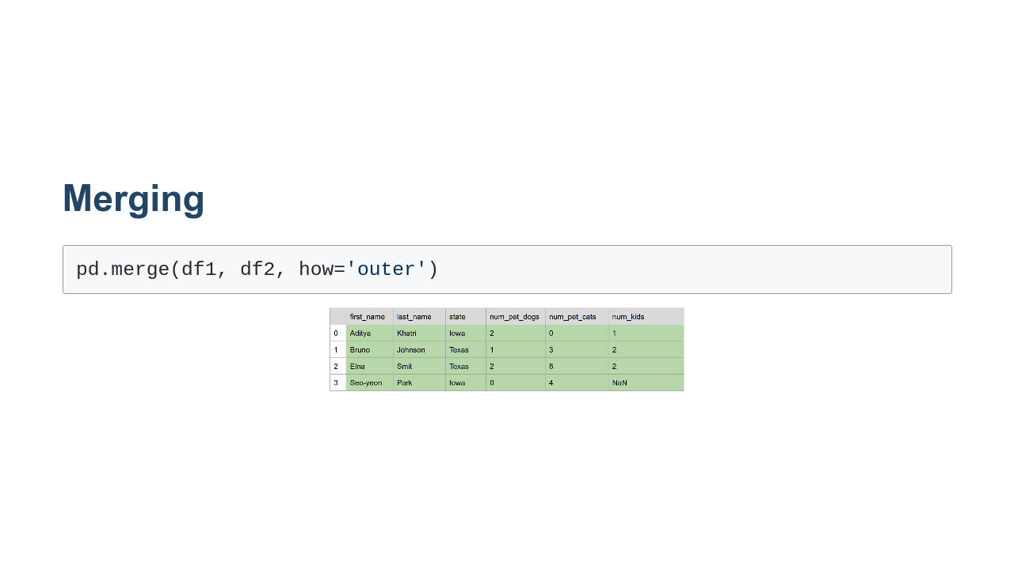
Notes:
You can instruct Pandas to keep the data in one or both of the tables in a join. This is called an outer join. There is a left-outer join that keeps unmatched rows in the left table. There is a right-outer join that keeps unmatched rows in the right table. And then there is the full outer join, which you see here, that keeps unmatched rows found in both tables. In any of the outer join cases, missing data is filled in with null values. `NaN` for numbers. `None` for strings and other objects. * Image name: res/tables_merged_outer.png * Repo link: https://github.com/google/applied-machine-learning-intensive/tree/master/content/02_data/02_intermediate_pandas/res/tables_merged_outer.png * Source https://github.com/google/applied-machine-learning-intensive/tree/master/content/02_data/02_intermediate_pandas/res/tables_merged_outer.png by Author Google LLC under License Copyright [2020] Google LLC.

Slide 23
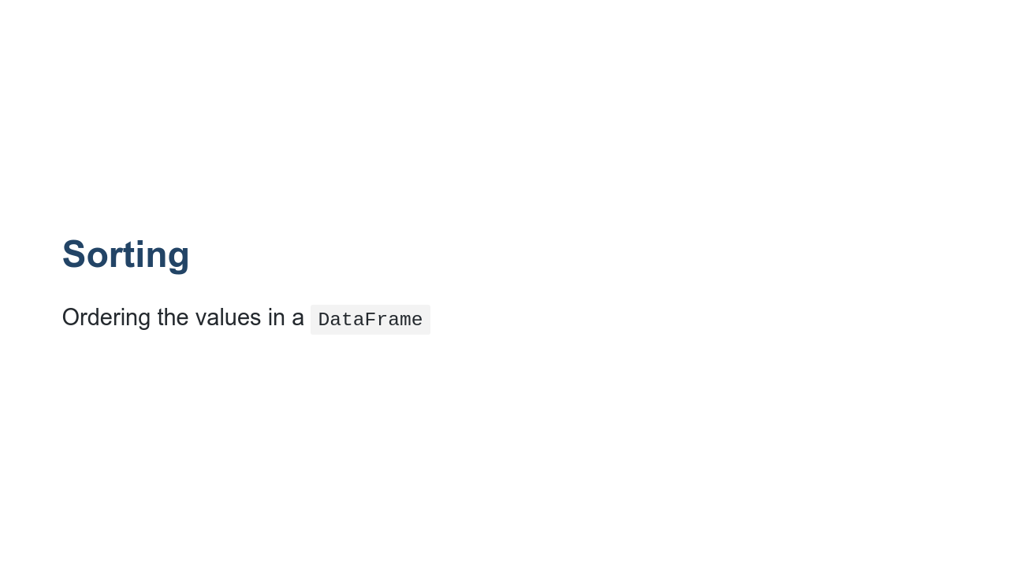
Notes:
Another way of modifying a `DataFrame` is to sort the data contained in it. Sorting can be done in an ascending or descending manner. Sorting can be performed on one or more columns. Let's look at an example.

Slide 24
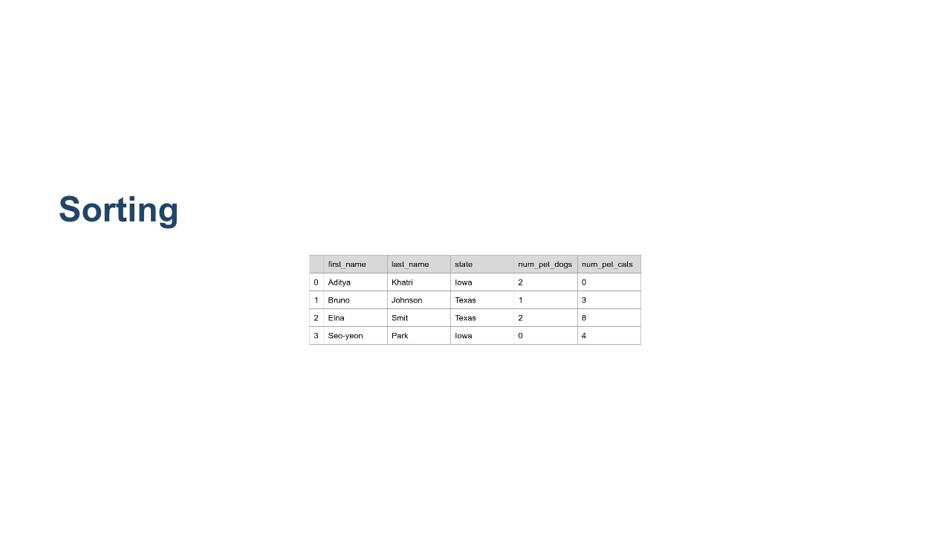
Notes:
Again we have the name-state-pets table that we've seen in this presentation. Let's say we want to view that data sorted by the number of cats owned by each person in ascending order. How would we do that? * Image name: res/table_to_sort.png * Repo link: https://github.com/google/applied-machine-learning-intensive/tree/master/content/02_data/02_intermediate_pandas/res/table_to_sort.png * Source https://github.com/google/applied-machine-learning-intensive/tree/master/content/02_data/02_intermediate_pandas/res/table_to_sort.png by Author Google LLC under License Copyright [2020] Google LLC.

Slide 25
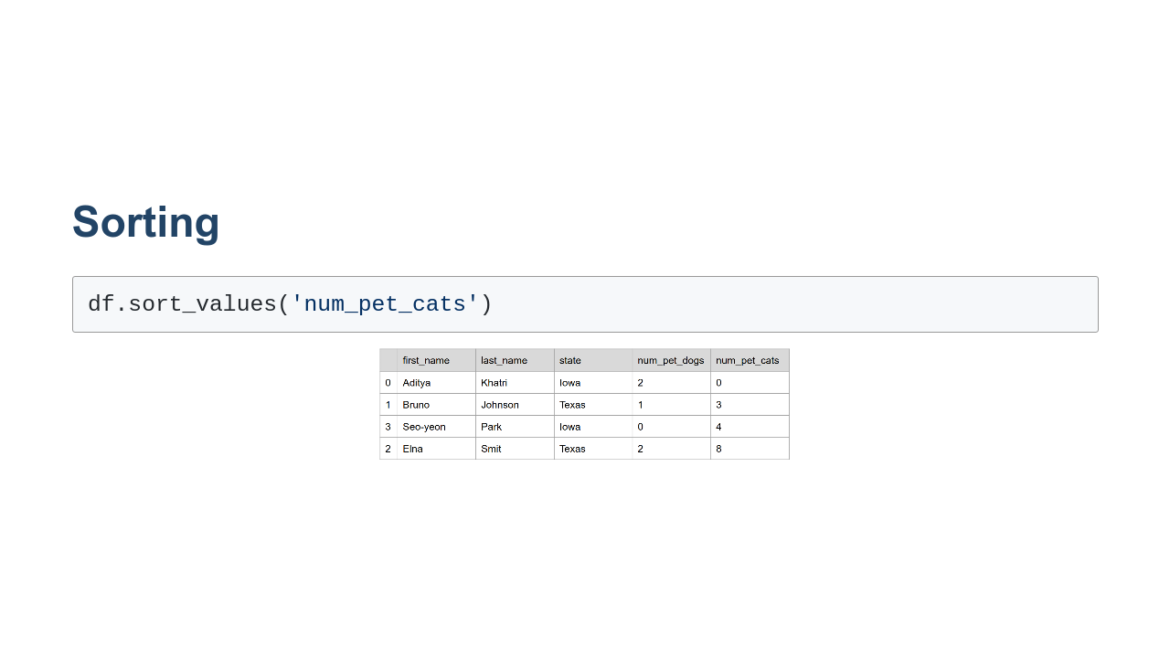
Notes:
Here we can see the `sort_values()` method in use. We have asked to sort by the 'num_pet_cats' column. The default sort order is ascending. * Image name: res/table_sorted.png * Repo link: https://github.com/google/applied-machine-learning-intensive/tree/master/content/02_data/02_intermediate_pandas/res/table_sorted.png * Source https://github.com/google/applied-machine-learning-intensive/tree/master/content/02_data/02_intermediate_pandas/res/table_sorted.png by Author Google LLC under License Copyright [2020] Google LLC.

Slide 26
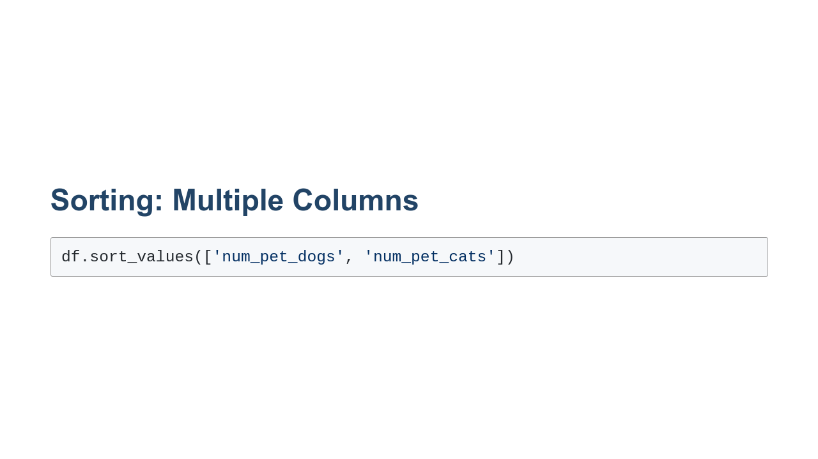
Notes:
There are many other options for sorting. For instance, we can sort on multiple columns as seen in this example. First the `DataFrame` will be sorted by the number of pet dogs. The next level of sorting is by the number of pet cats.

Slide 27
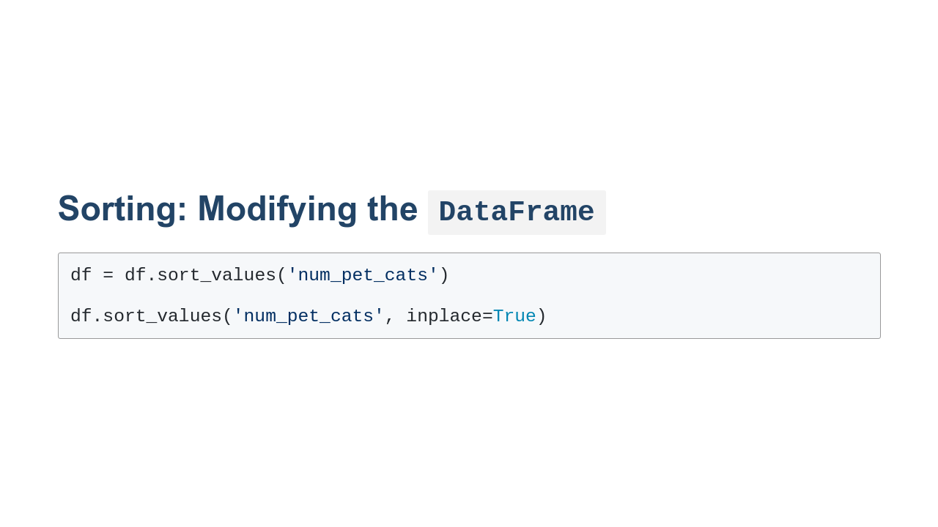
Notes:
Also, sorting doesn't actually modify the `DataFrame`, but instead creates a view into the `DataFrame`. If we actually want to modify the `DataFrame` we can either assign the result of `sort_values()` back to the original `DataFrame` or we can pass an `inplace=True` argument to `sort_values()`.

Slide 28
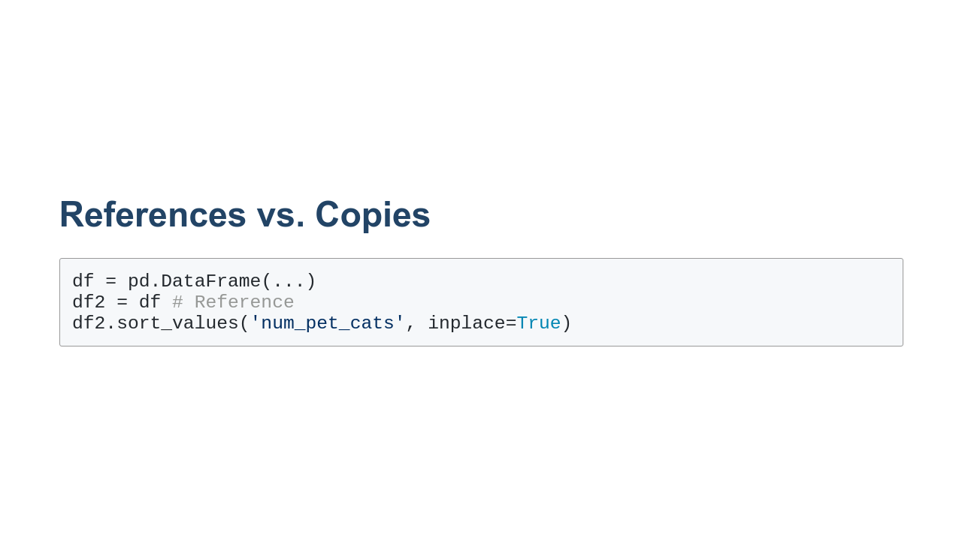
Notes:
When working with `DataFrame` objects it is often important to know when you are working with a reference-to or copy-of the original `DataFrame`. Take, for instance, this example. We create a new `DataFrame`, `df`, and then store a reference to the original `DataFrame` in the variable `df2`. When we then ask to sort `df2` and modify it in-place, we change the original `DataFrame`.

Slide 29

Notes:
If we want to leave the original `DataFrame` intact, we can make a copy of it and then work with the copy. Be warned that this can be slow and memory-intensive on large `DataFrame` objects. Often you don't have to worry whether you're working with a reference or a copy. Pandas strives to be efficient and will use references or views, depending on which makes most sense in most cases. But sometimes the abstractions break down, and you need to know a little more about what specific data you are working with.

Slide 30

Notes:
Now it's time to practice more with pandas in the lab.

