Slide 1


Slide 2
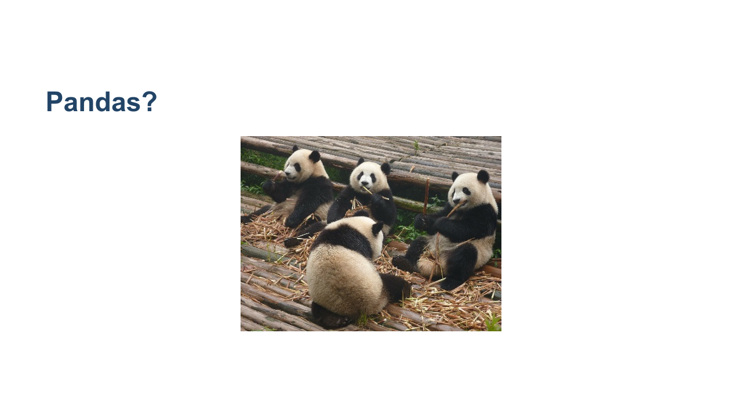
Notes:
These animals are adorable, but we are going to talk about a Python library called Pandas, which is a popular tool for handling and analyzing input data. * Image name: res/pandas.jpg * Repo link: https://github.com/google/applied-machine-learning-intensive/tree/master/content/02_data/01_introduction_to_pandas/res/pandas.jpg * Source https://pixabay.com/photos/panda-giant-panda-bear-red-panda-317980/ by Author natuurfan1978 / Marlies V https://pixabay.com/users/natuurfan1978-202752/ under License https://pixabay.com/service/license/.

Slide 3
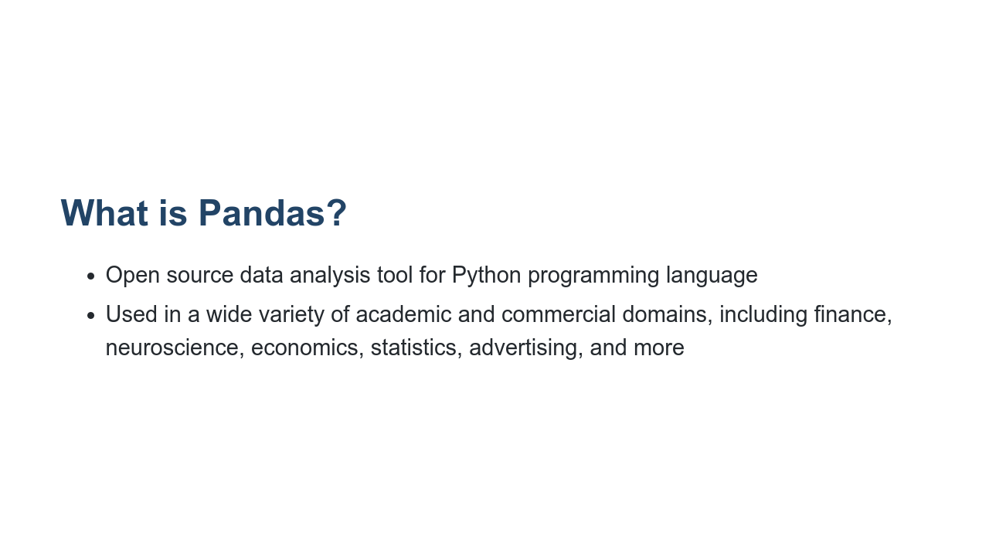
Notes:
Python is a popular language for working on files and data munging. But to do more data analysis and modeling, you may feel tempted to switch to a more domain-specific language like R. Pandas provides data structures and tools similar to R that also help with data analysis. Hence by combining Python and Pandas, you will be able to carry out the entire data analysis workflow using Python.

Slide 4
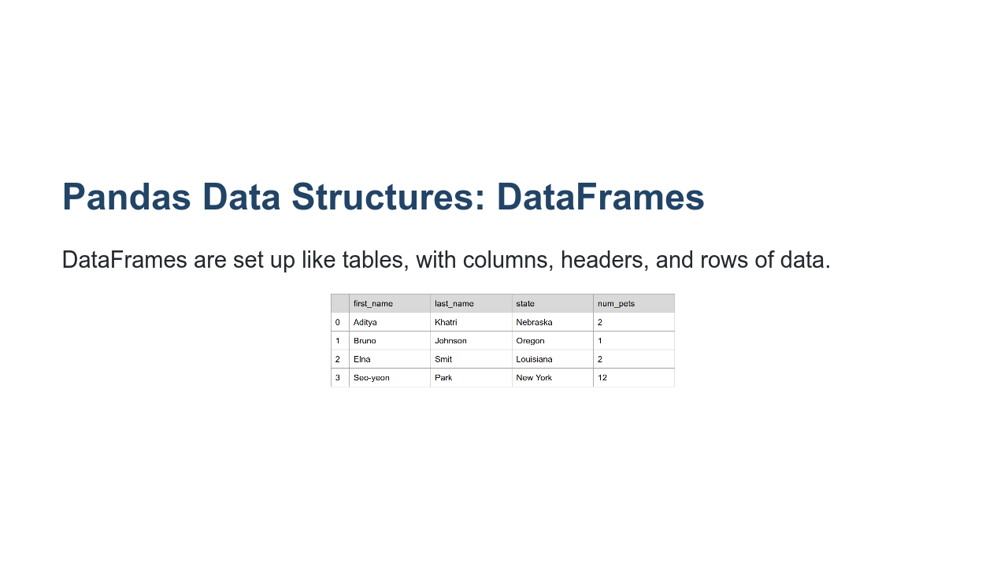
Notes:
The DataFrame is Pandas' data structure. It is very much like a table with one or more columns, which means it works well with the CSV data file format. It looks like a table, which consists of rows and columns. The first row contains column headers. * Image name: res/dataframe.png * Repo link: https://github.com/google/applied-machine-learning-intensive/tree/master/content/02_data/01_introduction_to_pandas/res/dataframe.png * Source https://github.com/google/applied-machine-learning-intensive/tree/master/content/02_data/01_introduction_to_pandas/res/dataframe.png by Author Google LLC under License Copyright [2020] Google LLC.

Slide 5
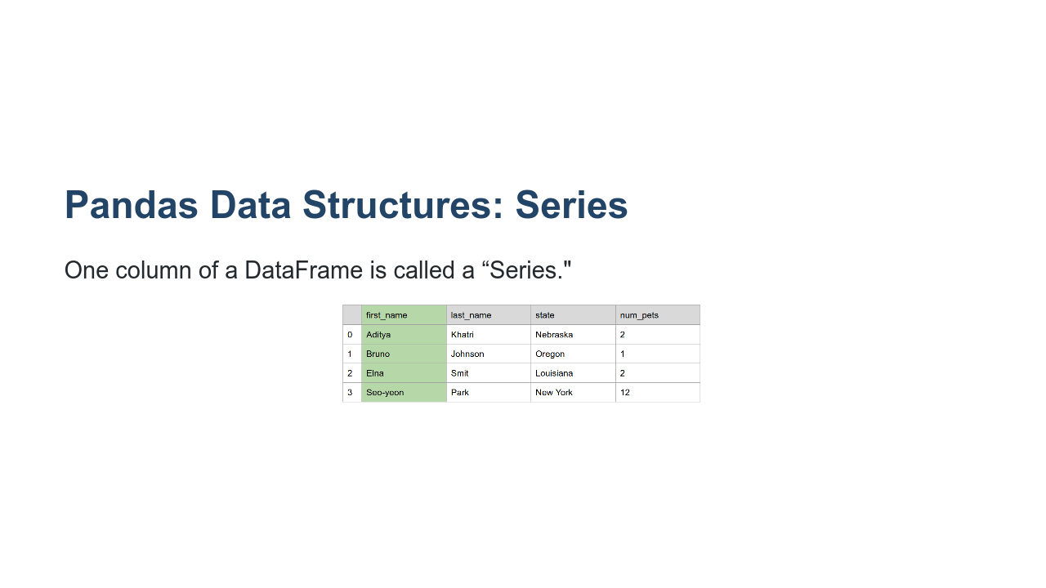
Notes:
Pandas Series is one-dimensional and contains a homogeneously-typed array. So, in summary, a DataFrame contains one or more Series. * Image name: res/dataframe-column.png * Repo link: https://github.com/google/applied-machine-learning-intensive/tree/master/content/02_data/01_introduction_to_pandas/res/dataframe-column.png * Source https://github.com/google/applied-machine-learning-intensive/tree/master/content/02_data/01_introduction_to_pandas/res/dataframe-column.png by Author Google LLC under License Copyright [2020] Google LLC.

Slide 6
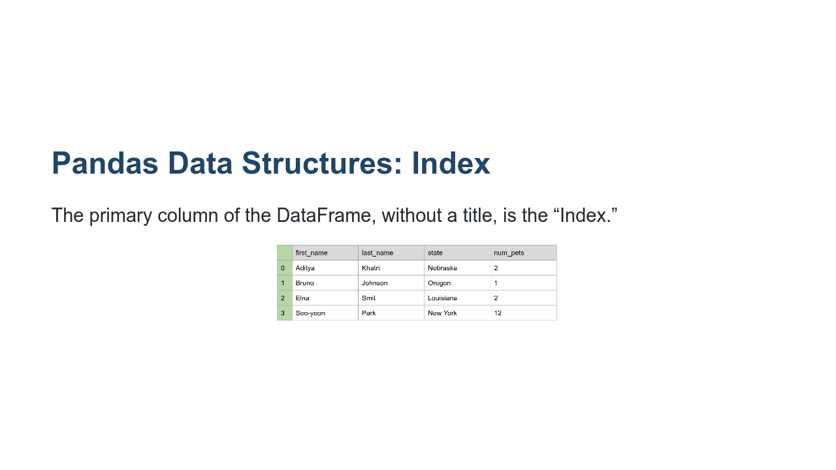
Notes:
Last, the first column is an index column. In this case it’s numeric values, but it can be non-numeric as you’ll see as you dig deeper into Pandas usage. * Image name: res/dataframe-index.png * Repo link: https://github.com/google/applied-machine-learning-intensive/tree/master/content/02_data/01_introduction_to_pandas/res/dataframe-index.png * Source https://github.com/google/applied-machine-learning-intensive/tree/master/content/02_data/01_introduction_to_pandas/res/dataframe-index.png by Author Google LLC under License Copyright [2020] Google LLC.

Slide 7
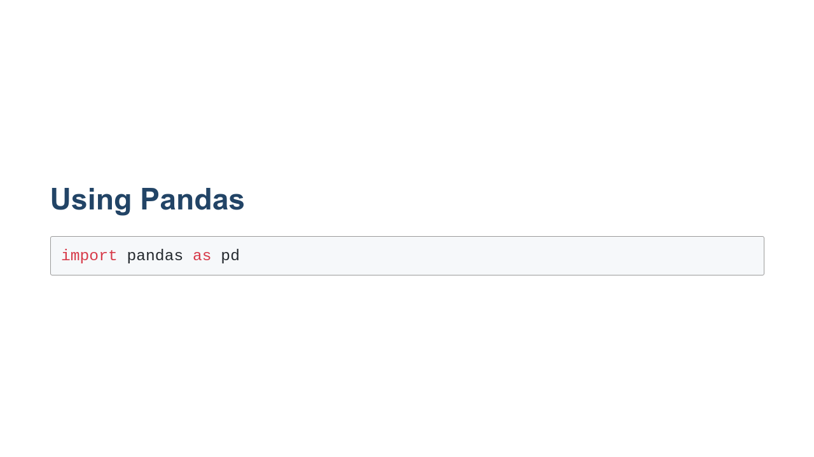
Notes:
Pandas isn't a core part of Python. To use it you'll need to import it. You could do this by simply writing `import pandas'. In practice, however, you'll see `import pandas as pd`. This isn't a requirement, but it is a convention that you'll see in quite a bit of code that uses Pandas and in documentation and on help sites. Aliasing `pandas` as `pd` will make it easier to utilize these resources. If you are using Colab, you can import Pandas without needing to install it. If you are using Jupyter or scripting in a text editor, you may need to download and update the Pandas library (i.e. pip install pandas if you are using pip). See the documentation here: https://pandas.pydata.org/pandas-docs/stable/

Slide 8
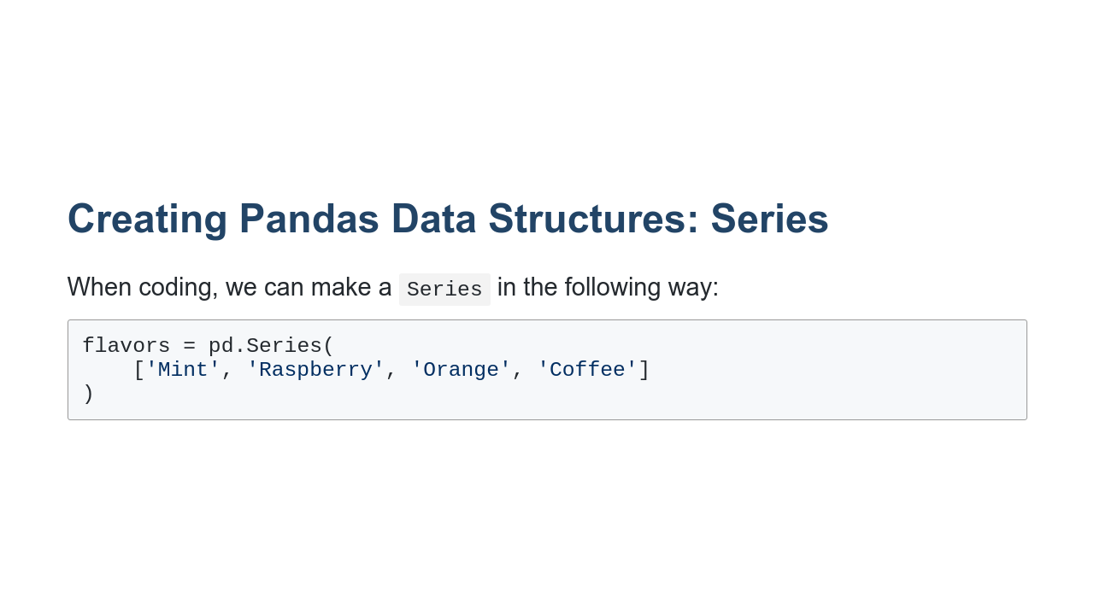
Notes:
Here, we create a Series indexed by 0, 1, 2, 3. It is one column called "flavors" with entries ['Mint', 'Raspberry', 'Orange', 'Coffee']

Slide 9
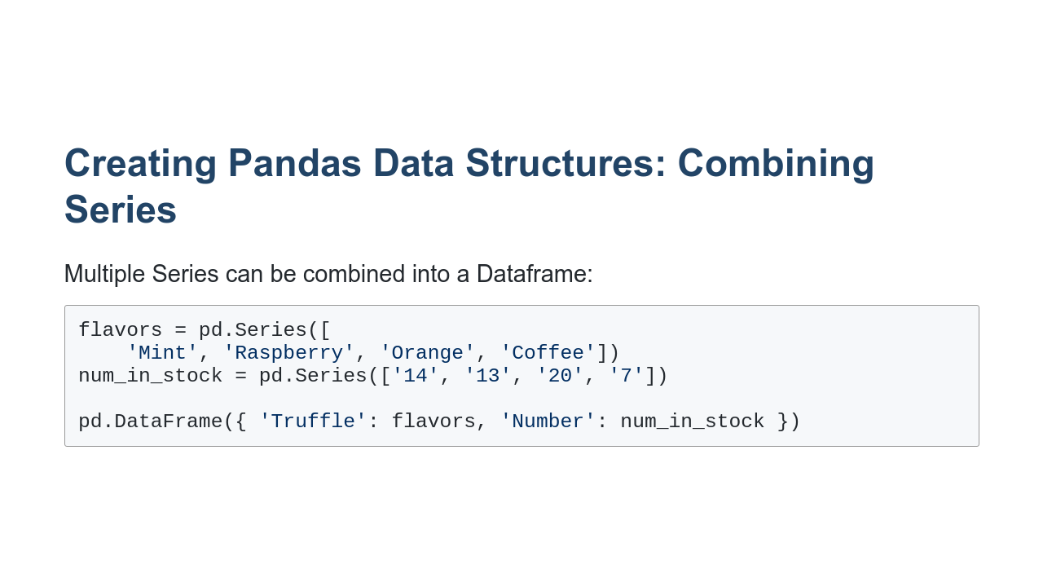
Notes:
In this code, we first create two series, flavors and num_in_stock. Then, we make a DataFrame, giving each series a title (“Truffle” and “Number”).

Slide 10
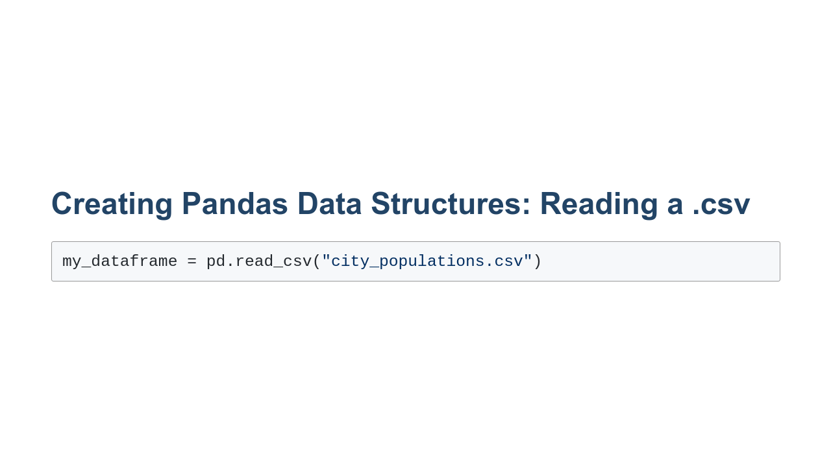
Notes:
This method reads in a file in the format “csv," meaning that the data in the file is separated by commas. A CSV is a file type, meaning “comma separated values." Essentially, it signifies that the data has commas between each value to signify where one entry ends and the next begins. The first argument is a string and can either be the name of a local file (as shown) or the url of a file on the internet.

Slide 11
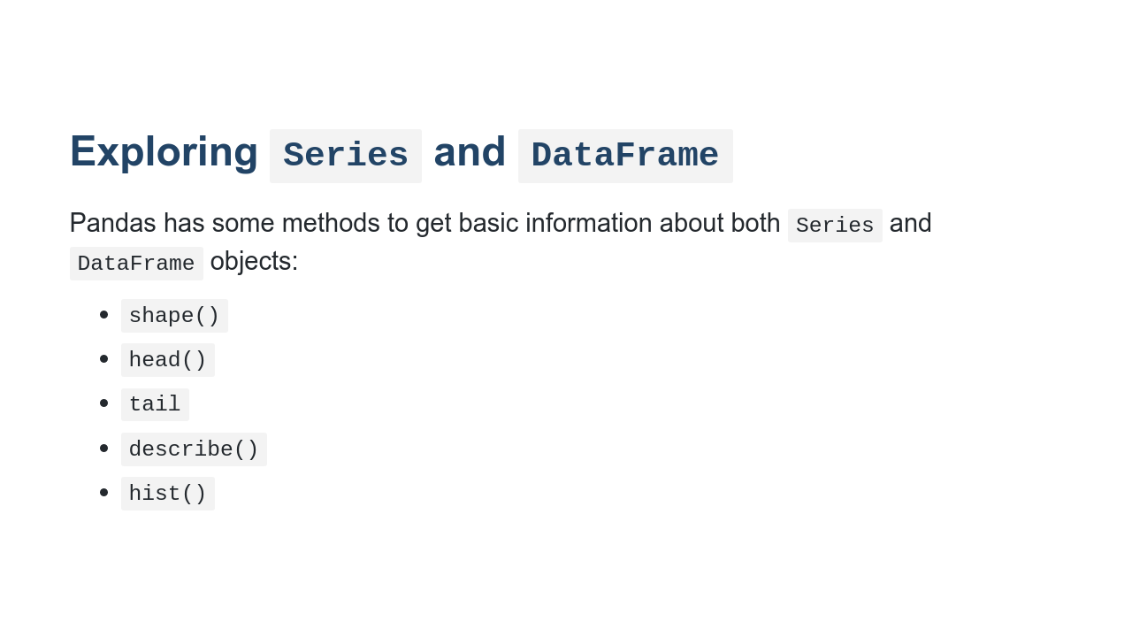
Notes:
We’ll go through each of these methods in turn. Each of these methods works with both Series and DataFrame objects. None of them modify the data, but do they let us view the data in a few different ways, so we can get a sense of what we’re looking at.

Slide 12
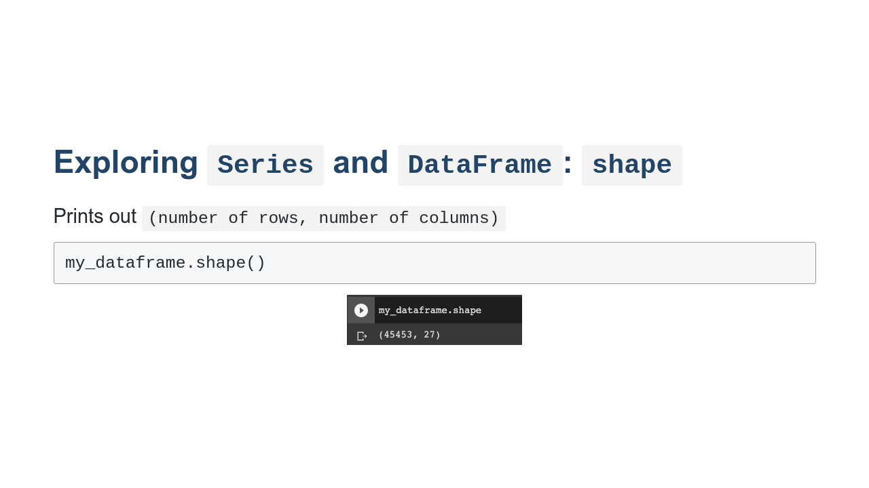
Notes:
shape() prints (number of rows, number of columns) * Image name: res/shape.png * Repo link: https://github.com/google/applied-machine-learning-intensive/tree/master/content/02_data/01_introduction_to_pandas/res/shape.png * Source https://github.com/google/applied-machine-learning-intensive/tree/master/content/02_data/01_introduction_to_pandas/res/shape.png by Author Google LLC under License Copyright [2020] Google LLC.

Slide 13
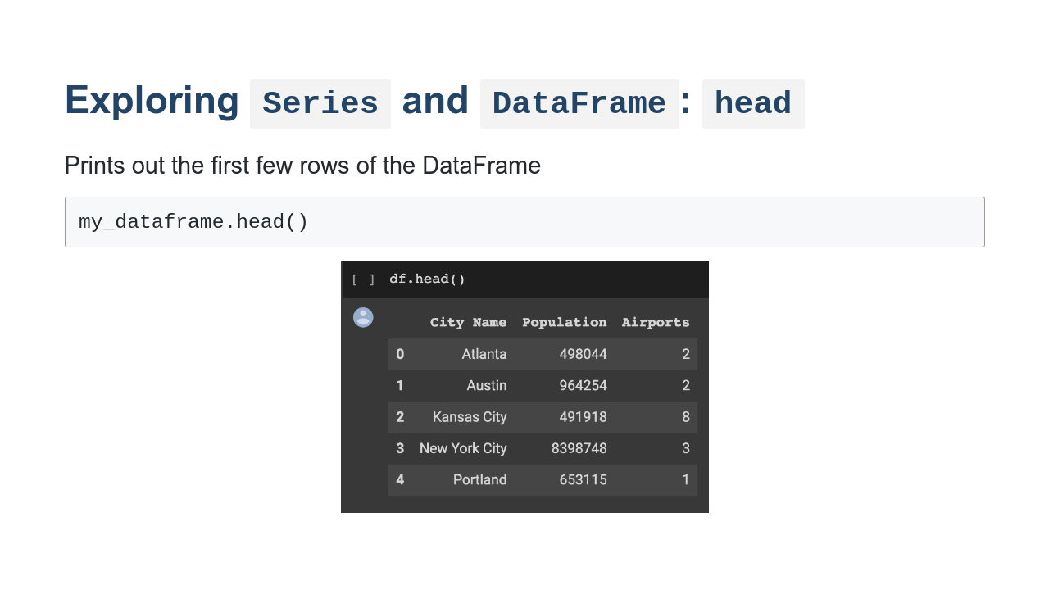
Notes:
head() prints the full contents of the first 5 rows. * Image name: res/head.png * Repo link: https://github.com/google/applied-machine-learning-intensive/tree/master/content/02_data/01_introduction_to_pandas/res/head.png * Source https://github.com/google/applied-machine-learning-intensive/tree/master/content/02_data/01_introduction_to_pandas/res/head.png by Author Google LLC under License Copyright [2020] Google LLC.

Slide 14
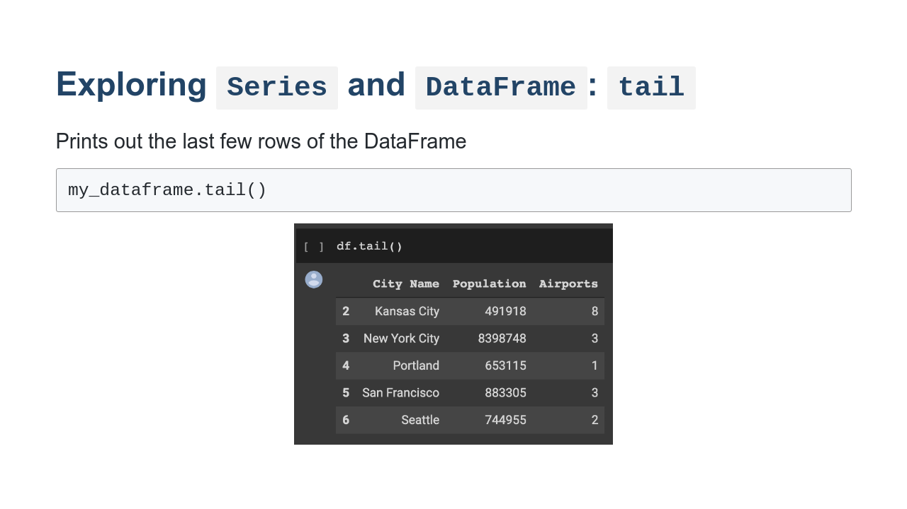
Notes:
tail() prints the full contents of the last 5 rows. * Image name: res/tail.png * Repo link: https://github.com/google/applied-machine-learning-intensive/tree/master/content/02_data/01_introduction_to_pandas/res/tail.png * Source https://github.com/google/applied-machine-learning-intensive/tree/master/content/02_data/01_introduction_to_pandas/res/tail.png by Author Google LLC under License Copyright [2020] Google LLC.

Slide 15
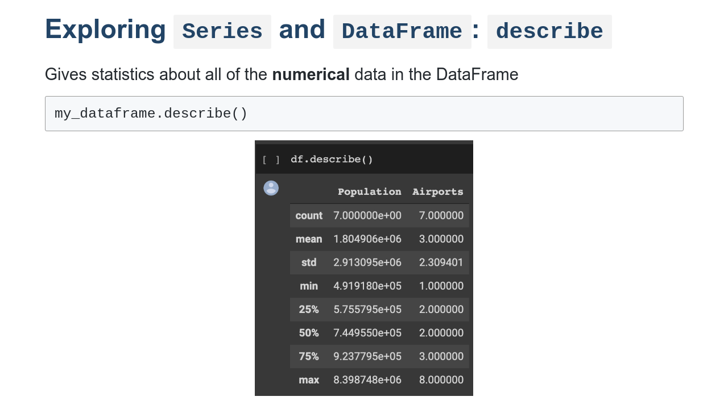
Notes:
describe() gives statistics such as mean and median about numerical data. Note that any columns without numerical data are not included. * Image name: res/describe.png * Repo link: https://github.com/google/applied-machine-learning-intensive/tree/master/content/02_data/01_introduction_to_pandas/res/describe.png * Source https://github.com/google/applied-machine-learning-intensive/tree/master/content/02_data/01_introduction_to_pandas/res/describe.png by Author Google LLC under License Copyright [2020] Google LLC.

Slide 16
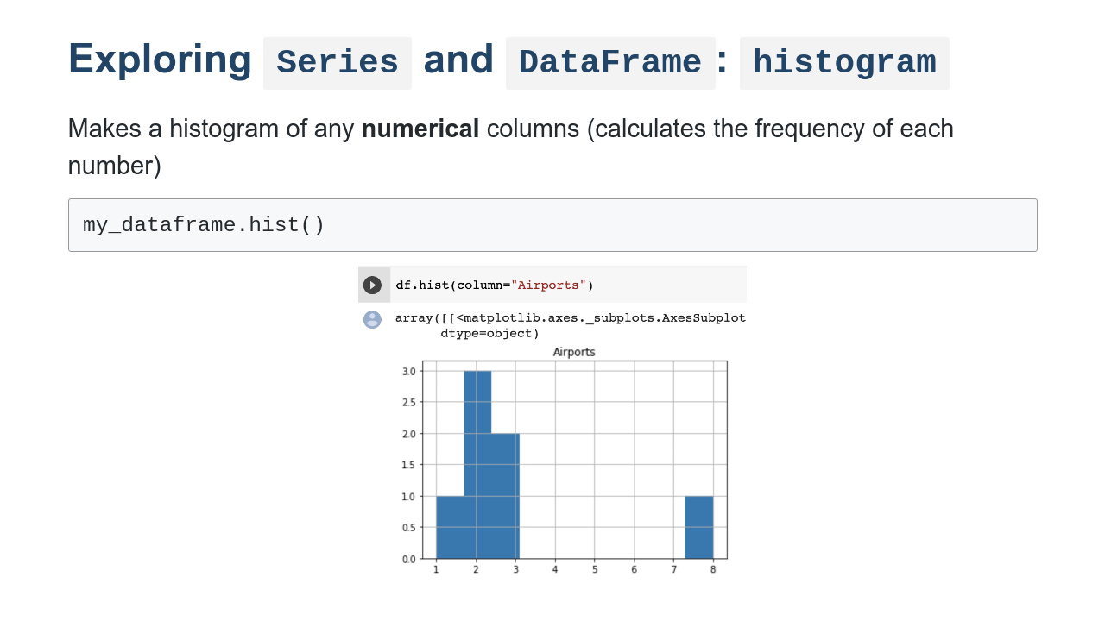
Notes:
hist() visualizes the frequency of various results for one or more numerical columns. * Image name: res/hist.png * Repo link: https://github.com/google/applied-machine-learning-intensive/tree/master/content/02_data/01_introduction_to_pandas/res/hist.png * Source https://github.com/google/applied-machine-learning-intensive/tree/master/content/02_data/01_introduction_to_pandas/res/hist.png by Author Google LLC under License Copyright [2020] Google LLC.

Slide 17
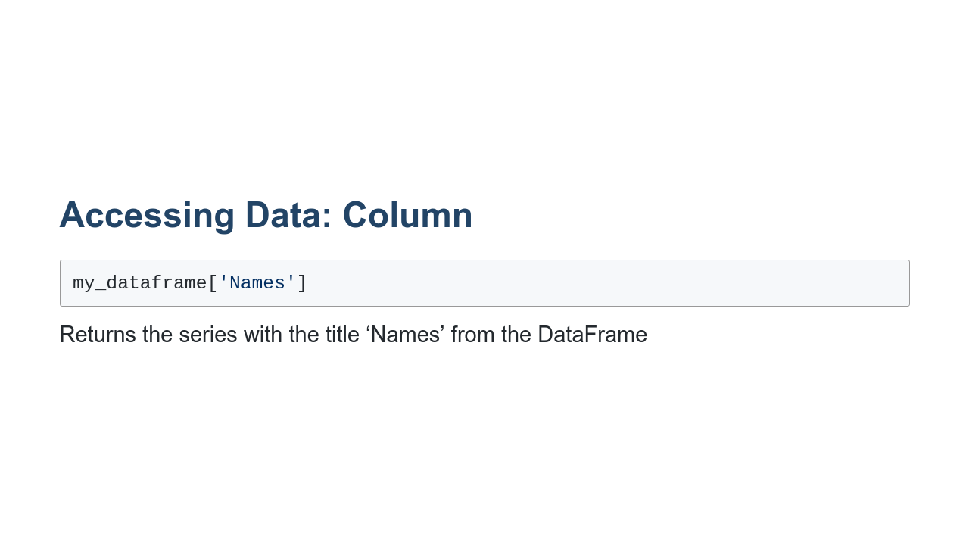
Notes:
If you have a column called “Names”, this command will give you only the contents of that column.

Slide 18
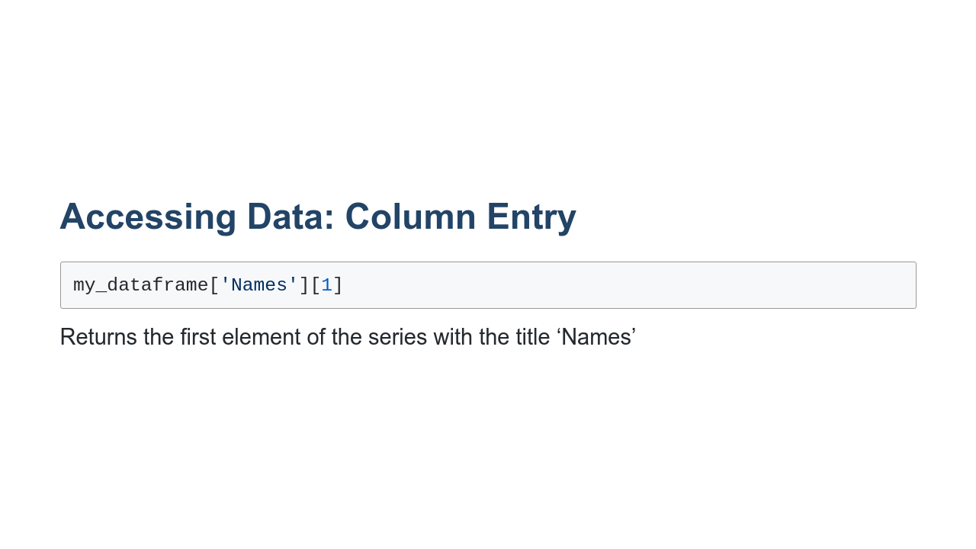
Notes:
Since series can be indexed like arrays, this command will return a single element from the series.

Slide 19
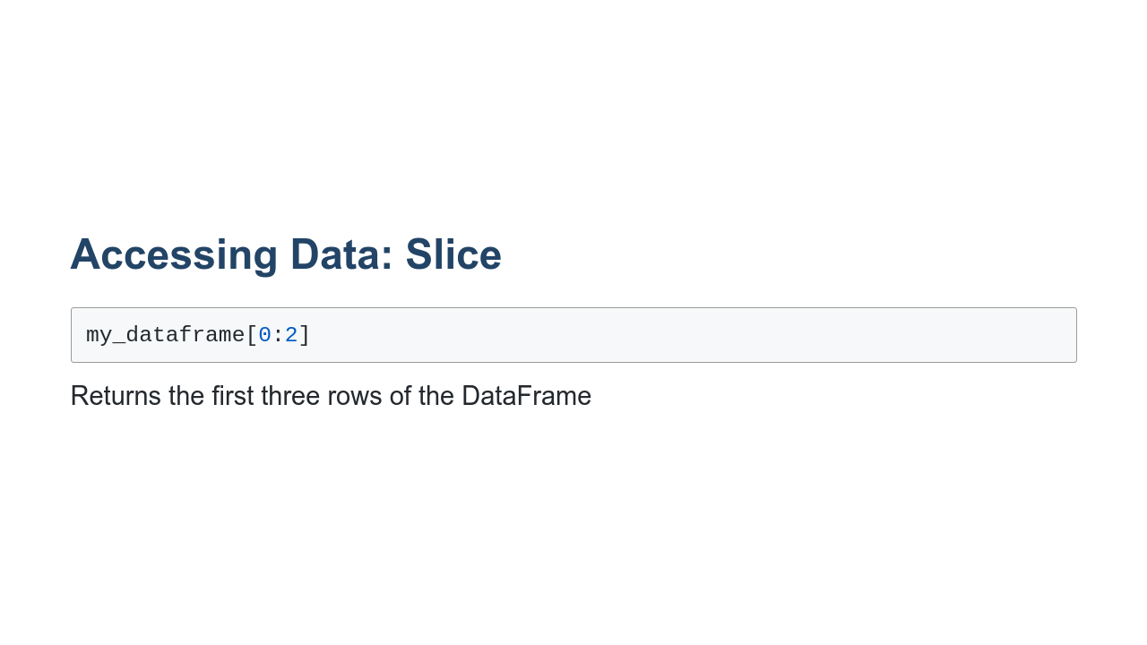
Notes:
Like python arrays again, you can specify a group of rows to be shown. In this case, the first three will be returned. Note that even though the square bracket syntax is the same, this command returns row data rather than column data.

Slide 20
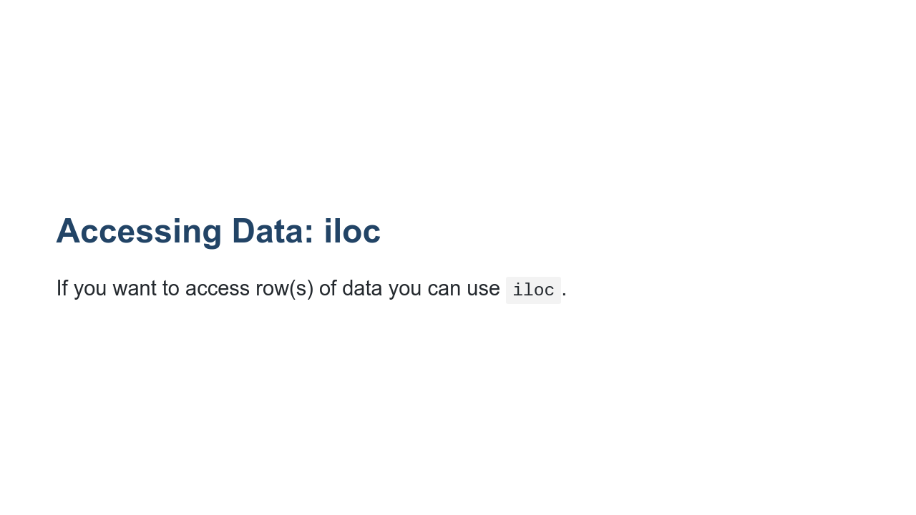
Notes:
the iloc command takes an integer index and accesses the row located at that index. df.iloc[0] returns the first row (i.e. the 0th indexed row) of df.

Slide 21
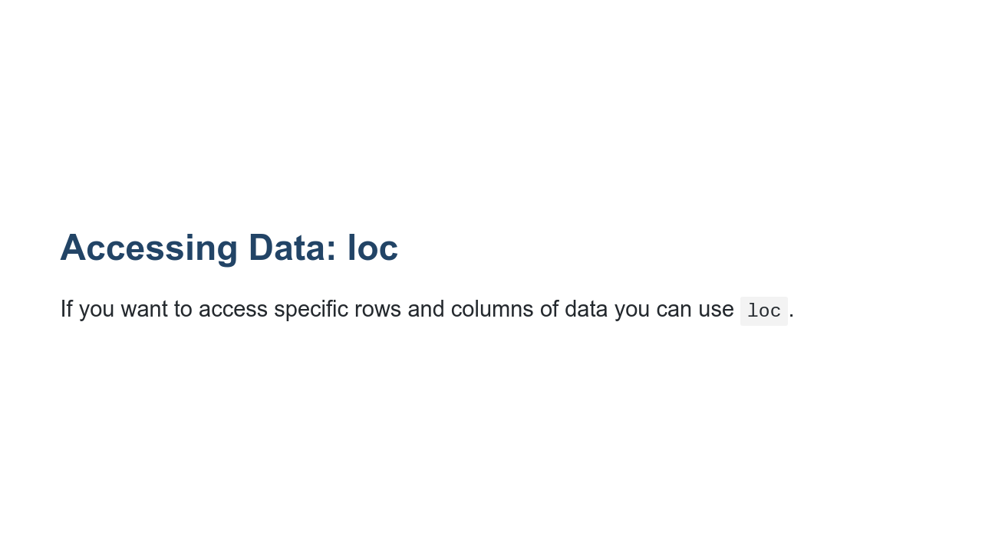
Notes:
The loc command is like a combination of column indexing and row indexing. It allows you to access a group of rows *and* columns by label(s) or a boolean array.

Slide 22
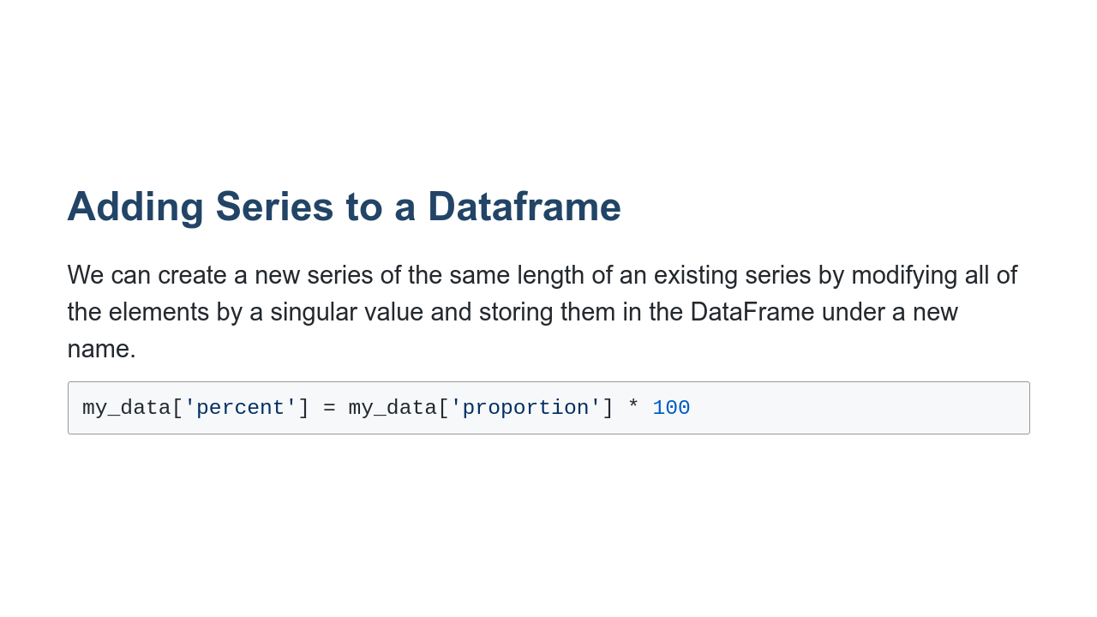
Notes:
The series my_data[‘percent’], which is added to the my_data dataframe, will be equal to 100 times the series ‘proportion.' This means for each row, the entry in the ‘percent’ column will be 100 times the entry in the ‘proportion’ column.

Slide 23
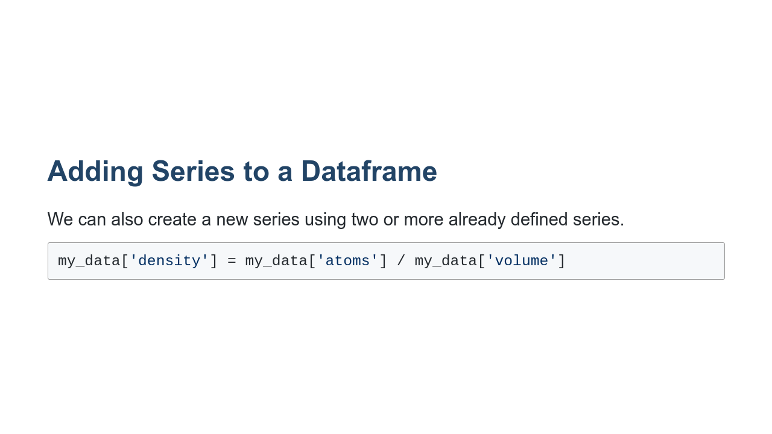
Notes:
In this case, one series is being divided by another. For each row, the entry in the ‘density’ column is equal to the entry in the ‘atoms’ column divided by the entry in the ‘volume’ column.

Slide 24
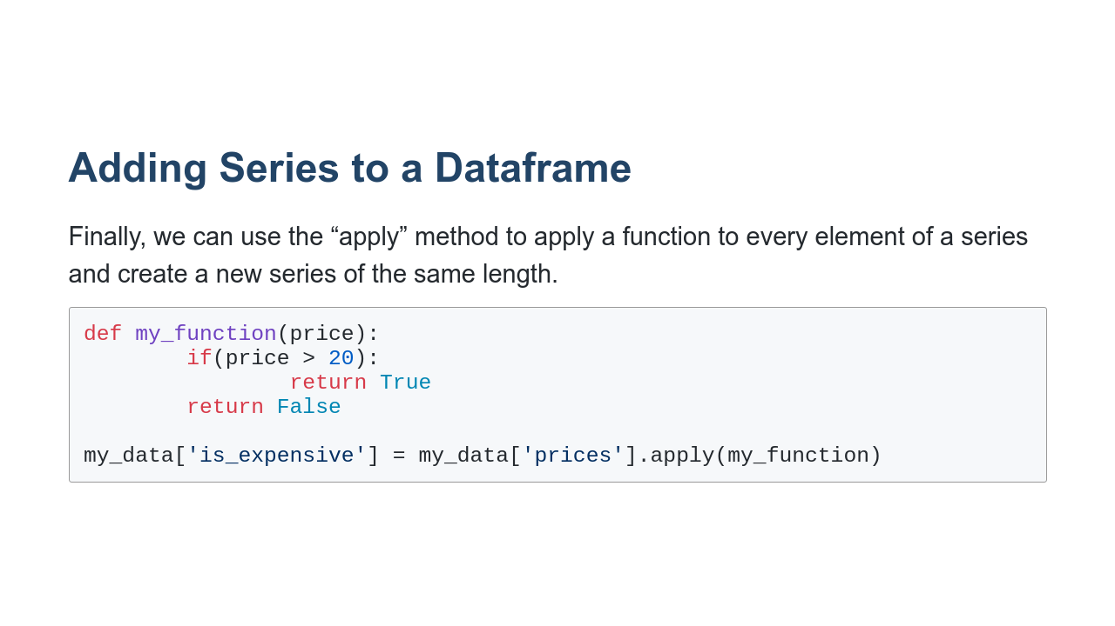
Notes:
My_function is a function that takes in a value and returns a value. In this case, we can imagine that my_function takes in an integer (the ‘price’) and returns a boolean value, indicating whether or not the item is expensive.

Slide 25
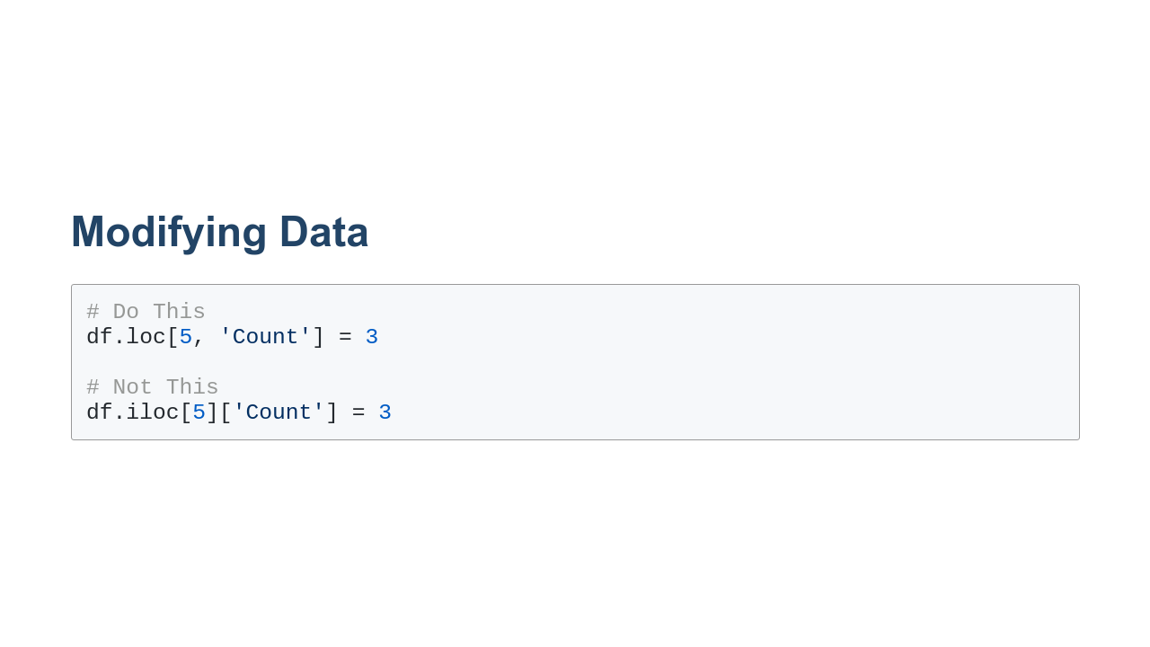
Notes:
It is possible to modify individual data points. To do this, it is best to use the `.loc[]` accessor as shown in this slide. The modification still works most of the time when you use `.iloc[]` or other methods, but some funny things are going on internally. When you reference data in a `DataFrame`, sometimes you are referencing the data in the `DataFrame` itself and sometimes you are access a copy of the data. In the `.iloc[]` case, a copy is involved. In the `.loc[]` case it is not.

Slide 26
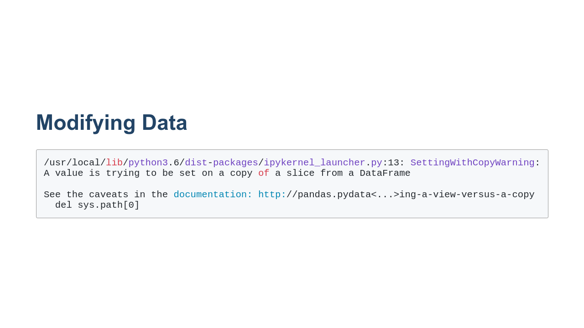
Notes:
If you do have code that is or could potentially be working with copies, you'll see a warning like the one shown in this slide. Typically this warning can be avoided by moving from whatever data referencing scheme you are using to `.loc[]` on the left-hand side of the expression.

Slide 27
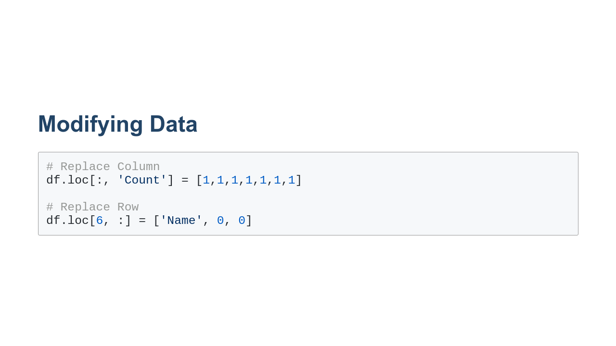
Notes:
Entire rows and columns can be replaced using the all-slice, ':', Smaller scoped slices can also be used.

