Slide 1
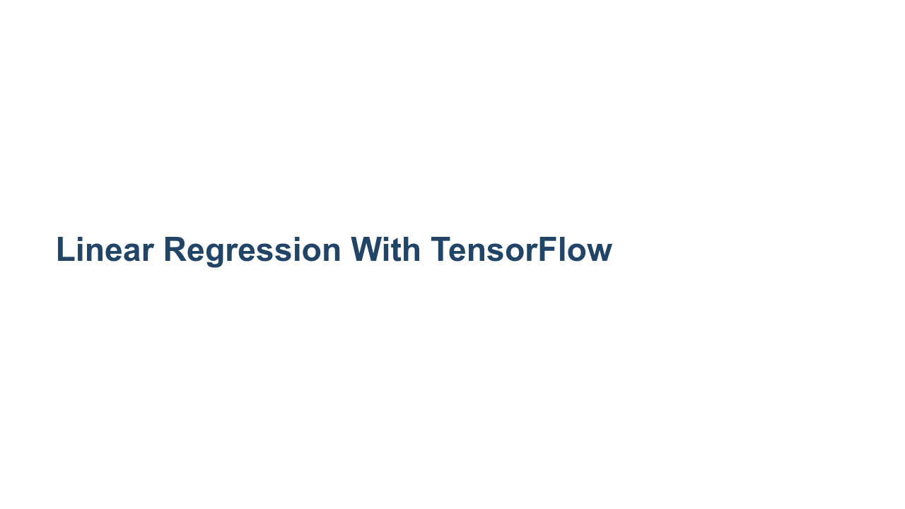
Notes:
We have learned about how to perform regression with scikit-learn, and we have taken a peek at TensorFlow. Now it's time to try to train a real model using TensorFlow.

Slide 2

Notes:
Why would we want to build a linear regression using TensorFlow? It's true that scikit-learn is perfectly good at linear regression most of the time. However, TensorFlow has some features like distributed model training that can help you build models when you have huge amounts of data. It is also useful to learn a new tool by practicing on content that you are familiar with.

Slide 3
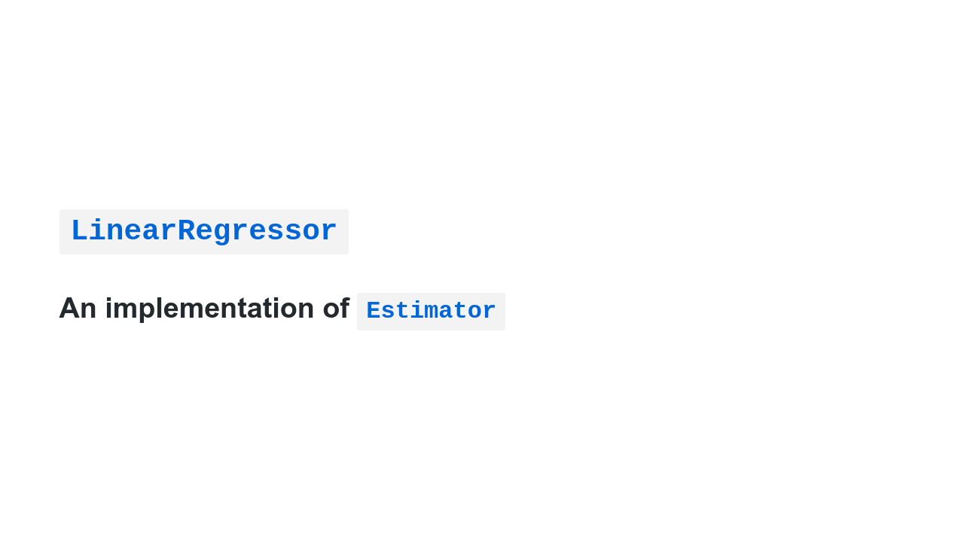
Notes:
In this lab we'll be using the [`LinearRegressor`](https://www.tensorflow.org/api_docs/python/tf/compat/v1/estimator/LinearRegressor) class. `LinearRegressor` is an [`Estimator`](https://www.tensorflow.org/api_docs/python/tf/compat/v1/estimator/Estimator). `Estimator` is an API and programming model that was introduced in TensorFlow version 1. It is a little more difficult to use than modern Keras-style TensorFlow, but you will still see it used in practice, and support for it will continue in TensorFlow 2 because the `Estimator`-style of programming works better for some specific machine learning applications.

Slide 4
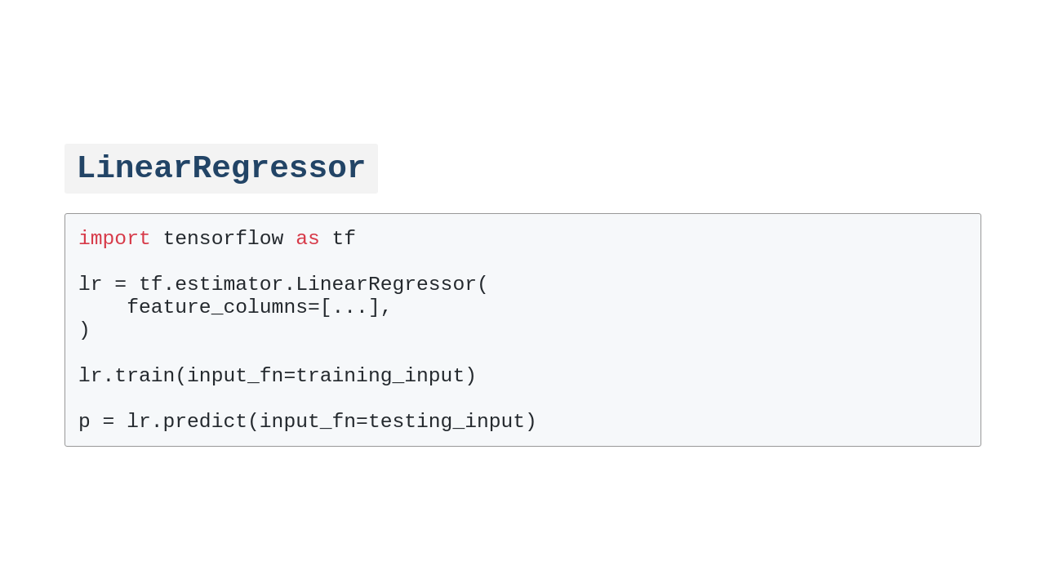
Notes:
Here you can see the main programming flow of the `LinearRegressor.' We: 1. Import TensorFlow. 2. Create an estimator class. 3. Train the estimator by passing it a function that provides data. 4. Use the model by passing it a function that provides data.

Slide 5
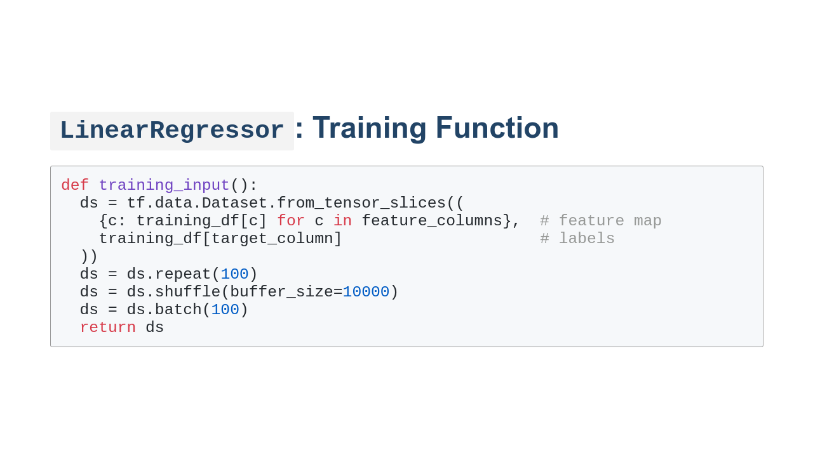
Notes:
Here you can see what an input function might look like. The function: 1. Creates a `Dataset` object. This particular `Dataset` is just wrapping a bunch of Pandas `Series` objects, but `Dataset` can represent other data acquisition and storage strategies. 2. Sets the number of times to pass the data to the model. Remember that our models will be using an optimizer to try to find good weights. In order to do this, it helps to pass the data to the model a few times. 3. Shuffles the data between repeats. 4. Defines the mini-batch size. This is the number of data points that will be passed to the model in each training step. Note that repetition and batch are hyperparameters that you can change in the model. You might find that you don't need to repeat the data as much or that you need to repeat it more. You might find that smaller batches work better than big batches.

Slide 6
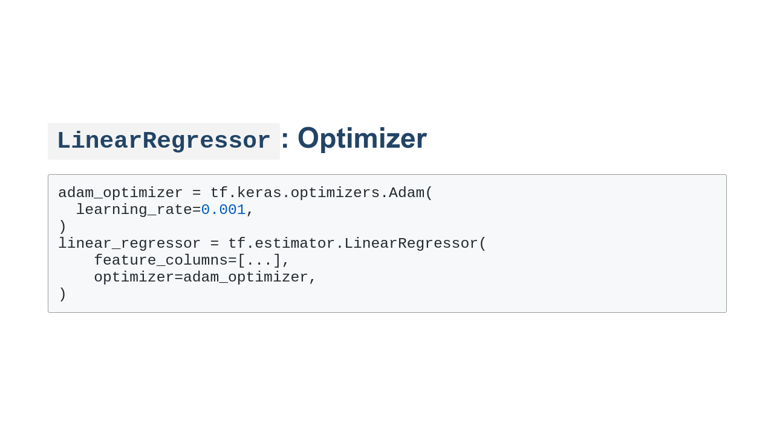
Notes:
Another interesting hyperparameter is the optimizer. By default `LinearRegressor` uses the [`Ftrl`](https://www.tensorflow.org/api_docs/python/tf/keras/optimizers/Ftrl) optimizer; however, there are many more options. In this example we use the [`Adam`](https://www.tensorflow.org/api_docs/python/tf/keras/optimizers/Adam) optimizer. In this case, we also manually set the learning rate. Each optimizer has settings like this that you can change to help your model train faster and better.

Slide 7
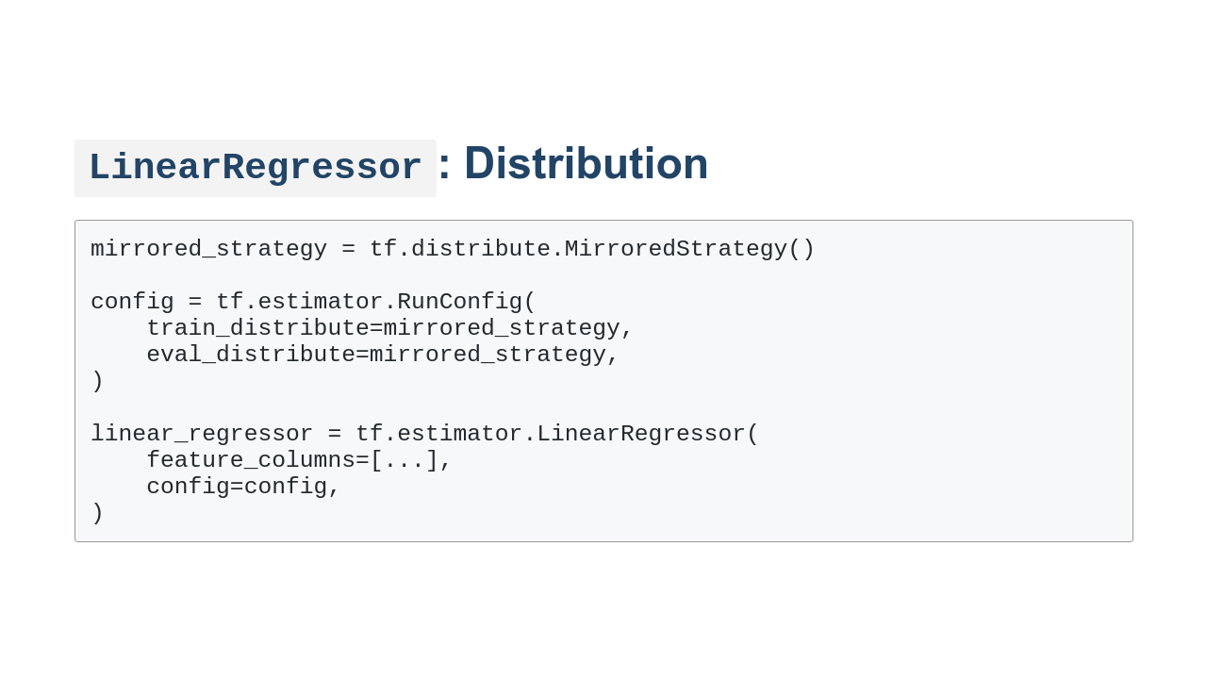
Notes:
In order to distribute training and evaluation across workers, you can optionally pass the `LinearRegressor` a distribution method via config. We'll show how to do this in the lab, though it doesn't help much on the small virtual machines that we'll be working with.

Slide 8
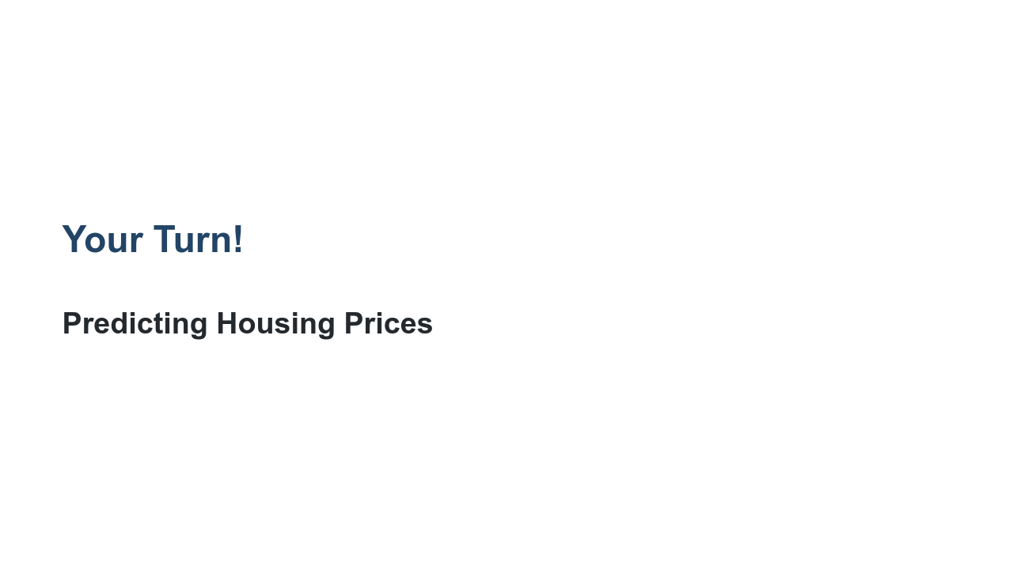
Notes:
In the lab we will use United States census data to try to predict housing prices in California. We'll examine the data, manipulate the data, and then build and adjust a model.

