Slide 1
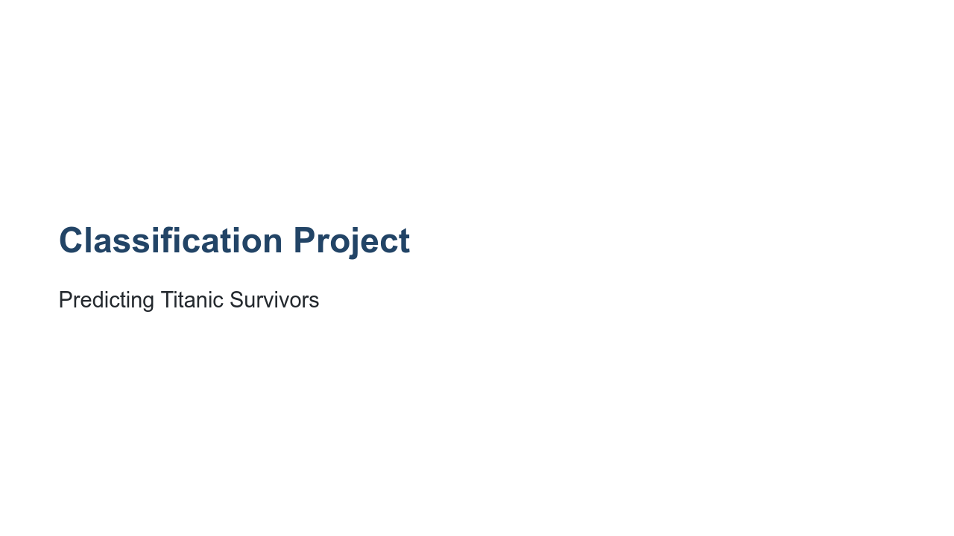
Notes:
In this project you will apply what you have learned about classification and TensorFlow to complete a project from Kaggle.

Slide 2
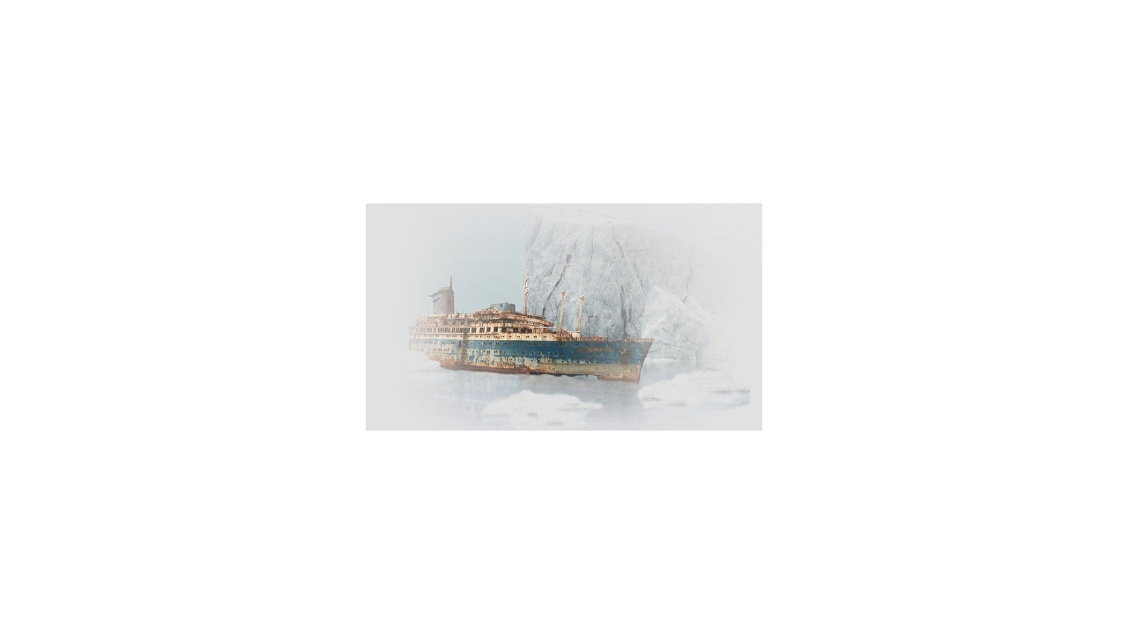
Notes:
The challenge is to achieve a high accuracy score while trying to predict which passengers survived the Titanic shipwreck. * Image name: res/ship.jpg * Repo link: https://github.com/google/applied-machine-learning-intensive/tree/master/content/04_classification/04_classification_project/res/ship.jpg * Source https://pixabay.com/photos/ship-wreck-old-rust-stranded-3401500/ by Author Pixel2013 / S. Hermann & F. Richter https://pixabay.com/users/pixel2013-2364555/ under License https://pixabay.com/service/license/.

Slide 3
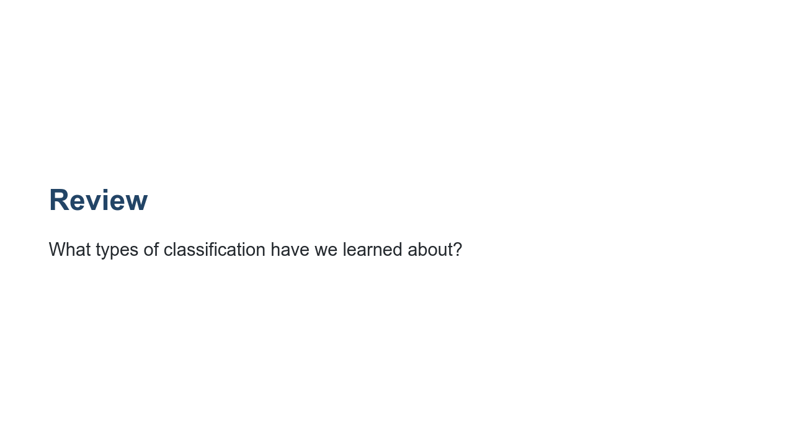
Notes:
Let's review a bit before diving in. @Exercise(5 minutes) { Have students name and discuss the types of classification they have learned so far. If they need prompting, remind them about binary and multiclass classification. Have them give examples of binary classification vs. multiclass classification. Ask students to discuss what type of classification would be most appropriate for predicting which passengers survived the Titanic shipwreck. }

Slide 4

Notes:
We have learned many different models and tools for performing classification. What are some of those models and tools? @Exercise(5 minutes) { Have students discuss the models and tools they have learned so far. Get them to explain a bit about each of the tools. If they need prompting, remind them about logistic regression and scikit-learn's Logistic Regression. For multiclass classification we talked about OvO and OvA along with scikit-learn's SGDClassifier. We also practiced classification using Keras and Tensorflow. }

Slide 5
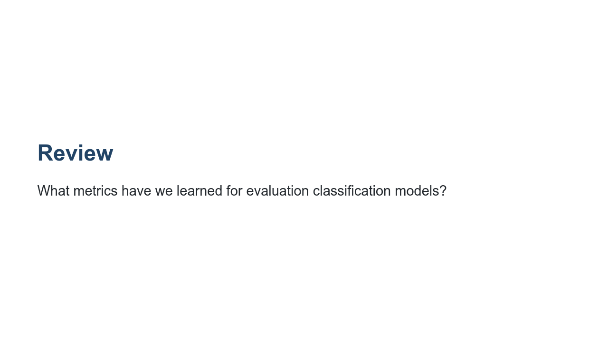
Notes:
What are some of the evaluation metrics we've discussed? @Exercise(5 minutes) { Have students talk about the evaluation metrics for classification models. If they need prompting, remind them about the confusion matrix, accuracy, precision, recall, F1, and RoC. Have students discuss what each metric measure is and how we interpret them. }

Slide 6
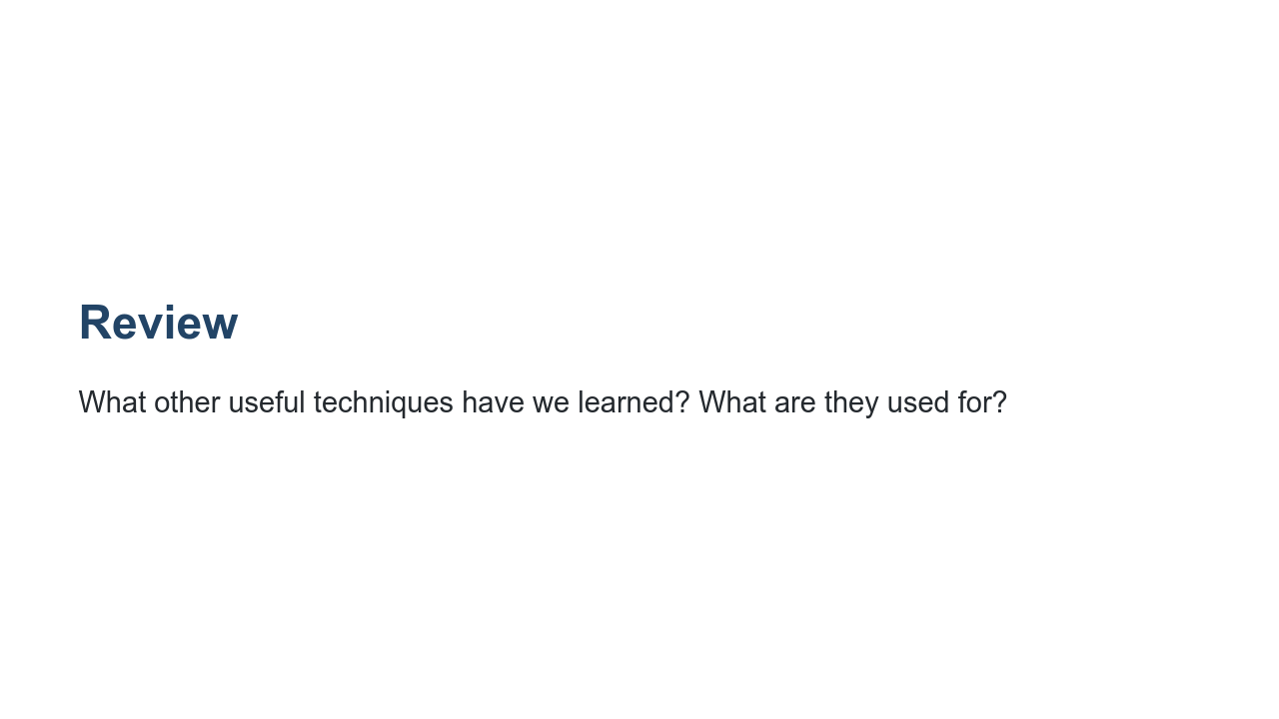
Notes:
We've covered a few other techniques that can be useful for model training and testing. Can you name a few and describe their purpose? @Exercise(5 minutes) { Have students talk about any other useful miscellaneous techniques that come to mind. If they need prompting, remind them about stratification and cross-validation. }

Slide 7
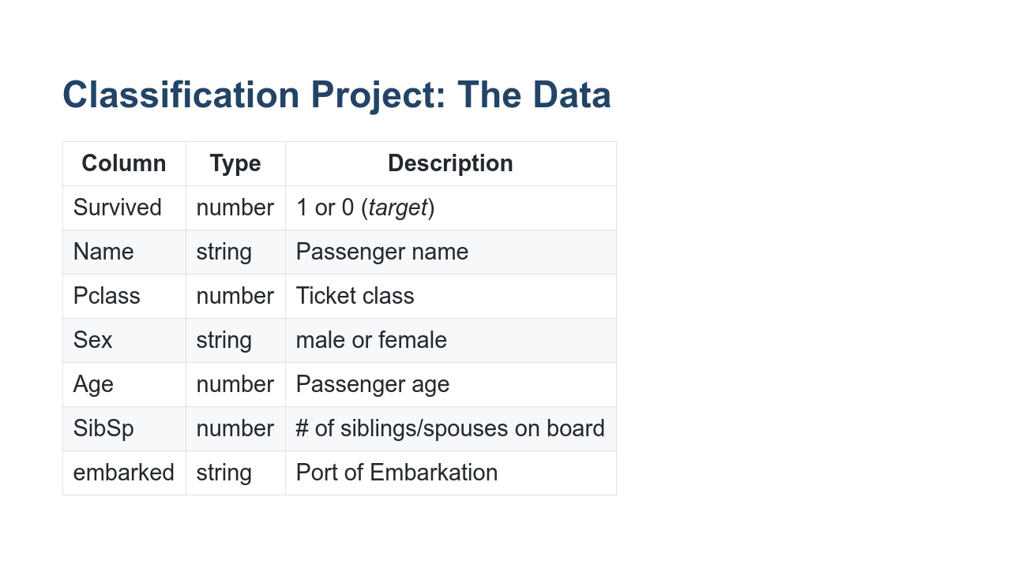
Notes:
The dataset we're using comes from Kaggle. Here are just a few of the columns of data you'll be working with. As you can see, we have both numbers and strings. The target column is 'Survived', and it is a number that is either 0 or 1.

Slide 8
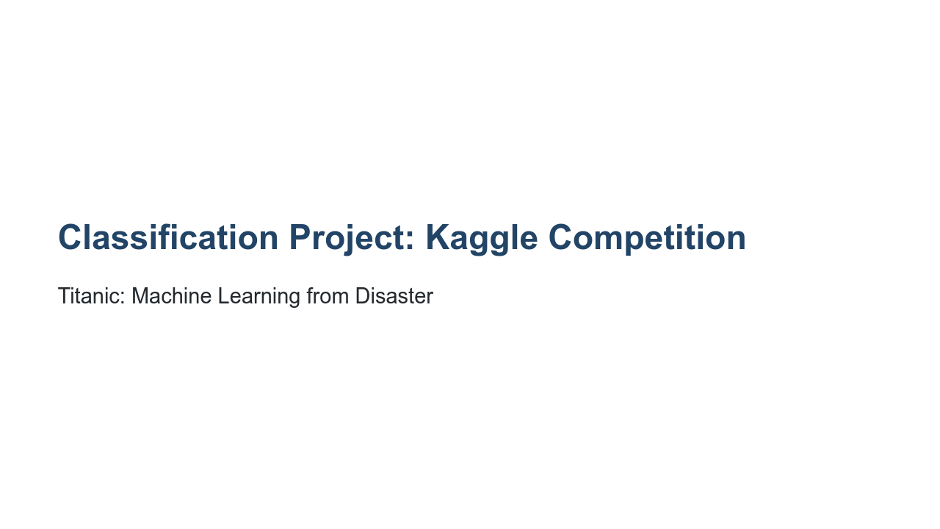
Notes:
Kaggle hosts several competitions that are open to users. It's an exciting way to engage with the broader machine learning community and learn new things. At the end of this lab, you will upload your results to the Kaggle competition and see how your model compares to the over 17,000 other models people have created!

Slide 9
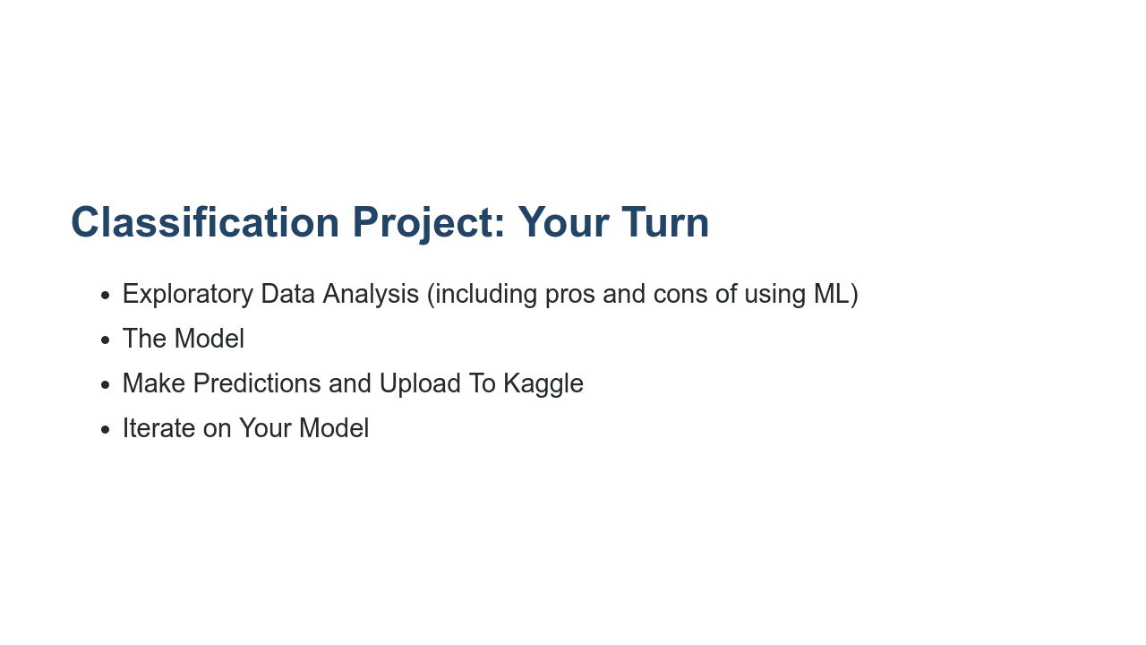
Notes:
It is now your turn to perform a classification from end-to-end. The lab you are about to be given is divided into four primary parts, shown on this slide. In the first section, you'll acquire and explore the data. Here we expect you to write code and prose about the data. Does the data have obvious problems? Do any model-independent changes need to be made to the data? EDA is the place to reason about and perform these tasks. This is also a good time to think about the pros and cons of using machine learning to solve this problem. In the next section, you will build and evaluate your model. You may choose to use scikit-learn or Tensorflow. You may even try multiple approaches and compare your results. Here you should also evaluate your model and discuss your particular evaluation metrics, including why you chose them and what they say. Finally, you will make predictions on the features found in the test.csv file and upload them to Kaggle using the Kaggle API. Your lab should discuss your predictions as well as your Kaggle results. Last but not least, iterate on your model. Tweak hyperparameters, and see if you can improve your model. Discuss your method for changing specific hyperparameters. Be thoughtful and methodical; don't just do it at random! Since this is a popular Kaggle dataset and competition, research other users' solutions. Try looking at solutions that both do and don't use ML, and discuss their relative merits. Take your time. Experiment. Don't be afraid to throw away some work along the way.

