Slide 1
Recurrent Neural Networks
Christan Grant
AMLI 2021

Slide 2
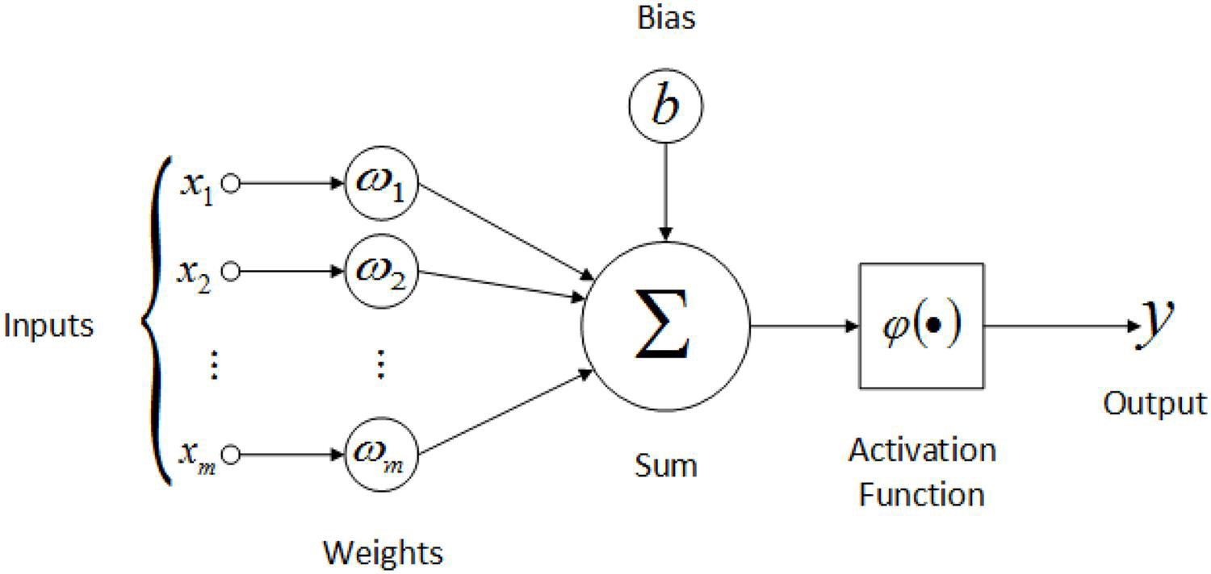
Feed forward Neuron
Notes:
Here we see a typical feedforward neuron. Depending on the size of the layers before and after, one or more weights feed into the neuron. These are multiplied by the bias, summed, and then passed through an activation function. The resultant value is then passed to the nodes in the next layer of the network.

Slide 3
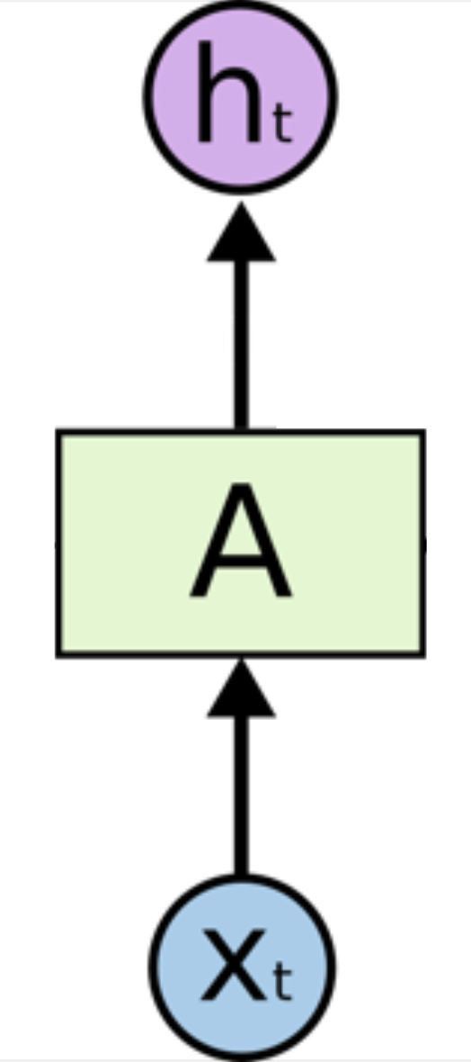
Feedforward Neuron
Hidden state that we propagate forward.
Inside A are the sum and activation function details.
Input to the neuron.

Slide 4
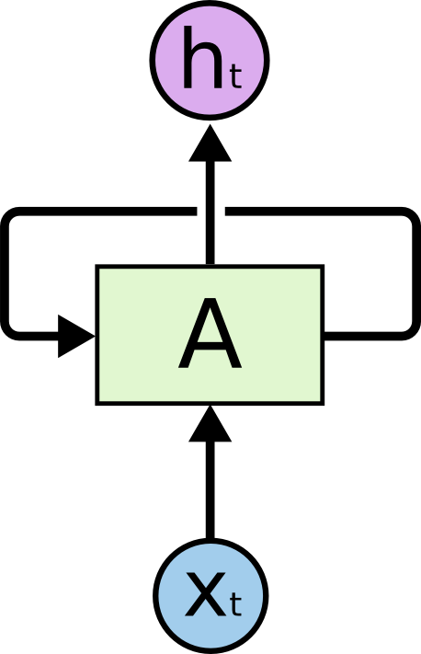
Recurrent Neuron
The neuron has feedback (without backpropagation).
Via https://colah.github.io/posts/2015-08-Understanding-LSTMs/

Slide 5
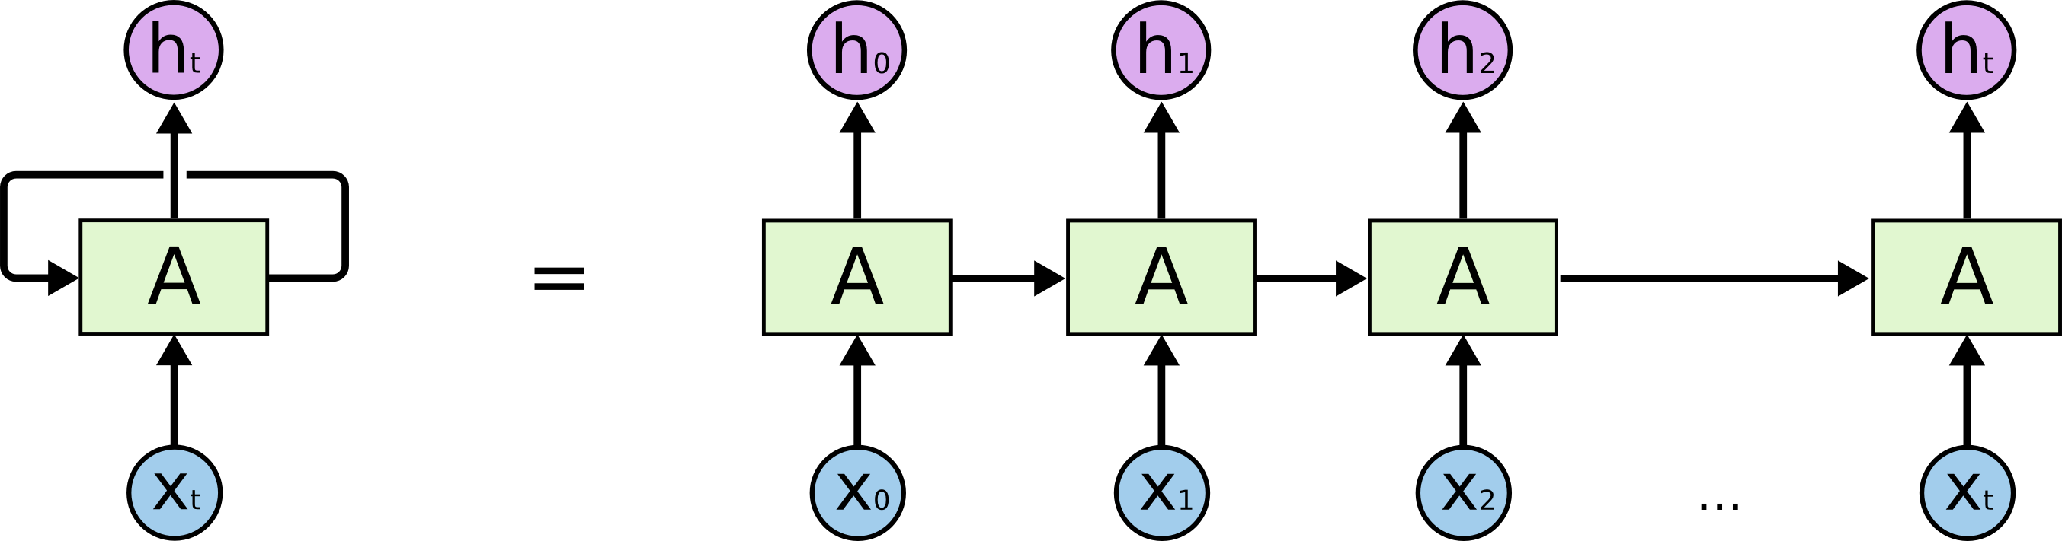
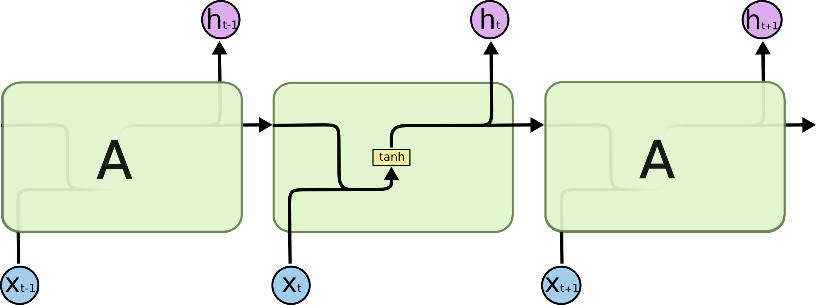
Recurrent Neuron Over Time
Previous inputs and new inputs are combined and passed through an activation function.
Notes:
This is what it would look like to "unroll" the flow of data through a recurrent neuron over time. You can see that it typically starts out with a seeded input value of zero for its backfeed. At each point in the series, the neuron both passes data to the next layer of neurons and passes data forward in time to itself the next time it fires. Also note that we're looking at a single neuron in a layer with one input and one output. In reality you'll have wide layers, so imagine multiple recurrent nodes side by side, each with multiple inputs and outputs.

Slide 6
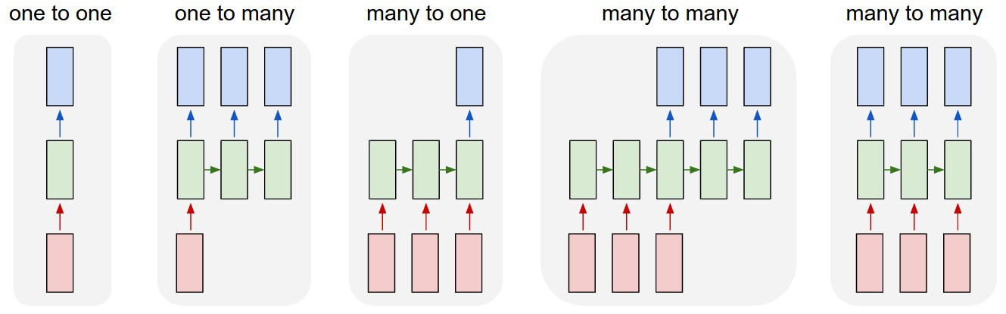
Designing RNNs
Via https://karpathy.github.io/2015/05/21/rnn-effectiveness/
Notes:
Each rectangle is a vector and arrows represent functions (e.g. matrix multiply). Input vectors are in red, output vectors are in blue and green vectors hold the RNN's state (more on this soon).
From left to right:
(1) Vanilla mode of processing without RNN, from fixed-sized input to fixed-sized output (e.g. image classification).
(2) Sequence output (e.g. image captioning takes an image and outputs a sentence of words).
(3) Sequence input (e.g. sentiment analysis where a given sentence is classified as expressing positive or negative sentiment).
(4) Sequence input and sequence output (e.g. Machine Translation: an RNN reads a sentence in English and then outputs a sentence in French).
(5) Synced sequence input and output (e.g. video classification where we wish to label each frame of the video). Notice that in every case are no pre-specified constraints on the lengths sequences because the recurrent transformation (green) is fixed and can be applied as many times as we like.

Slide 7

Long Short-Term Memory (LSTM) Neuron
RNNs have problems with long-term dependencies. As they get longer, they start to forget.
LSTMs adds a memory gates to the neuron.
The neuron passes two weights back to itself. One represents the long-term member, and the other represents the short-term member.
More info: https://towardsdatascience.com/illustrated-guide-to-lstms-and-gru-s-a-step-by-step-explanation-44e9eb85bf21

Slide 8
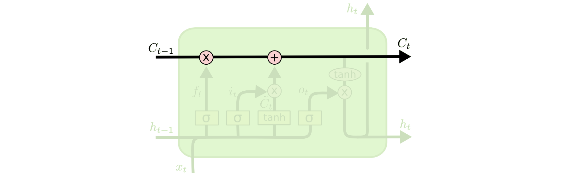
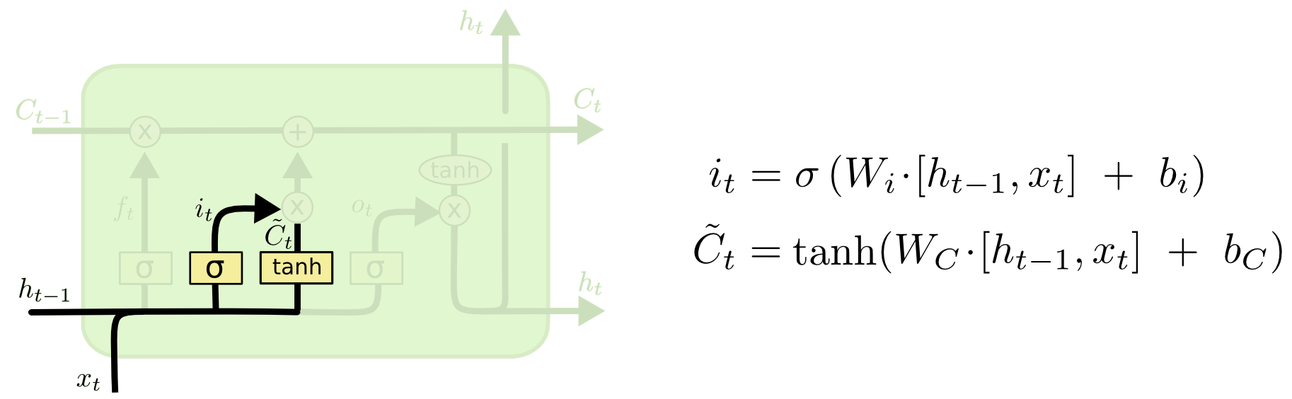
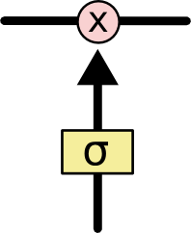
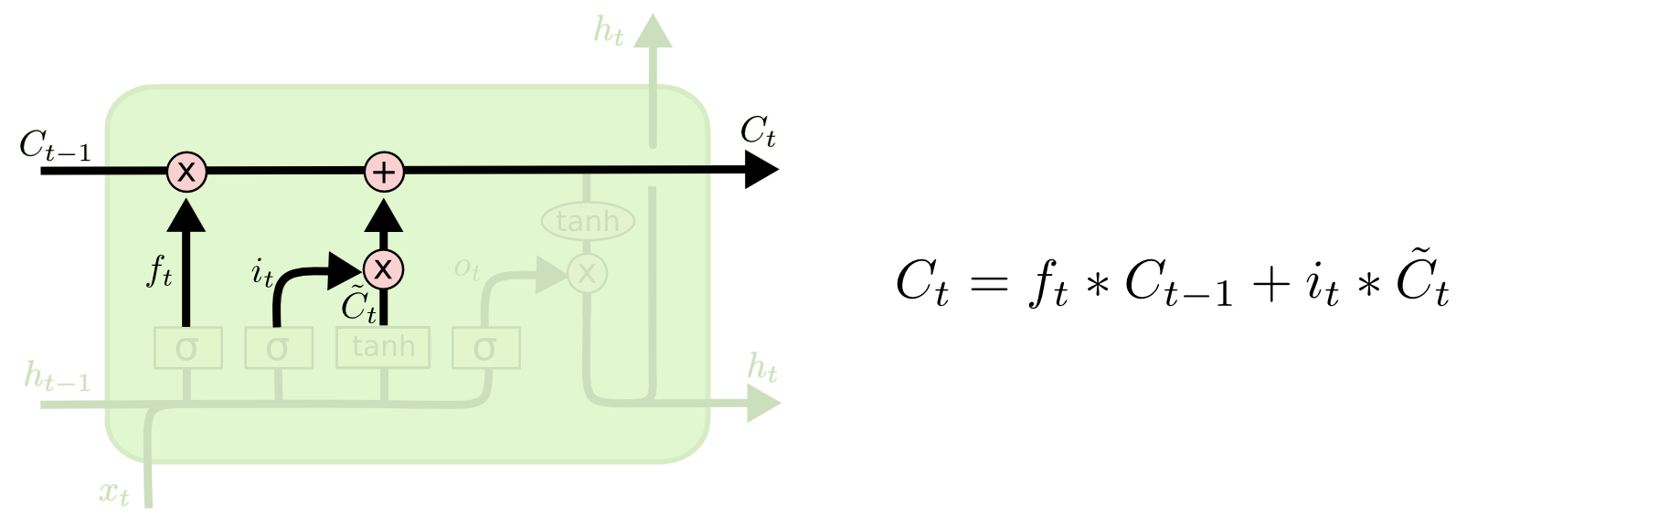
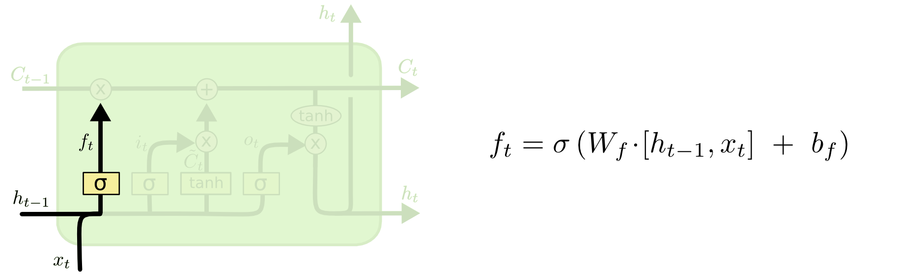
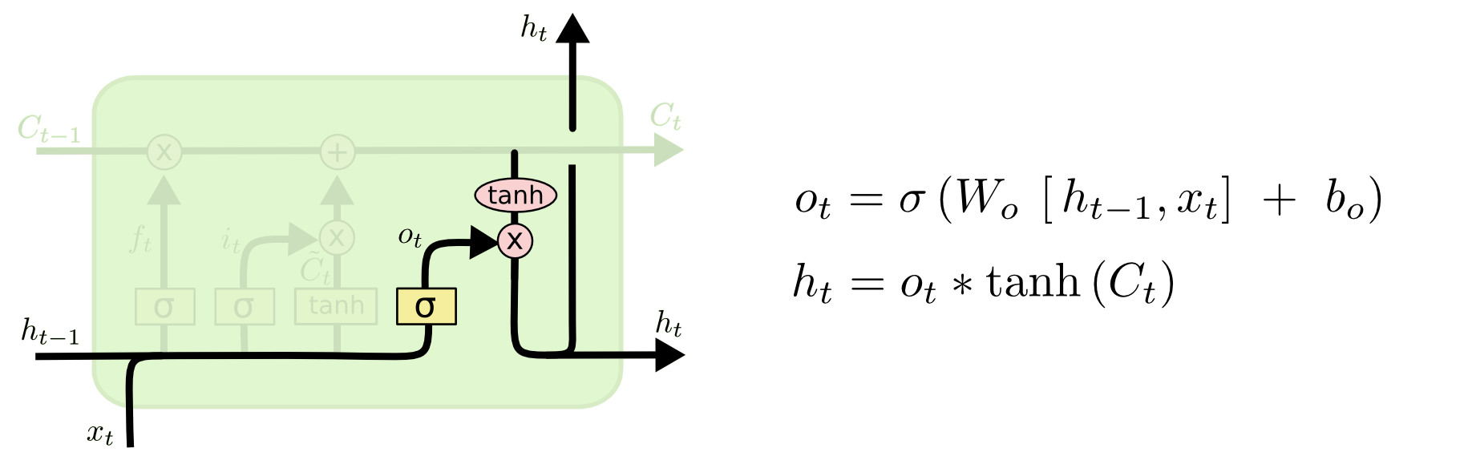
LSTM Deconstructed
Via https://colah.github.io/posts/2015-08-Understanding-LSTMs/
Propagates information forward.
Input gate decides if we want to keep the current information.
Gates control information flow. (A zero from the activation function closes the gate.)
Combine old and current state to create the new state.
Forget gate decides if we want to keep previous information.
Decide what to output based on the current state.
Notes:
C tilde is a new candidate value that we create based on keeping it or not.

Slide 9
Other RNNs
Gated Recurrent Unit (GRU)
Simpler than an LSTM with comparable performance in practice.
1D Convolutional Net
Sliding window with some kernel size of k.

Slide 10
Why use RNNs?
Language Translation
Sequence Predictions
Sequence Generation
Word Tagging
Text Summarization
Stock Prediction
Human Activity Recognition
… and more!

Slide 11
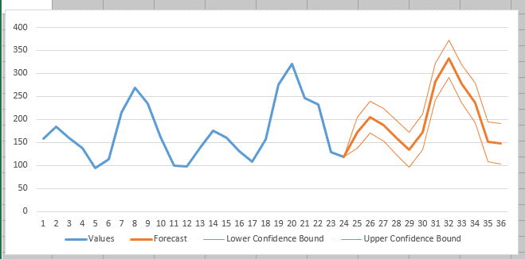
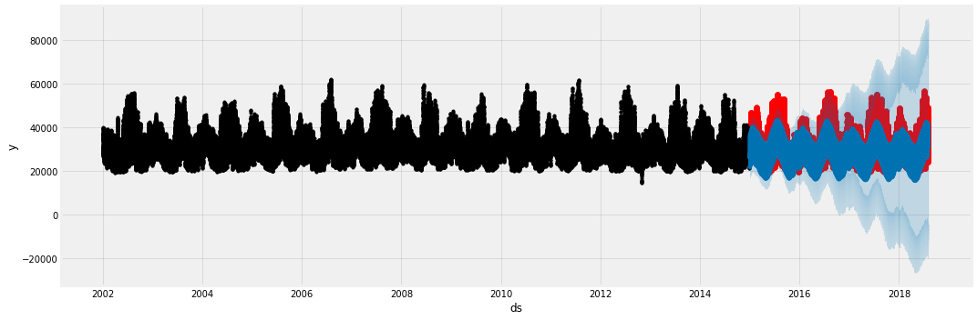
Sequence Prediction --- Time Series Data
Notes:
Order of the data is important.
One application that RNNs are particularly good at is sequence prediction. Our lab will actually be a sequence prediction lab. So far in this course, all of our predictions have assumed the data are time-independent. That is, we could shuffle around all the data points and prediction points in time, and nothing would change.
In this unit, we will look at sequence prediction. In sequence prediction the input data is an *ordered* set of data, most commonly a time series. A time series is a set of data where the index is a date. Since dates have an inherent ordering, time series are ordered data.

Slide 12
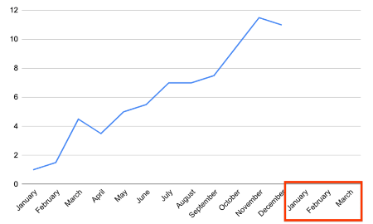
What are we predicting?
Notes:
Sequence prediction is about predicting what happens next in a sequence. For example, if we have a year's worth of data, we may want to know what happens in Q1 of the next year.

Slide 13
RNNs for Sequence Prediction
Statistical methods are traditional used for sequence prediction
E.g. Markov Chains Models, ARIMA, others.
RNNs do require a lot of data to perform well.
We will look at the performance of RNNs in the colab.

