Slide 1

READING GROUP UNITY

Slide 2
Agenda
Essentials
Scripting API
Physics
Tank Game
Optimization
Communications (ROS2)

Slide 3


Slide 4
Essentials
Editor layout
Project structure
GameObjects
Components

Slide 5
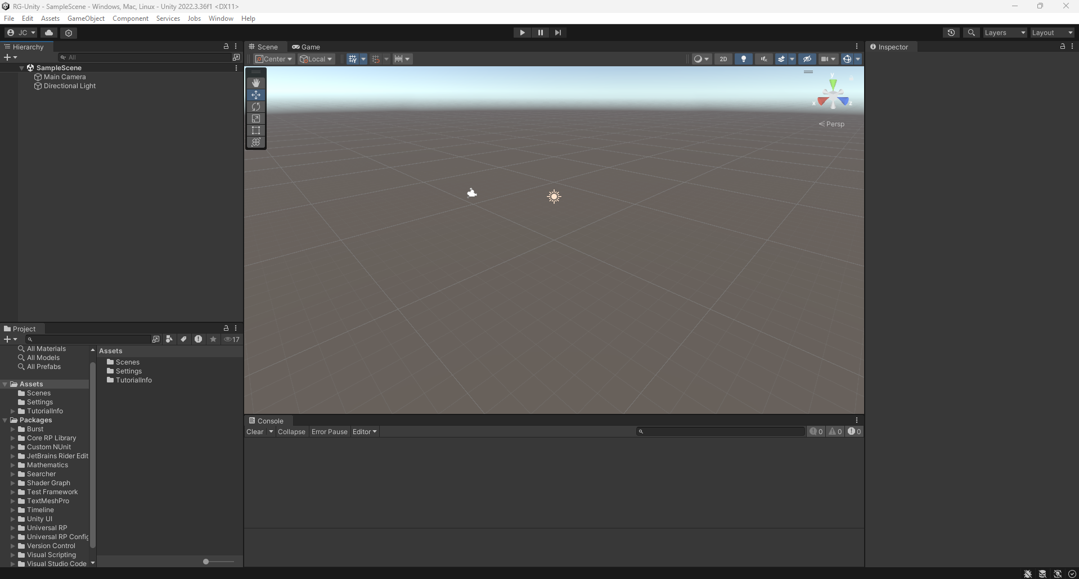
Editor layout
Scene
Hierarchy
Inspector
Project
Console
RG-UNITY/ESSENTIALS

Slide 6
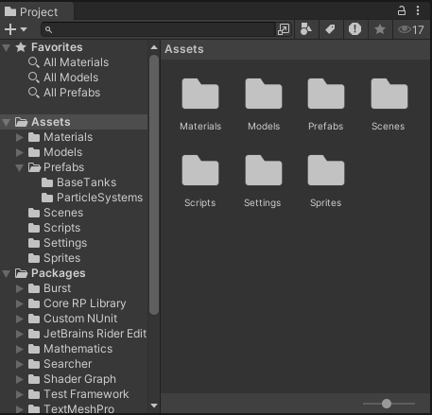
Project structure
Materials
Models
Prefabs
Scenes
Scripts
…
RG-UNITY/ESSENTIALS

Slide 7
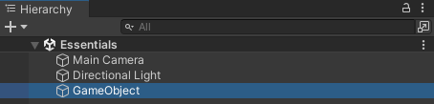
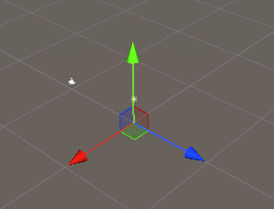
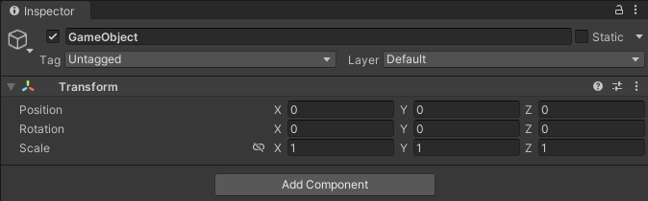
GameObjects
Add an empty GameObject
RG-UNITY/ESSENTIALS

Slide 8
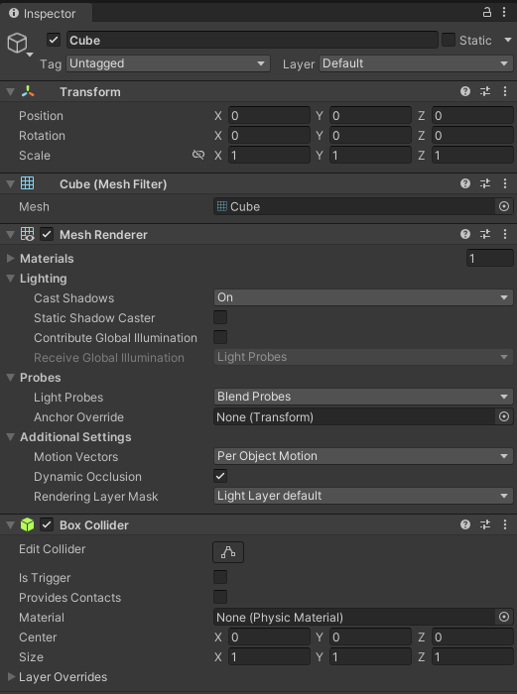
Components
Functional pieces that define the behavior of a GameObject.
RG-UNITY/ESSENTIALS

Slide 9
Scripting API
Creating a new script
Execution order
Debug
Inspector variables
Input
Instantiate & Destroy

Slide 10
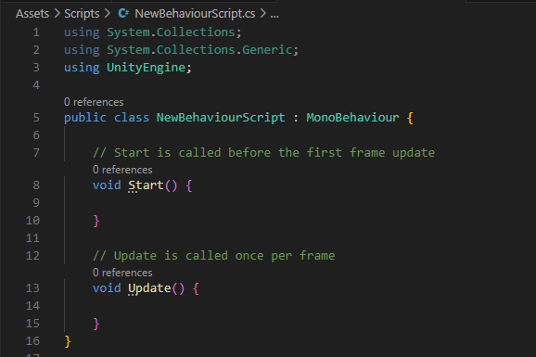
Creating a new script
Scripts > Create > C# Script
RG-UNITY/SCRIPTING API

Slide 11
Execution order
Awake
OnEnable
Callbacks to events in core Unity subsystems like physics, rendering, user input, etc.
Start
FixedUpdate
Input
Update
OnDisable
OnDestroy
RG-UNITY/SCRIPTING API
https://docs.unity3d.com/Manual/ExecutionOrder.html

Slide 12
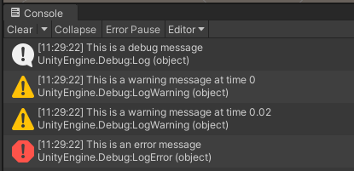
Debug
Debug.Log();
Debug.LogWarning();
Debug.LogError();
RG-UNITY/SCRIPTING API

Slide 13
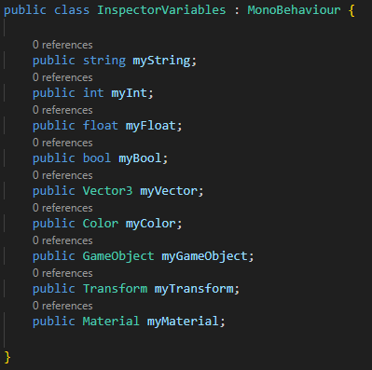
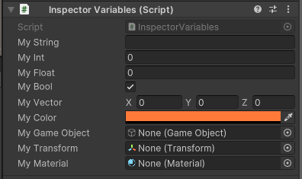
Inspector variables
RG-UNITY/SCRIPTING API

Slide 14
Input
Input.GetAxis("Horizontal"); -> float
Input.GetAxis("Horizontal"); -> float
Input.GetAxis("Mouse ScrollWheel"); -> float
Input.GetKey(KeyCode.E); -> bool
RG-UNITY/SCRIPTING API
https://docs.unity3d.com/ScriptReference/Input.html

Slide 15
Instantiate & Destroy
Instantiate(original, position, rotation);
Destroy(copy, 5f);
RG-UNITY/SCRIPTING API

Slide 16
Questions so far?

Slide 17
Physics
Rigidbody & Collider
Forces & Velocities
Collisions
Triggers
Raycast

Slide 18
Scene setup
Create a plane
Create a cube
(Optional) Create and apply materials
Play!
RG-UNITY/PHYSICS

Slide 19
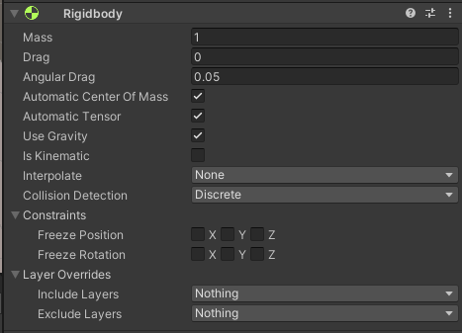
Rigidbody & Collider
Control of an object's position through physics simulation.
RG-UNITY/PHYSICS
https://docs.unity3d.com/ScriptReference/Rigidbody.html

Slide 20
Forces & Velocities
[RequireComponent(typeof(Rigidbody))]
GetComponent<Rigidbody>();
_rigidbody.velocity;
_rigidbody.AddForce();
RG-UNITY/PHYSICS

Slide 21
Collisions
Add another cube (Wall)
Change the tag to “Wall”
void OnCollisionEnter(Collision collision)
RG-UNITY/PHYSICS

Slide 22
Triggers
Add another cube (TriggerVolume)
Set isTrigger to true
(Optional) Change to a transparent material
void OnTriggerEnter(Collider other)
RG-UNITY/PHYSICS

Slide 23
Raycast
Ray(Vector3 origin, Vector3 direction)
if (Physics.Raycast(ray, out RaycastHit hit, rayLength, layerMask))
Debug.DrawLine(Vector3 start, Vector3 end, Color color)
RG-UNITY/PHYSICS
https://docs.unity3d.com/ScriptReference/Physics.Raycast.html

Slide 24
Questions so far?

Slide 25
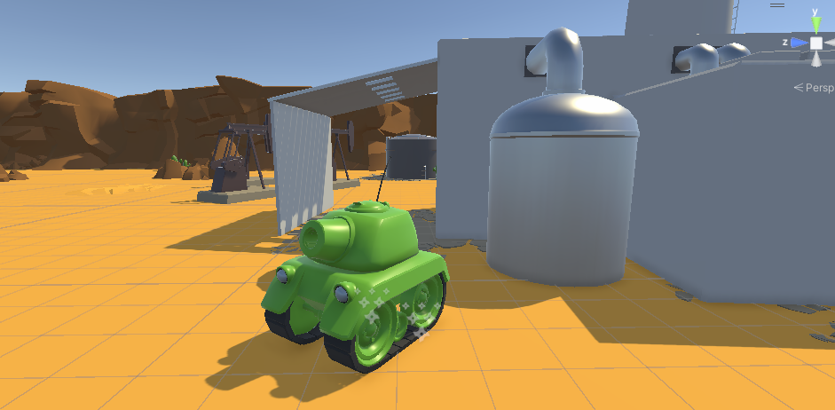
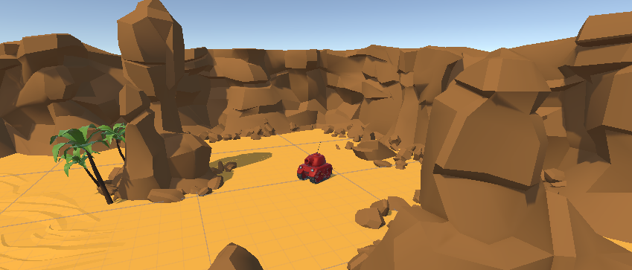
TankGame!

Slide 26
TankGame
Fix the navigation
Fix the turret rotation
Fix the turret shooting system
Destroy the target!
transform.TransformDirection(Vector3 direction)
Time.deltaTime
RG-UNITY/PHYSICS
https://docs.unity3d.com/ScriptReference/Physics.Raycast.html

Slide 27
Optimization
Object Pooling
Profiler
DOTS

Slide 28
Object Pooling
RG-UNITY/OPTIMIZATION

Slide 29
Profiler
RG-UNITY/OPTIMIZATION

Slide 30
DOTS
RG-UNITY/OPTIMIZATION

Slide 31
Communications (ROS2)
Workspace & Packages
Nodes
Publisher & Subscriber
Service & Client
ROS-TCP-Connector

Slide 32
Workspace & Packages
RG-UNITY/COMMUNICATIONS (ROS2)

Slide 33
Nodes
RG-UNITY/COMMUNICATIONS (ROS2)

Slide 34
Publisher & Subscriber
RG-UNITY/COMMUNICATIONS (ROS2)

Slide 35
Service & Client
RG-UNITY/COMMUNICATIONS (ROS2)

Slide 36
ROS-TCP-Connector
RG-UNITY/COMMUNICATIONS (ROS2)

