Slide 1


Services
Overview
Javier Cacheiro

Slide 2
1. Big Data & Storage

Slide 3
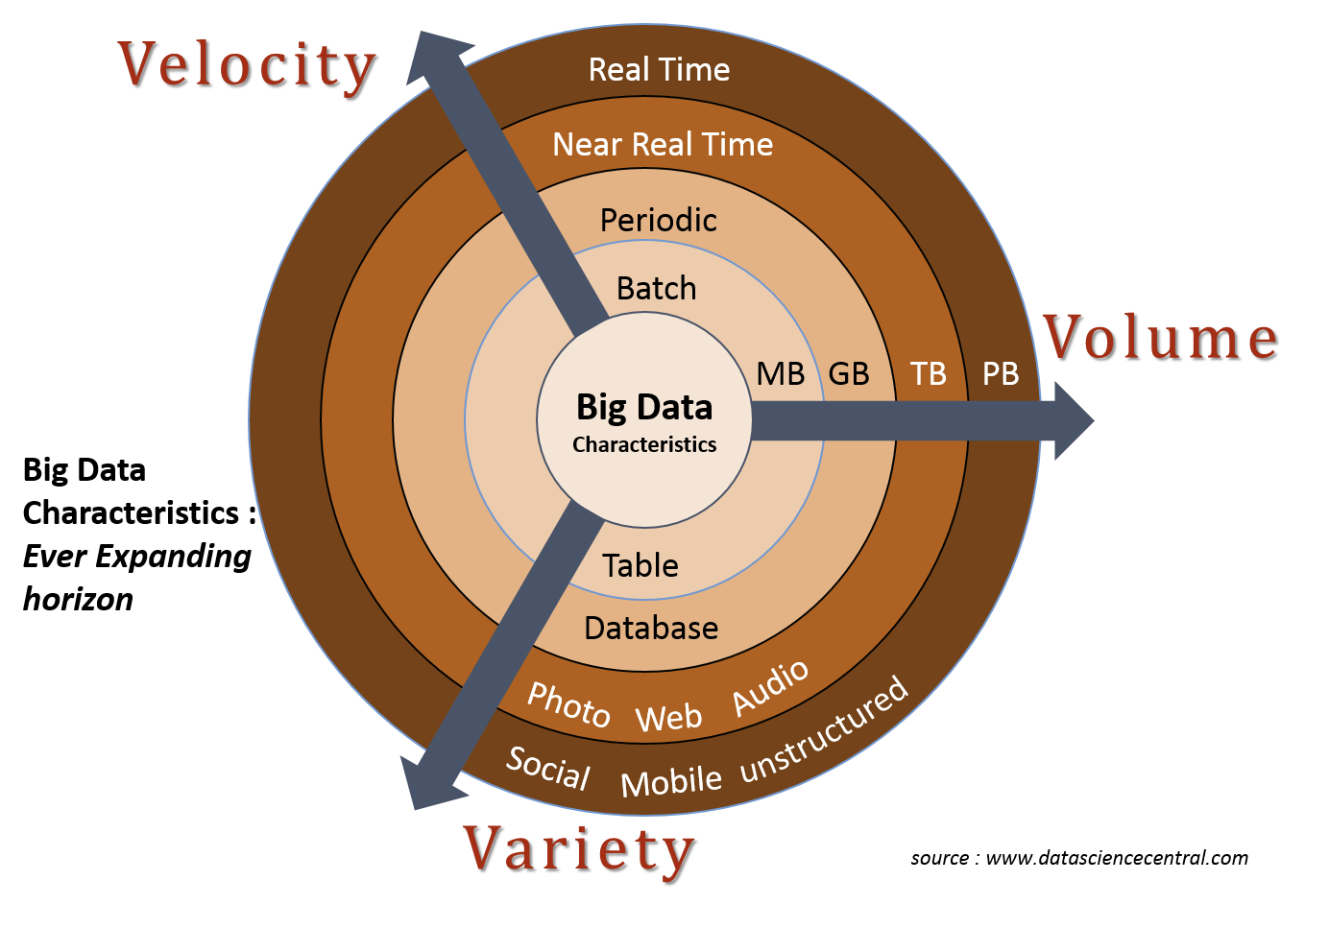
3Vs of Big Data

Slide 4
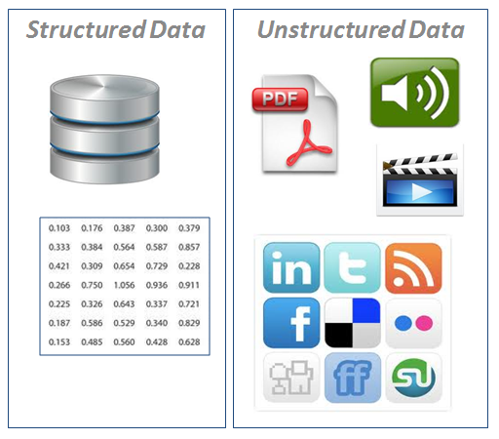
Variety

Slide 5

Scaling Options
Scale up
Scale out

Slide 6
DATA CENTRIC
Compute centric:
Bring the data to the computation
Data centric:
Bring the computation to the data

Slide 7
Hardware Infrastructure
38 nodes: 4 masters + 34 slaves
Storage capacity 816TB
Aggregated I/O throughput 30GB/s
64GB RAM per node
10GbE connectiviy between all nodes

Slide 8
Hardware Master Nodes
Model: Lenovo System x3550 M5
CPU: 2x Intel Xeon E5-2620 v3 @ 2.40GHz
Cores: 12 (2x6)
HyperThreading: On (24 threads)
Total memory: 64GB
Network: 1x10Gbps + 2x1Gbps
Disks: 8x480GB SSD SATA 2.5" MLC G3HS
Controller: M5210 1GB Cache FastPath

Slide 9
Hardware Slave Nodes
Modelo: Lenovo System x3650 M5
CPU: 2x Intel Xeon E5-2620 v3 @ 2.40GHz
Cores: 12 (2x6)
HyperThreading: On (24 threads)
Total memory: 64GB
Network: 1x10Gbps + 2x1Gbps
Disks: 12x 2TB NL SATA 6Gbps 3.5" G2HS
Controller: N2215 SAS/SATA HBA

Slide 10
BD|CESGA Software
Hadoop Platform
PaaS Platform

Slide 11
Hadoop Platform
HDFS
MapReduce
Hive
HBase
Kafka
Spark

Slide 12
PaaS Platform
MongoDB
Cassandra
PostgreSQL
MariaDB
etc

Slide 13
Parallel Storage
HDFS
Ceph
Lustre

Slide 14
Lustre FT2
4xOSS Servers
2xMDS Servers
8xNetApp E5600 (OSTs):
  480x2TB HDD SAS 7200 RPM
1xNetApp E2724 (MDS):
  24x1TB HDD SAS 10.500 RPM

Slide 15
Lustre FT2
Bandwidth: 24GB/s
Capacity: 695TB
Connectivity: Infiniband FDR 56Gbps

Slide 16
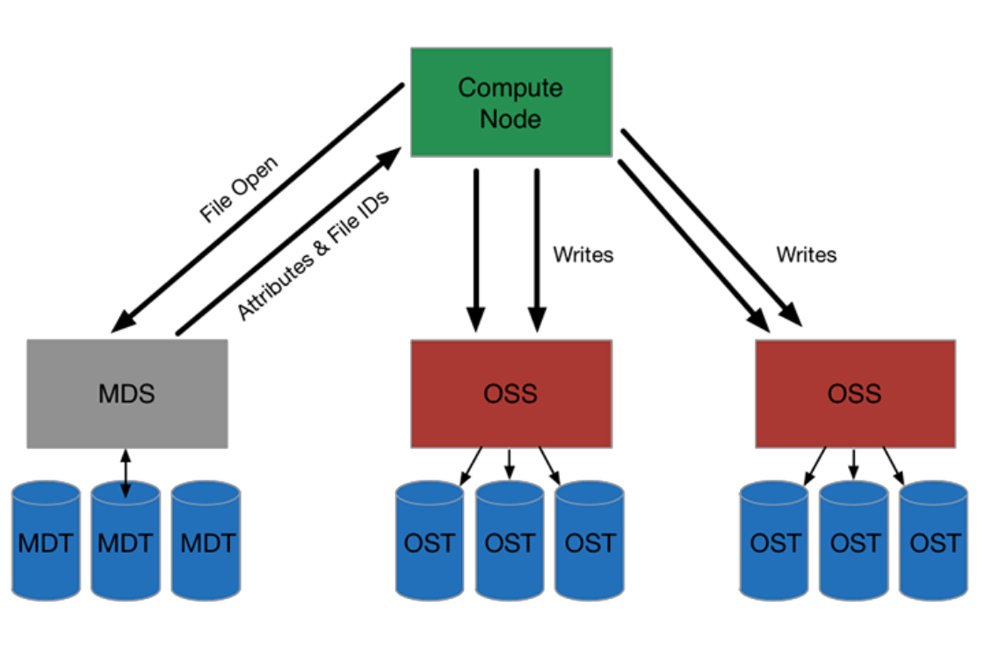
Lustre

Slide 17
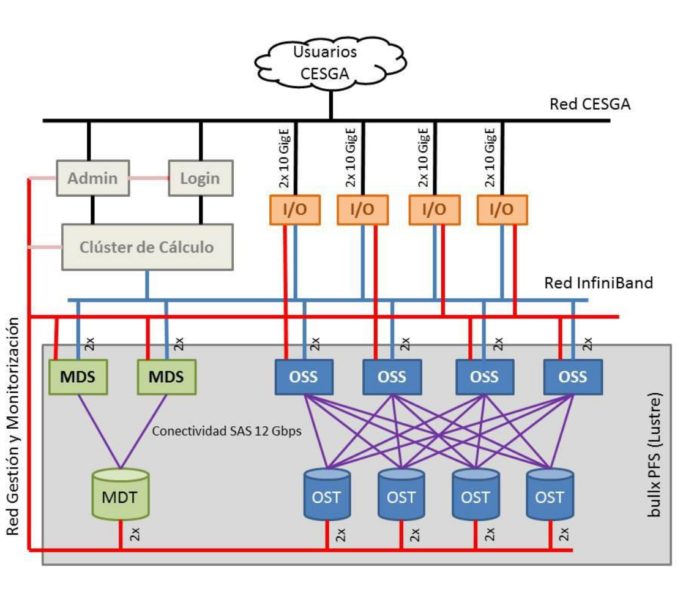

Slide 18
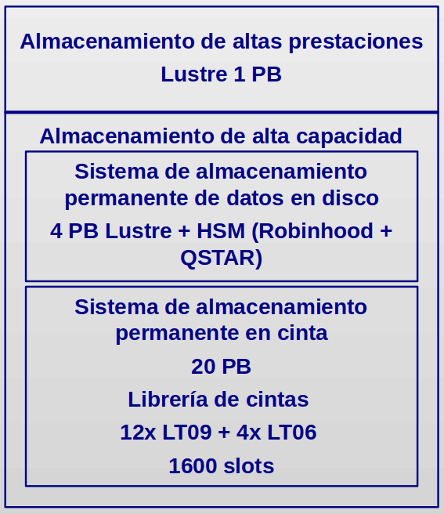
FT3 Storage

Slide 19
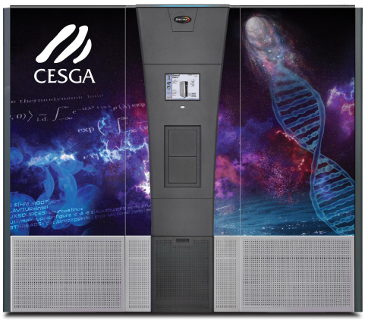
Backups: Tape Library

Slide 20
Netapp FAS9000HA
Big Data/FT2/FT3 HOME
  High availability
  High cost
  Lower parallel performance

Slide 21
Netapp
Bandwidth: 14GB/s
Capacity: > 1PB
Performance: 1.5M IOPS

Slide 22
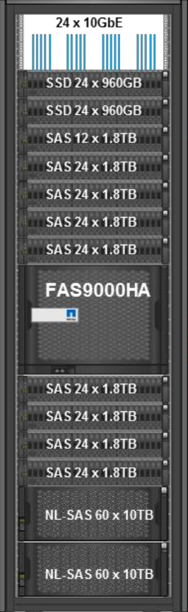

Slide 23
2. Computing

Slide 24
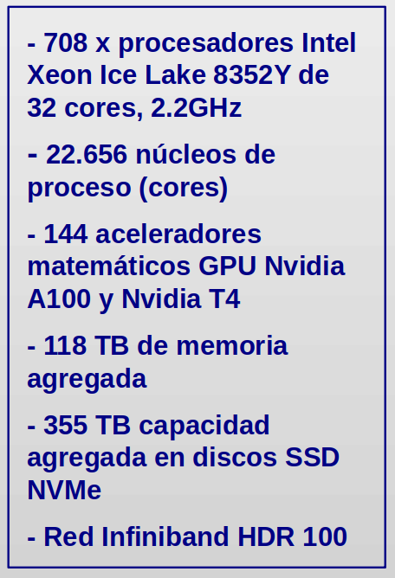
FinisTerrae III (FT3)

Slide 25
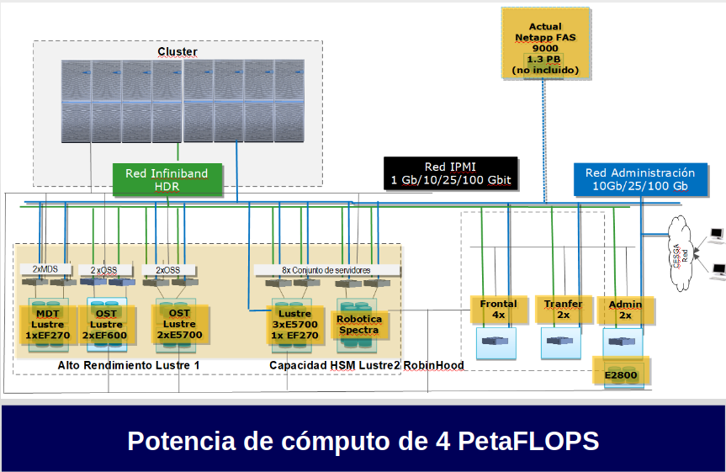

Slide 26
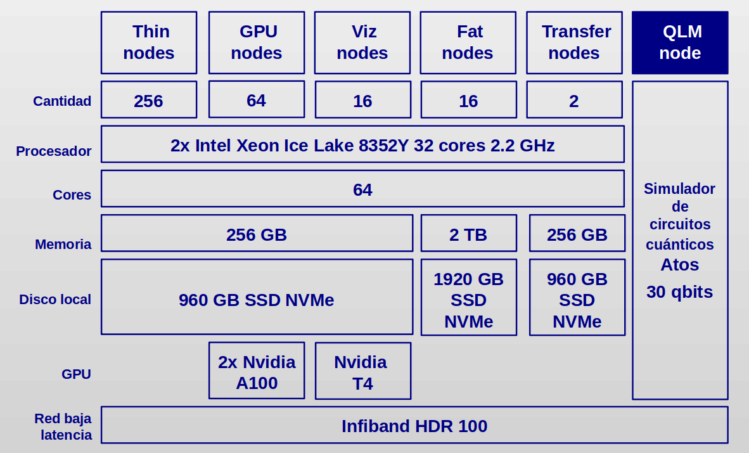

Slide 27
3. Cloud

Slide 28
