Slide 1
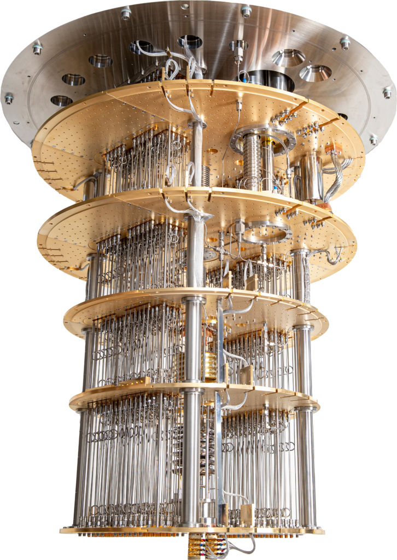

Introduction

Slide 2
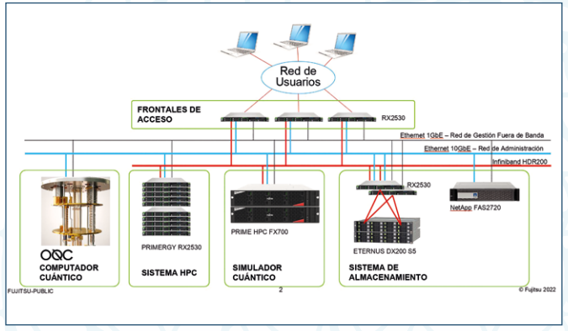
What is Qmio?
Computing infrastructure designed to research in Quantum Computing and Quantum inpired computing
It is composed of:
  Quantum Processing Unig (QPU)
  HPC System
  Quantum Computer Emulator
  Storage system
Access is granted through specific open calls

Slide 3
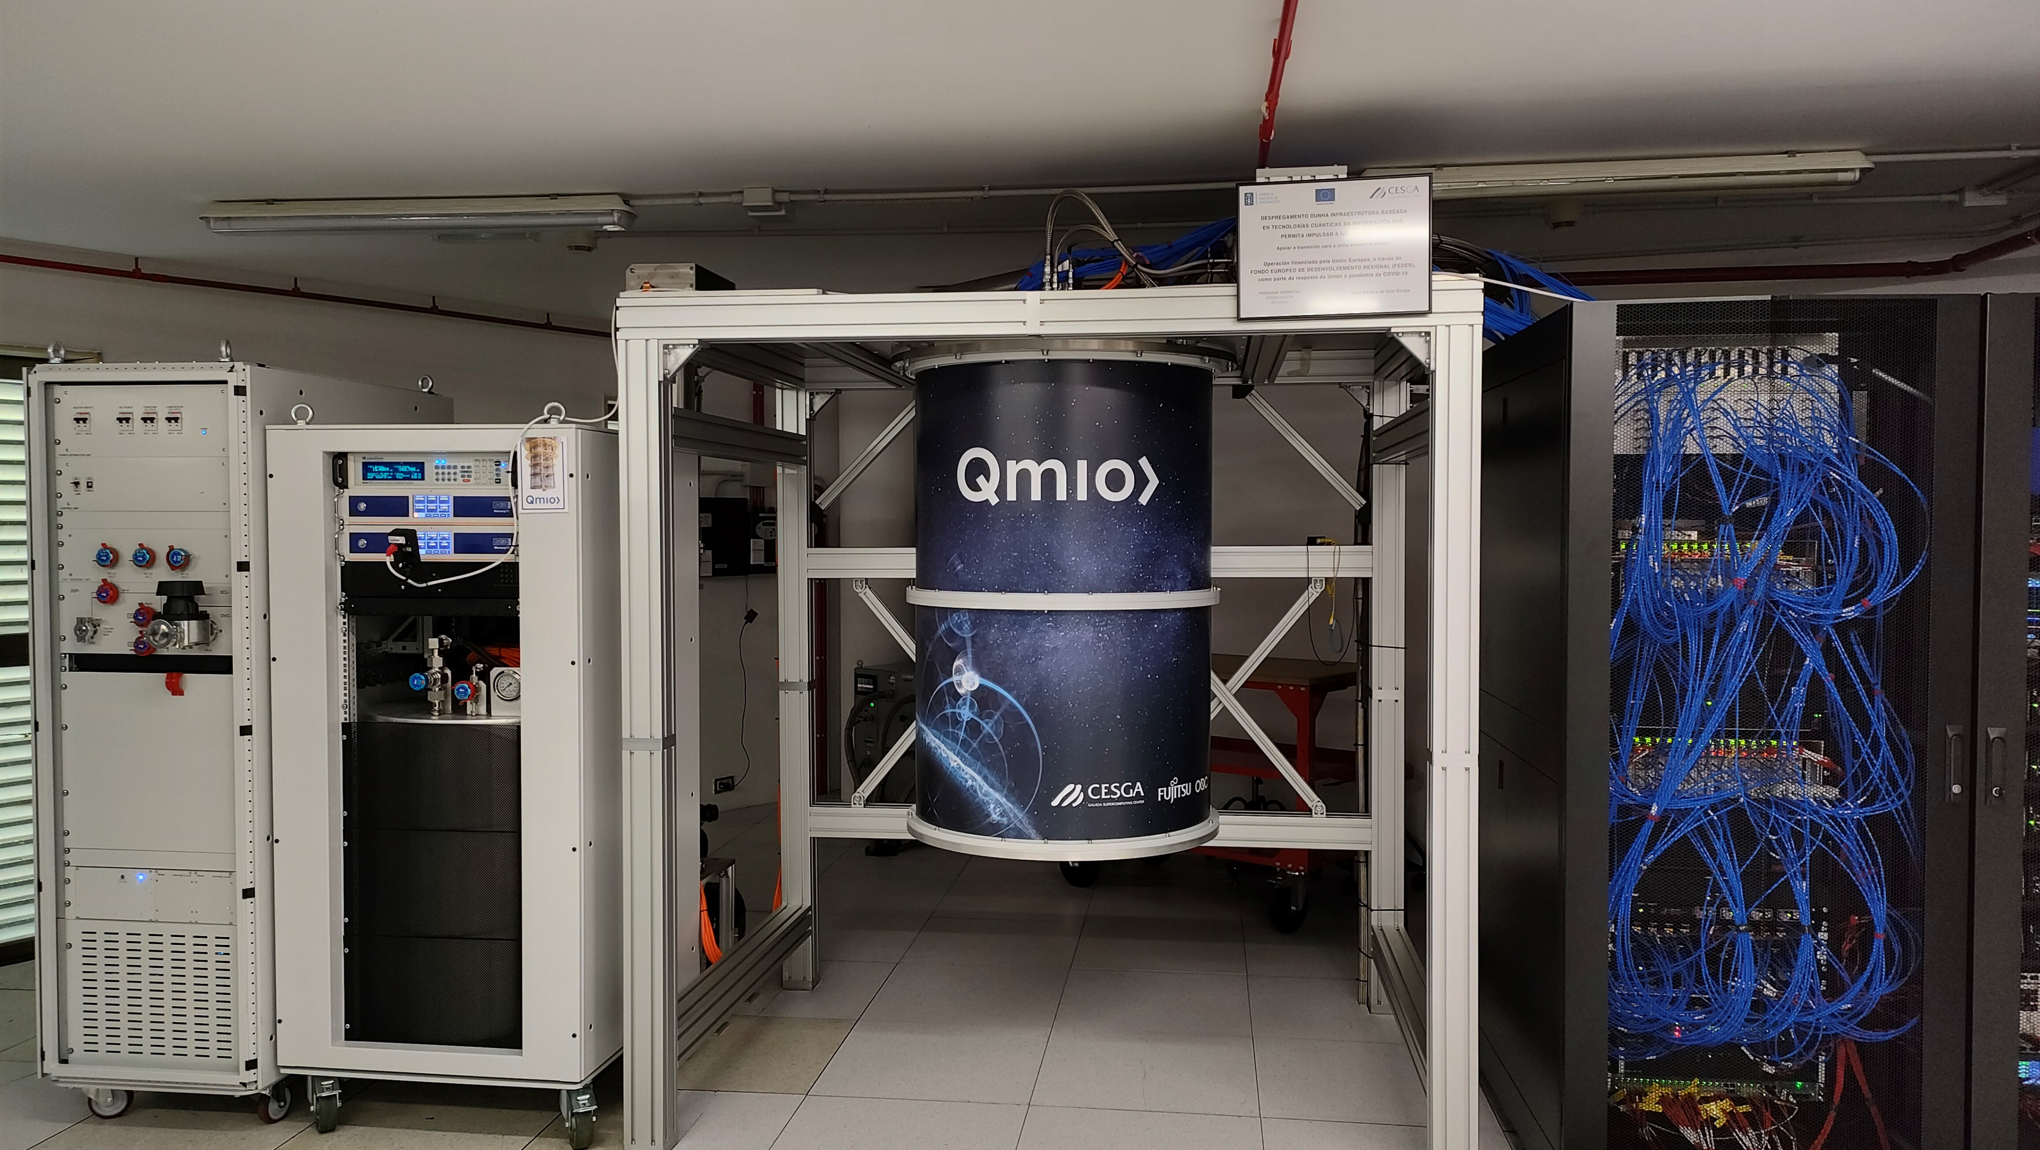
QPU Cooling
QPU Control
<40K
<4K
<1K
<100mK
<20mK
QPU

Slide 4
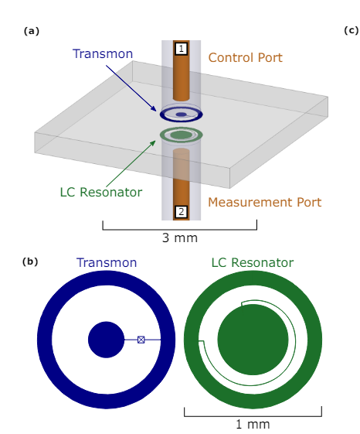
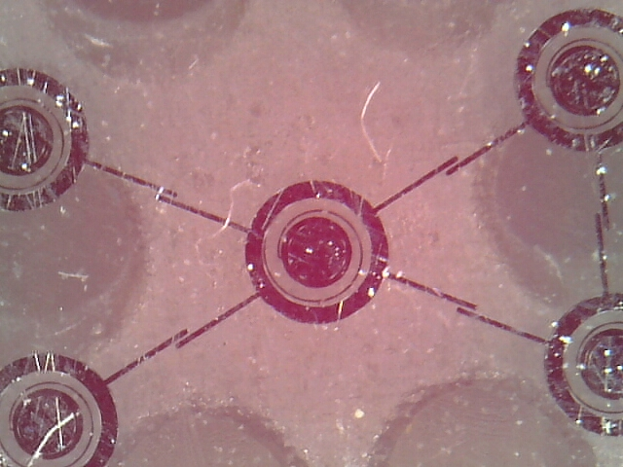
Qmio QPU Specs
Qubits: 32 (35)
Qubit technology: CoaxMon
Native Gates:
1Q: RZ (virtual), SX
2Q: ECR (actually RZX(pi/4))
ArXiv:1703.05828

Slide 5
Qmio QPU Software stack
pyTKET
Qiskit
Other
TKET Backend
QmioBackend
HPC Node
QMIO-RUN
ZMQ Client
ZMQ Server
Qasm/QIR Parser
QPU
Signals/Pulses

Slide 6

Qmio QPU Software stack- Lowest level
HPC Nodes
Login
Nodes
qpu partition
c7-23
SLURM
…
login01
login02
…
login03
…
ZMQ Client
ZMQ Server
…
c7-23
lx7
ilk partition
ilk_interactive partition
a64 partition

Slide 7
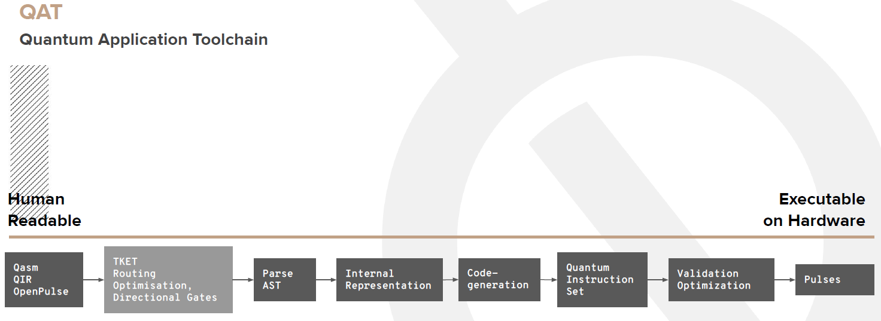

Qmio QPU – QPU Software stack
ZMQ Server
Qasm/QIR Parser
QPU
Signals/Pulses
QPU
Recommendation: transpile circuit before sending it to QPU
Source:

Slide 8
Qmio QPU – Software stack- Repetition_period
ZMQ Server
Repetition Period
QPU
Qasm/QIR Parser
Signals/Pulses
Execution time
How to use it:
service = QmioRuntimeService()
with service.backend(name="qpu") as backend:
results = backend.run(input, shots, repetition_period, res_format)
It is useful because there is no active initialization (not yet): good value ~5xT1

Slide 9
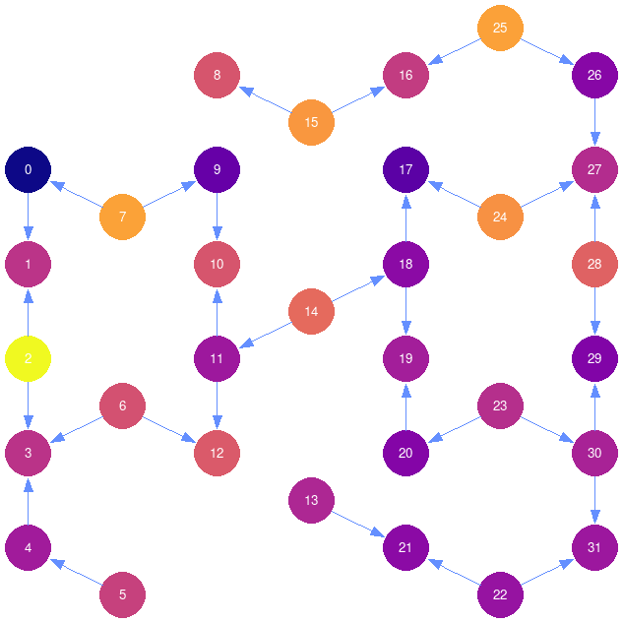
Qmio QPU Topology

