Slide 1
Title
Javier Flores · n-Op
Notes:
• I'm a CS undergrad, and I work on crystals.
• Half of this is complexity theory and compilers. The claim is that the data structure and the physical law are the same object.

Slide 2
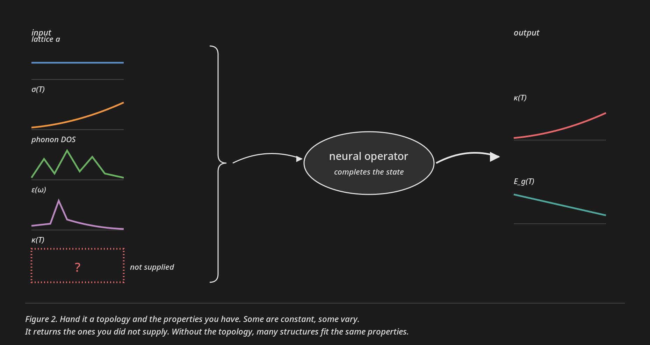
What this operator does
Notes:
• The operator does channel completion. You hand it a topology plus whatever properties you know, and it returns the ones you didn't.
• Some channels are constants, some are curves. All of them are functions.
• The topology has to be there, or the problem is one-to-many. What I'm after is predicting crystal structures.

Slide 3
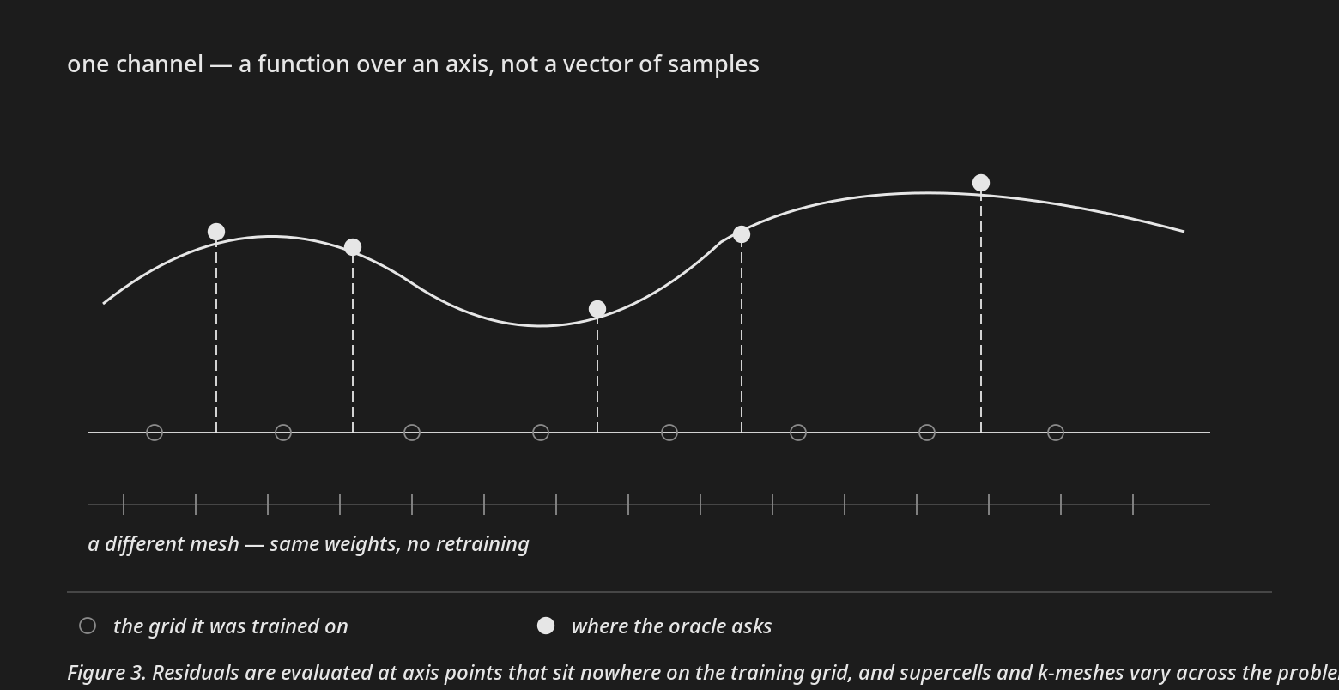
Why an operator
Notes:
• A few things here push toward an operator rather than a fixed-size network.
• The channels are functions — the density matrix over two points in space, the field over space and time. A wide output layer has to pick a grid and commit to it, and the meshes change per material.
• The oracle also evaluates residuals at arbitrary points on an axis, nowhere near the training grid, and the model has to answer there.
• And the physics is nonlocal, so a kernel that sees the whole cell in one layer beats a local stencil.

Slide 4
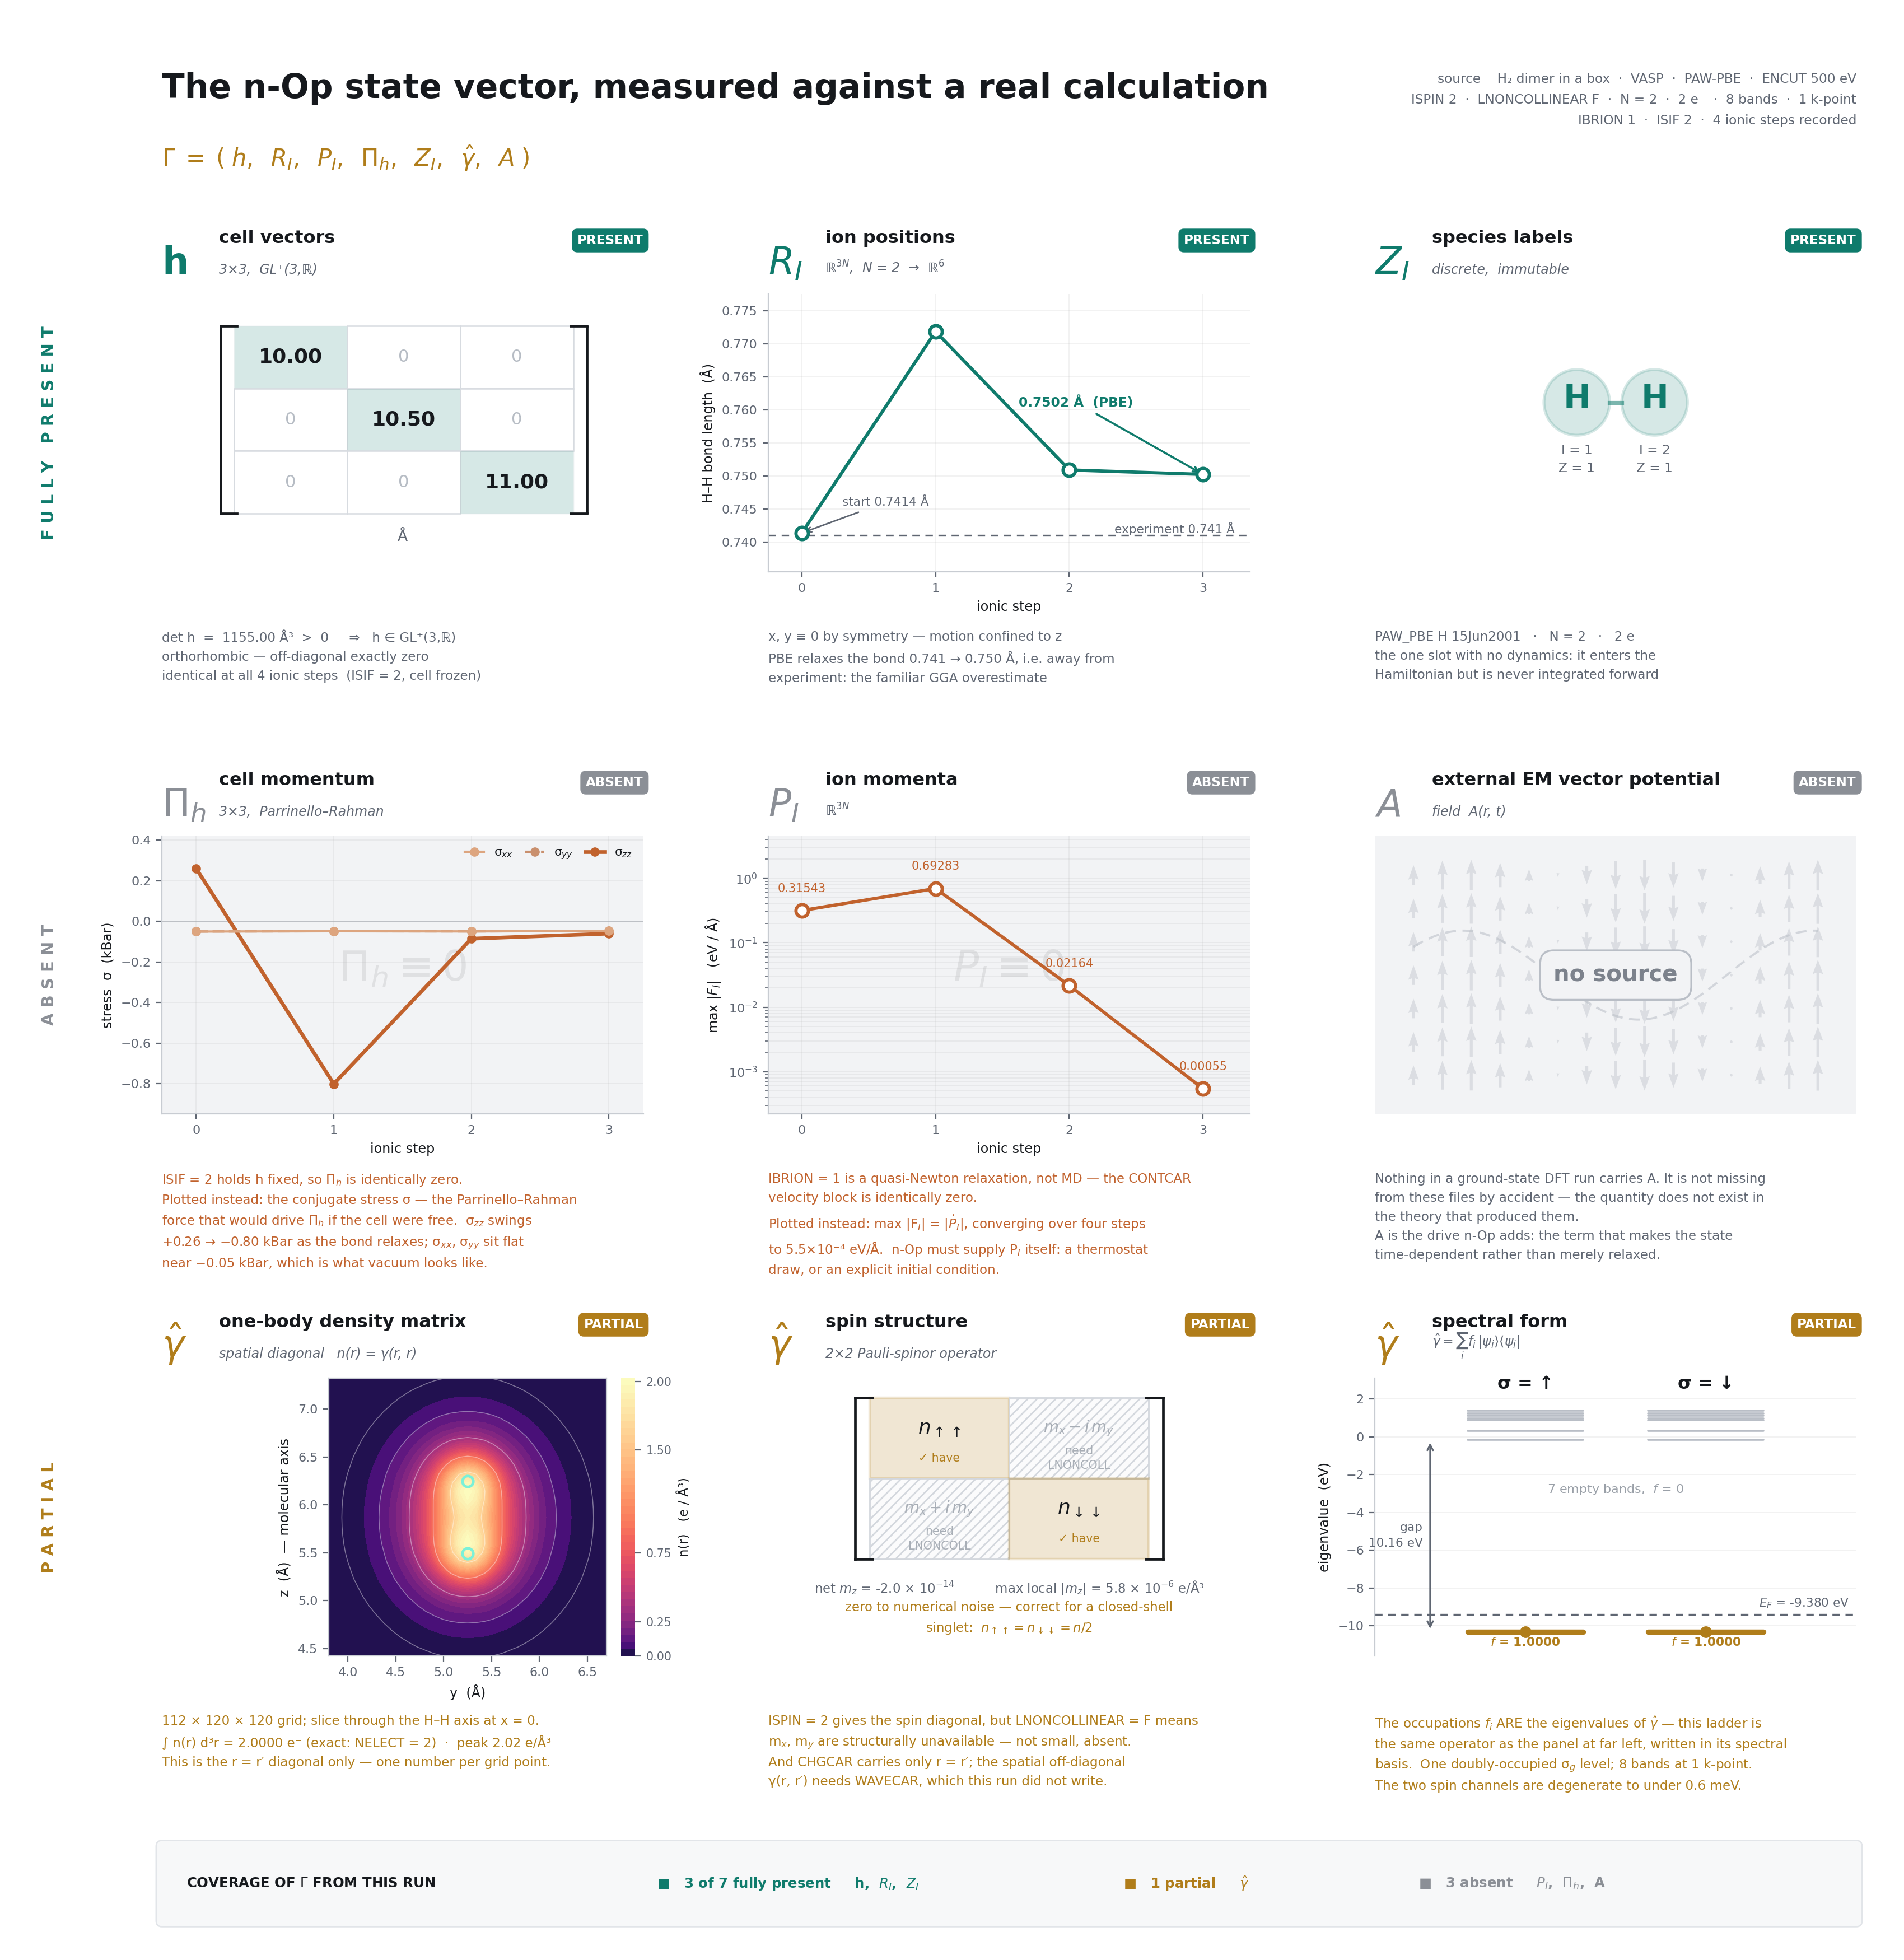
The state, against a real run
Notes:
• The record is seven slots, and this is it measured against a real calculation. Hydrogen in a box, four ionic steps.
• h is the cell. R and P are the ion positions and momenta, and Pi-h is the cell's own momentum.
• Z is species — the only discrete slot, and it never changes. No gradient runs through an integer, so you can't search over composition by descent.
• Gamma-hat is the one-body density matrix, a function of two points in space. A is the external field.
• Three slots come straight out of the run. Gamma-hat is partial — the charge density file gives me the diagonal, and the off-diagonal needs a wavefunction file this run didn't write.
• Three are missing, for three different reasons. Two are settings: I froze the cell, and this was a relaxation and not dynamics, so I've plotted the conjugate quantities instead.
• The vector potential is different. It doesn't exist in the theory that produced these files. That's the term n-Op adds.

Slide 5
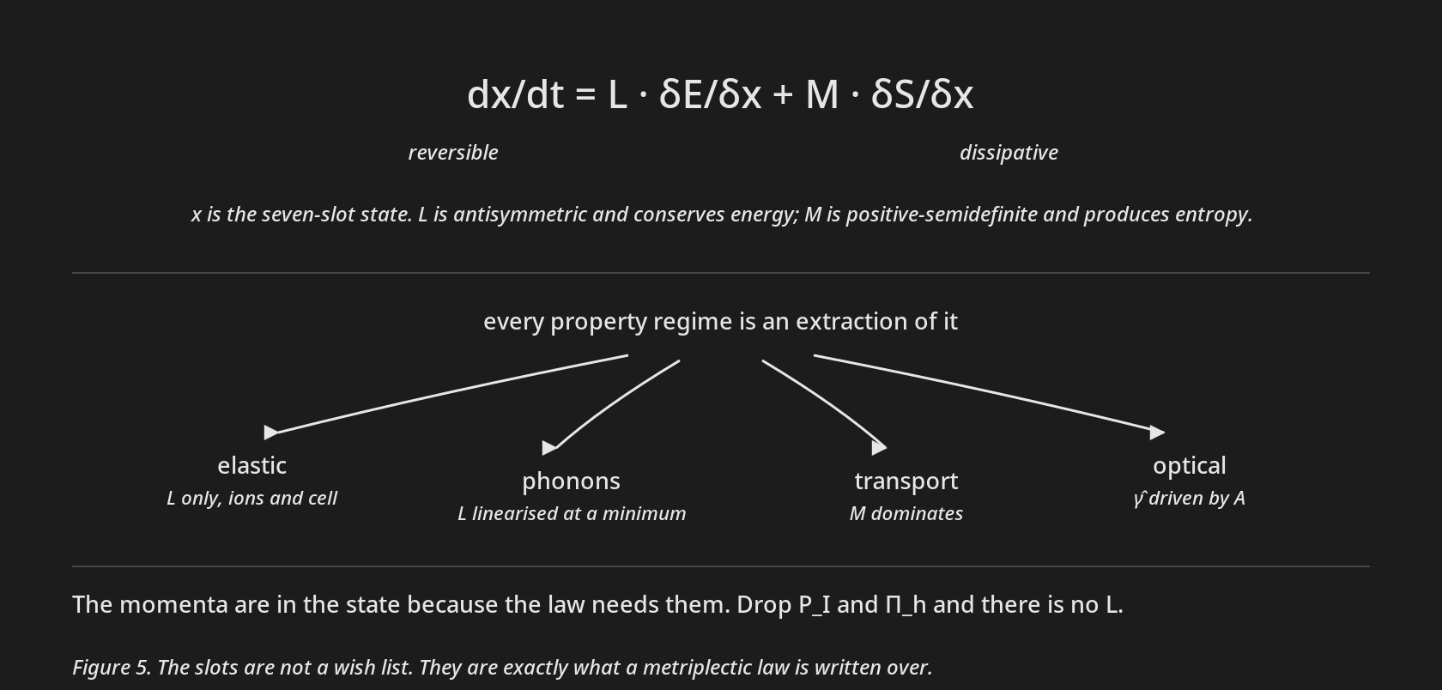
Why those seven
Notes:
• This is the law I care about. L is the reversible part, antisymmetric and energy-conserving; M is dissipative and makes entropy.
• Elastic response, phonons, transport and optics are all restrictions of that one law.
• L acts on conjugate pairs, so the momenta have to be in the state. The record is the domain of the law, not a schema I picked. Leave a slot out and you've deleted the physics that needed it.

Slide 6
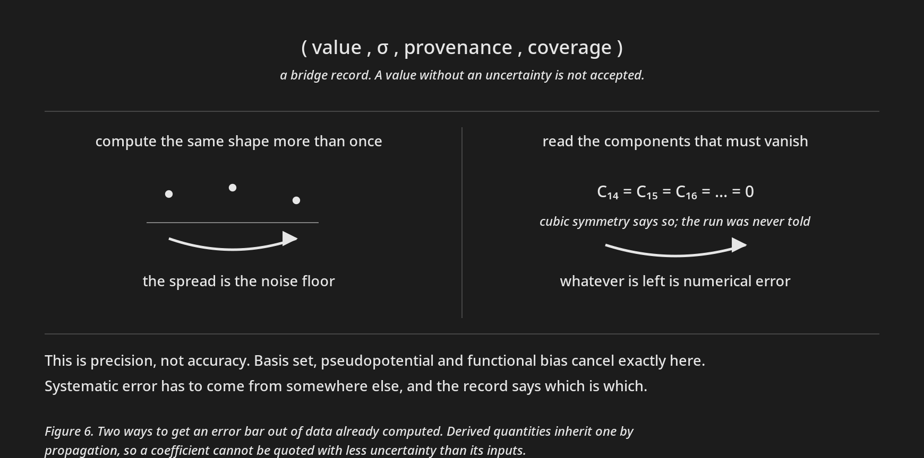
Getting data in
Notes:
• Before I read a run I hash its settings — functional, cutoff, pseudopotentials, k-mesh, smearing, symmetry. Energies only compare within one hash.
• Then it has to pass arithmetic it already claims. Forces sum to zero, stress is symmetric, occupations count the electrons, the determinant matches the volume. One frame, closed form, free.
• Past that gate every value carries an uncertainty or it doesn't go in. Either I compute the same shape twice and look at the spread, or I read the components symmetry says must vanish. Either way that's precision, not accuracy.

Slide 7
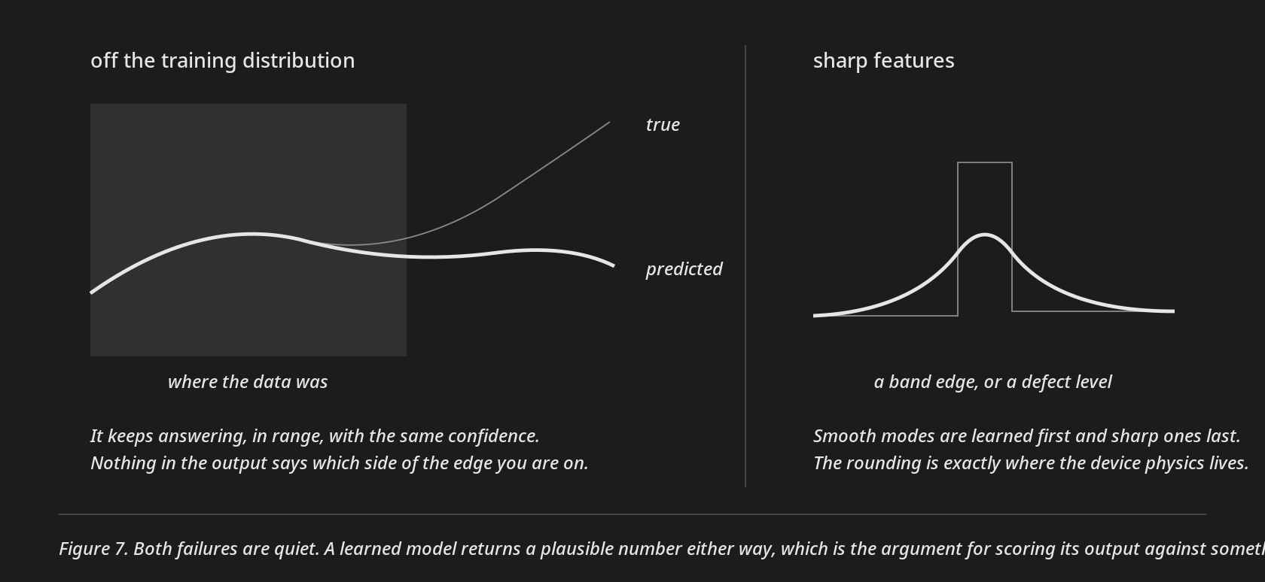
Where it falls short
Notes:
• The honest other half. Two failure modes, and both are quiet.
• Off the training distribution it keeps answering, in range, with the same confidence. And spectral bias means smooth modes get learned first and sharp ones last, so band edges and defect levels come out rounded.
• Neither announces itself, which is the argument for scoring the output against something that isn't learned.

Slide 8
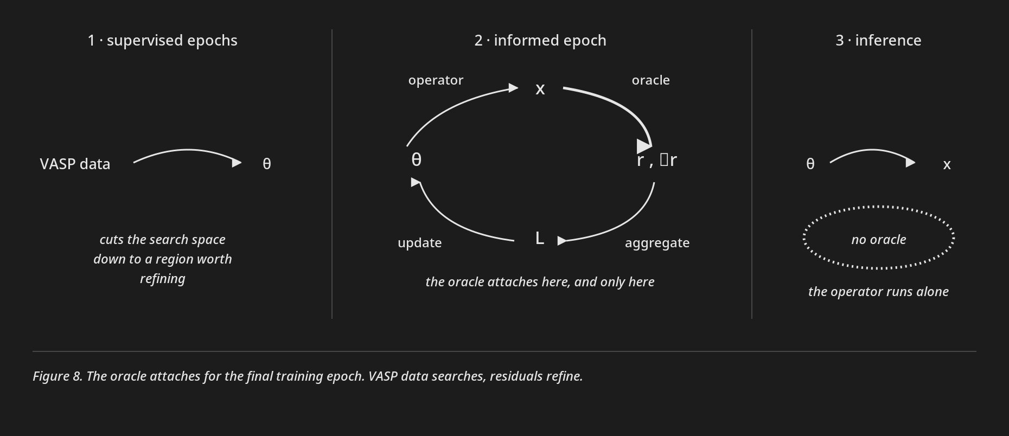
The checker, and where it goes
Notes:
• Running DFT directly at device conditions is trustworthy and unaffordable. Finding a ground state is NP-hard — Barahona, 1982 — and the quantum version is QMA-complete, which is Kitaev. But checking a candidate you already have is one pass.
• So I build the checker. A textbook oracle hands back one bit; mine hands back one residual per law, with gradients, because a bit gives a learner no direction to move in.
• It attaches here. Supervised epochs on VASP data first, which is what narrows the search space, then the informed epoch, where the oracle scores the operator's output into the loss.
• The data does the searching and the oracle only refines. At inference the operator runs alone.
• Residuals stay keyed and never summed, so I can weight them and see which law fired. And none of this is implemented yet — every number is a design target.

Slide 9
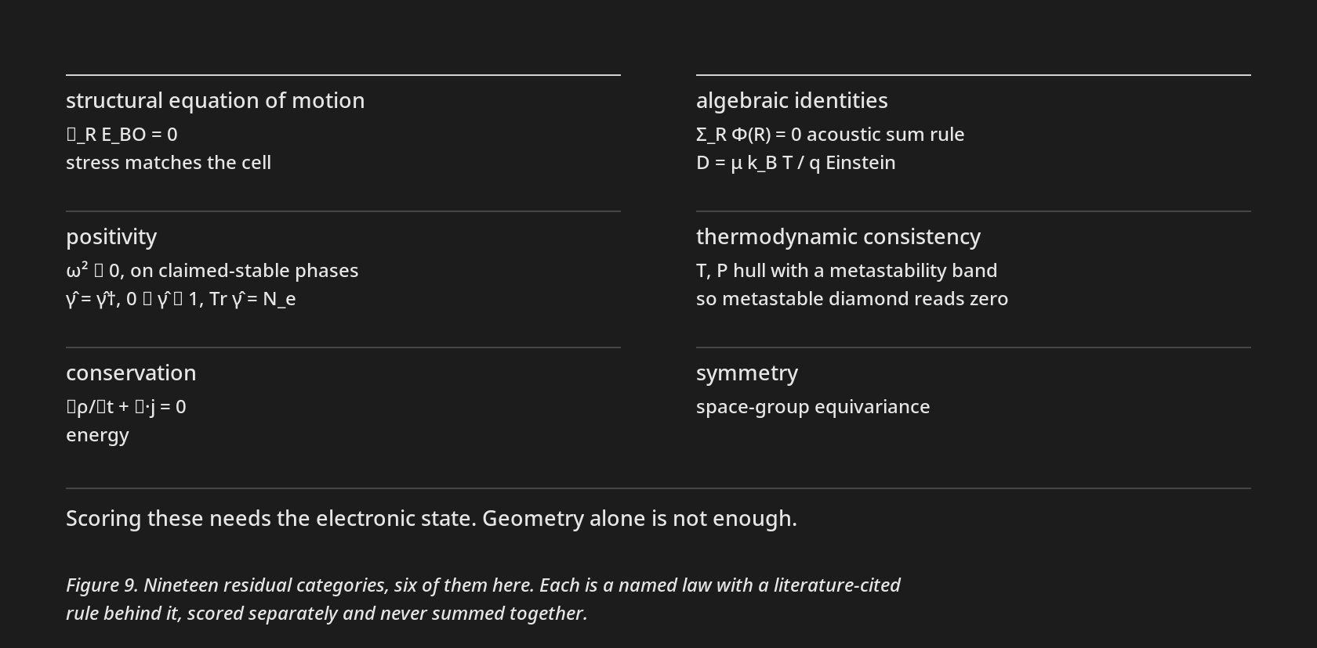
What gets checked
Notes:
• These are named laws, not one penalty term.
• Forces vanish at a relaxed structure. Phonon frequencies squared stay non-negative on anything claimed stable. The density matrix is Hermitian, eigenvalues between zero and one, trace is the electron count. Then conservation, algebraic identities, thermodynamics and symmetry — nineteen categories.
• The last few need gamma-hat, so you can't get them out of geometry. That's why the operator hands over the whole record.

Slide 10
Close
Verifying is cheaper than solving.
Notes:
• The general problem stays hard and checking stays cheap, so put the checker inside the loss.
• Pick the state so the law fits it, and make the data pass a gate before it gets in.
• Thanks — happy to take questions.

