Slide 1
IBM Unsupervised Machine Learning Course Final Project: Major Projects Clusters by Region
By Javier A. Jaime-Serrano
June 15, 2021

Slide 2
Abstract
For this Project we used the Major Project dataset from the province of Alberta in Canada [1], it contains more than 700 currently active projects on the province, this Data set if filtered for Projects valued at $5 million or greater.
This Dataset contain a lot of valuable information on the Major Projects. The Estimated Cost, Sector & Type and the Location data will be used.
We will like to find the features that can predict the cost of the project for a given project type in an industry sector and a geographical region.
We will be using to unsupervised machine learning algorithms to cluster the location data into regions that will be used to estimate cost of the projects.

Slide 3
Data Cleaning
In order to prepare and clean the dataset:
We drop the projects where there is no estimated cost.
Made some assumptions about schedule completion and status.
Drop not required columns and renamed the remaining columns.
Made corrections on project types and sectors.
A problem encountered was how to extract the location coordinates (Longitude & Latitude) from a GeoJASON column. The problem was solved with Python code that loop over all rows and extract the start (first) locations by a type condition.

Slide 4
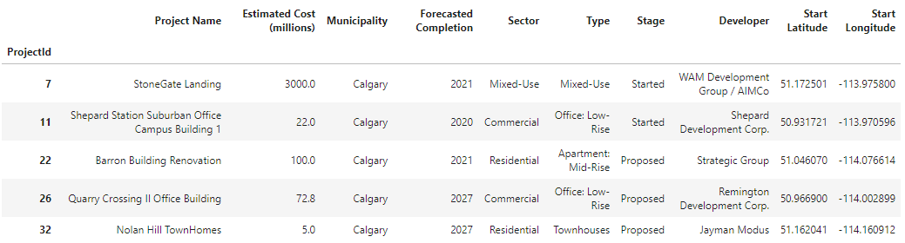
Data Cleaning
Figure 1. Cleaned Dataset

Slide 5
Data Exploration
We explored the data, first with descriptive statistics and bar charts (see Figure 2).
Second, we used box plots for the cost estimate ranges by type (see Figure 3).
Third, we used folium library to create a map using latitude and longitude values (See Figure 4).

Slide 6
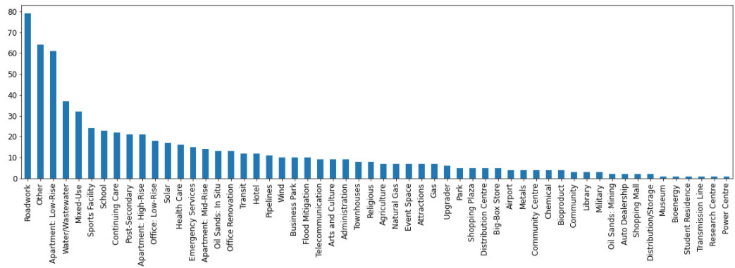
Data Exploration
Figure 2. Project types bar chart

Slide 7
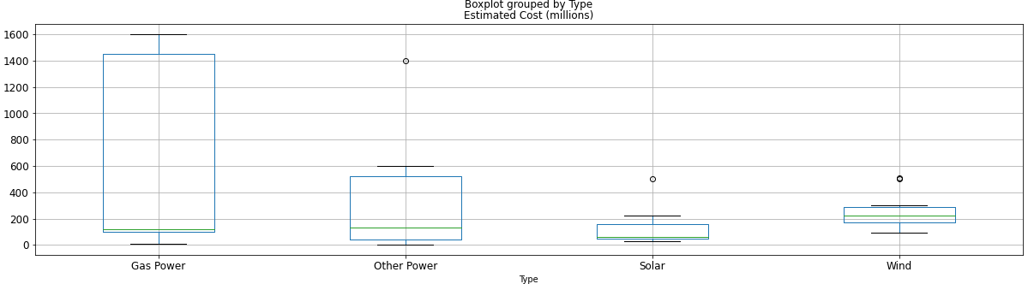
Data Exploration
Figure 3. Box Plot Estimated Cost for Power Sector

Slide 8
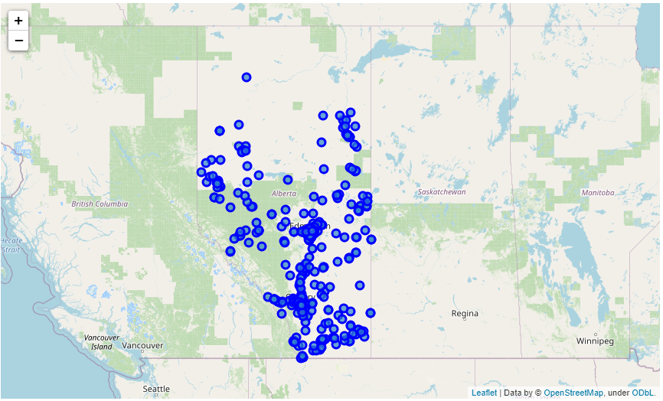
Data Exploration
Figure 4.
Projects Map

Slide 9
Key Findings and Insights
After corrections, we ended with 58 unique types in 9 sectors (see figure 5).
We used KMeans [2] to Cluster the projects by geographical region and type using the location values and one hot encoding of project types (See Figure 6).
We choose to minimize the inertia without splitting the major cities of the province, after a few runs we found that a k = 10 clusters have a minimum inertia of 866.
We also used DBSCAN to Cluster the project by region using the location coordinates only, but we were not able to separate the major cities (See Figure 7).

Slide 10
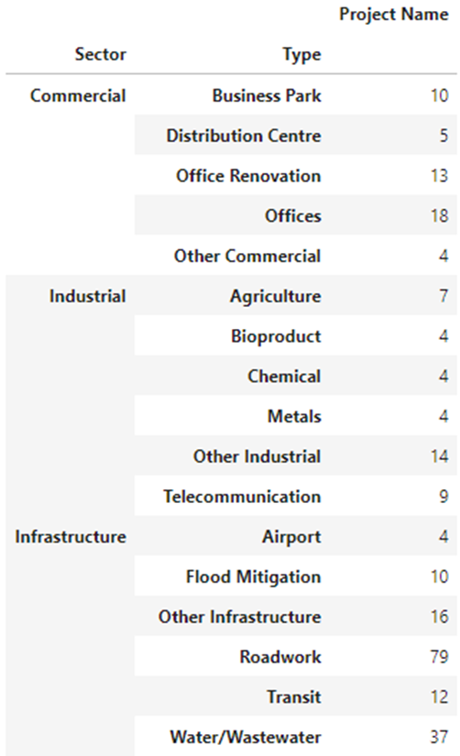
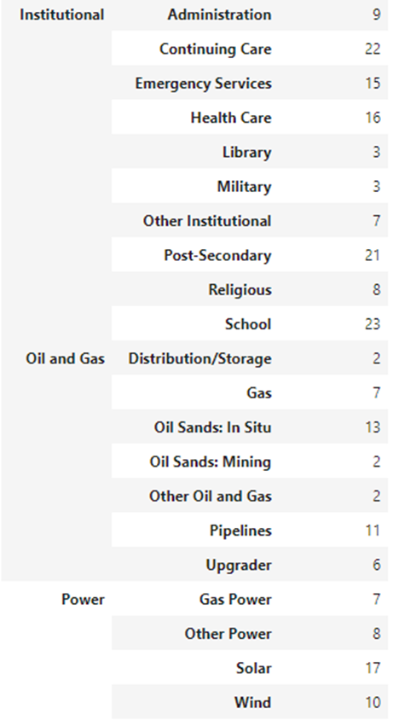
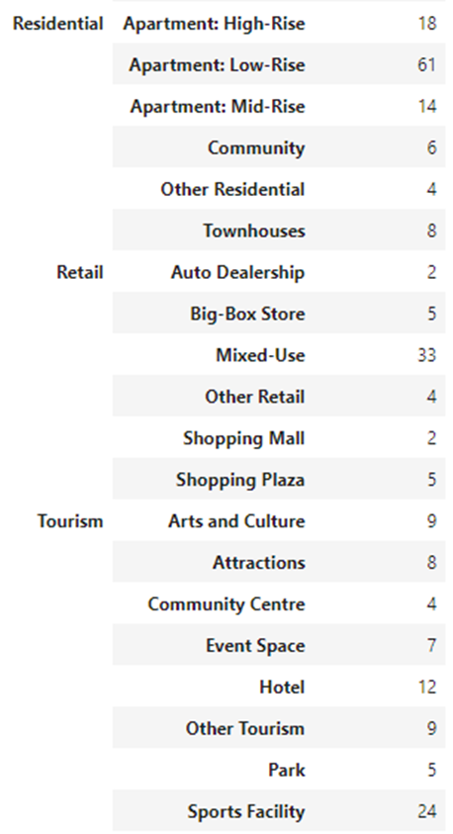
Findings
Figure 5.
Unique Sectors
and Types

Slide 11
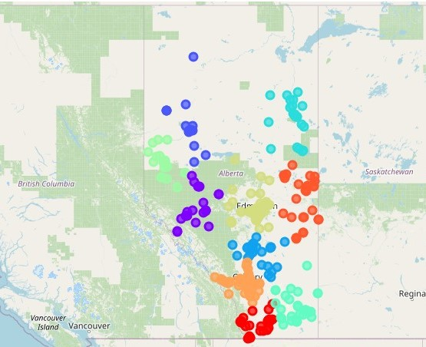
Findings
Figure 6. Projects Map
KMeans Clusters by
Region with Project type

Slide 12
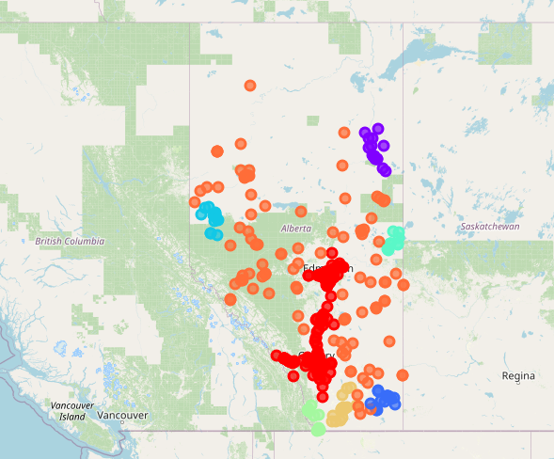
Findings
Figure 7. Projects Map
DBSCAN Clusters by
Region

Slide 13
Results
We used KMeans with only the location coordinates and loop through the number of cluster and found the minimum inertia of 211 with k = 10 clusters, also keeping all the major cities in one cluster each (See Figure 7).
The resulting clusters are identical at the ones found using the one hot encoding of the project type (See Figure 6), so there was no need to use the project type.

Slide 14
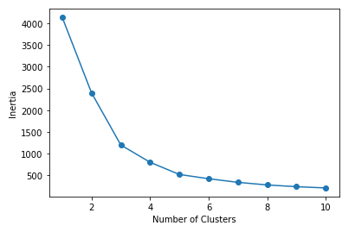
Results
Figure 8. Inertia Vs.
Number of Clusters

Slide 15
Conclusions
Using the Major Project dataset from the province of Alberta, after preparation and cleaning, we were able to extract valuable but limited information.
We found that KMeans was better able to split the Projects location coordinates in regions keeping the major cities in separate clusters, with the minimum inertia.
The use of DBSCAN created only one cluster for the main industrial corridor, and did not comply with the requirement of separating major cities.
This project was done with only one Province dataset, and other Canadian Provinces has datasets available for Future work in similar formats.

Slide 16
References
[1] Alberta Major Projects: https://majorprojects.alberta.ca/
[2] Scikit-learn library: https://scikit-learn.org/stable/
[3] Jupiter Notebook: https://github.com/javier-jaime/IBM-Machine-Learning-Capstone/

