Slide 1
IBM Supervised Machine Learning Regression Course Final Project: Major Projects Cost Estimating with Regression
By Javier A. Jaime-Serrano
June 17, 2021

Slide 2
Abstract
For this Project we used the Major Project dataset from the province of Alberta in Canada [1], it contains more than 700 currently active projects on the province, this Data set if filtered for Projects valued at $5 million or greater.
This Dataset contain a lot of valuable information on the Major Projects. The Estimated Cost, Sector & Type and the Location data will be used.
From this dataset, we will like to find the features that can predict the cost of the project for a given project type in a sector and in a region.

Slide 3
Objectives
From the Major Projects in the dataset, we want to be able to estimate the cost of similar projects, with a rough order of magnitude (ROOM).
We will choose the type of projects were we have enough data within a valid range, so we can estimate the cost of similar projects, with a rough order of magnitude (ROOM) in a matter of seconds, instead of using current techniques.
This quick ROOM Cost Estimate can be used as benchmark in multiple industries.

Slide 4
Data Cleaning
In order to prepare and clean the dataset:
We drop the projects where there is no estimated cost.
Made some assumptions about schedule completion and status.
Drop not required columns and renamed the remaining columns.
Made corrections on project types and sectors.
A problem encountered was how to extract the location coordinates (Longitude & Latitude) from a GeoJASON column. The problem was solved with Python code that loop over all rows and extract the start (first) locations by a type condition.

Slide 5
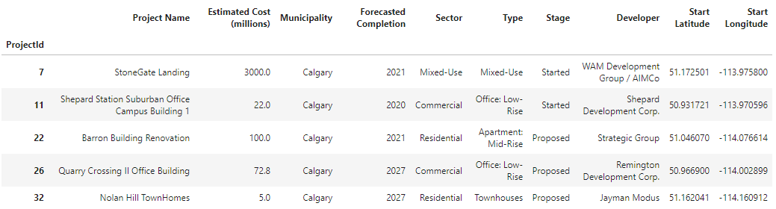
Data Cleaning
Figure 1. Cleaned Dataset

Slide 6
Data Exploration
We explored the data, first with descriptive statistics and bar charts (see Figure 2).
Second, we used box plots for the cost estimate ranges by type (see Figure 3).
Third, we used folium library to create a map using latitude and longitude values (See Figure 4).
We also used KMeans [2] to Cluster the projects by geographical region using the location coordinates (See Figure 5).
And then we will be able to try the different Regressors from Scikit-learn [2] to estimate the (ROOM) Cost and evaluate the Results.

Slide 7
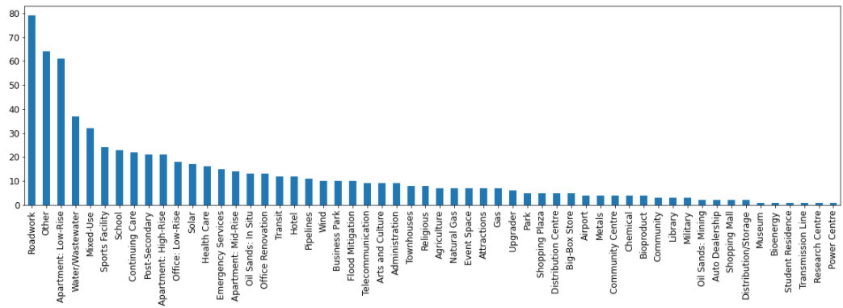
Data Exploration
Figure 2. Project types bar chart

Slide 8
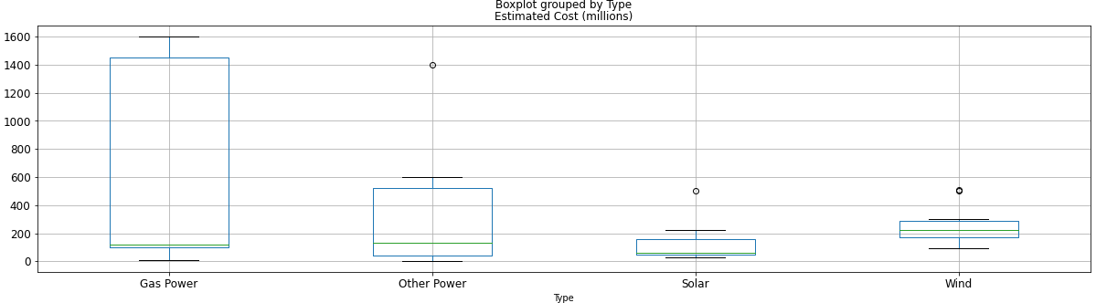
Data Exploration
Figure 3. Box Plot Estimated Cost for Power Sector

Slide 9
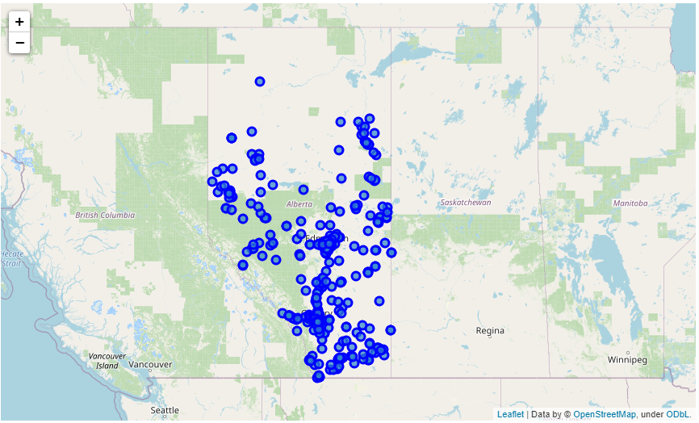
Data Exploration
Figure 4.
Projects Map

Slide 10
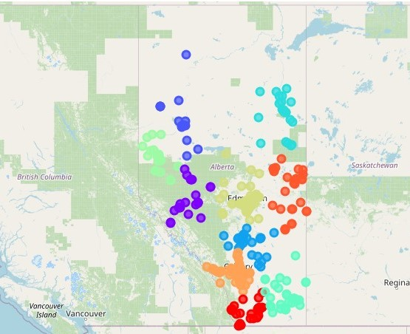
Data Exploration
Figure 5. Projects Map
KMeans Clusters by
Region with Project type

Slide 11
Key Findings and Insights
After corrections, we ended with 58 unique types in 9 sectors (see figure 6).
For the feature engineering, we extracted size and capacity data by type from the dropped project details column, adding units and cleaning it manually in excel.
The Estimated Cost was set as the Target variable in millions (removing 3 zeros).
The datasets were merged back, and one hot encoding was used again to transform the categorical features into numerical dummy features, resulting in 72 Columns.

Slide 12
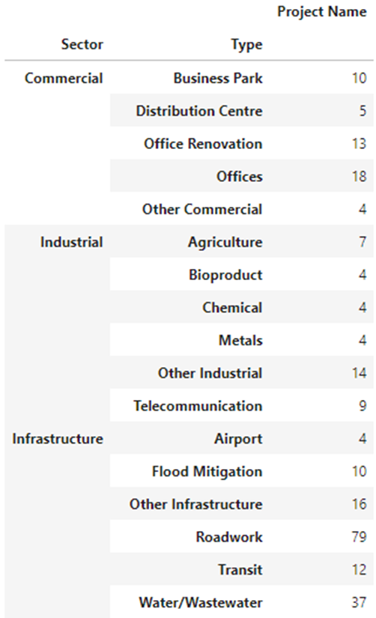
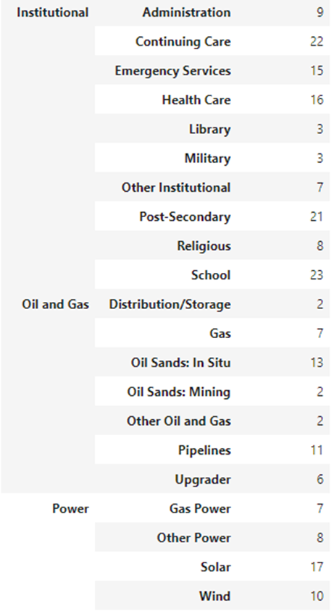
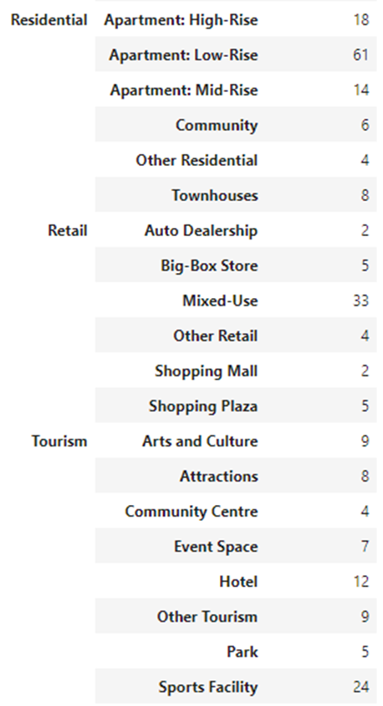
Findings
Figure 6.
Unique Sectors
and Types

Slide 13
Hypothesis Testing
We want to be able to estimate the cost of similar projects, with a rough order of magnitude (ROOM). In order to test the predictive features with correlation, we need first to pick a sector, for this case we choose the power sector (see figure 7).
Is Size/Capacity in Megawatts is correlated with the Estimated Cost?
- Null Hypotesis (H0): Size/Capacity is not correlated with Estimated Cost
- Alternative Hypotesis (H1): Size/Capacity is correlated with Estimated Cost
From SciPy, Pearson Correlation Coeficient: 0.9676147594295178 Two-tailed p-value: 6.958427885850458e-19
Conclusion: There is a relationship between Capacity and Cost (see figure 8).

Slide 14
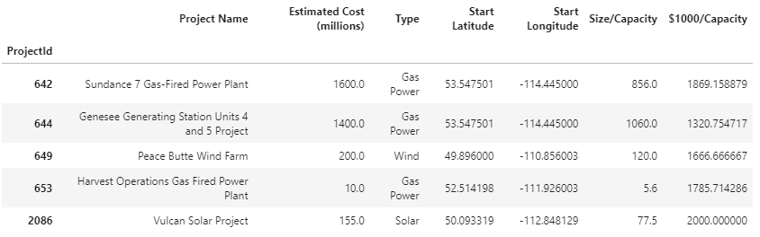
Hypothesis Testing
Figure 7. Power Sector Data

Slide 15
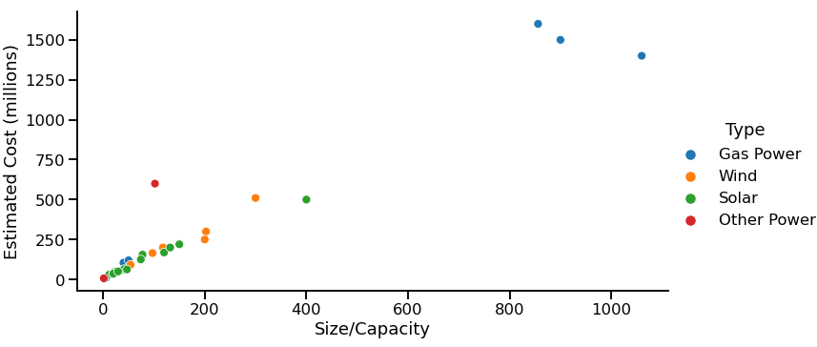
Hypothesis Testing
Figure 8. Estimated Cost Vs. Size/Capacity by Project Type

Slide 16
Results
We did the split of one hot encoded data, with 70% for training and the remaining 30% for Testing. And we run a simple linear regression with poor results.
We transformed the data with the Standar Scaler and fit the linear regression model again, with a considerable improvement on the predictions.
We added Polynomial Features to the one hot encoded data, fit the linear regression model again and obtained even worse results.
We tried a simpler model with the Capacity and Location Coordinates from the Power sector data only, from the Hypothesis Testing (See Figure 7), and after training the model with the spilt data, we obtained considerable better Results.
We applied the Standard Scaler and added Polynomial Features (See Table 1).

Slide 17
Results
Table 1. r2 Score
r2 Score | One Hot Encoded | Not Encoded
LR Simple | 0.3562 | 0.6745
LR with StandardScaler | 0.6477 | 0.7983
LR with Poly Features | 0.3473 | 0.8769

Slide 18
Conclusions
Using the Major Project dataset from the province of Alberta, after preparation and cleaning, we were able to extract valuable but limited information.
After exploring the dataset, we were able to do some feature engineering and filter the data set to extract valid information. We also performed significance testing to prove the correlation between the Capacity in the Power Sector and the Cost.
We tried two different approaches to linear regression: the one hot encoding of all the features and a simpler model with the selected features from the hypotesis testing with added Polynomial Features.
The Linear Regression Model with 2nd Degree Polynomal Features (without one hot encoding) obtained the best results using the r2 Score (See Table 1).

Slide 19
Future Work
Most of the projects have not enough data for the engineered features of size and/or capacity, so we only were able to predict the cost in one sector.
The polynomial features added complexity to the model, but without enough data in one sector, we couldn't obtain better results with higher degrees.
Further work is required to search for capacity data from other sources (company websites, industry associations, etc.).
With an augmented data set, we will be able to cross validate and fine tune the model with the optimum parameters.

Slide 20
References
[1] Alberta Major Projects: https://majorprojects.alberta.ca/
[2] Scikit-learn library: https://scikit-learn.org/stable/
[3] Jupiter Notebook: https://github.com/javier-jaime/IBM-Machine-Learning-Capstone/

