Slide 1
Major Projects 20 Questions
Javier A. Jaime-Serrano

Slide 2
Abstract
For this Project we used the Major Project dataset from the province of Alberta in Canada [1], there are more than 700 projects valued at $5 million or greater.
The Research Question is: With 20 questions or less, can we classify projects by type, cost and capacity and compare them with similar projects from the dataset?
We used KMeans Clustering and Decision Tree Classification from Scikit-learn [2].
We successfully trained a Classifier for the Projects with 89% Accuracy (Test set).

Slide 3
Motivation
From the Major Projects in the dataset, we will like to know if the cost of the project is within a reliable range for the project type and size and/or capacity.
If the classifier results are projects “too cheap” or “too expensive”, or there is not enough data available in the data set, further analysis will be required.
For the type of projects that we have enough data within the range, we will be able to estimate the cost of similar projects, with a rough order of magnitude (ROOM).
This quick ROOM Cost Estimate can be used as benchmark in multiple industries.

Slide 4
Dataset
The Major Project Dataset [1] contain more than 700 currently active project in the Province of Alberta in Canada, this Data set if filtered for Projects valued at $5 million or greater.
This Dataset contain a lot of valuable information on the Major Projects. The Estimated Cost, Sector & Type and the Location data were used in the Classifier.

Slide 5
Data Preparation and Cleaning
In order to prepare the dataset:
We drop the projects where there is no estimated cost.
Made some assumptions about schedule completion and status.
Drop not required columns and renamed the remaining columns.
Made corrections on project types and sectors.
A problem encountered was how to extract the location coordinates (Longitude & Latitude) from a GeoJASON column. The problem was solved with Python code that loop over all rows and extract the start (first) locations by a type condition.

Slide 6
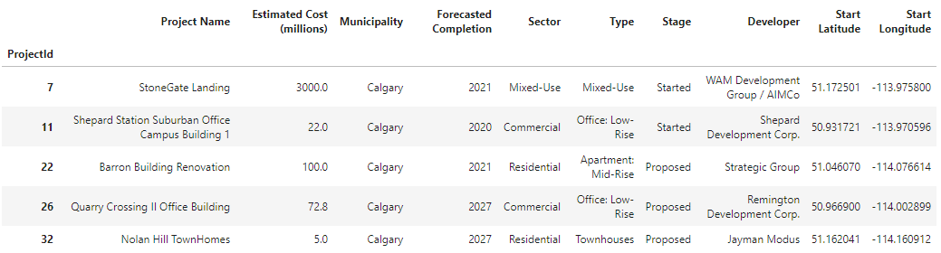
Data Preparation and Cleaning
Figure 1. Cleaned Dataset

Slide 7
Research Questions
With 20 questions or less, can we classify projects by type, cost and capacity and compare them with similar projects from the dataset?
In addition to the research question is the final objective of this classification: to be able to estimate the cost of similar projects with a rough order of magnitude.

Slide 8
Methods
We explored the data, first with descriptive statistics and bar charts (see Figure 2).
Second, we used box plots for the cost estimate ranges by type (see Figure 3).
Third, we used folium library to create a map using latitude and longitude values.
We used KMeans [2] to Cluster the projects by geographical region and type using the location values and one hot encoding of project types (See Figure 4).
Finally we used Decision Tree Classification [2] to predict one of 4 labels:
1. Too Cheap 2. In the Range. 3. Too Expensive 4. Not Enough Data

Slide 9
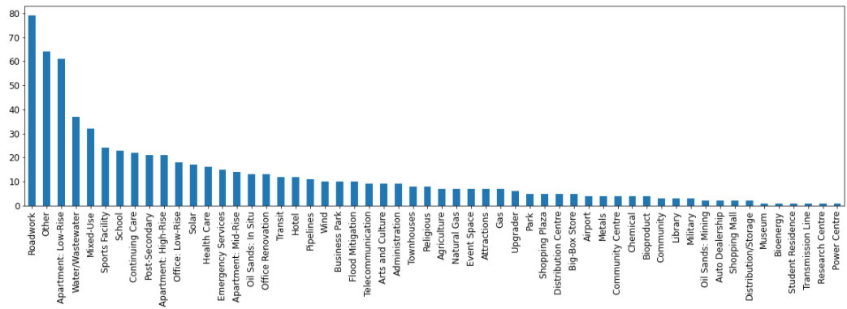
Methods
Figure 2. Project types bar chart

Slide 10
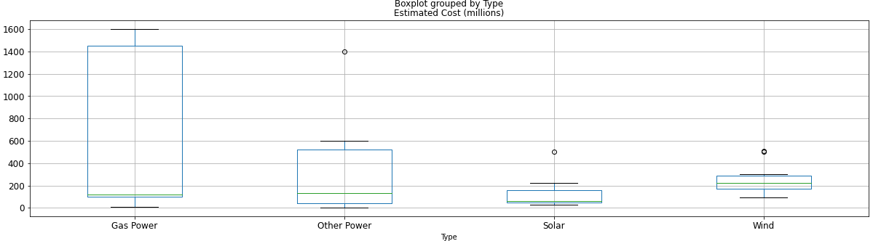
Methods
Figure 3. Box Plot Estimated Cost for Power Sector

Slide 11
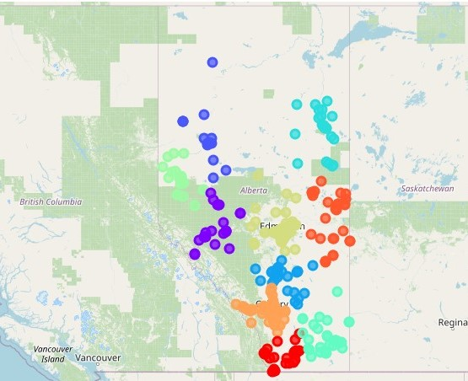
Methods
Figure 4. Projects Map
(Clusters by Region)

Slide 12
Findings
After corrections, we ended with 58 unique types in 9 sectors (see figure 6).
For the feature engineering, we extracted size and capacity data by type from the dropped project details column, adding units and cleaning it manually in excel.
The target variable was set from a percentage range in relation to average cost, divided by capacity per type of projects, labeled with conditional formulas in excel.
The datasets were merged back, and one hot encoding was used again to transform the categorical features into numerical dummy features (89 Columns).

Slide 13
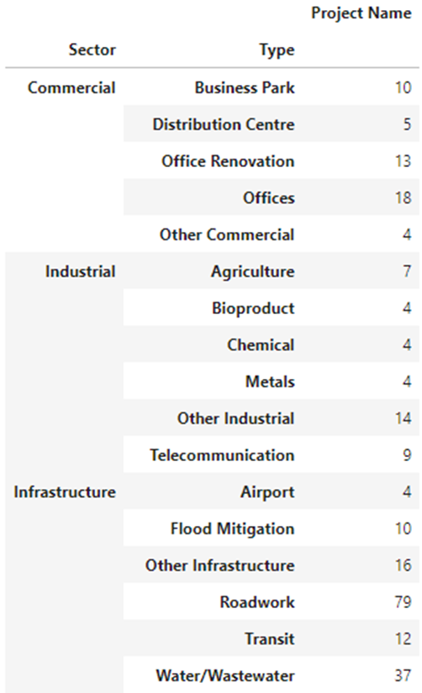
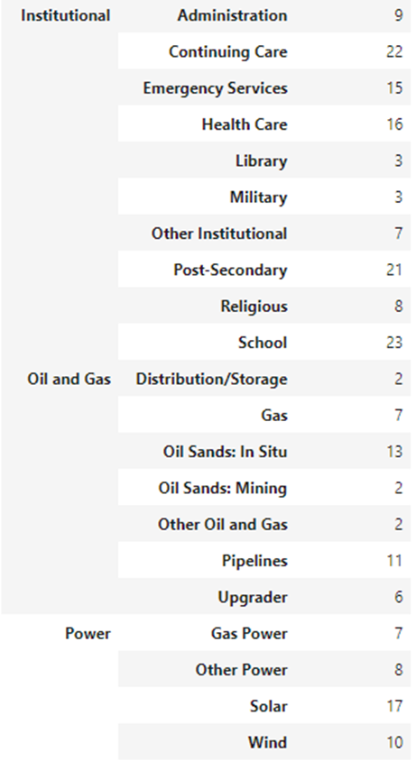
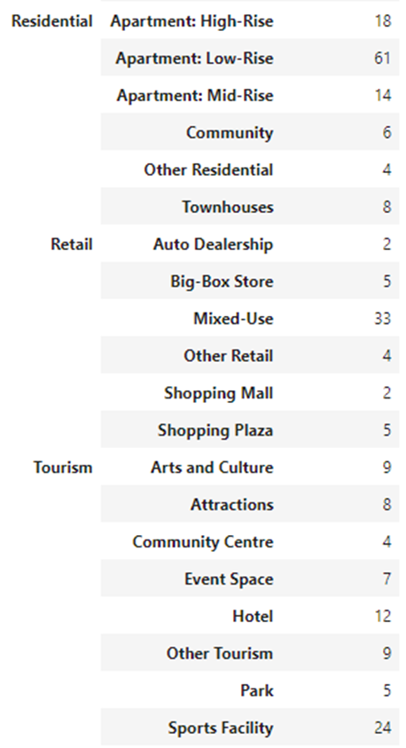
Findings
Figure 6.
Unique Sectors
and Types

Slide 14
Findings
The Decision Tree Classifier was trained with 70% of the Dataset, reserving the remaining 30% for Testing.
We used the Entropy (information gain) as the classifier criterion, and a maximum depth of 20 nodes (these are the 20 questions of the Project Name).
The Decision Tree Accuracy is 89% on the test set.
The Decision Tree didn’t use the maximum number of nodes (depth is 16), we can classify projects with 20 questions or less, per research question (see figure 7).

Slide 15
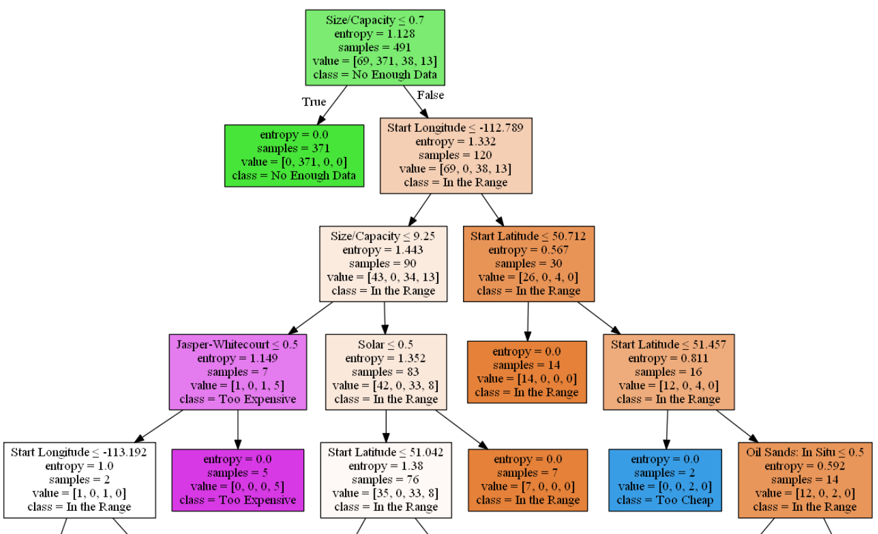
Findings
Figure 7.
Decision Tree

Slide 16
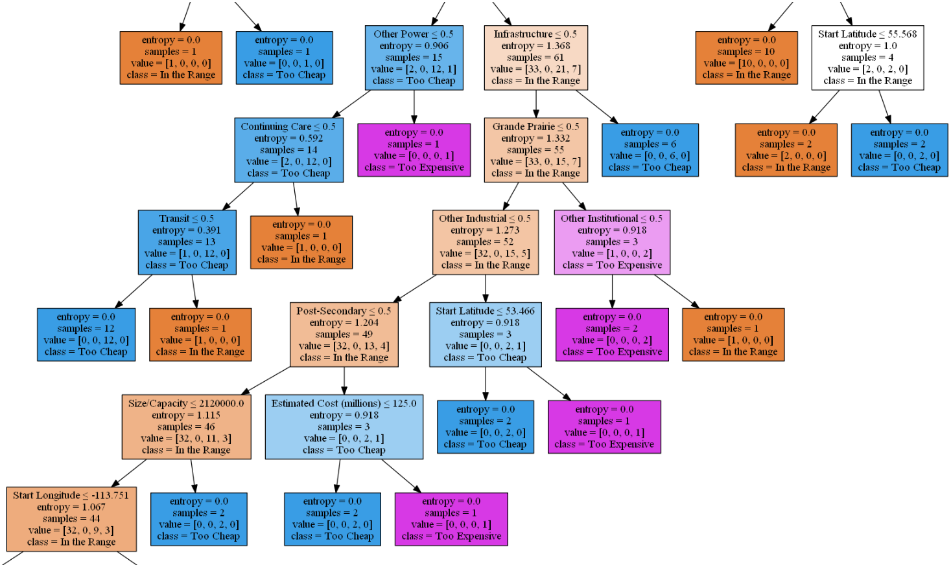

Slide 17
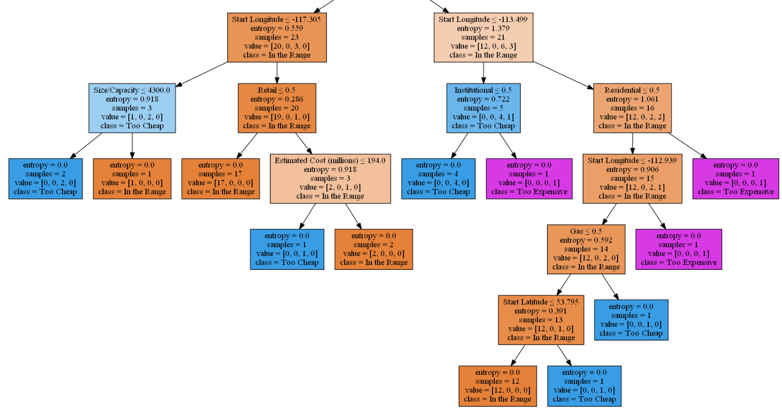

Slide 18
Limitations
The results of Decision Tree Classifier show the limitations of the Dataset, the first split take most of the projects out, classifying them as “Not Enough Data”.
Only 97 projects were classified as “In the Range”, and Only 3 types has more than 10 Projects in this valid range.
This work was done with only one Province Dataset, and other Canadian Provinces has Datasets available for Future work in similar formats.

Slide 19
Conclusions
We were able to classify project by type, cost and capacity with less than 20 question with the use of a Decision Tree Classifier with 89% accuracy on the training set.
Most of the projects has not enough data for the engineered features of size and/or capacity. Further work is required to search for capacity data from other sources (company websites, industry associations, etc.).
We found additional uses for the classifier, as the detected outliers were in a couple of cases, big projects announcements (as publicity stunts) and later withdrawn. And projects that were too expensive were never completed.

Slide 20
References
[1] Alberta Major Projects: https://majorprojects.alberta.ca/
[2] Scikit-learn library: https://scikit-learn.org/stable/
[3] Jupiter Notebook: https://github.com/javier-jaime/Major-Projects-20-Questions
Acknowledgements
Thank you for your Feedback!

