Slide 1
A first touch on NoSQL servers: couchdb
Genoveva Vargas Solar, Javier espinosa
CNRS, LIG-LAFMIA, France
Genoveva.Vargas@imag.fr; Javier.Espinosa@imag.fr
http://www.vargas-solar.com
Notes:
Polyglot persistence is motivated by the new challenges and characteristics of the data market today

Slide 2
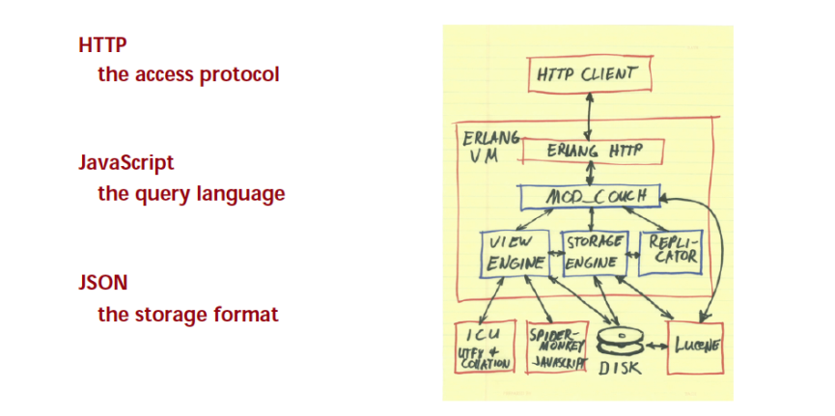
Architecture

Slide 3
Downloads
For executing these examples download CouchDB:
Binary version for windows
http://wiki.apache.org/couchdb/Installing_on_Windows
For communicating with the server we can use a browser or the tool cURL:
cURL is a tool for transfering data from the server using different protocols including HTTP
http://curl.haxx.se/download.html

Slide 4
CouchDB (1)
CouchDB is a document oriented DBMS, i.e., it is not relational:
Without database schema
Key-value model
Distributed and fault tolerant
Data are modeled as autocontained documents:
A document is represented by a JSON structure with attributes of any type
Queries are done via JavaScript

Slide 5
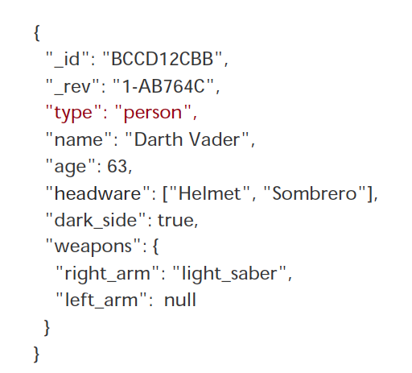

JSON document
Example

Slide 6
CouchDB (2)
Different data types are supported as add-in documets (video, audio, images, etc.)
Communication with applications and users is done via RESTful services:
«Representational State Transfer» is a software client-server architecture model used for distributed hypermedia systems
The communication protocol HTTP:
Used the HTTP methods explicitly
Stateless
Exposes the structure via URIs
Data transfered are XML or JSON (for CouchDB)

Slide 7
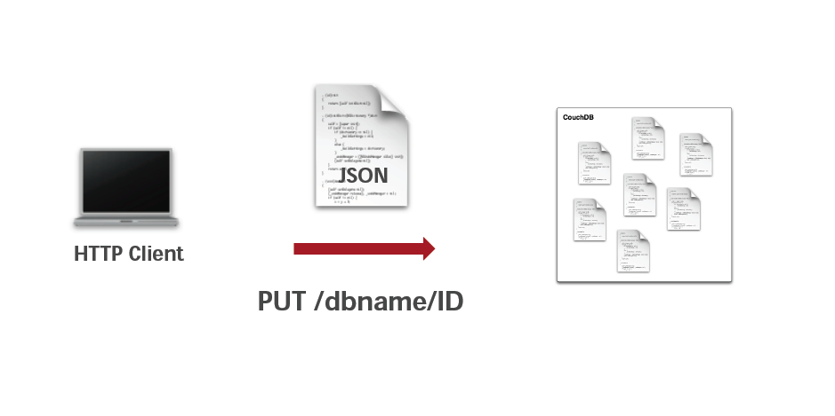
Interacting with CouchDB

Slide 8
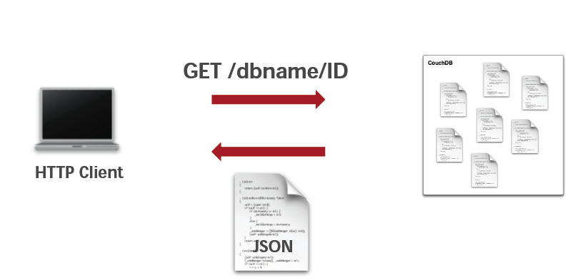
Interacting with CouchDB

Slide 9
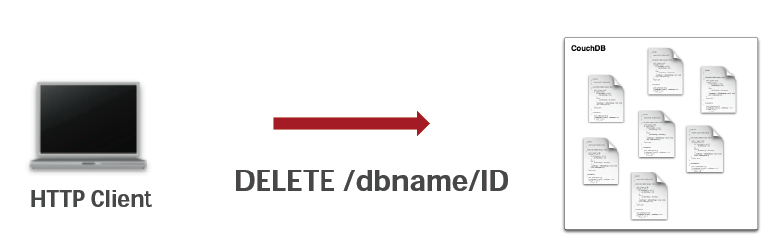
Interacting with CouchDB

Slide 10
Creating and retrieving
Creating the database "albums":
curl -X PUT http://localhost:5984/albums
Creating the document "album1":
curl -X PUT http://localhost:5984/albums/album1 -d @-
{
"artista": "Megadeth",
"titulo": "Endgame",
"anio": 2009
}
<EOF> // en Windows es ^z y en Unix ^d
Retrieving the created document:
curl -X GET http://localhost:5984/albums/album1

Slide 11
Updating (1)
For updating a document:
Give the last version
Otherwise an error (code 409) will be generated, as shown in the following example:
curl -X PUT http://localhost:5984/albums/album1 -d @-
{
"artista": "Megadeth",
"titulo": "Endgame",
"anio": 2010
}
^z

Slide 12
Updating (2)
The attribute "_rev" specifies the version that will be updated:
curl -X PUT http://localhost:5984/albums/album1 -d @-
{
"_rev": "1-142438dc8c583cda2a1f292c62291215",
"artista": "Megadeth",
"titulo": "Endgame",
"anio": 2010
}
^z

Slide 13
Deleting (1)
Delete the document "album1":
curl -X DELETE http://localhost:5984/albums/album1?rev=2-d05127b44500ec19a2e5a25adc610380
If you try to retrieve it, an error is generated:
curl -X GET http://localhost:5984/albums/album1
{"error":"not_found","reason":"deleted"}
You have access to the version generated by the deletion operation:
curl -X GET http://localhost:5984/albums/album1?rev=3-fac16c94309ed5ff842ffa89cc6048b1
{"_id":"album1","_rev":"3-fac16c94309ed5ff842ffa89cc6048b1","_deleted":true}

Slide 14
Deleting (2)
We purge the document from the database:
curl -X POST -H "Content-Type: application/json" http://localhost:5984/albums/_purge -d @-
{
"album1": ["3-fac16c94309ed5ff842ffa89cc6048b1"]
}
We try to query the version again:
curl -X GET http://localhost:5984/albums/album1?rev=3-fac16c94309ed5ff842ffa89cc6048b1
{"error":"not_found","reason":"missing"}

Slide 15
Attachments (1)
Any binary type can be stored by adding it to a document
Let us create again "album1":
curl -X PUT http://localhost:5984/albums/album1 -d @-
{
"artista": "Megadeth", "titulo": "Endgame", "anio": 2010
}
The method HTTP PUT is used for attaching a file to the document using the attribute "cover.jpg":
curl -X PUT -H 'Content-Type: image/jpg' --data-binary @300px-Endgame_album_art.jpg http://localhost:5984/albums/album1/cover.jpg?rev="1-8a015dd26403219af66f05542cb540b2"

Slide 16
Attachments (2)
On adding an attachment to a document its version number changes:
For adding an attachment it is imperative to specify the version number of the document object
Whe an attachment is created, the special attribute "_attachments” is created
The method GET enables the retrieval of the attachment through the corresponding attribute:
curl -X GET http://localhost:5984/albums/album1/cover.jpg?rev="2-31e1ce62601aac5b9de7059788361641" > tmp.jpg

Slide 17
VIEWS
Views are useful for many purposes:
Filtering the documents in your database to find those relevant to a particular process.
Extracting data from your documents and presenting it in a specific order.
Building efficient indexes (B-Trees)to find documents by any value or structure that resides in them.
Use these indexes to represent relationships among documents.
Views you can make all sorts of calculations on the data in your documents.
E.g., if documents represent your company’s financial transactions, a view can answer the question of what the spending was in the last week, month, or year.

Slide 18
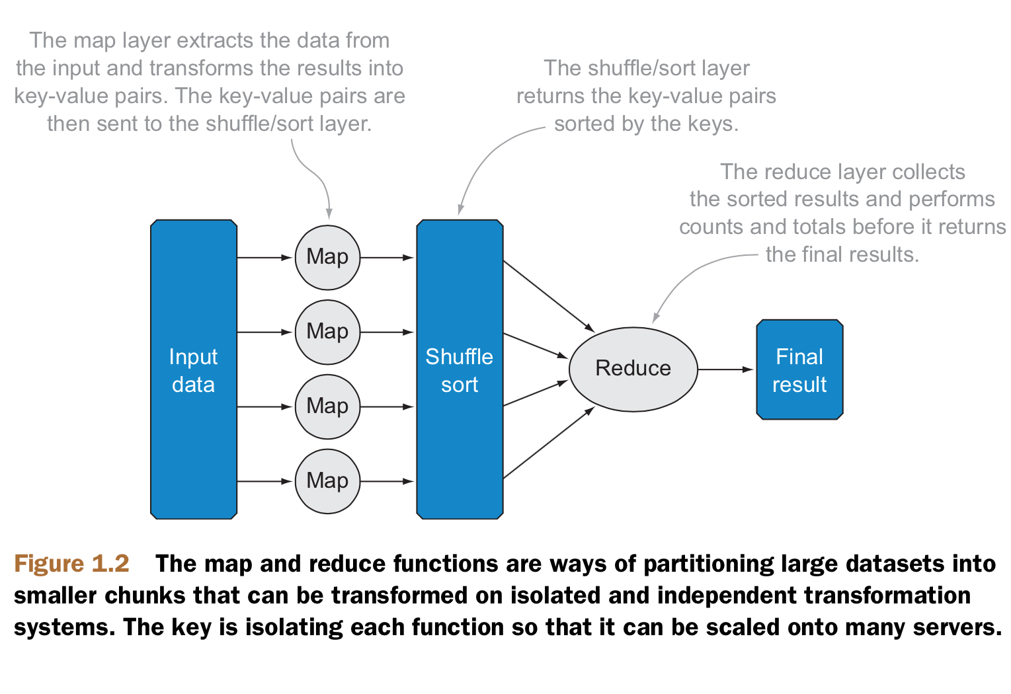
Defining views (1)
Views are based on the working model MapReduce:
Map and reduce function are specified in javascript
Built-in views are provided
curl -X GET http://localhost:5984/albums/_all_docs

Slide 19
Example: defining a view
curl -X PUT http://localhost:5984/albums/_design/vistas1 -d @-
{
"language": "javascript",
"views": {
"por_anio": {
"map": "function( doc ) { if( doc.anio ) { emit( doc.anio, 1 );}}",
"reduce": "function( keys, values, rereduce ) {return sum( values );}"
}
}
}

Slide 20
Counting words Example
(URI, document) → (term, count)
see 1
bob 1
throw 1
see 1
spot 1
run 1
bob <1>
run <1>
see <1,1>
spot <1>
throw <1>
bob 1
run 1
see 2
spot 1
throw 1
see bob throw
see spot run
Map
Shuffle/Sort
Reduce

Slide 21
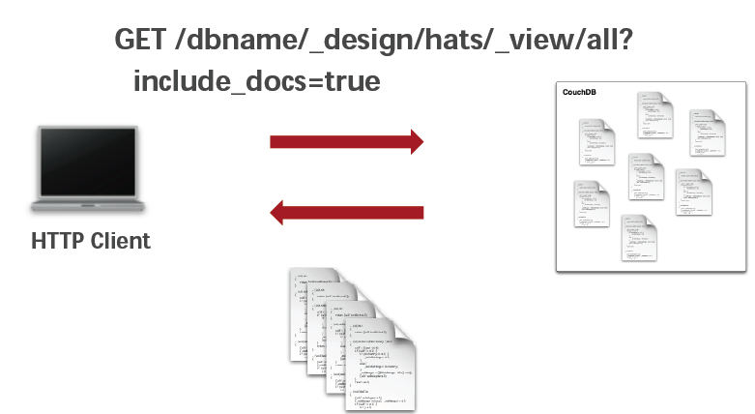
Querying a view

Slide 22
Example: using a view
Reduce values retrieved without considering the keys:
curl http://localhost:5984/albums/_design/vistas1/_view/por_anio
curl -X GET http://localhost:5984/albums/_design/vistas1/_view/por_anio
Reduce the values retrieved considering the values of the different keys:
curl http://localhost:5984/albums/_design/vistas1/_view/por_anio?group=true

Slide 23
Management tools
Web management console : complete interface for configuring , managing and monitoring a CouchDB instalation
REST API: management interface exported under a REST HTTP protocol
Command interface: tools providing information and control of a CouchDB instalation
Use the REST API
Can be used with scripts and management proceedures (failover, backups)

Slide 24
Using CouchDB with Java (1)
There are several projects that enable the use of CouchDB with Java
Visit the following links:
CouchDB4Java (http://github.com/mbreese/couchdb4j)
JRelax (https://github.com/isterin/jrelax/wiki)

Slide 25
Using CouchDB with Java (2)
CouchDB4Java is easy to use, you only have to download the application and integrate the JARs located in the folder lib
Java code for connecting an application:
public static void main( String [] args ) throws Exception {
Session s = new Session( "localhost", 5984 );
Database db = s.getDatabase( "albums" );
Document newdoc = new Document();
newdoc.put( "artista", "Megadeth" );
newdoc.put( "titulo", "Endgame" );
newdoc.put( "anio", 2010 );
db.saveDocument( newdoc, "album1" );
}

Slide 26
Using CouchDB with Java (3)
JRelax
For this case you have to download the project and its dependencies:
Restlet 2.0 (http://www.restlet.org/)
Jackson (JSON process - http://jackson.codehaus.org/)
Particularly the following JARs:
org.json.jar
jackson-all-1.6.2.jar
org.restlet.jar
org.restlet.ext.json.jar

Slide 27
Using CouchDB with Java (4)
Java code for connecting a JRelax application
public static void main( String[] args ) {
ResourceManager resourceMgr = new
DefaultResourceManager( "http://localhost:5984" );
List<String> dbs = resourceMgr.listDatabases();
for( String db : dbs ) {
System.out.println( db );
}
Document doc = resourceMgr.getDocument( "albums", "album1" );
System.out.println( doc.asJson() );
}

Slide 28
Example: Album DB
Adding more documents to the Albums database
curl -X PUT http://localhost:5984/albums/album4 -d @-
{
"artista": "Pantera",
"titulo": "Reinventing the Steel",
"anio": 2009
}
curl -X PUT http://localhost:5984/albums/album5 -d @-
{
"artista": "Slayer",
"titulo": "South of Heaven",
"anio": 2009
}

Slide 29
Back to theory …

