Slide 1
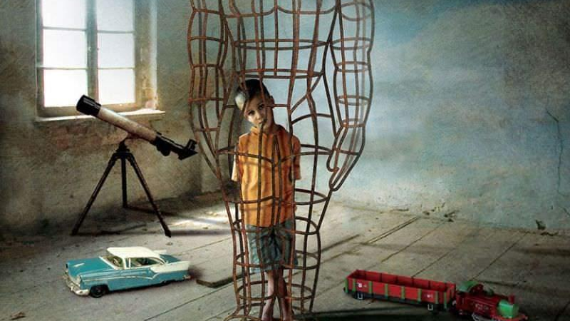

DEI@ADBIS 2024: PANEL More Than Muscles in the Lab: Expanding Masculinities in a Competitive Research Culture
https://conferences.sigappfr.org/adbis2024/diversity-and-inclusion-guidelines/
http://vargas-solar.com/adbis-dei/

Slide 2
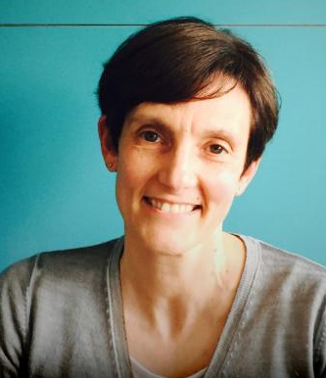
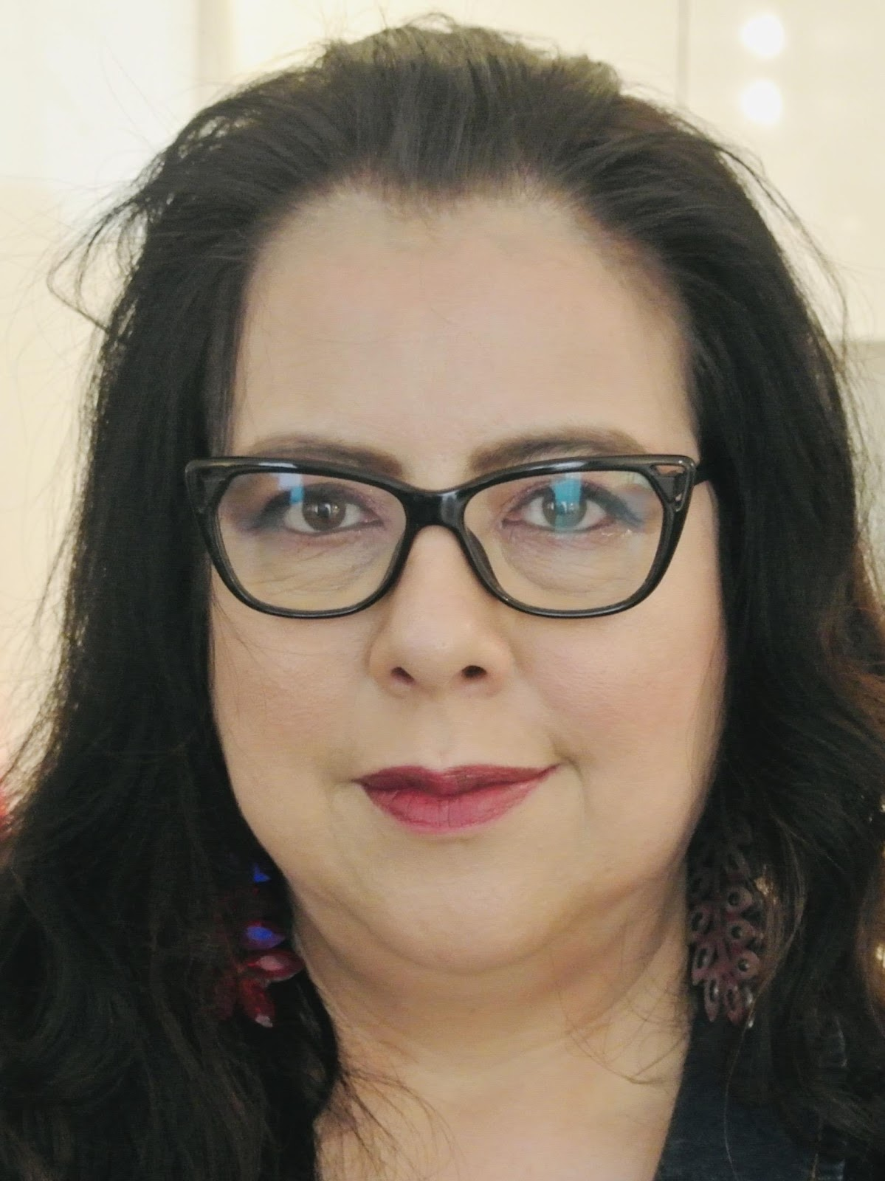
ADBIS 2024 DEI co-chairs
Barbara Catania (she/her)
Università degli Studi di Genova Italy
Genoveva Vargas-Solar (she/her)
CNRS, France

Slide 3
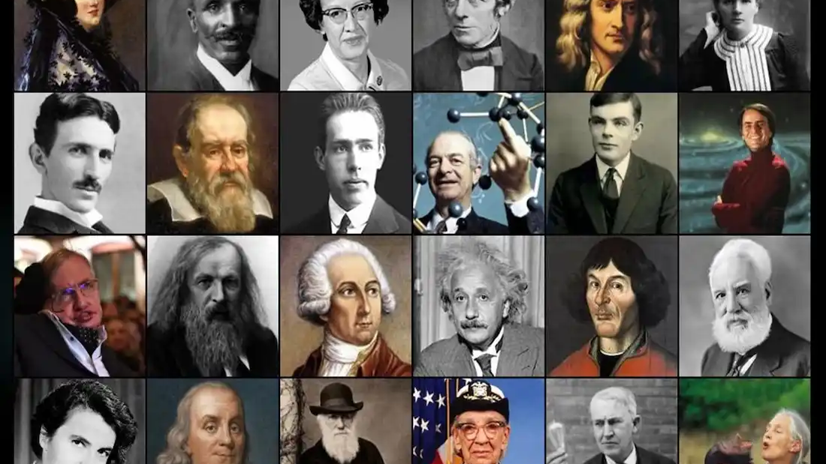
ADBIS Panels Discussions on DEI in Science

Slide 4
DEI in (Computing) Science: Perspectives
Critically assess technology-driven solutions: Design of research initiatives integrating feminist and decolonial methodologies (2023)
Research and understand the impact of gender dynamics within the traditionally male-dominated scientific field
Significance of recognising various identities within a multicultural scientific community
(New) Masculinities in Science (2024)

Slide 5
Masculinity perspectives in the scientific community
Archetypal roles for men, such as the prayer, the builder, and the warrior
Conquerors and colonisers of physical, social, and symbolic spaces, including fields like art and science
Associated attributes: aggression, competitiveness, and emotional invulnerability
Global North and Global South societies challenge and redefine these conventional perceptions of masculinity
Associated attributes: collaboration, emotional openness, and a nurturing approach to mentorship that values cooperative success over competitive dominance
Critical examination: how do these roles influence & permeate societal domains

Slide 6
Objectives
Explore how gender identities influence scientific practices in the lab. Examine how these identities shape:
The approach to problem-solving, experimentation, and knowledge transfer to societal applications
The communication of results among peers and the public
Explore the dynamics within scientific communities as collectives that can cultivate virtuous or detrimental environments
How various expressions of masculinity interact with different femininities and non-binary identities, influencing the community’s overall culture

Slide 7
Format
Introduction of the panel’s theme, objectives, and guiding questions to frame the dialogue
Panellists: 5-minute statement addressing one or more teasing questions
Moderators: incorporate audience questions to deepen the discussion ed
Panellists: share final thoughts and key takeaways, summarising the insights gained from the dialogue

Slide 8
Guiding questions
Is it possible for science to be genuinely gender-neutral?
When scientists collaborate to advance knowledge, can they separate their work from their cultural, socioeconomic, and gender identities?
What does it mean to be a man (of science)?
Manhood in successfully driving science
Picture men of science as conquerors of nature & science through in vitro/in sillico practices
Muscles in the lab: occupying the (intellectual) space, monopolising the word
Challenging aggressive scientific conquest with alternative masculinities and being active actors in the scientific and technological arena

Slide 9
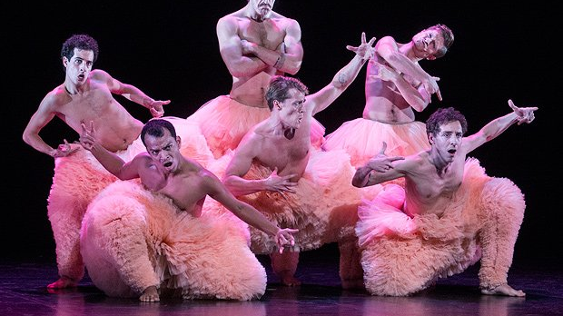
Distinguished panellists

Slide 10
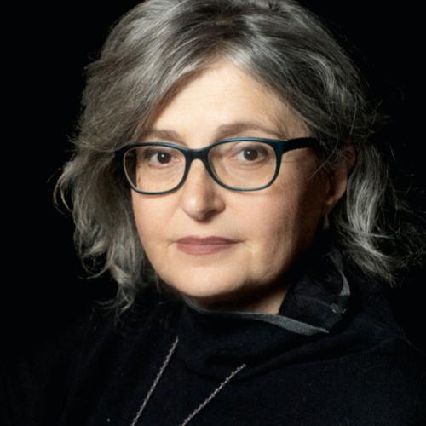
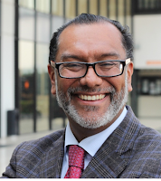
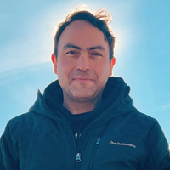
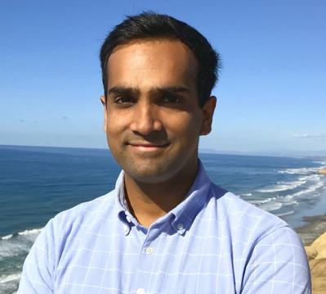
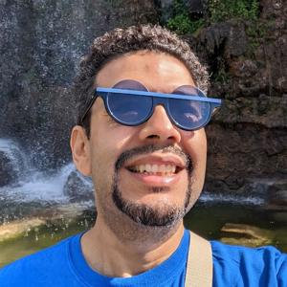

Rita Bencivenga (she/her)
University of Genova
Italy
Jorge Alberto Hidalgo Toledo (he/him) University Anáhuac
Mexico
Amir Hossein Payberah (he/him)
KTH Royal Institute of Technology Sweden
Arun Kumar (he/him) University of California San Diego, USA
Juan Antonio Navarro Pérez (he/him) Google
UK
Romain Sabathier (he/him)
COOP-EGAL
France

Slide 11
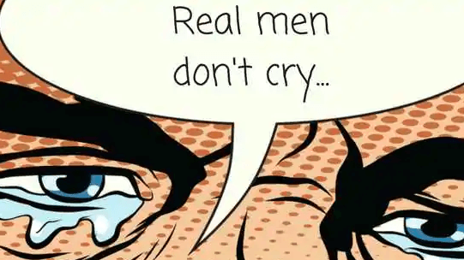
Let’s build a DEI community & Talk about Men
Thanks a lot!
Barbara Catania, University of Genoa, Italy
Genoveva Vargas-Solar, CNRS, France

Slide 13
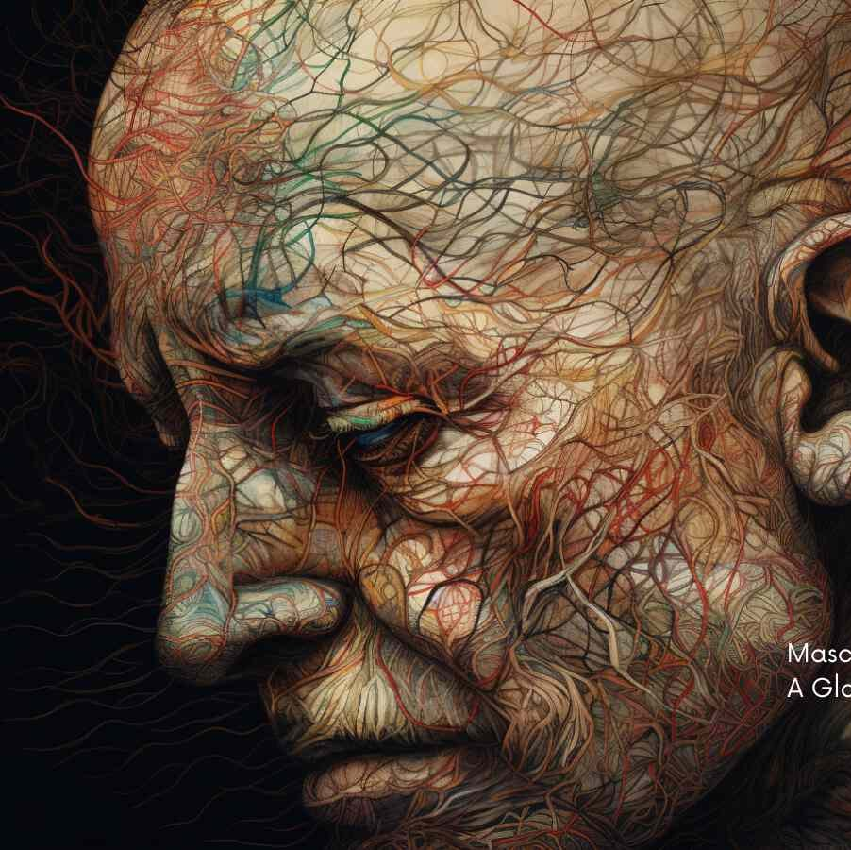
DEI@ADBIS 2024: PANEL More Than Muscles in the Lab: Expanding Masculinities in a Competitive Research Culture
https://conferences.sigappfr.org/adbis2024/diversity-and-inclusion-guidelines/
http://vargas-solar.com/adbis-dei/

