Slide 1
‘Your Power, Your Future’
Business and Analytic Analysis
Javiera Jáuregui

Slide 2
Business Fundamentals
Labor insertion of women who don’t have the educational tools to have a stable work, offering them online training and technical workshops so that they can specialize and get the job they want.
Women who can´t pay for job training.
Women who can pay for job training.
Companies.

Slide 3
Business Fundamentals
Market Entry
Creation of an online platform for training and workshops.
Dissemination of our Value Proposition.
Generation of alliances with companies.
Revenue Model
Partnerships with companies.
Receive payment from students belonging to the two highest income quintiles.
Students below the third quintile pay the Startup 10% of their salary for six months when they get a paid job.
Investors that after one year their investment is returned with a return of 10%.

Slide 4
Business Fundamentals
Key Metrics
Budget in months.
Fixed expenses.
Variable expenses of a student.
Increase in sales.
Number of students enrolled.
Contribution of partner companies.
Employability index.
Employability time.

Slide 5
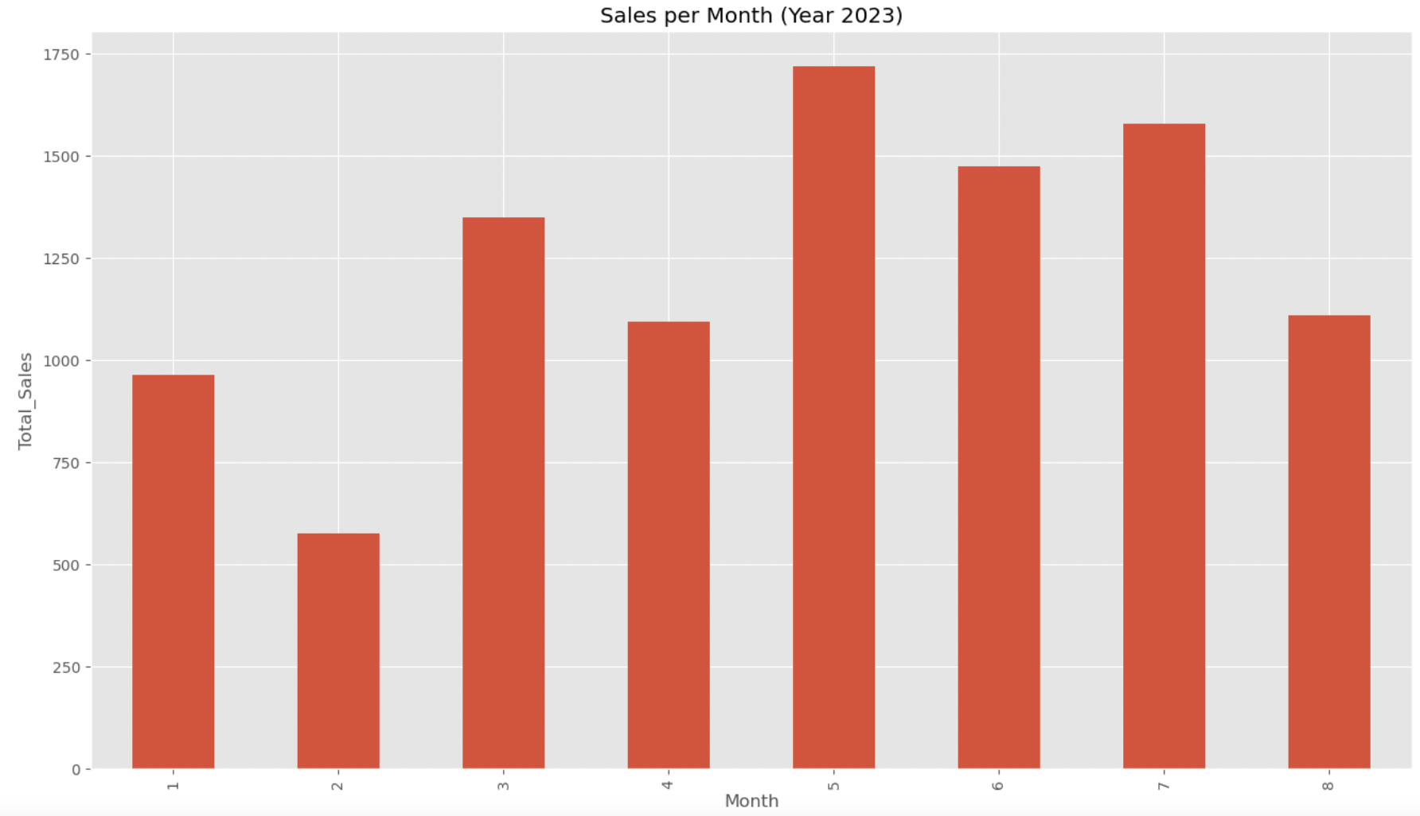
Data Visualization
May is the month where most sales have been recorded during the year 2023, with an approximate value of 1750 usd.
Increase in Sales

Slide 6
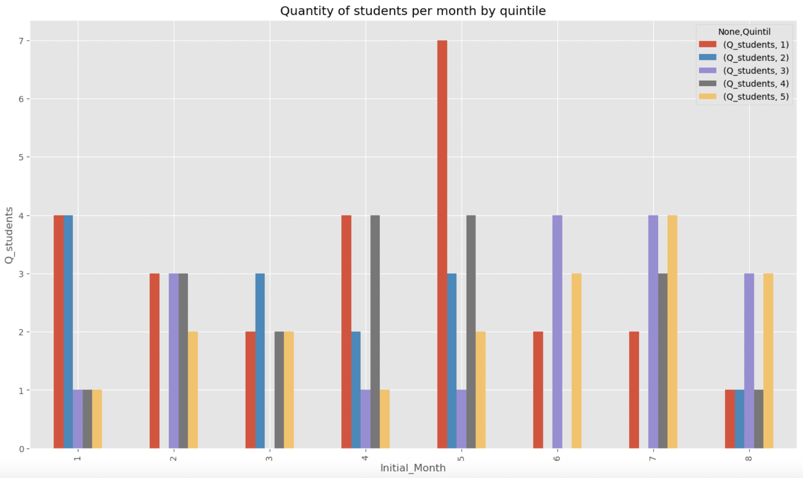
Data Visualization
Quantity of students per month by quintile
In most months, students belonging to the first three quintiles, i.e., the lowest socioeconomic sectors of the population, predominate.

Slide 7
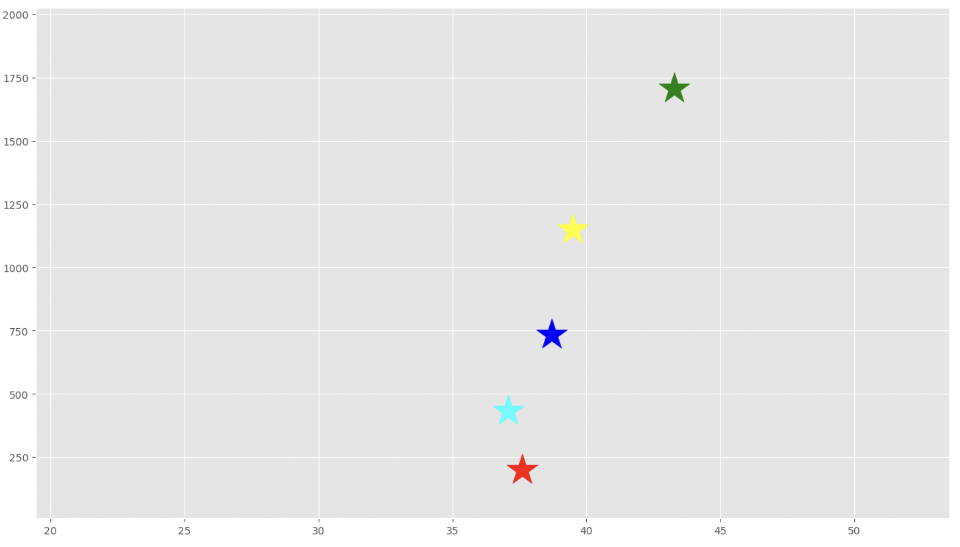
Statistical Modeling
A K-means segmentation model was implemented to validate the hypothesis that most of the enrolled female students belong to lower socioeconomic sectors:
Five clusters were obtained from the model.

Slide 8
Conclusion
Most of the students enrolled belong to the first three quintiles of the population; therefore, the hypothesis stated at the beginning has evidence to be validated and to continue working towards better access to education for women from lower socioeconomic sectors.
The result can prove that there are people with lower incomes interested in studying, but because they do not have the income they cannot do it, and with this initiative they can take advantage of their potential to fulfill their dreams.

Slide 9
‘Your Power, Your Future’
Business and Analytic Analysis
Javiera Jáuregui

