Slide 1


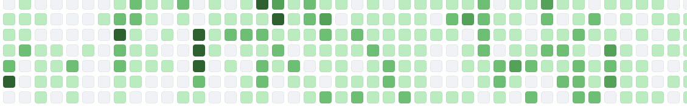
Tutorial 3: Code Development in Flexodeal
These slides are available at www.github.com/javieralmonacid/flexodeal-tutorials
Javier Almonacid
Research Assistant @ NML
March 20, 2026

Slide 2
Brief Recap of Previous Tutorials
In Tutorial 1, we discussed the main details of the Flexodeal framework. We discussed how different types of contractions can be studied using Flexodeal Lite.
In Tutorial 2, we turned our focus to Flexodeal and its default experiment. We also discussed how working with non-standard meshes requires the use of a quadrature point file.
In essence, we have discussed how to use Flexodeal. We will now focus on how to modify Flexodeal.

Slide 3
Recommended Workflow
Are you testing or modifying Flexodeal?
Testing
Modifying
Clone the repository from the NML’s GitHub page or download a release.
Fork the repository from the NML’s GitHub page, then clone Flexodeal from your account

Slide 4
Forking a Repository
If you clone Flexodeal from the NML’s GitHub page:
You can only perform local changes.
You cannot create remote branches (local branches can still be created).
You cannot track your changes.
If you fork Flexodeal, and then clone this repository from your account:
Your can create multiple branches for different projects and track your changes.
You can fix the version of Flexodeal you’d like to use.

Slide 5
Why Should You Track Your Changes?
Reproducibility
Recover the exact code used for results.
Re-run experiments months (or years) later.
Debugging & Validation
Identify when and why results changed.
Compare working vs broken versions.
Collaboration
Share clear, traceable contributions.
Enable others to review and build on your work.
Project Management
Keep features and experiments organized.
Ensure consistency across papers and collaborators.
Safely experiment without losing stable code.
Avoid overwriting or losing teammates’ changes.
Work on multiple ideas in parallel (via branches).
Maintain a clean, structured codebase.
Long-term Research Value
Preserve your work beyond a single project.
Make your research transparent and credible.
Support future extensions of your work.

Slide 6
Main Goal
We wish to include intramuscular fat in Flexodeal Lite. Since this is already included in Flexodeal, we take relevant design from there and port it over to Flexodeal Lite.
We will do this in a tracked setting, starting from the latest version of Flexodeal Lite.

Slide 7
Introducing Intramuscular Fat in Flexodeal Lite

Slide 8
Software Development Life Cycle (SDLC)
As with any piece of software, any new feature in Flexodeal should be designed and implemented with care.
The SDLC is a ubiquitous framework for managing an entire software project from start to finish, ensuring consistency, efficiency, and quality.
Requirements gathering and analysis
System design
Coding
Testing
Deployment
Maintenance and support
https://github.com/resources/articles/what-is-sdlc

Slide 9
Requirements Gathering and Analysis
Objective
Capture the effect of intramuscular fat on active muscle dynamics.
Modelling Approach
Homogenized strain-energy function
Fat is assumed to be isotropic, quasi-incompressible, and uniformly distributed.
Inputs
Fat fraction
Parameters that define the strain-energy function for fat
Validation Targets
Decreasing force generation with increasing fat fraction.
Decrease proportional to the fat fraction in the context of an isometric contraction of parallel fibred muscle.
Constraints
Backwards compatible (zero fat fraction should recover original behaviour).
Minimal computational overhead.
Out of Scope
Spatial heterogeneity (clumps).
Viscoelastic model

Slide 10
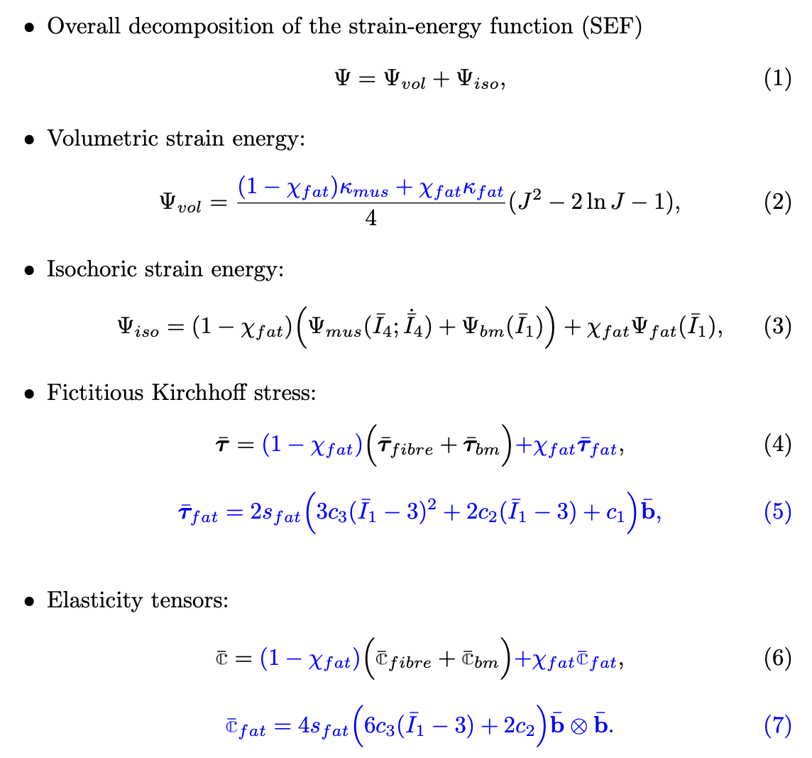
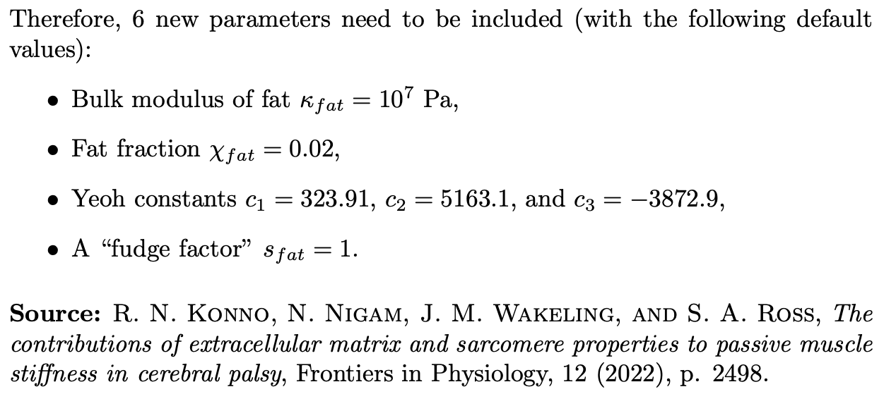
System Design: Mathematical Details
Quantities in blue are new to the code

Slide 11
Coding
First, clone the repository and set your tracking environment
Description | UNIX Command
Fork Flexodeal Lite from the NML’s GitHub page | -
Navigate to a convenient directory, then clone your forked version of Flexodeal Lite | git clone https://github.com/<your-username>/flexodeal-lite.git
Navigate to the Flexodeal Lite folder. | cd flexodeal-lite
Create a new branch, let’s call it fat_implementation | git checkout –b fat_implementation
Link your local branch to GitHub | git push –u origin fat_implementation
Important: Because you are cloning the repository using the https address, ”push” operations will require you to enter your username and “password” for GitHub. Note that your password here is given by one of your Personal Access Tokens (PAT), which you can obtain from your account. To do this, go to your profile, then Settings -> Developer Settings -> Personal Access Tokens -> Tokens (classic) -> Generate New Token. Make sure to give “repo” permissions. To avoid being asked for username and password every time you push changes, sync your machine’s SSH key with your GitHub account.

Slide 12
Coding
Compile Flexodeal Lite, then run an isometric contraction (the one in the examples folder) and save these results (you will need them for the testing phase).
Open the folder flexodeal-lite in Visual Studio Code.
Modify the files parameters.prm and flexodeal-lite.cc according to the instructions in the file T3_SYSTEM_DESIGN.md, located in the flexodeal-tutorials repository.
You may replace the contents of the file flexodeal-lite.cc by those of the file flexodeal-lite-with-fat.cc, also available in the flexodeal-tutorials repository.
./flexodeal-lite -PARAMETERS=examples/IC_parameters.prm
-BDY_STRAIN=examples/IC_strain.dat -ACTIVATION=examples/IC_activation.dat
-OUTPUT_DIR=results-original

Slide 13
Testing
Run 4 simulations with the following fat fractions: 0.00, 0.02, 0.10, 0.20.
Using the file force_data-3d.csv for each simulation:
Verify that the output for fat fraction = 0 matches the output of the unmodified code.
Verify that, as the fat fraction increases, the total force at either one of the fixed ends decreases.

Slide 14
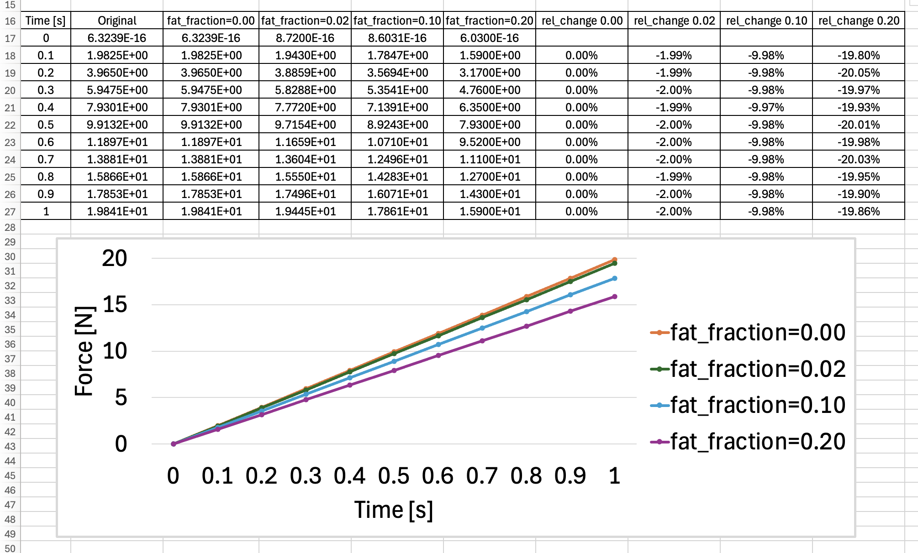
Force [N] at the +X Fixed End
Do these results make sense?

Slide 15
Git Workflow: Add, Commit, Push
Step 1: git add (staging)
Select which files to include.
Can stage:
Specific files, for example, git add flexodeal-lite.cc parameters.prm
All files: git add .
Think: “What do I want in this update?”
Step 2: git commit (local save)
Creates a snapshot of staged changes.
Write clear, concise messages: git commit -m “Added intramuscular fat”
Step 3: git push (Share)
Upload commits to GitHub.
Makes changes visible to collaborators.
Think: “What did I change and why?”
⚠️ Good practices
Commit small, logical changes.
Use meaningful commit messages.
Push regularly (don’t accumulate too much).
⚠️ If this is your first time commiting your changes, you might be asked to provide your name and email address.

Slide 16
Deployment
Deployment is the process of making new code usable by others.
Goes beyond coding. It includes integration, documentation, and reproducibility. In our example, this could mean:
Updating all the .prm files.
Updating any README.md files.
Creating further examples that may be used as tests.
Releasing a new version.
This is particularly important if:
You’re planning to submit a pull request (PR) to include your changes in the main Flexodeal repository.
You’re planning to share your code publicly.

Slide 17
Contributing to Flexodeal: Key Questions
Before opening a pull request (PR), or even before thinking of adding a new feature to Flexodeal, ask:
Is this feature broadly useful? That is, not just for a single project or boundary conditions.
Is it generalizable? That is, is it independent of specific geometry or boundary conditions.
Is it testable? Can you verify correctness with a clear test case?
Is it reproducible? Can others run and obtain consistent results?
Is it documented?

Slide 18
Maintenance & Support
This is ongoing work after deployment to ensure any new feature remains correct, stable, and useful over time.
Typical work includes bug fixes or developing new test cases based on new data or literature.
Always prevent regressions.

Slide 19
Best Software Development Practices
Write clear, readable code
Use meaningful names for your variables and keep a simple structure.
Keep changes small and focused.
One feature or fix per commit.
Document your work
Explain what your code does and why.
Test your code
Verify (and, if possible, benchmark) your results and avoid breaking existing functionality.
Use version control (Git)
Track changes and work safely with others.
Reuse, don't duplicate
Build on existing code instead of rewriting (unless you have a very good reason to do so).

Slide 20
More Resources
Finite element simulation using deal.II: https://www.dealii.org/current/doxygen/deal.II/Tutorial.html
Mathematical details of Flexodeal:
Almonacid, J. A., Domínguez-Rivera, S. A., Konno, R. N., Nigam, N., Ross, S. A., Tam, C., & Wakeling, J. M. (2024). A three-dimensional model of skeletal muscle tissues. SIAM journal on applied mathematics, 84(3), S538-S566.
Almonacid Paredes, J. A. (2025). On the nonlinear elastodynamics of skeletal muscle (Chapters 5 and 6). PhD Thesis, Simon Fraser University (available at www.sfu.ca/~Javiera).
ParaView documentation: https://docs.paraview.org/en/v5.13.1/UsersGuide/introduction.html

Slide 21






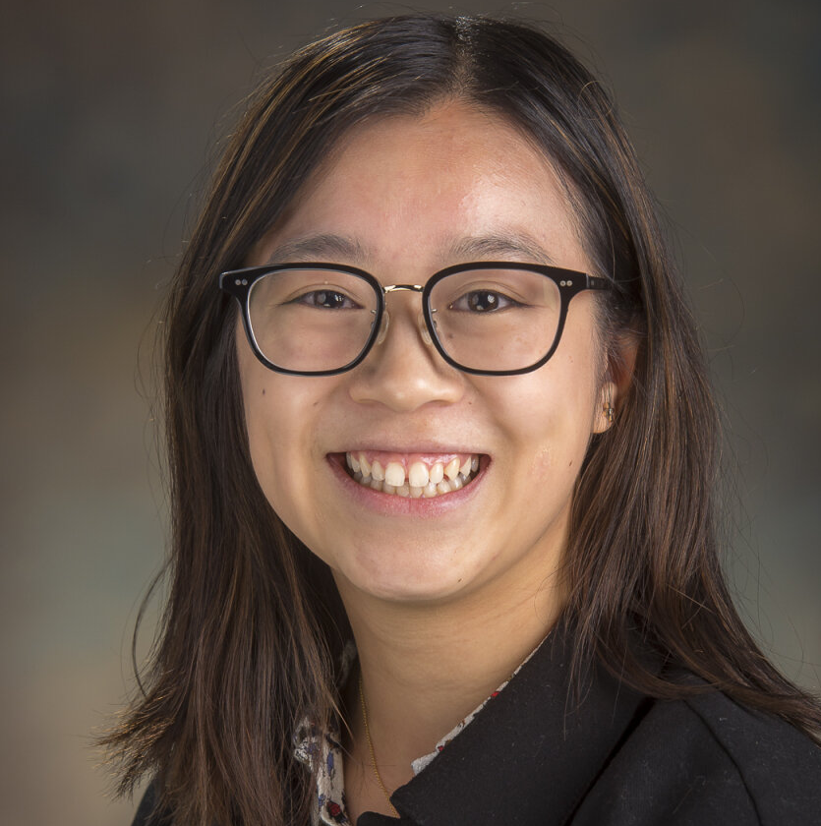
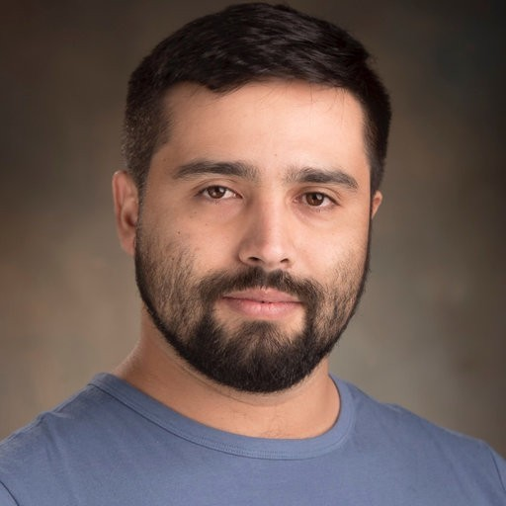




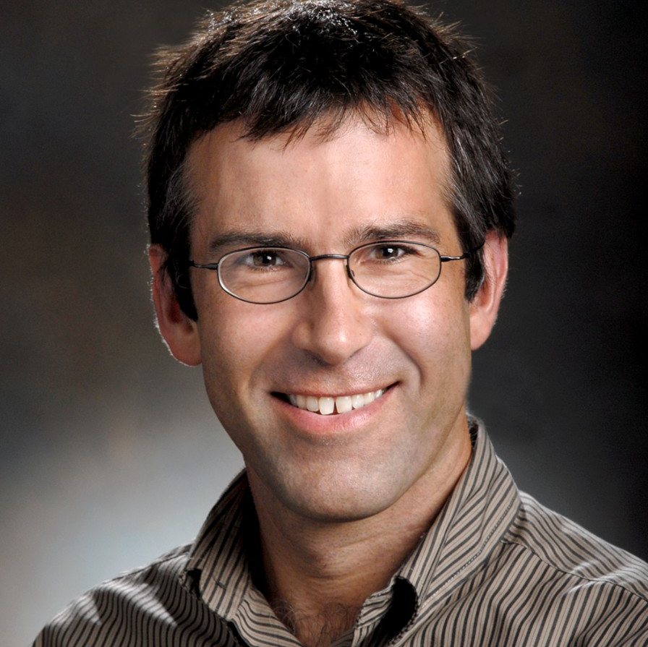
www.github.com/sfu-nml
www.linkedin.com/company/sfu-nml
Flexodeal contributors
Javier Almonacid
Harshil Pathak
Kshitij Patil
Ryan N. Konno
Cassidy Tam
Sebastian Dominguez
Stephanie A. Ross
David S. Ryan
Hadi Rahemi
Nilima Nigam
James M. Wakeling

