Slide 1

Sybase Adaptive Server Advanced SQL Programming and Optimization
Soaring Eagle
Consulting, Inc.
Single – Table Optimization
Chapter Six
Presented by:
Jeff Garbus

Slide 2


Acknowledgements
Sybase Adaptive Server is a trademark of Sybase Inc.
This presentation is copyrighted.
This presentation is not for re-sale
This presentation shall not be used or modified without express written consent of Soaring Eagle Consulting, Inc.

Slide 3






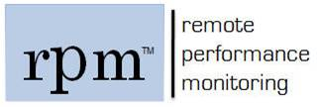

About Soaring Eagle
Since 1997, Soaring Eagle Consulting has been helping enterprise clients improve their overall system performance at the database tier, arguably the most volatile and critical component of distributed application architecture. Our clients range in size from fledgling startups through Fortune 100 companies and leading financial institutions.
Soaring Eagle has been a leader in software development, architecture, performance and tuning databases, while promoting mentoring and training all over the world for over a decade. Many of our employees, and partners have written books, speak at seminars about leading edge technologies. We have expertise in all business tiers, financial; health, manufacturing, government agencies and many ecommerce businesses.
Consulting
Performance & Tuning
Data Performance Management
Emergency Triage
Performance & Security Audits
Staff Augmentation
Project management
Database architecture
Scalability assessment and planning
Training
Onsite/Web based
Microsoft
Sybase
Oracle
APM
Six Sigma
Managed Services
Remote Database Management
Performance management
Emergency db Service
Proactive mitigation
Problem notification
Problem resolution
Software
Application Performance Management
Database performance accelerator
Database performance management
Database Security
db
9

Slide 4
Single - Table Optimization
Topics
Examine Detailed Topics in Query Optimization
Indexes with SARGs
Improvised SARGs
Clustered vs. Nonclustered Indexes
Queries with OR
Index Covering
Forcing Index Selection
Partition Support

Slide 5
Adaptive Server Search Techniques
Adaptive Server uses three basic search techniques for query resolution
Table Scans
Index Searches
Covered Index Searches

Slide 6
Table Scans
If Adaptive Server can’t resolve a query any other way, it does a table scan
Scans are expensive
Table scans may be planned even if the rest of the query is false!
Identify table scan searches
select * from pt_tx where 1 = 2

Slide 7
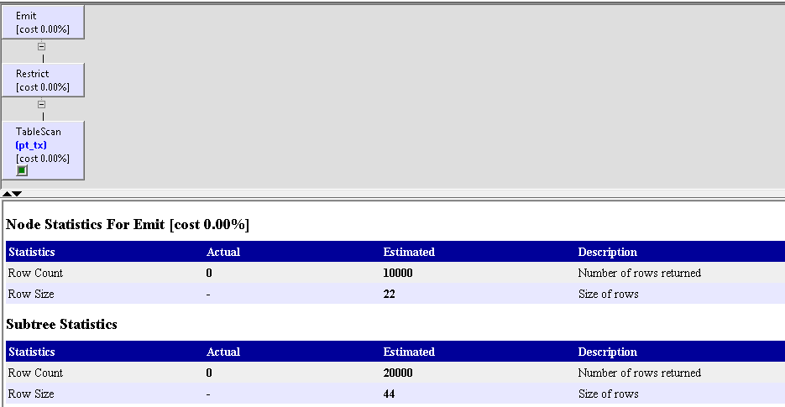
Table Scans
SHOWPLAN OUTPUT
select * from pt_tx where 1=2

Slide 8
Table Scans Continued
QUERY PLAN FOR STATEMENT 1 (at line 1).
STEP 1
The type of query is SELECT.
2 operator(s) under root
|ROOT:EMIT Operator
|
| |RESTRICT Operator
| |
| | |SCAN Operator
| | | FROM TABLE
| | | pt_tx
| | | Table Scan.
| | | Forward Scan.
| | | Positioning at start of table.
| | | Using I/O Size 16 Kbytes for data pages.
| | | With LRU Buffer Replacement Strategy for data pages.
SHOWPLAN OUTPUT
select * from pt_tx where 1=2

Slide 9
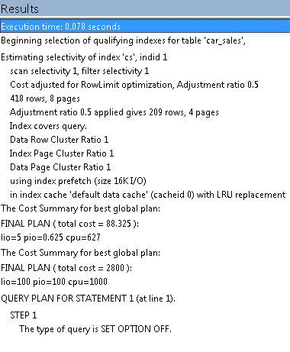
Table Scans
DBCC TRACEON (3604, 302,
select * from pt_tx where 1=2

Slide 10
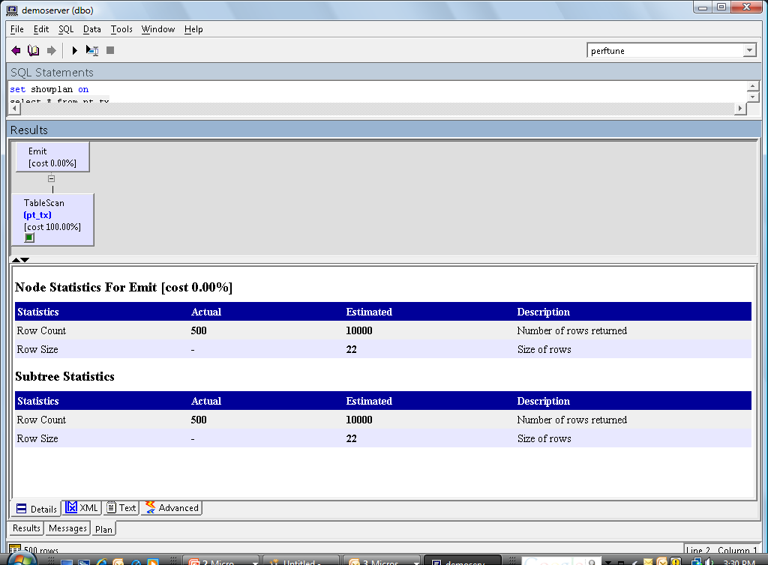
Table Scan Output: SELECT
SHOWPLAN
select * from pt_tx

Slide 11
Table Scan Output: SELECT
STEP 1
The type of query is SELECT.
1 operator(s) under root
|ROOT:EMIT Operator
|
| |SCAN Operator
| | FROM TABLE
| | pt_tx
| | Table Scan.
| | Forward Scan.
| | Positioning at start of table.
| | Using I/O Size 16 Kbytes for data pages.
| | With LRU Buffer Replacement Strategy for data pages.
SHOWPLAN
select * from pt_tx

Slide 12
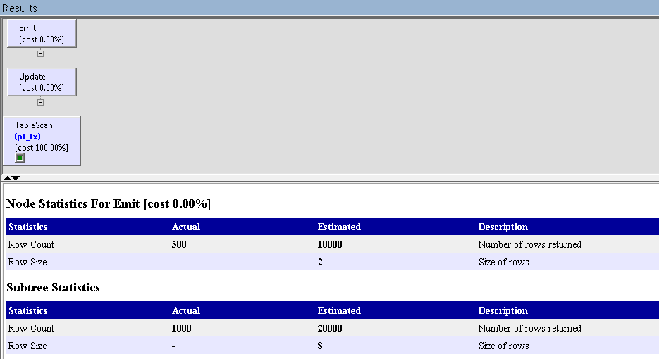
Table Scan Output: UPDATE
SHOWPLAN OUTPUT
update pt_tx set id = id + 1

Slide 13
Table Scan Output: UPDATE
STEP 1
The type of query is UPDATE.
2 operator(s) under root
|ROOT:EMIT Operator
|
| |UPDATE Operator
| | The update mode is direct.
| |
| | |SCAN Operator
| | | FROM TABLE
| | | pt_tx
| | | Table Scan.
| | | Forward Scan.
| | | Positioning at start of table.
| | | Using I/O Size 16 Kbytes for data pages.
| | | With LRU Buffer Replacement Strategy for data pages.
| |
| | TO TABLE
| | pt_tx
| | Using I/O Size 2 Kbytes for data pages.
SHOWPLAN OUTPUT
update pt_tx set id = id + 1

Slide 14
Optimization vs. Execution
Scans planned at optimization may not happen
Use SET STATISTICS IO ON to verify what actually happens when the query executes
Example 1 (scan planned and executed)
update pt_tx set id = id + 1

Slide 15
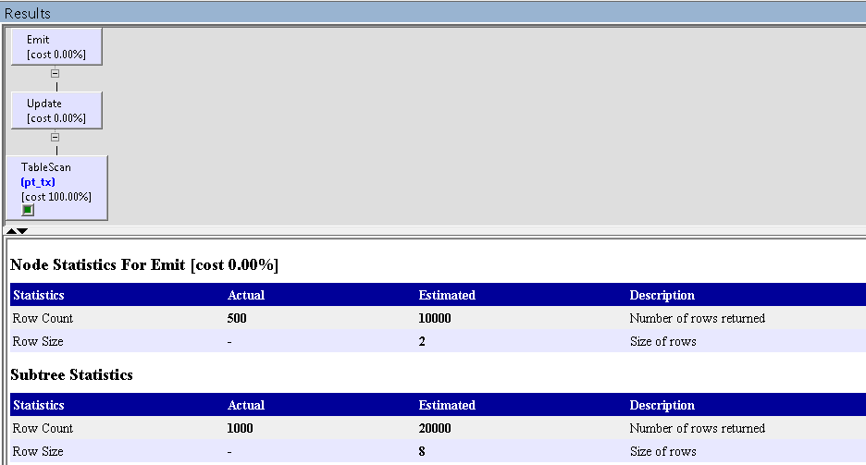
Optimization vs. Execution
STATISTICS IO OUTPUT
update pt_tx set id = id + 1
Slide 2 of 5

Slide 16
Optimization vs. Execution
STEP 1
The type of query is UPDATE.
2 operator(s) under root
|ROOT:EMIT Operator
|
| |UPDATE Operator
| | The update mode is direct.
| |
| | |SCAN Operator
| | | FROM TABLE
| | | pt_tx
| | | Table Scan.
| | | Forward Scan.
| | | Positioning at start of table.
| | | Using I/O Size 16 Kbytes for data pages.
| | | With LRU Buffer Replacement Strategy for data pages.
| |
| | TO TABLE
| | pt_tx
| | Using I/O Size 2 Kbytes for data pages.
STATISTICS IO OUTPUT
update pt_tx set id = id + 1
Table: pt_tx scan count 1, logical reads: (regular=6 apf=0 total=6), physical reads: (regular=0 apf=0 total=0), apf IOs used=0
Table: pt_tx scan count 0, logical reads: (regular=0 apf=0 total=0), physical reads: (regular=0 apf=0 total=0), apf IOs used=0
Total writes for this command: 9

Slide 17
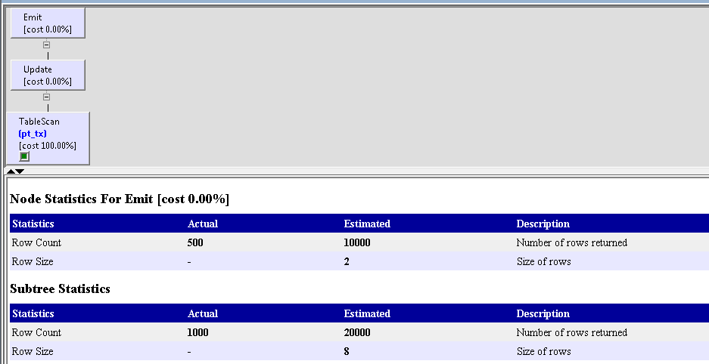
Optimization vs. Execution
Example 2 (scan planned but not executed)
SHOWPLAN
update pt_tx
set id = id + 1
where 1 = 2

Slide 18
Optimization vs. Execution
STEP 1
The type of query is UPDATE.
2 operator(s) under root
|ROOT:EMIT Operator
|
| |UPDATE Operator
| | The update mode is direct.
| |
| | |SCAN Operator
| | | FROM TABLE
| | | pt_tx
| | | Table Scan.
| | | Forward Scan.
| | | Positioning at start of table.
| | | Using I/O Size 16 Kbytes for data pages.
| | | With LRU Buffer Replacement Strategy for data pages.
| |
| | TO TABLE
| | pt_tx
| | Using I/O Size 2 Kbytes for data pages.
SHOWPLAN
update pt_tx
set id = id + 1
where 1 = 2
Example 2 (scan planned but not executed)

Slide 19
Optimization vs. Execution Continued
STATISTICS
Table: pt_tx scan count 1, logical reads: (regular=6 apf=0 total=6), physical reads: (regular=0 apf=0 total=0), apf IOs used=0
Table: pt_tx scan count 0, logical reads: (regular=0 apf=0 total=0), physical reads: (regular=0 apf=0 total=0), apf IOs used=0
Total writes for this command: 9
In this example, the optimizer still plans a table scan even though the WHERE clause short-circuits the query at execution time
Use STATISTICS IO output to verify a scan really happened

Slide 20
Index Selection
Topics
Index types
Optimizer selection criteria
When indexes slow access
Index statistics and usage

Slide 21
Index Types
Adaptive Server provides three types of indexes
Clustered
Nonclustered
Full text
One clustered index per table
Data is maintained in clustered index order
248 nonclustered indexes per table
Nonclustered indexes maintain pointers to rows
Full text is beyond scope

Slide 22
Index Types
Indexes are balanced b-tree type structures
An index may contain between 1 and 31 columns, but the total index entry width must be no greater than 600 bytes
Text, image and bit columns can be indexed
Indexes are maintained and used internally by the server to improve performance or to enforce uniqueness
The application programmer does not usually refer to indexes

Slide 23
Clustered Index Mechanism
Here, we’re clustered on last name
With a clustered index, there will be one entry on the last intermediate index level page for each data page
The data page is the leaf or bottom level of the index

Slide 24
Nonclustered Index Mechanism
Here, we have a nonclustered index on first name
The nonclustered index has an extra, leaf level for page / row pointers
Nonclustered indexes do not affect data placement

Slide 25
Clustered vs. Nonclustered
A clustered index tends to be 1 I/O faster than a nonclustered index for a single-row lookup
Clustered indexes are excellent for retrieving ranges of data
Clustered indexes are excellent for queries with order by
Nonclustered indexes are a bit slower, take up much more disk space, but are the next best alternative to a table scan
Nonclustered indexes may cover the query for maximal retrieval speed; For some queries; covered queries, nonclustered indexes can be faster

Slide 26
Primary Key vs. Clustering vs. Nonclustering
A primary key is a logical concept, not a physical concept
Indexes are physical concepts, not logical concepts
There is a strong correlation between the logical concept of a key and the physical concept of an index
By default, when you define relationships as part of table design, you will build indexes to support the joins / lookups
By default, when you define a primary key, you will create a unique clustered index on the table
Unique is good, clustered isn’t always good
When you define a clustered index, the server automatically appends the key column(s) (plus a unique identifier, if necessary) to the nonclustered indexes

Slide 27
Optimizer Selection Criteria
During the index selection phase of optimization the optimizer decides which (if any) indexes best resolve the query
Identify which indexes match the where clauses
Estimate rows to be returned
Estimate page reads

Slide 28
SARG Matching
Indexes must correspond with SARGs.
Useful indexes will specify a row or rows or set bounds for the result set
An index may be used if at least the first column of the index matches the SARG
where dob between '3/3/1941' and '4/4/65'

Slide 29
SARG Matching (Continued)
Create index a on authors(au_lname, au_fname)
Which of the following queries (if any) is helped by the index?
select * from authors where au_fname = 'Jim' and au_lname = 'Smith‘
select * from authors where au_fname = 'Jim‘
select * from authors where au_lname = 'Smith' or au_fname = 'Jim'

Slide 30
Using Indexes
Clustered Index Indications
Columns searched by range of values
Columns by which the data is frequently sorted (order by or group by)
Sequentially accessed columns
Join columns (if other than the primary key)
Static columns

Slide 31
Using Indexes
Nonclustered Index
NCI selection tends to be much more effective if less than about 10% of the data is to be accessed (documentation says 20%, it is wrong)
NCIs help sorts, joins, group by clauses, etc., if other column(s) must be used for the CI
Index covering

Slide 32
Index Covering
The server can use the leaf level of a nonclustered index the way it usually reads the data pages of a table: this is index covering.
The server can skip reading data pages
The server can walk leaf page pointers
A nonclustered index will be faster than a clustered index if the index covers the query for a range of data (why?)
Adding columns to nonclustered indexes is a common method of reducing query time
This has particular benefits with aggregates

Slide 33
Index Covering Continued
Beware making the index too wide; As index width approaches row width, the benefit of covering is reduced
# of levels in the index increases
Index scan time approaches table scan time
Remember that changes to data will cascade into indexes
Over-indexing can cause OLTP performance problems

Slide 34
Index Selection Examples
What index will optimize this query?
What index will optimize this query?
In the second query, what would the net effect be of changing the range to this?
select title
from titles
where title = "Alleviating
VDT Eye Strain"
select title from titles where price between $5. and $20.
between $500 and $600

Slide 35
CI vs. NCI
select * from titles where price between $5. and $20.
2,000,000 titles
40 rows / page (=50,000 pages)
1 million rows in the range
Table facts:
INDEX USED | PAGE READS
Clustered index non-clustered index | 25,000 +index levels (worst case) 1,000,000,+ 7,150
No index (table scan) | 50,000

Slide 36
CI vs. NCI
It is feasible, occasionally likely, that a table scan is faster than using a nonclustered index for specific queries
The server evaluates all options at optimization time and selects the least expensive query plan

Slide 37
Or Indexing
select title
from titles
where price between $5. and $10.
or type = 'computing'
What indexes should (could) be used?
Will a compound index help?
Which column(s) should be indexed?

Slide 38
Or Indexing Continued
How is the following query different (from a processing standpoint)?
What is a useful index for?
select title from titles where price between $5. and $10. and type = 'computing'
select * from authors where au_fname in ("Fred", "Sally")

Slide 39
Or Clauses
Format
SARG or SARG
How many indexes may be useful?
Examples
select * from authors where au_lname = 'Smith' or au_fname = 'Fred'
select * from authors where au_lname in ('Smith', 'Jones', 'N/A')

Slide 40
Or Strategy
An OR CLAUSE may be resolved via a table scan, a multiple match index or using OR Strategy
Table Scan
Each row is analyzed, and criteria applied
Matching rows are returned in the result set
The cost of all the index accesses is greater than the cost of a table scan
At least one of the clauses names a column that is not indexed, so the only way to resolve the clause is to perform a table scan

Slide 41
OR Strategy Continued
Multiple match index
Using each part of the OR clause, select an index and retrieve the row
Only used if the results sets can not return duplicate rows
Rows are returned to the user as they are processed

Slide 42
OR Strategy Continued
OR Strategy (also known as dynamic index)
Used when the result from a multiple match index can return duplicate rows
Rowid that satisfy the OR are saved in a temp table
Duplicate rows are then eliminated
Results are then retrieved
Note: This strategy has additional overhead of repeated reads and the creation and sorting of the work table

Slide 43
OR: Example
select * from authors where au_lname in ('Baker', 'Garfield') or state like 'A%'
Result
The server generates a dynamic index from indexes supporting each individual SARG
The dynamic index consists of pointers to rows matching one or both criteria
The server unions the results, removing duplicate values
Note: If any individual SARG requires a table scan, a table scan will resolve the query.

Slide 44
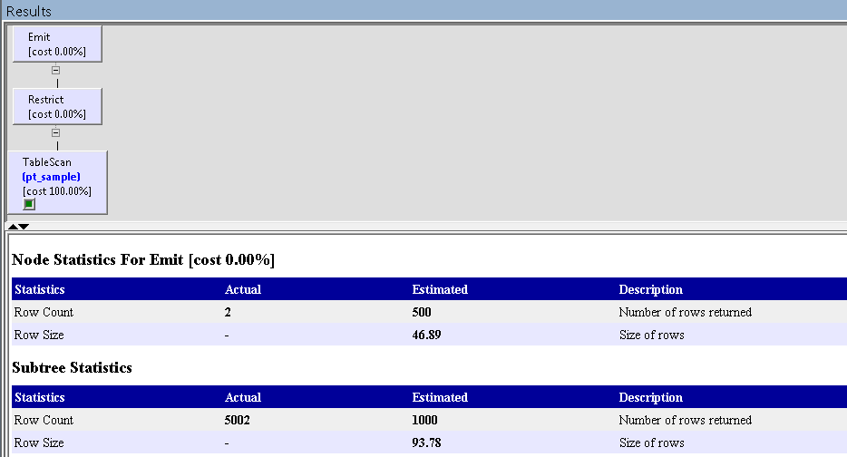
OR: Query Plan
SHOWPLAN OUTPUT
select company, street2 from pt_sample
where id = 2017 or id = 2163

Slide 45
OR: Query Plan
STEP 1
The type of query is SELECT.
2 operator(s) under root
|ROOT:EMIT Operator
|
| |RESTRICT Operator
| |
| | |SCAN Operator
| | | FROM TABLE
| | | pt_sample
| | | Table Scan.
| | | Forward Scan.
| | | Positioning at start of table.
| | | Using I/O Size 16 Kbytes for data pages.
| | | With LRU Buffer Replacement Strategy for data pages.
SHOWPLAN OUTPUT
select company, street2 from pt_sample
where id = 2017 or id = 2163

Slide 46
Index Selection and the Select List
select * from publishers where pub_id = 'BB1111'
What is the best index?
Do the columns being selected have a bearing on the index?

Slide 47
Index Selection and the Select List
select royalty from titles where price between $10 and $20
Should there be a difference between the utilization of the following two indexes?
create index idx1 on titles (price)
/* or */
create index idx2 on titles (price, royalty)

Slide 48
Composite Indexes
Composite (compound) indexes may be selected by the server if at least the first column of the index is specified in a where clause
create index idx1 on employee (division, department, emp_num)

Slide 49
Composite Indexes (Continued)
Which queries may use the index?
select * from employee where division = 'abc', and department = 123 and emp_num = '123-456-789'
select * from employee where division = 'abc' and emp_num = '123-456-789'
select * from employee where department = 123 and emp_num = '123-456-789'

Slide 50
Composite vs. Many Indexes
Each additional index impacts update performance
In order to select appropriate indexes, we need to know how many indexes the optimizer will use, and how many rows are represented by the where clause

Slide 51
Composite vs. Many Indexes (Continued)
select pub_id, title, notes from titles where type = 'Computer' and price > $15.
Options
CI or NCI on type
CI or NCI on price
One index on each of type & price
Composite on type, price
Composite on price, type
CI or NCI on type, price, pub_id, title, notes
Which are the best options in which circumstances?

Slide 52
Index Usefulness
It is imperative to be able to estimate rows returned for an index. Therefore, the server will estimate rows returned before index assignation
If statistics are available (When would they not be?) the server estimates number of rows using distribution steps or index density
If statistics are not available, the server estimates the number of matching rows based on default statistics
10% for equality SARGS (=)
25% for closed range SARGS (between, > and <)
33% for open range SARGS (>, >=, <, <=)
If you have an equality join on a unique index, the server knows only one row will match and doesn't need to use statistics

Slide 53
WHERE with Improvised SARGs
Improvised SARGs are WHERE clause restrictions that are not SARGs at compile time, but are SARGs at run time
Adaptive Server will attempt to improvise SARGs where it can
Adaptive Server will calculate indexes for improvised SARGs as though they were literal SARGs
Adaptive Server will use table scans for those WHERE clause restrictions it cannot improvise into SARGs
Prior to ASE 15 COLUMN = @VARIABLE is not a SARG at compile time, so it cannot use distribution steps, it uses index density
Consider this example: what is the potential impact of an improvised SARG?
COLUMN like @VARIABLE

Slide 54
When Distribution Steps Are Not Used
Constant Expression
(prior to 15)
Local Variable as Constant
Col = 5*12
Col = @value
These are SARGS at run time, but not at optimization time. The server will treat this as a SARG but will use index density or default statistics, rather than distribution steps

Slide 55
Row Estimates
Selectivity is based on density stored in the statistics page
Selectivity = 1/# rows in smaller table if no statistics are available
1,000,000 orders, 5,000 customers
selectivity = 1/5000
Probable number of orders/customer:
1,000,000 * 1/5000 = 200
Density = 1/number of unique values
1,000,000 rows, 1,000 unique values
Density = 1/1,000
A single search value would, on average, yield 1,000,000 * .001 or 1000 rows
Low density is most selective; as density approaches 1, the index approaches uselessness

Slide 56
Estimating Logical Page I/O
If there is no index, there will be a table scan, and the estimate will be the number of pages in the table (stored in sysindexes)
If there is a clustered index, estimate will be the number of index levels plus the number of pages to scan
For a nonclustered index, estimate will be index levels + number of leaf pages + number of qualifying rows (which will correspond to the number of physical pages to read)
For a unique index and an equality join, the estimate will be 1 plus the number of index levels

Slide 57
Data Distribution
You have a 1,000,000 row table. The unique key has a range (and random distribution) of 0 to 10,000,000
How many rows will be returned by the following query:
select *
from table
where key between 1,000,000 and 2,000,000
How does the optimizer know whether to use an index or table scan?

Slide 58
Index Statistics
Adaptive Server keeps distribution information about indexes in a table called sysstatistics
There is distribution information for every index, and possibly (depending on your DBA’s decision) statistics for nonindexed columns as well
The optimizer uses this information to estimate the number of rows returned for a query
The distribution page(s) are built at index creation time and not maintained by the server
The dbo should periodically issue the command to enable the optimizer to continue picking the correct strategies
update index statistics table [index]

Slide 59
When to Force Index Selection
Don't Do It !
With every release of the server, the optimizer gets better at selecting optimal query paths
Forcing the optimizer to behave in a specific manner does not allow it the freedom to change selection as data skews
It also does not permit the optimizer to take advantage of new strategies as advances are made in the server software

Slide 60
When to Force Index Selection Continued
Exceptions
When you (the developer) have information about a table that Adaptive Server will not have at the time the query is processed (i.e., using a temp table in a nested stored procedure)
Occasions when you've proven the optimizer wrong

Slide 61
How to Force Index Selection
To force the server to use a specific index for a specific table, you must first know the index id of the index you want to use
In this example, the titles index with the id of 3 will be used for the titles table, and the publishers index with an id of 4 will be used for publishers
select * from titles (3), publishers (4) where titles.pub_id = publishers.pub_id

Slide 62
Partition Support Topics
Partition Strategies
Hash Partitions
List
Range
Round Robins
Using alter table
Add partition

Slide 63
Semantic Partition Support
Divides large tables and indexes into manageable pieces
Are database objects that are managed independently
Create index cannot be done at partition level
Selects, inserts, deleting data can be done on partitioned table
Horizontal partitioning selects table rows that can be distributed among partitions on different disk devices
Semantic partitioning allows data values in specified, key columns in each row to determine the partition assignment of that row
Round-robin partitioning assigns rows randomly without reference to data values

Slide 64
Partition Strategies
Hash partitioning (semantic) –system supplied hash function determines the partition assignment for each row
List Partitioning (semantic) compares values in key columns to user-supplied values for each partition
Range Partitioning (semantic) –compares key columns within a set lower and upper bound for each partition
Round-robin partitioning – randomly assigned rows to partitions so that each partition contains equal number of rows (default)

Slide 65
Partition Strategies II
Allows
Using the create table and create index commands when creating partitions
Using alter table command to alter table’s partitioning strategy
Using add partition to partition to an existing table
Use of partitioning to expedite the loading of large amounts of data

Slide 66








Pre – ASE 15 Partitioning → Segment Slices
Segment partitioning
aka “slices”
Table only (no index partitioning)
Primary goals
Decrease last page contention
Allow parallel query
Allow parallel dbcc checkstorage
Allow parallel index creation
Assessment
Myth that they are no longer useful due to SAN disk speeds
Datarow + partitioned table is fastest for inserts (20-25%)
Not a great solution
But still decent
Parallel Query/DBCC
Create Index
Worker Threads
Segment
Partitions
Round-Robin
Parallel Inserts

Slide 67
ASE 15 Semantic Partitioning
Semantic Data Partitioning strategies
Hash based partitioning
Range Partitioning
List Partitioning
Round-Robin Partitioning
Index Partitioning
Global indexes – Index spans all partitions
Local indexes – Index spans one partition
Improved Query Support
Optimizer and Execution support (parallelism & elimination)
Partition-Aware Maintenance
Update statistics on one or all partitions
Truncate, reorg, dbcc, bcp (out) partition
Parallel Query/DBCC
Create Index
Worker Threads
A-I
J-R
S-Z
Range/Hash
Partitions
Range/Hash
Parallel Inserts

Slide 68


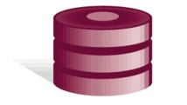
Range Partitioning - Example
create table customer
( c_custkey integer not null,
c_name varchar(20) not null,
c_address varchar(40) not null,
other columns …
) partition by range (c_custkey)
(cust_ptn1 values <= (20000) on segment1,
cust_ptn2 values <= (40000) on segment2,
cust_ptn3 values <= (60000) on segment3 )
cust_ptn1:
values <=20000
cust_ptn2:
values <=40000
cust_ptn3:
values <=60000
Segment 1
Segment 2
Segment 3

Slide 69
Index Partitioning
Indexes on a partitioned table may be partitioned
Hash, List, Range only
Round-Robin does not support partitioned indexes
Think about it
If partitioned, an index inherits the same partition keys as the table
Terminology
Local Index → Index is partitioned
Global Index → Index is not partitioned (single b-tree)
PKey Constraint is automatically partitioned
This can lead to pkey enforcement issues if the partitioning is on columns other than pkey
You will get a warning about this if it applies
Work-around is to use a unique non-clustered (global) index on PKey vs. Pkey constraint.

Slide 70

Clustered (Local) Index - Example
Customer is range-partitioned table on c_custkey column
Create unique clustered index ci_nkey_ckey on customer(c_custkey, c_nationkey)
Segment 1
Segment 2
Segment 3
Note: All primary key constraint indexes for range, hash, list partitioned tables are local indexes by definition.

Slide 71
(Non-clustered) Global Index
Create unique index ci_nkey_ckey
on customer(c_nationkey, c_custkey)
on segment4
Segment 4
Segment 1
Segment 2
Segment 3

Slide 72
(Non-clustered) Local Index
Create unique index ci_nkey_ckey
on customer(c_nationkey, c_custkey)
on segment4 local index
Segment 4
Segment 1
Segment 2
Segment 3

Slide 73
Performance Enhancement Through Partitioned Index
Increased concurrency through multiple index access points.
Reduced root page contention
Index size adjusted according to the number of rows in each partition
Fewer index pages searched for smaller partitions
Pre-15.0 with unpartitioned index
15.x Local Index on partitioned table
Query C
Query B
Query A
Query B
Query C
Query A
Shorter Access Path
Partitioned Index
Unpartitioned Index
Unpartitioned Table
Partitioned Table

Slide 74
Local Indexes vs. Unique Indexes
Uniqueness may not be enforceable!!!
If you partition a table by keys other than the pkey columns, duplicate key values may be inserted
ASE will warn you of this when you partition the table
Insert table (cust_id, state, …)
values (12345,'CA', …)
Insert table (cust_id, state, …)
values (12345,'NY', …)
Insert table (cust_id, state, …)
values (12345,'TX', …)
Access path
Local Index (Partitioned by State)
CA
NY
TX
Partitioned Table by State (pkey is cust_id)

Slide 75
Local Indexes vs. Unique Indexes
Why does ASE Just warn vs. enforce?
Originally table is unpartitioned with indexes 7 levels deep
Now, partition on state
Assume 10 partitions
Assume now each index is only 3 levels deep
Unique enforcement now requires 30 (10x3) I/O's vs. 7
Unique enforcement would block partition specific maintenance
What's the Work-Around?
Create unique/pkey indexes as nonclustered global indexes
Other indexes can still be local – helping insert speeds.

Slide 76
Summary
The optimizer uses indexes to improve query performance when possible
Watch out for improvised SARGs
Queries with OR may require a table scan
Try to take advantage of covered queries
Be careful when forcing an index
Partition allows large tables to be broken into usable pieces
Partition Strategies
Hash partitioning (determines the partition assignment for each row
List Partitioning supplied values for each partition
Range Partitioning compares key columns within a set lower and upper bound for each partition
Round-robin partitioning – randomly assigned rows to partitions so that each partition contains equal number of rows (default)

Slide 77
Function-based indexes
Function-based indexes permit indexes based upon derived values in multiple columns
Create index nci on
phone_numbers (substring(phone,4,7))

Slide 78
Lab 6.1: Indexes vs Table Scans
Use showplan to observe what ranges of values tend to use an index versus a table scan to resolve this query
Now declare variables @low and @high and see whether variations in the values are reflected in the optimization
Does it make any difference if you do this in a stored procedure?
Use set statistics io to track reads with various ranges, then force use of the index / scan technique and track the query statistics. Can you outguess the optimizer?
select max(id)
from pt_tx_NCamount
where amount between ? and ?

Slide 79
Let’s take a few questions Jeff Garbus jeff@soaringeagle.biz 813. 641.3434
Thank You!

