Slide 1
SYBASE ase:
Warm Standby / HA
Pro-s and con-s
http://andrewmeph.wordpress.com
mailto: andrew.me.ph@gmail.com
Rev. 7.2012

Slide 2
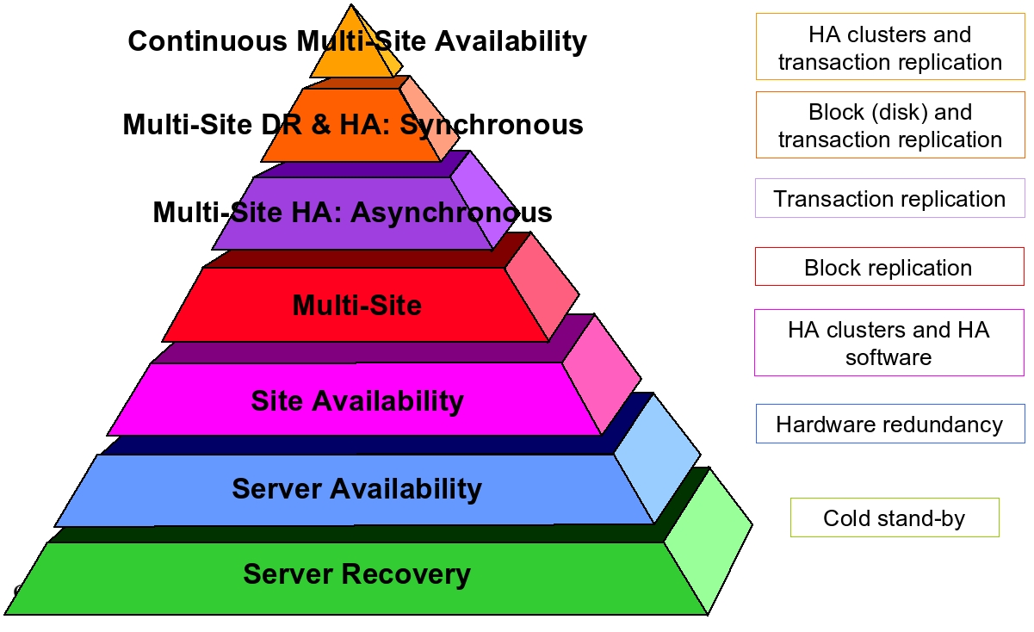
Business continuity: the pyramid
When we talk about business continuity we usually talk about the availability pyramid (the higher up the better).
HA & Replication
OS & Tran Repl.
DB Replication
Disk Mirroring
OS/DB Clustering
HW Redundancy
Backup Policy

Slide 3
Business continuity: the pyramid
When we talk about business continuity we usually talk about the availability pyramid (the higher up the better).
HA & Replication
Highest: OS/DB Host/Data duplication & data integrity
Transactional integrity & Storage duplication (DRP)
DB host/data duplication: transactional integrity
OS/DB storage duplication: data loss protection
OS/DB server duplication: downtime minimalized
Host redundancy: downtime minimalized.
Lowest: DB/OS Cold backup. Partial recovery.
OS & Tran Repl.
DB Replication
Disk Mirroring
OS/DB Clustering
HW Redundancy
Backup Policy

Slide 4
Business continuity: the pyramid
What is obvious from the pyramid is that Replication Solution and Clustering Solution protect different things.
HA & Replication
It is not really fair to compare Sybase Warm Standby Solution with Sybase Clustering / HA Solution sine the two operate on different protection levels.
Still, for those who ask themselves (or are asked by CTOs) where to go next in the business continuity methodology, the comparison is valid.
Both address different business continuity strands and both have their inherent strengths and weaknesses.
It is important to keep this in mind when considering business continuity options.
OS & Tran Repl.
DB Replication
Disk Mirroring
OS/DB Clustering
HW Redundancy
Backup Policy

Slide 5

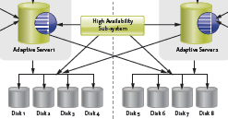


Business continuity: WS – HA
HA
Active
Standby
WS
Warm Standby - PROs:
data corruption local to the instance
no downtime/risk on maintenance
no downtime to implement
solution failure does not result in downtime
no demand for identical storage / server architecture
Warm Standby - CONs:
queue dependent
switch may be delayed or impossible
no / poor load balancing
vertical scaling only
ASE Clustering/HA - PROs:
no delay to fail over
load balancing over multiple ASE hosts
horizontal/vertical scaling
ASE Clustering/HA - CONs:
corruption propagated to all nodes
downtime/risk on ASE maintenance
downtime to implement
solution failure may result in downtime
demand for identical storage architecture
performance depends on logical application redesign

Slide 6
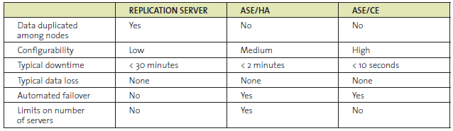
Clustering benefit #1: failover
There are two major advantages for cluster architecture for existing customers: ease to failover and horizontal scaling. The first is undisputed (though governed by SLA demands).
It is customary to compare the failover speed between solutions as 30 minutes to < 2 minutes, but this is really imprecise. Warm standby failover, if not impeded by non-empty queue, may be a matter of minutes, but definitely not seconds.
If failover SLA of only a few seconds is a must – clustering rules.

Slide 7
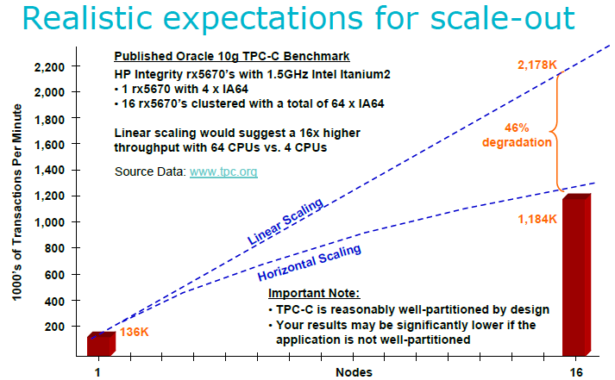
Clustering benefit #2: scaling
The second – is more disputed: typical comparison of horizontal to vertical scaling (origin - TPC.org):
Horizontal
Scaling:
May help
to save
money
Vertical
Scaling:
Helps to
get higher
throughput

Slide 8
Clustering benefit #2: APP. scaling
Another issue is application design:
Lack of application planning may result in a cluster that performs much more poorly than a single SMP node.
Overhead of messaging for distributed locking slows query processing.
Updates in different nodes could drive a physical I/O for each data modification vs. the usual SMP consideration in which multiple writes are cached until checkpoint or house keeper runs.
Not all applications are well-suited for horizontal scale-out.
Clustering enterprise database applications using shared disk cluster solutions adds complexity that both developers and DBAs need to understand and take into account in order to deliver on the promise of horizontal scalability.
Paying attention to Application Partitioning techniques is important to future-proof applications and reduce the on-going TCO of application development and deployment.

Slide 9
Business continuity: WS vs. HA
Given application which has not been optimized for clustering environment, the only real advantage of clustering is failover speed.
But we pay very high price:
No DB maintenance window.
No transactional integrity / data loss solution.
No database corruption protection.
Full dependency on the clustering solution.
Simply put clustering solutions is not a real alternative to DB replication. It may supplement in places where SLA is of the highest priority but not replace it.

Slide 10
Replication benefit #1: data rules
The major advantage of replication is true data duplication. Not only there are two servers available (ideally, each with independent storage/host) but the data available in both are guaranteed to contain all the transactions committed on the primary server.
Where clustering solution may add horse power to the server, replication is aimed primarily to protects data and adds an independent DB clone available for off-shoring some operations.
If data integrity is a must – replication rules.

Slide 11
WS benefit #2: DBA’s wet dream
One of the greatest advantages of warm-standby replication is an increased maintenance window and reduced maintenance risk (including DB upgrades).
Most of the blocking maintenance operations are performed on standby server and later switched over. No risk of getting stuck (of shut down) in the narrowing maintenance window.
In addition, Sybase replication warm standby solution does not require setup downtime. It may be added on the fly to the active running ASE server.
Easy to setup. Easy to break down. No risks.

Slide 12
Standby synchronization issues
The major challenge of replication is its queue.
To keep the time needed to switch active as short as possible in the warm-standby architecture the following steps should be taken:
Queue size to the Standby server must be constantly monitored and any delay treated at once (e.g. stale transactions in systransactions/syslogshold caused by connection pooling).
Any obstacles preventing the switch must be removed (e.g. huge DML batches, additional application dependencies on data in non replicated databases on the same primary ASE).
The switch process itself must be made automatic (scripting or auxiliary application, perhaps with OpenSwitch added).
No activities should be run on the standby server that may result in synchronization delay (including reports causing DSI commit delays).

Slide 13
HA&WS: Yin & yang
Warm standby solution and clustering/ha solution should better be thought as working together covering up each other’s weaknesses.
Having said that, the decision to force a choice is governed by two simple rules:
For environments that may scale horizontally and care less about data than about DB availability clustering has greater weight that replication.
For environments that put data at the center and may permit minimal failover downtime replication has greater weight than clustering.
Databases naturally incline towards replication. But it depends.

