Slide 1


SAP Sybase IQ 16 Tap Into Big Data at the Speed of Business
[Speaker’s name] [Date]
Notes:
Note to presenter:
This L1 presentation introduces the latest version of SAP Sybase IQ, version 16, which offers new capabilities for managing Big Data and extreme-scale data warehouses. This presentation is intended for CXO and IT Management audiences and describes how SAP Sybase IQ 16 addresses how companies deal with Big Data (typically unstructured data) and massive data volumes to make them easier to analyze, manage, and make accessible to a broad range of users throughout the enterprise.

Slide 2

Today’s topics
Introduction to SAP Sybase IQ
Challenges and Trends
Key Capabilities:
Exploit the value of Big Data
Transform businesses through deeper insights
Extend the power of analytics across the entire enterprise
Customer and Ecosystem Success
Notes:
Today we are going to discuss how SAP Sybase IQ can help organizations like yours to address the many challenges of Big Data and increasingly massive data volumes.
The SAP Sybase IQ server is a column-based analytics database that provides major innovations in the areas of performance optimization, data compression and data protection.
SAP Sybase IQ 16 was developed to address the Big Data and extreme scale analytics challenges that many companies are struggling with today. As we will describe,
SAP Sybase IQ makes it simpler and more cost-effective to exploit the value of massive amounts of Big Data at the speed of business. There are a lot of technology solutions available to you to analyze Big Data, but are often quite complex, expensive to scale, and difficult to integrate into your existing business landscape. As a result, Big Data analytics has remained out of reach for many organizations. SAP Sybase IQ can handle Big Data and extreme scale EDWs with high performance at an affordable price point. This makes it possible to extend the transformational power and value of analytics beyond the “powerful few” and deploy it more broadly across the enterprise.
And SAP Sybase IQ is a trusted, proven solution with a strong ecosystem of partners.

Slide 3



SAP Sybase IQ: smarter answers now
Speed & Flexibility
Lower TCO
Mature and Proven
Up to 1,000x faster than traditional DBMS
Handles volumes of ad hoc queries in real time
Simple and complex analytics on structured and unstructured data
Compression reduces data volume by up to 70%
Less storage and maintenance required
Easy to lean and use – requires minimal training
2x as many customers as the next leading provider
96%+ customer satisfaction rates
Consistently ranked as EDW market leader by leading analysts*
Source: Magic Quadrant for Data Warehouse Data Management System, Gartner, January 31, 2013
Notes:
SAP Sybase IQ is the #1 column database in the market today. In fact, with 4,500 installments in 2,100 accounts, it has more customers than all the other column database vendors combined! And we win more new customers each year than some vendors have in total. Sybase IQ was the first column database in the market over 15 years ago, and continues a very aggressive innovation roadmap. Customers can use SAP Sybase IQ as a data mart sitting alongside their data warehouse, or some customers use it as their primary data warehouse such as the Internal Revenue Service (IRS) here in the U.S.
We have learned that customers deploy SAP Sybase IQ for one of 3 reasons:
First: query performance. Customers often get queries running 10 times faster, and some customers have been able to achieve up to 1,000 times faster. That’s the difference between a query taking 10 minutes instead of 7 days. While some customers choose to limit what their users can do, others unleash SAP Sybase IQ to large user communities. For these, SAP Sybase IQ supports hundreds even thousands of concurrent users running ad hoc queries.
Second: the ability to store and query more data, more affordably. The biggest SAP Sybase IQ customers are in the petabyte range, with many in the dozens to hundreds of terabyte range. Often they are spending a lot of time administering their current database; or using more hardware than is required. SAP Sybase IQ is well known for its ability to compress data, often up to 70%. That in turn reduces storage costs. And SAP Sybase IQ is easy to learn and use, which reduces personnel overhead.
Third: it’s a mature and proven solution. When companies are looking for alternatives to relational disk-based databases for mission critical analytics or data warehouses, that want to go with a mature platform with an existing skill base and a strong ecosystem.
Think of SAP Sybase IQ as having a three-tiered architecture. At the foundation is a high performance column store, that scales with large data volumes and many users. Above, is an application services layer to enable developers to build smart applications - we provide a rich dialect of SQL, built-in full text search, Web 2.0 drivers, and UDFs for extending IQ capability and integrating with other computing paradigms such as Hadoop and R. IQ is a trusted open platform – that has strong support for all the 3rd party BI tools as well.
So if customers or partners have tools other than SAP they can use them with SAP Sybase IQ very successfully. And lastly, we have a rich integrated ecosystem of partners enabling advanced, in-database analytics, R integration, industry-standard PMML support, information lifecycle management, database management, and much, much more.
So you can see IQ provides a comprehensive platform and partner ecosystem for advanced analytics against data sets, big or small; with relational data, text data or even multimedia content. And, there has been a lot of integration work between the Sybase IQ engineering and other SAP engineering teams.

Slide 4

Business Challenges and Trends
Notes:
So, what are the most critical business challenges and trends today that are driving the need for this innovative approach?

Slide 5



What’s happening in the marketplace…
Exploding Data Volumes
The Need for Speed
Rising IT Costs and Complexity
Notes:
Data-driven analytics is making a measurable impact on businesses performance, helping companies pinpoint new sources of revenue and streamline operations. But traditional computing systems are challenged to keep up with a rapidly evolving data management landscape:
Huge Volumes of Data. Across almost every industry or sector, companies are faced with vast and growing amounts of information generated by business operations and enterprise applications, coupled with the need to make more data available to users for deeper analysis or compliance.
Higher Expectations. Today’s business users demand dynamic access to information in real time. While IT departments grapple with the complexities associated with more data, new types of data, and an assortment of purpose-built systems, they must also address their users’ insatiable appetite for faster and more conveniently delivered results.
Rising IT Cost and Complexity. The cost of managing data is exploding, despite Moore’s Law. Although the cost of creating, capturing, managing, and storing information today is one-sixth of what it was in 2005, the total investment in managing data increased 50% because the amount of information grew by 900% over that same period.

Slide 6






Today’s challenges
Lost Revenues; Lack of Insight
High Costs & Complexities
Slow Performance
Data Management Challenges
Security
Notes:
The ability to draw intelligence from all potentially valuable information is a top priority, yet organizations are not prepared for rapidly increasing volumes and variety of data. Insufficient or incomplete data can result in missed opportunities or lost revenues. IT organizations need new approaches for unlocking the value of both existing and new sources of data in order to help their organizations remain competitive in today’s data-driven business climate.
Here are some of the challenges we see:
[Lost revenues] Big Data and unstructured data contain significant potential business value, yet it is unwieldy and difficult to incorporate these new types of data into everyday business decision-making. Customer need to improve the ability to translate information into actionable insight across more business processes. Lack of timely insight results in missed opportunities due to poor decision-making.
[High Costs] The cost of capturing, storing, and managing relevant business data is becoming excessive. Traditional data management approaches are difficult or expensive to scale to handle exploding volumes and varieties of data. Upgrading systems and tools to collect more accurate information is adding excessive cost and complexity to IT landscapes.
[Data Management] Providing access to new users and adding new data sets are big manageability challenges - Ensure business managers have access to timely information - Accurate, relevant data is not delivered to the right people in real-time, impeding productivity and quality of products and services
Security risk and liability increases as data, users, applications and systems proliferate.
[Performance]….With the huge volumes and new formats of data you need to worry about…How large is the hard drive on your computer? How close are you to filling it? Things like iTunes and digital photos really start to eat up the memory, don’t they? And how do these kinds of applications impact your computer’s performance? If you have slow performance at home, you’re frustrated. On the other hand, if performance slows at business, you’re losing money.

Slide 7




Competitive advantage is now data-driven
Marketing analytics
Digital channels
Track visits, discover best channel mix: e-mail, social media, and search
Sales analytics
Deep correlations
Predict risks based on deal DNA (e-mails and meetings) and pattern match
Operational analytics
Atomic machine data
Analyze RFID, blogs, Short Message Service (SMS), and sensors — for continuous operational inefficiency
Financial analytics
Detailed simulations
Liquidity and portfolio simulations — for stress tests and error margins
Notes:
The new capabilities in SAP Sybase IQ 16 were motivated by these changes happening in the business world.
Data-driven analytics is becoming the new strategic advantage, from operations to revenue generation to coming up with new strategic directions.
But as we have discussed, traditional systems are being overwhelmed. Companies acquiring massive amounts of data in different forms from different sources, ranging from traditional channels with structured formats to social media channels with unstructured formats. This is changing the focus of analytics from highly specialized systems to more “real-world” deployments, where traditional approaches are simply falling short.

Slide 8
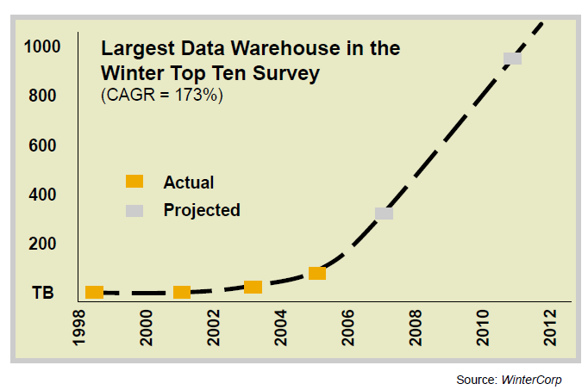
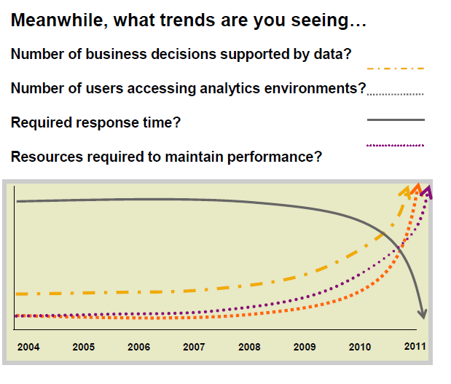
The data explosion continues
“Petabyte is the new Terabyte” - Forbes
Data volumes in analytics environments are growing exponentially
Trends in analytics:
# of business decisions supported by data?
# of users accessing analytics environments?
Required response time?
Resources required to maintain performance
Source: WinterCorp, Big Data and Data Warehousing, www.wintercorp.com
Notes:
SAP Sybase IQ has long addressed the challenges of Big Data in terms of very large data sets, complex analytics, large number of users, near real-time analytics and support for a variety of multiple types of data. Now, with version 16, we are introducing a host of new ways to handle these huge volumes, from much faster loading, new compression techniques, to new ways to organize and partition data. So, while traditional approaches are struggling to address these problems, SAP Sybase IQ 16 has the answers with its new, innovative approach. Let’s talk about why.

Slide 9

Key Capabilities
Notes:
So now let’s dig into some of the new capabilities of SAP Sybase IQ 16

Slide 10

SAP Sybase IQ 16
SAP Sybase IQ transforms the way companies compete and win through actionable intelligence delivered at the speed of business to more people and processes.
Notes:
SAP Sybase IQ uses its column-oriented, grid-based MPP architecture and patented data compression and indexing technology to transform the way companies deliver business intelligence. Its speed and power for extreme-scale enterprise data warehousing give companies the ability exploit the value of massive amounts of data at the speed of business.

Slide 11
Key Capabilities The Value of SAP Sybase IQ 16
Exploit the value of Big Data
1
Transform businesses through deeper insights
2
Extend the power of analytics across the entire enterprise
3
Notes:
The value of SAP Sybase IQ is best presented in terms of three core capabilities.
First, SAP Sybase IQ makes it simpler and more cost-effective for companies who want to exploit the value of Big Data, and massive amounts of data.
Second, it supports more accurate insight into business performance and market dynamics, and
Third, it makes it is designed specifically for companies that want to extend the power of analytics to large numbers of users and workloads across the entire enterprise.
Let’s get into more detail about how we do this

Slide 12

Exploit the value of Big Data
Unconstrained, unlimited, fast access
Flexible, expandable grid architecture
Integral native frameworks
Cost-effective compression
Notes:
Big Data contains significant potential business value, yet it is unwieldy and difficult to incorporate all the new types of data into everyday business decision-making. Traditional BI tools and EDWs usually depend on weekly or nightly batch-oriented approaches to upload massive quantities of new data, providing limited value to time-sensitive business processes. Now, with the release of SAP Sybase IQ 16, companies have at their disposal a host of new ways to handle these huge volumes, from much faster loading, new compression techniques, to new ways to organize and partition data.
In order to go from terabytes to petabytes you need to be able to load massive amounts of data fast – big volumes equal the need for fast velocity – otherwise your systems would be brought to a standstill. With high-performance data loading, SAP Sybase IQ ingests large amounts of data faster than ever—from terabytes to petabytes—making Big Data available to applications and people faster, for in-the-moment decisions. Essentially removing the constraints of traditional systems
The expandable grid-based MPP architecture of SAP Sybase IQ dynamically manages many analytics workloads in parallel, making it simpler and more cost-effective to support thousands of concurrent users, user-driven reports and ad hoc queries, along with data-driven processes across the entire enterprise.
SAP Sybase IQ offers the whole picture through data integration – multiple integration modes for using MapReduce and Hadoop, Predictive Model Markup Language (PMML) support, In-database analytics for high performance integration with third party libraries of statistical, data mining, and predictive analytics functions and our rich partner ecosystem make it easier for organizations to incorporate Big Data into operational analytics and decision-making.
Its next-generation column store compression allows for highly efficient compression of fixed and variable sized data reducing storage costs and improves performance by removing I/O bottlenecks.

Slide 13

Transform business through deeper insights
Unified platform for all data
Low latency for immediate updates
Comprehensive answers using massive volumes
Notes:
The explosion of data has also made it much more complex and challenging to bring insights that can transform for your business.
SAP Sybase IQ helps you build a more complete and accurate picture of the business by acting as a unified platform – managing both structured and unstructured data types in a unified analytical framework, and harmonizing data from multiple systems and sources.
One of the keys to improved decision making in a rapidly changing environment is enabling analytics on real-time information, so we’re introducing low latency real-time analytics –the new in-memory, read/write-optimized Row-level Versioning (RLV) store in SAP Sybase IQ provides fast, concurrent ingestion of data from multiple sources.
Comprehensive, in-the-moment answers to complex questions require months’ or even years’ worth of data to help companies spot new market opportunities, delight customers, or reduce risk.
SAP Sybase IQ is able to handle extreme-scale data volumes, putting all this data at users’ fingertips.

Slide 14

Extend the power of analytics across the entire enterprise
User driven self-service at “Google speed”
Highly available enterprise data
Fast and efficient MPP and query optimization
Secure data and systems
Notes:
And meeting high expectations for user-friendly tools, speed, availability and security is critical to extending analytics across the enterprise.
Users can perform deep drill-down analysis on vast amounts of data using familiar BI tools, without ongoing IT intervention, at “Google search” speeds. Users can get quick answers to any question, either recurring or one-of-a-kind.
Highly available – With SAP Sybase IQ, enterprise data is always available regardless of how large the workloads and datasets, thanks to multiplex resiliency.
Fast and efficient –Analytics performance is boosted at least ten-fold over traditional data management systems with our column-oriented, elastic grid-based massively parallel processing architecture and advanced query optimization.
And new security options make it easier to increase the security of enterprise data in SAP Sybase IQ using existing enterprise LDAP infrastructure and role based access control (RBAC) highly granular management of data access.
All of these capabilities make SAP Sybase IQ 16 faster, more secure, and more adaptable to changing business requirements. By extending the power of analytics to more people and processes with less effort and expense, SAP Sybase IQ is giving companies the power to act on insights that were previously impractical or impossible.

Slide 15

Customer & Partner Success
Notes:
Now let’s look at some of the customers and partners that are taking advantage of these capabilities.

Slide 16
SAP Sybase IQ Global Presence in a Range of Data-Driven Industries
…in North America
…in EMEA
…in EMEA
“
“
“
I would venture to say SAP Sybase IQ is the fastest in the industry. We load almost 10 billion rows a month, a terabyte a quarter. With SAP Sybase IQ, it just flies.
Craig Silver, Senior Database Architect, Nielsen Media Research
Since adding Sybase IQ, the demand for reports has risen dramatically as users realize just how much more helpful the information is that we can now provide. We receive requests for 10-20,000 more reports per month, and ad hoc queries have grown from 5,000 to 10,000 per month.
Marc Guillard, DBA , BNP Paribas Securities Services
SAP Sybase technology added a new dimension to our business – we can now report on any data our executives need within minutes. Previously, reports were impossible or took a full day to generate.
Bonjan Sovilj, Research and Development Manager, Mozzart
”
”
”
Notes:
Nielsen Media Research (OEM) - Created On-line Audience Data Warehouse with SAP Sybase IQ - Nielsen Media Research (OEM) is the leading provider of television audience measurement and related services in the world. With hundreds of broadcast channels running 24/7, it’s not surprising that there are hundreds of terabytes of data on audience demographics and viewing habits residing in the company’s data center. This data is critical to broadcasters and advertisers alike who rely on it to make and fine-tune programming decisions and advertising placements.
BNP Paribas Securities Services - Ad hoc queries have grown from 5,000 to 10,000 per month using SAP Sybase IQ - BNP Paribas Securities Services is part of the BNP Paribas Investment Solutions group. Europe’s leading securities services provider. Operating across the entire investment cycle, BP2S provides post-trade solutions to buy-side and sell-side financial institutions and issuers.
Mozzart - Betting on SAP Solutions to Increase Profitability and Improve Customer Service - As a leader in sports betting in the western Balkans, Mozzart implemented SAP® Sybase® IQ server and SAP Sybase PowerDesigner® software to analyze production database the profitability of 50,000 daily betting games. It can now review each game’s performance in real time and adjust odds when necessary, improving profitability, and the customer experience and enabling expansion into new markets.

Slide 17



Measurable benefits for our customers
75%
75%
800%
Reduced daily DB administration by 75%
Faster data loads - increase productivity during maintenance window
Reduced BI storage requirements by 75% a ratio of 4 to 1
Notes:
“The compression facility has allowed us to reduce the disk space required for each project considerably—by a ratio of 4 to 1.” Jean-Pierre Demont, Applications Manager, BNP Paribas Corporate and Investment Banking
“Sybase IQ’s column-based architecture has really made a big difference for us. It’s improved performance dramatically. That has made our end-users happier and it has reduced daily database administration by 75% and cut hardware requirements in half. Sybase IQ delivers better performance at a fraction of the cost.” Tugce Denizlerkurdu, Head of the Decision Support Systems Unit, Digiturk
I would venture to say SAP Sybase IQ is the fastest in the industry. We load almost 10 billion rows a month, a terabyte a quarter. With SAP Sybase IQ, it just flies.”
Craig Silver, Senior Database Architect, Nielsen Media Research

Slide 18






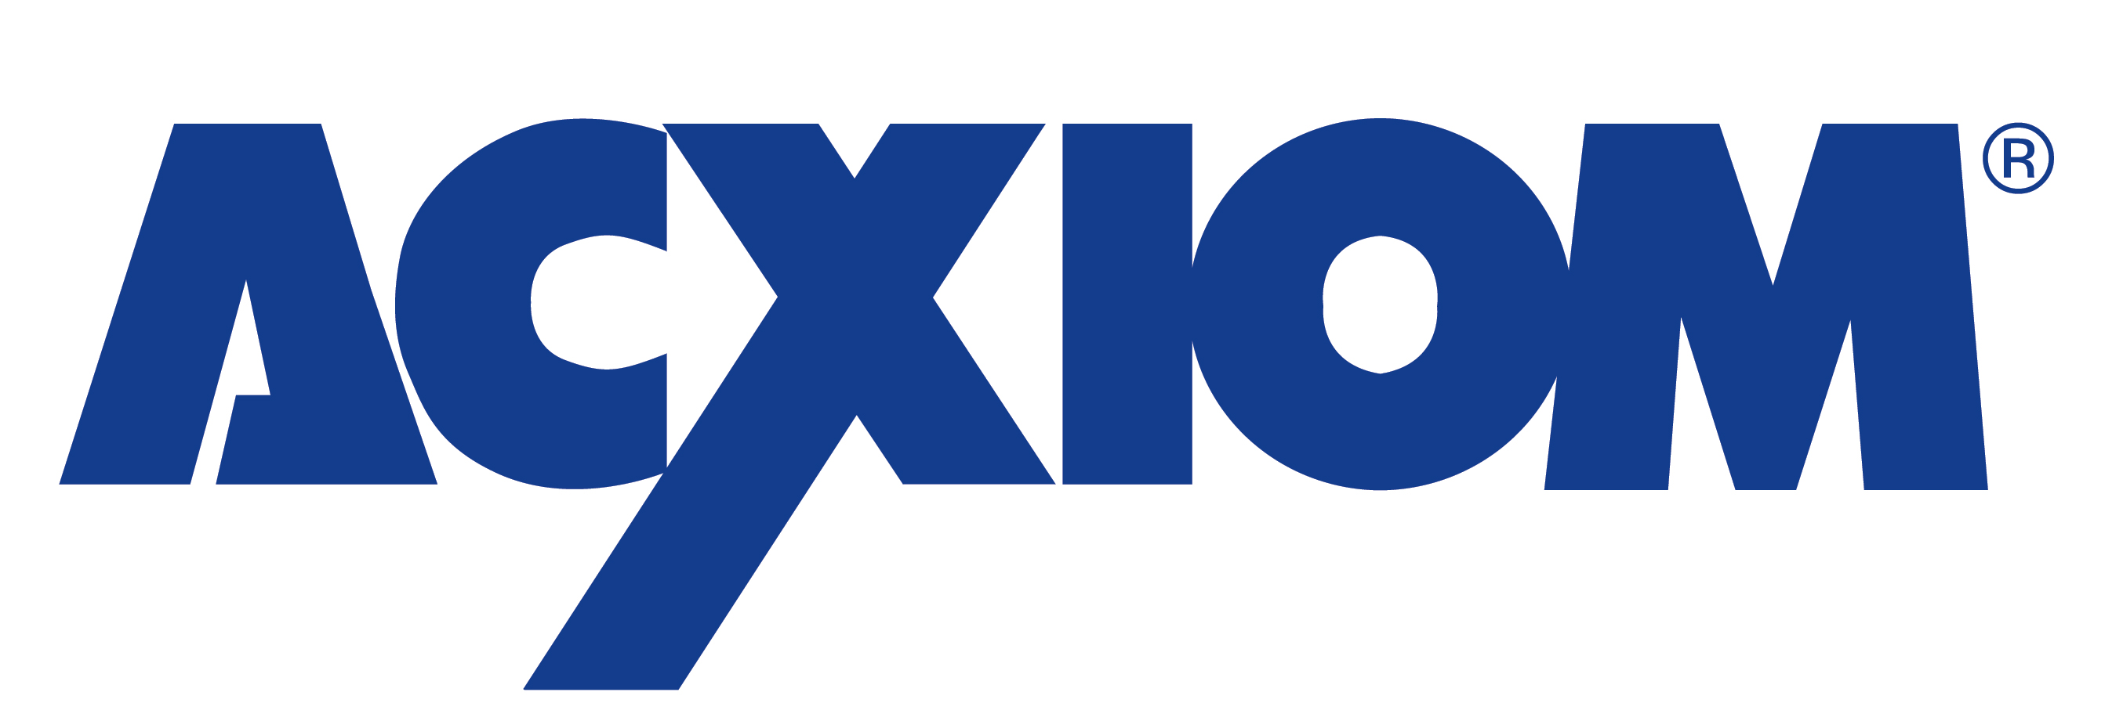


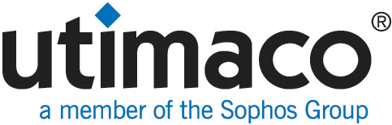




SAP Sybase IQ Market-Leading RDBMS Platform for EDW
2,100 + Customers
4,500 Installations
96% Customer satisfaction rating
Notes:
SAP Sybase IQ is the original column-based RDBMS, designed and optimized for high performance enterprise data warehousing and analytics, with over 2,100 customers (twice that of the nearest competitor in the market), 4,500 installations, and a 96% customer satisfaction rating.
Companies and organizations around the world and across many industries rely on SAP Sybase IQ to give them a competitive edge.

Slide 19

SAP Ecosystem
Notes:
SAP Sybase IQ is also part of a rich ecosystem of SAP technologies.

Slide 20
SAP Real-Time Data Platform Unified open software platform for real-time business
SAP Real-time Data Platform
SAP Real-Time Data Platform foundations
Cross-paradigm data access for new models of value discovery.
Hyper-performance on all classes of application and usage scenarios
Price-Performance value across all use cases
Benefits
Execute, record, analyze, and optimize without system limitations
Embrace and extend across variations of data forms and processing models
Common modeling, integrated development environment, shared systems management infrastructure, and deployment-independent solutions
Trusted and unified data environment
Common programming APIs
SAP Sybase ASE
transactions
SAP Sybase IQ
EDW
In-memory/real-time
SAP HANA
SAP Sybase PowerDesigner modeling
SAP Sybase Control Center monitoring
SAP Sybase ESP
streams
SAP Sybase SQL Anywhere
mobile and embedded
Hadoop Big Data
SAP Data Services / SAP Information Steward
information management
Notes:
The purpose of this slide is to show the products that are part of the RTDP.
There are four main areas:
Database engines – HANA, ASE, IQ, SQLA and ESP
HANA is the core of the RTDP, and provides the in-memory acceleration for customers who need to dramatically speed up key processes, reports, etc
ASE is the price performance leader for standard transaction processing, and a great selection for Business Suite
IQ provides large historical analytics as well as disk based analytics up to 1,000 times faster than traditional databases (i.e. Oracle, DB2, MSFT SQL)
SQL Anywhere is the leader in mobile data management, including sophisticated synchronization to ensure that data gets where it is needed and is safe, fresh and valuable
ESP (Event Stream Processor) can aggregate events from inside and outside the business and analyze them in real time. It can also feed HANA at up to 1.5M events/second to give HANA the real-time data it needs to run a real-time business
Modeling (LHS) – PowerDesigner is a market leading data modeling tool that can model all the data in your enterprise to ensure a clear vision of your data architecture
Monitoring (RHS) – The RTDP has monitoring capabilities – it is like your own NASA Control Center, but for the data in your enterprise
SAP Data Services – This is the brains that can move data to the right place in real-time, and address the perennial problem facing organizations – data quality – with SAP Data Services you can feel more comfortable that the data you are using to make business decisions is as accurate as possible

Slide 21




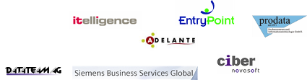























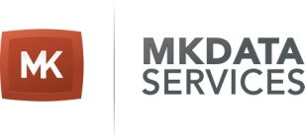








Comprehensive Worldwide Partner Ecosystem
System Integrators and Global Trade Experts
Consulting
Data Providers
Technology Partners
Notes:
Finally, SAP Sybase IQ is supported by a wide range of system integrators, data providers and technology providers. These organizations offer a wide range of expert services for installation, training, support, consulting, and customization.
SAP and its partners can ensure your success with SAP Sybase IQ by transforming the challenges of extreme-scale enterprise data warehousing and Big Data analytics into business insights that deliver a competitive edge, with dramatic affordability and efficiency.

Slide 22
Questions?

Slide 23
Thank You!
Contact information:
F name MI. L name
Title
Address
Phone number

Slide 26
The Grid
Headline area
White space
Drawing area

