Slide 1

ISUG - Sybase IQ Special Interest Group
Index Maintenance in Sybase IQ
Lou Stanton
Principal Systems Consultant
Sybase, Inc
Audio: 1-888-288-9321
Pass Code: 604060
*
6 Will Mute Your Phone Line

Slide 2
Today’s Session
Introduce functionality in IQ 12.6 for index maintenance
  System stored procedures
  Sybase Central functions
This material is currently missing from our customer training course
  Provide class graduates with an important update
This material is part of a new module on “Maintenance”
  (I am ‘beta testing’ this material on you today)

Slide 3
Index Maintenance
Index maintenance helps maintain optimal query performance and better disk space usage in the database
Circumstances warranting index maintenance
  A table was created with Minimize_Storage = ‘OFF’
  Cardinality of a column with a flat FP index has changed to permit rebuilding it as an optimized FP index
  Rows have been randomly deleted from a table and new rows were inserted with Append_Load = ‘ON’
    This could lead to ‘index fragmentation’ for all the indexes on a table
Notes:
Some IQ databases might never require index maintenance, but there are circumstances when some maintenance is recommended to maintain performance
The Append_Load database option is OFF by default which means if there have been rows deleted from a table any newly inserted rows will ‘backfill’ empty rows before appending to the table
If Append_Load has been set to ON there will be unused space on index data pages where rows were deleted

Slide 4
System Procedures for Index Maintenance
sp_iqrowdensity
  Reports on FP index fragmentation and row density for an entire table or specific columns in a table
sp_iqindexfragmentation
  Reports information about the amount of empty space within B-trees, G-arrays and Bitmaps in non-FP indexes
sp_iqrebuildindex
  Rebuilds FP indexes to original IQ UNIQUE value
  or a new user specified value
  Rebuilds other index types to correct fragmentation
Notes:
sp_iqrowdensity only reports on FP indexes
sp_iqindexfragmentation is used to check fragmentation on the other index types

Slide 5
sp_iqrowdensity
Reports column density as a ratio of the minimum number of FP index pages required to the actual number of pages used
  Returns density as number from 0 to 1
Syntax: sp_iqrowdensity (‘target’)
  target: (table table-name | column column-name (…) )
  Target table table-name reports on all columns in the table
  Target column column-name reports on the named columns
    Keywords table and column must be used together
    The keyword column must be repeated for multiple columns
Sybase Central: Table Properties -> Columns Tab
Notes:
sp_iqrowdensity
Owned by the dbo user
Requires DBA Authority to execute but may be granted to others
Sybase Central can be used to report row density
Select a table from the Tables folder
Right click on the table
Choose Table Properties
Column Tab
A density of report of 1 would indicate there is no fragmentation or empty space for an FP index

Slide 6
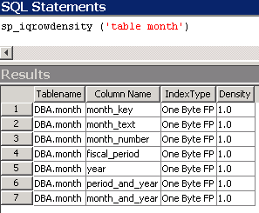
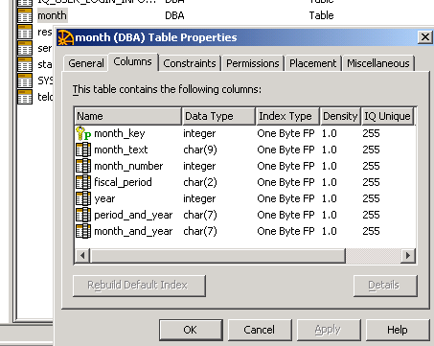
Row Density Reports
Density: Ratio of minimum # of FP index pages required to the actual # of pages used
sp_iqrowdensity
Sybase Central
SCJ: “Tables” Folder
right-click a table
Properties - Columns Tab
*
6 to Mute Your Phone Line
Notes:
You see similar information about Index Density from the system stored procedure and Sybase Central

Slide 7
sp_iqindexfragmentation
sp_iqindexfragmentation reports the number of pages and percentage full of these index structures
  B-tree Pages
  B-tree Node Pages
  G-array Pages
  Bitmap Pages
B-tree pages are used with these indexes
  HG, LF, WD, DATE and DTTM
G-array pages are used with HG indexes
All indexes use bitmap pages
Notes:
Btree and Btree Node Pages
There will be at least one Btree Page for the indexes that use Btrees
A Btree Node Page is a non-leaf level Btree page. Btree Node Pages may or may not exist depending on the number of distinct values

Slide 8

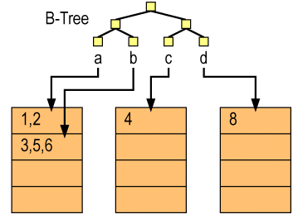
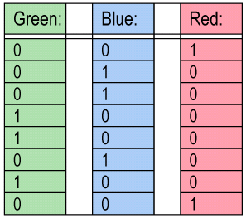
Sybase IQ Index Structure Review
Low Fast
High Group
B Tree Node Pages
B-Tree
…
Garray Pages
Bitmap Pages
Notes:
Low Fast Index
Regular LF: Btree with bitmaps.
One bitmap page chain for each distinct value
Unique LF: Btree only
High Group Index
Regular HG: Btree with a Garray and bitmaps
One Garray page chain per unique value containing rowids.
Some Garray pages are converted to bitmaps
Unique HG: Btree only
Date, Datetime and Word indexes use Btree structures
Other indexes are bitmaps

Slide 9
sp_iqindexfragmentation
Syntax: sp_iqindexfragmentation (‘target’)
target: (table table-name (index index-name (…) )
  table-name reports on all non-default indexes in the table
  index-name reports on the named index
  Example: sp_iqindexfragmentation (‘table residential_customer’)
Sybase Central provides index fragmentation reporting
  Select a table, then the Indexes Tab
  Right-click an Index and select Properties
  Select the Fragmentation Tab
The next few slides address interpreting the output
Notes:
sp_iqindexfragmentation
Owned by the dbo user
Requires DBA Authority to execute but may be granted to others
The example above would report on all non-default indexes on the residential_customer table
Multiple indexes in the target table may be checked, but the index keyword must be specified with each index
sp_iqindexfragmentation (‘table residential_customer’ index )

Slide 10
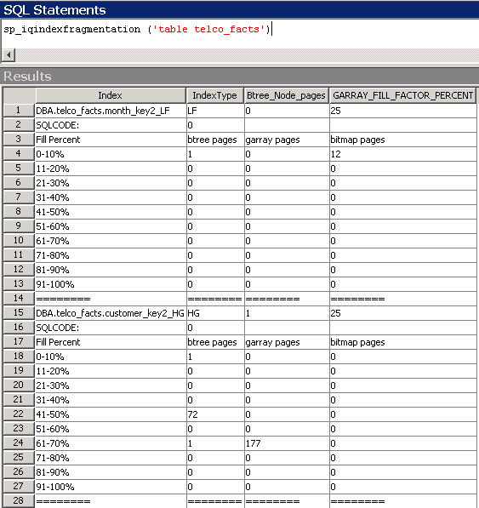
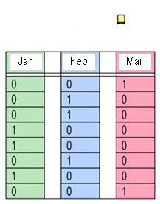
sp_iqindexfragmentation
LF
…
HG
Notes:
This is a partial report of the non-default indexes from the telco_facts table
The first index is the month_key LF index.
It has 1 Btree page that is less than 10% full.
There are 12 bitmaps (one bitmap for each month) all less than 10% full
The second index shown is the customer_key HG index.
This index has 74 Btree pages including 1 Btree Node Page
There are 177 Garray pages, all between 61% and 70% full
The SQLCODE line for each index reports if any errors are detected (0 = no errors)
See Chapter 9 of the IQ Reference Guide for more information about sp_iqindexfragmentation

Slide 11
Rebuilding Indexes
To reclaim space from index structures and increase density you can rebuild indexes without reloading source data
  FP indexes can be changed from Flat to Optimized
  Non-FP indexes can be rebuilt
Rebuilding an index rebuilds the index structures
  May be time consuming depending on index type/row count
To rebuild an index use either -
  sp_iqrebuildindex system procedure
  Sybase Central
Notes:
If the density of an index has been reduced as a result of table deletes you can reclaim the space by rebuilding the index. Rebuilding an index may reduce the number of pages and improve query performance
Both methods to rebuild an index will be presented

Slide 12
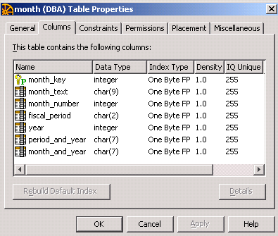
Rebuilding FP Indexes
FP indexes can rebuilt to –
  Change storage type from Flat to optimized (one or two-byte)
  Increase the density of the index
When an FP index is rebuilt it uses the original IQ Unique value unless a new IQ Unique value is specified
  Both rebuild methods accept
  new values for IQ Unique
  Example:
  All columns in this table were
  created as IQ Unique(255)
Notes:
Increasing the index density may reduce the number of data pages required for an index
The value for IQ Unique is stored in the system table SYS.SYSIQCOLUMN in “approx_unique_count” column
The system procedure sp_iqcolumn <tablename> shows the current values for IQ UNIQUE in “est_cardinality”
Sybase Central shows the value for IQ Unique used for a table’s columns
‘Tables’ Folder -> right-click <table-name> -> select ‘Properties’ -> ‘Columns’ Tab

Slide 13
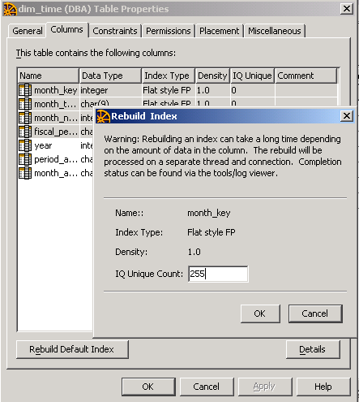

Rebuilding FP indexes – Sybase Central
Table Properties -> Columns Tab
  Highlight column(s) to rebuild
    Multiple indexes accepted
  Click ‘Rebuild Default Index’
  Provide IQ Unique value for each index
    Original value is the default
  Click ‘OK’ to rebuild
    Indexes are rebuilt sequentially
    Note the ‘Warning’
Notes:
This table was created with IQ Unique (0) meaning that Minimize_Storage was ‘OFF’ when the table was created
In the dialog shown four indexes were selected to be rebuilt (highlighted in gray)
Select multiple indexes using a combination of right-click Shift or right-click Ctrl keys
When Rebuild Default Index is clicked a dialog box is presented for each index to allow entering a new value for IQ Unique
Click ‘OK’ to continue to the next index selected

Slide 14
sp_iqrebuildindex
Uses
  Rebuilds FP indexes with the original IQ UNIQUE value specified in the Create Table statement, or with a user provided value (“count” parameter)
  Rebuilds other index types that have become fragmented
Syntax: sp_iqrebuildindex ‘table_name’ , ‘index_clause’
  Both the table_name and index_clause are required
  index_clause may be one or more of the following strings:
    column column_name [count]
    Index index_name
(count is only used for an FP index)
Notes:
INSERT permission on the table is required to execute this procedure
If not the table owner, the table name must be fully qualified as owner.table_name
The optional count parameter is used to provide a value for IQ Unique when rebuilding FP indexes

Slide 15
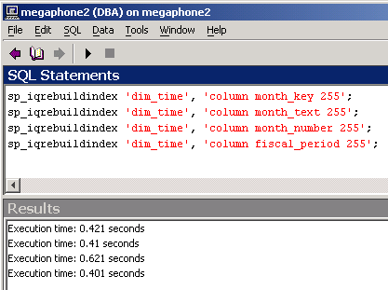
Rebuild FP Indexes – sp_iqrebuildindex
To rebuild FP indexes with a new IQ Unique value use the column string for the index_clause and provide an integer for the count parameter to specify a new IQ Unique value
Example: Rebuild 4 FP indexes in table dim_time with IQ Unique(255)
Notes:
This is the same table shown in the Sybase Central example
Indexes are be rebuilt sequentially

Slide 16
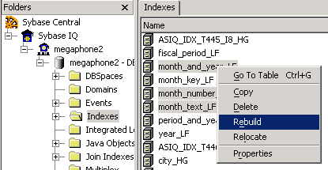
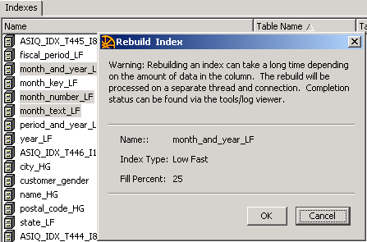
Rebuild Other Indexes – Sybase Central
From the Indexes Folder
  select the indexes to rebuild
  Then “right-click”
Dialog for each index selected appears
  Click ‘OK’ to confirm rebuild
  Indexes are rebuilt sequentially
Notes:
The Indexes Folder lists all the indexes except FP indexes
Click the Table Name column to sort the indexes by table name
Multiple indexes may be selected using a combination of right-click Shift or right-click Ctrl keys

Slide 17
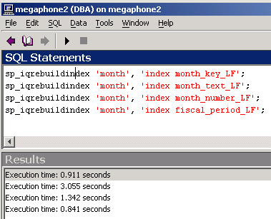
Rebuild Non-FP Indexes
Rebuilding indexes using the index clause and index name

Slide 18
Rebuild Indexes – Log Entries
Results of rebuilding indexes is recorded in both the -
  The IQ Server Log
  IQ Message File
Messages are similar to load notification messages
  Time to rebuild the index
  Number of records inserted into the index

Slide 19
ISUG - Sybase IQ Special Interest Group
Time for a few Questions…
Techwave returning to Caesar’s Palace
Las Vegas, NV
August 6 -10, 2006
Sybase IQ 12.6.1 release will be featured

