Slide 1
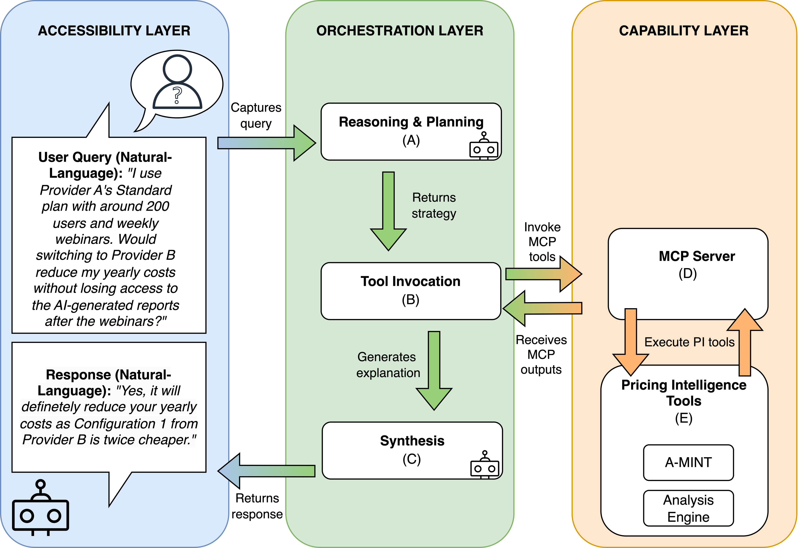
H.A.R.V.E.Y. Architecture
ACCESIBILITY LAYER
ORCHESTRATION LAYER
CAPABILITY LAYER
12

Slide 2
H.A.R.V.E.Y. Architecture
ACCESIBILITY LAYER
ORCHESTRATION LAYER
CAPABILITY LAYER
12

Slide 3
H.A.R.V.E.Y. Architecture
ACCESIBILITY LAYER
ORCHESTRATION LAYER
CAPABILITY LAYER
12

Slide 4
H.A.R.V.E.Y. Architecture
ACCESIBILITY LAYER
ORCHESTRATION LAYER
CAPABILITY LAYER
12

Slide 5
H.A.R.V.E.Y. Architecture
ACCESIBILITY LAYER
ORCHESTRATION LAYER
CAPABILITY LAYER
12

Slide 6
H.A.R.V.E.Y. Architecture
ACCESIBILITY LAYER
ORCHESTRATION LAYER
CAPABILITY LAYER
12

Slide 7
H.A.R.V.E.Y. Architecture
ACCESIBILITY LAYER
ORCHESTRATION LAYER
CAPABILITY LAYER
12

Slide 8
H.A.R.V.E.Y. Architecture
ACCESIBILITY LAYER
ORCHESTRATION LAYER
CAPABILITY LAYER
12

