Slide 1
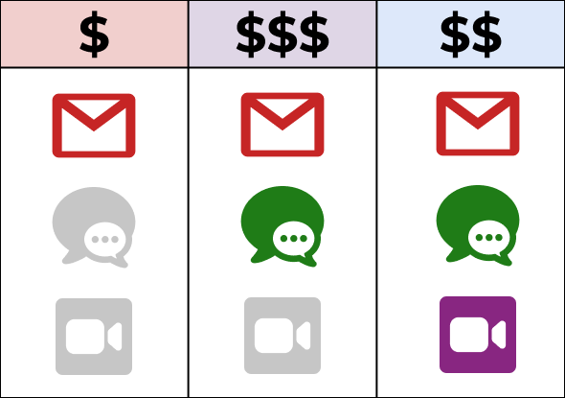
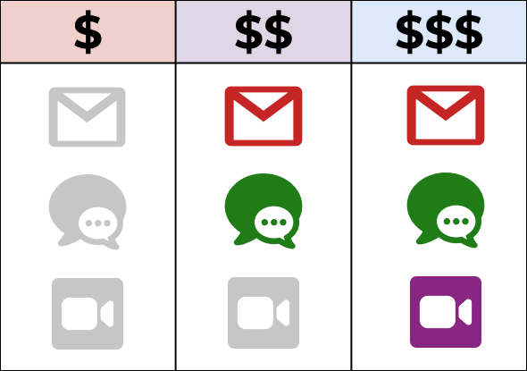



Common Cases of Invalid Pricings
Inconsistent Prices
Empty Plans
Dead Features
7

Slide 2
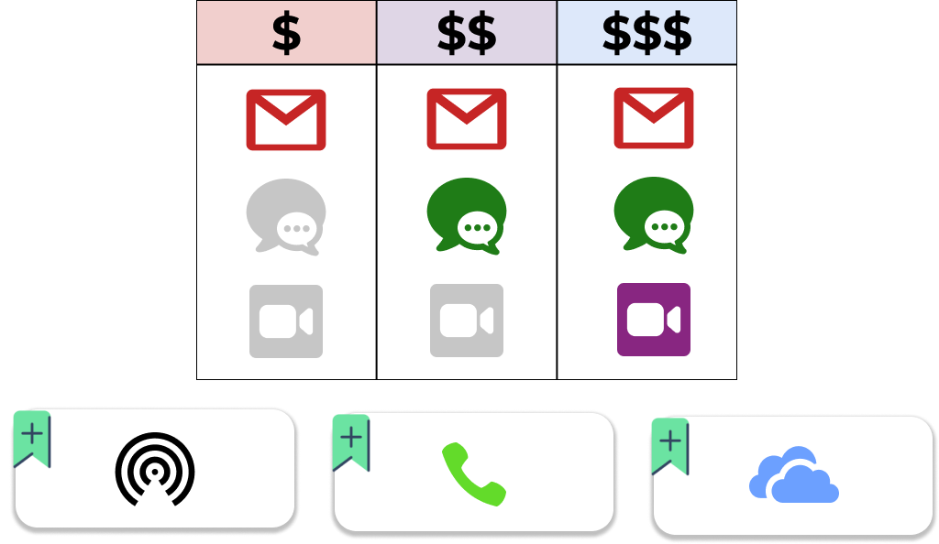

Common Cases of Invalid Pricings
Depends on
8

Slide 3

Complex Cases of Invalid Pricings
Depends on
Excludes
8

