Slide 1


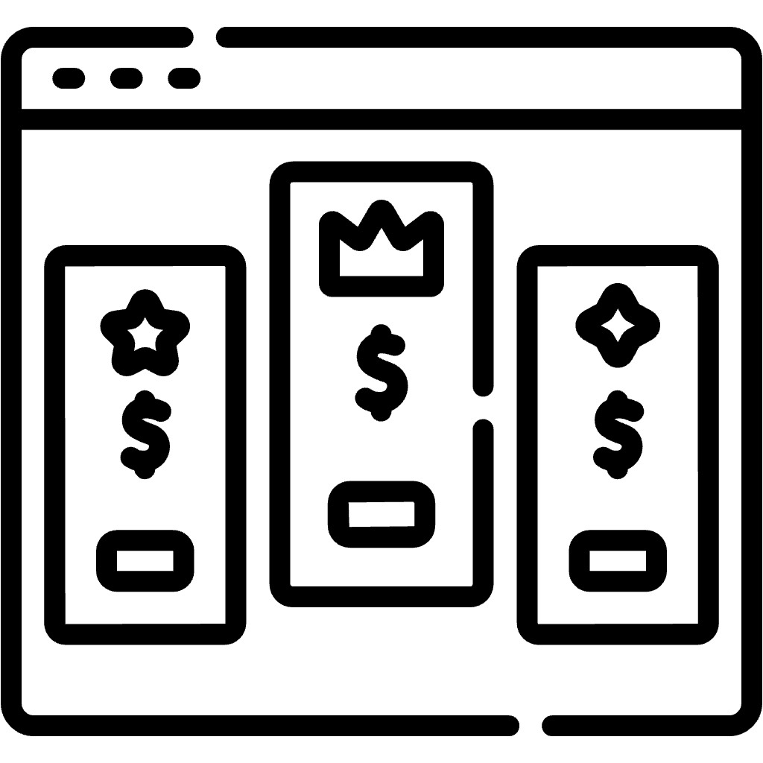





Conclusions & Future Work
1. Pricing & Subscription Modeling
2. Pricing Design Methodologies
toggle
Dev
Ops
operate
plan
release
3. Pricing-driven Self-Adaptation
4. Subscription Compliance Testing
test
monitor
5. Automated Analysis of Pricings
Number of Contributions
HIGH
MEDIUM
LOW
NOT YET ADDRESSED
36

Slide 2

Conclusions & Future Work
1
Explore iPricing as VML
37

Slide 3
Conclusions & Future Work
1
Explore iPricing as VML
2
Subscription Compliance Testing
37

Slide 4


Conclusions & Future Work
1
Explore iPricing as VML
2
Subscription Compliance Testing
3
Test SPACE in realistic setups
37

