Slide 1
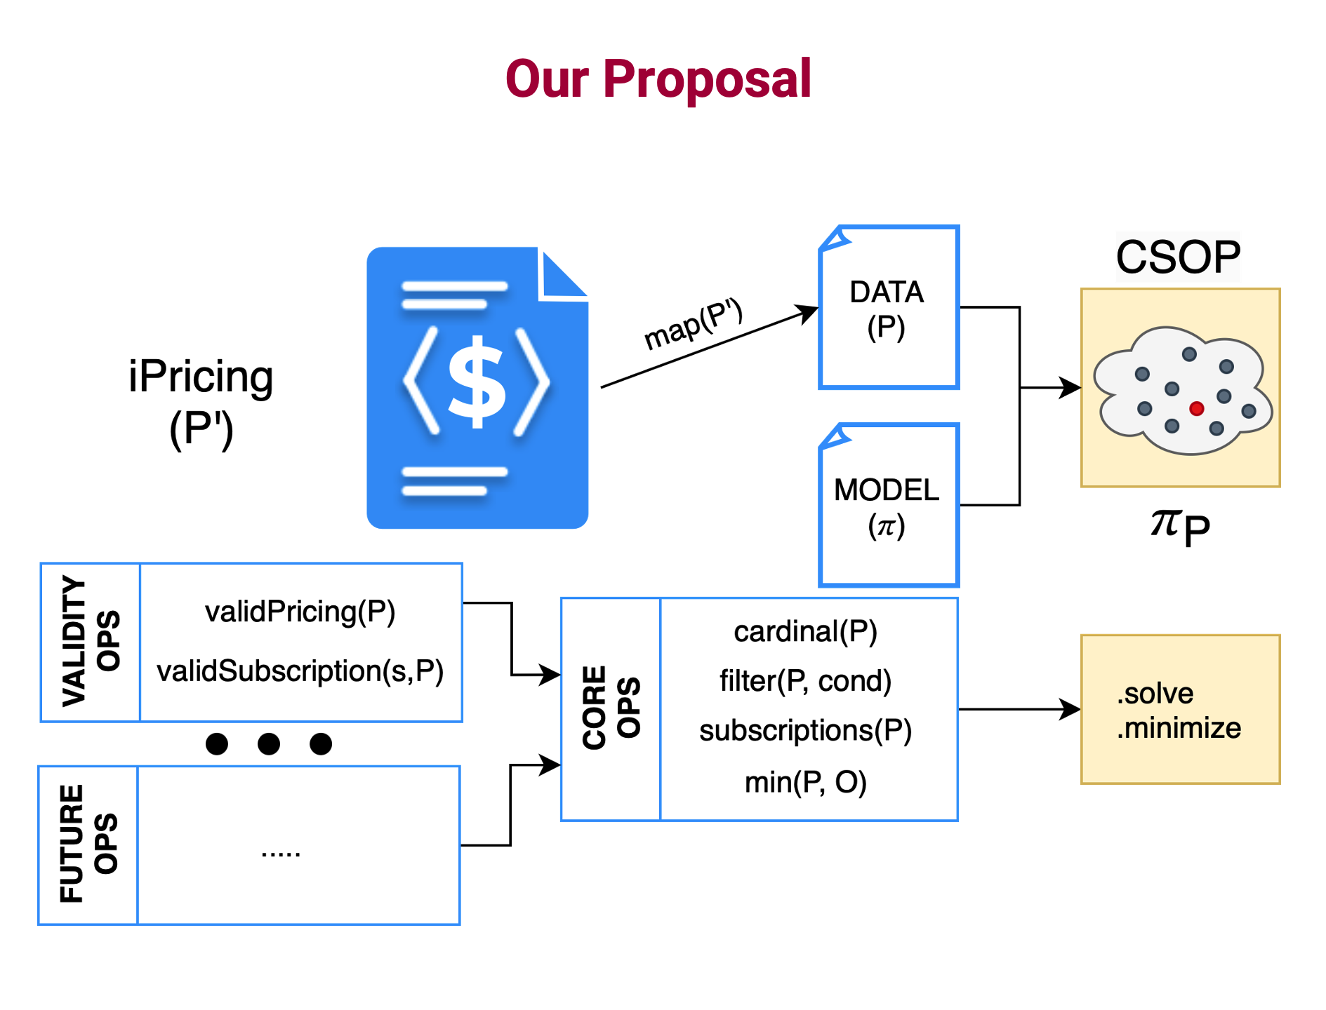
Conclusions
1. A generic, CSOP representation of iPricings.
30

Slide 2
Conclusions
1. A generic, CSOP representation of iPricings.
2. A mapping of iPricings into CSOP datafiles, which combined with the generic model creates a CSOP whose solutions define the iPricing’s configuration space.
30

Slide 3
Conclusions
1. A generic, CSOP representation of iPricings.
2. A mapping of iPricings into CSOP datafiles, which combined with the generic model creates a CSOP whose solutions define the iPricing’s configuration space.
3. An extensible core set of analysis operations.
30

Slide 4
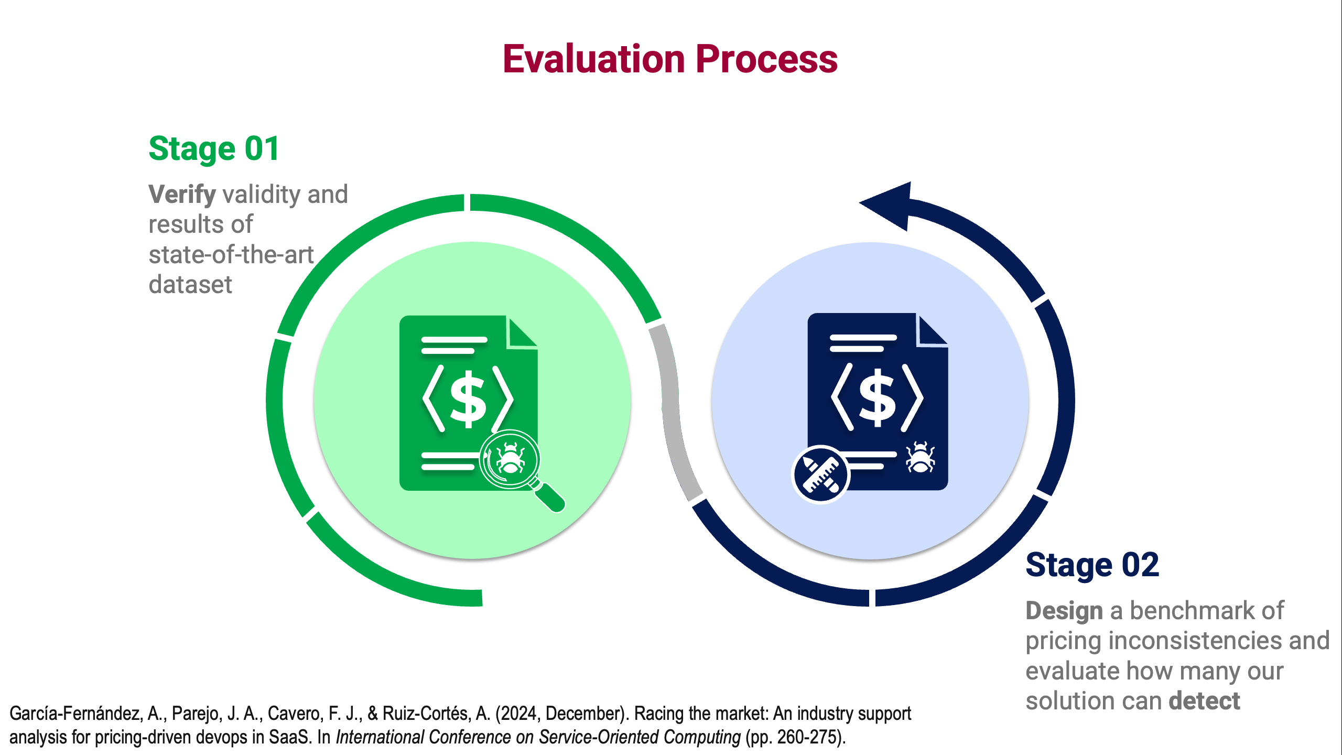
Conclusions
1. A generic, CSOP representation of iPricings.
2. A mapping of iPricings into CSOP datafiles, which combined with the generic model creates a CSOP whose solutions define the iPricing’s configuration space.
3. An extensible core set of analysis operations.
4. A tool with a layered architecture that implements the approach using Minizinc as solver.
5. A benchmark of pricing inconsistencies
that can be used to evaluate future solutions
in automated iPricing validation.
30

