Slide 1


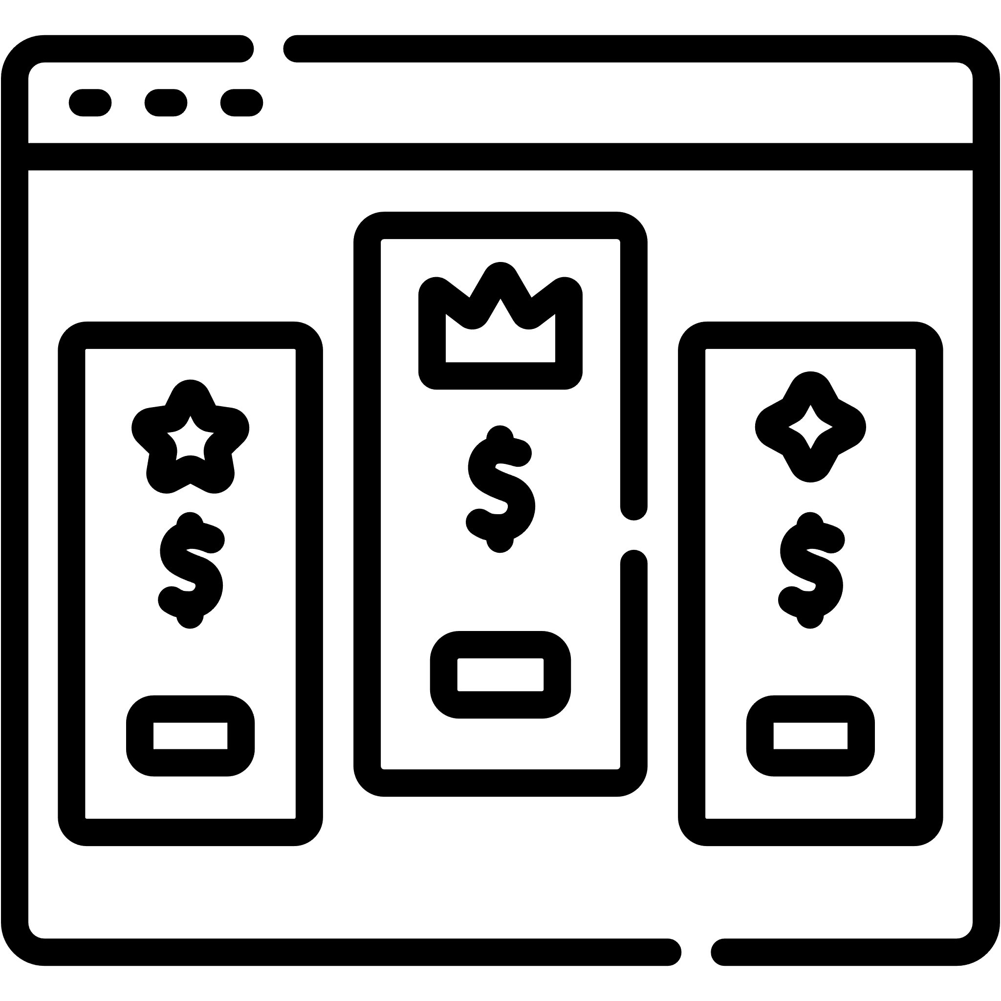

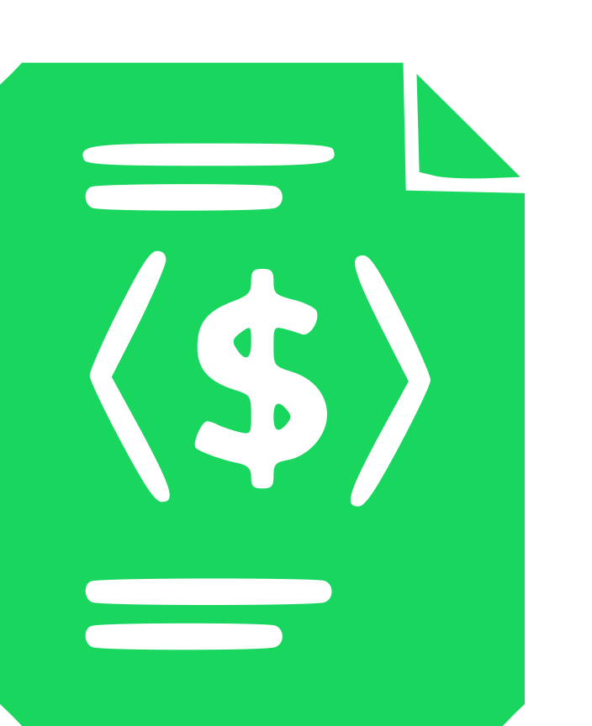



Pricing-driven Development and Operation of SaaS
1. Pricing & Subscription Modeling
2. Pricing Design Methodologies
toggle
Dev
Ops
operate
plan
3. PRICING-DRIVEN SELF-ADAPTATION
release
4. Subscription Compliance Testing
test
monitor
5. Automated Analysis of Pricings
PROVIDER EVENTS (pe_{j})
pe_{1 (new plan)}
pe_{3 (price change)}
23
pe_{j (feature reallocation)}

Slide 2
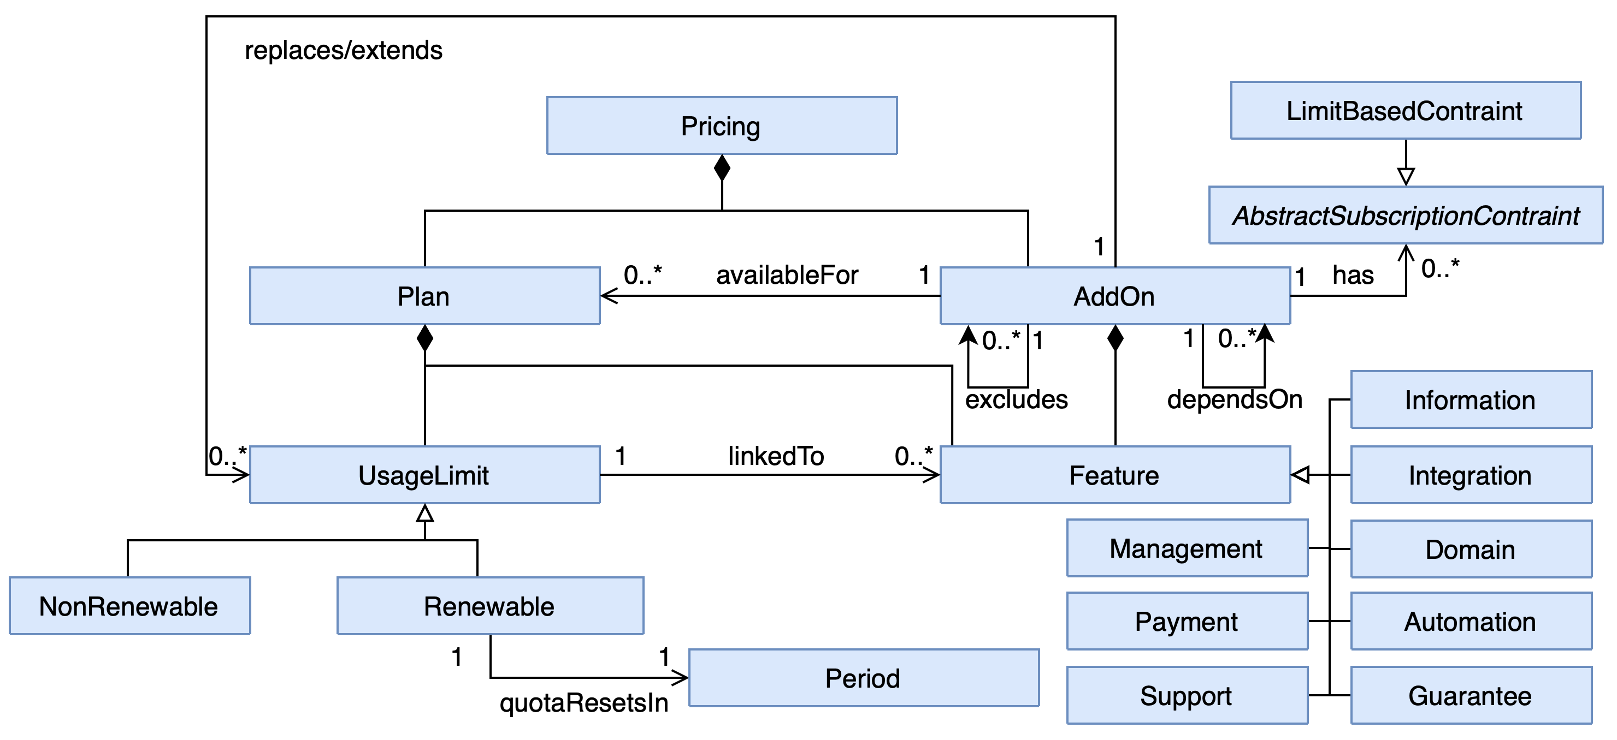
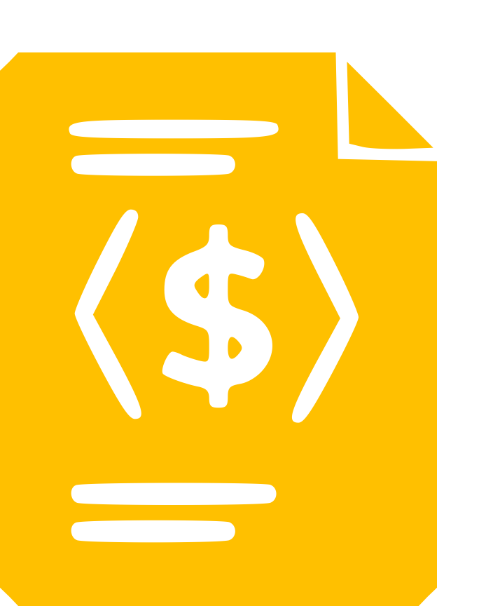

Pricing-driven Development and Operation of SaaS
1. Pricing & Subscription Modeling
2. Pricing Design Methodologies
toggle
Dev
Ops
operate
plan
3. PRICING-DRIVEN SELF-ADAPTATION
release
4. Subscription Compliance Testing
test
monitor
5. Automated Analysis of Pricings
iPricing
PROVIDER EVENTS (pe_{j})
pe_{1 (new plan)}
pe_{3 (price change)}
23
pe_{j (feature reallocation)}

Slide 3
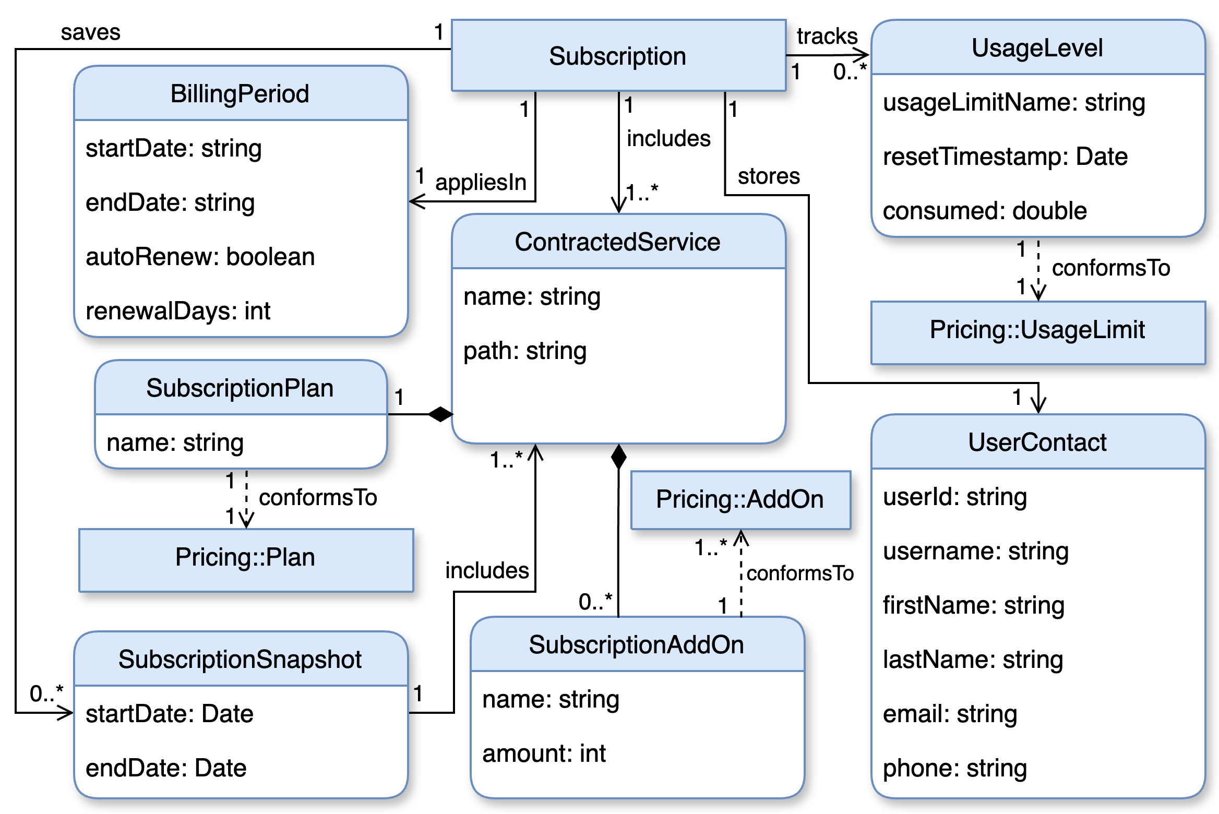
Pricing-driven Development and Operation of SaaS
1. Pricing & Subscription Modeling
2. Pricing Design Methodologies
toggle
Dev
Ops
operate
plan
3. PRICING-DRIVEN SELF-ADAPTATION
release
4. Subscription Compliance Testing
test
monitor
5. Automated Analysis of Pricings
iSubscription
PROVIDER EVENTS (pe_{j})
pe_{1 (new plan)}
pe_{3 (price change)}
23
pe_{j (feature reallocation)}

Slide 4
Pricing-driven Development and Operation of SaaS
1. Pricing & Subscription Modeling
2. Pricing Design Methodologies
toggle
Dev
Ops
operate
plan
3. PRICING-DRIVEN SELF-ADAPTATION
release
4. Subscription Compliance Testing
test
monitor
5. Automated Analysis of Pricings
PROVIDER EVENTS (pe_{j})
pe_{1 (new plan)}
pe_{3 (price change)}
23
pe_{j (feature reallocation)}

Slide 5

Pricing-driven Development and Operation of SaaS
1. Pricing & Subscription Modeling
2. Pricing Design Methodologies
3. PRICING-DRIVEN SELF-ADAPTATION
toggle
Dev
Ops
operate
plan
4. Subscription Compliance Testing
release
5. Automated Analysis of Pricings
test
monitor
PROVIDER EVENTS (pe_{j})
pe_{1 (new plan)}
pe_{3 (price change)}
23
pe_{j (feature reallocation)}

Slide 6
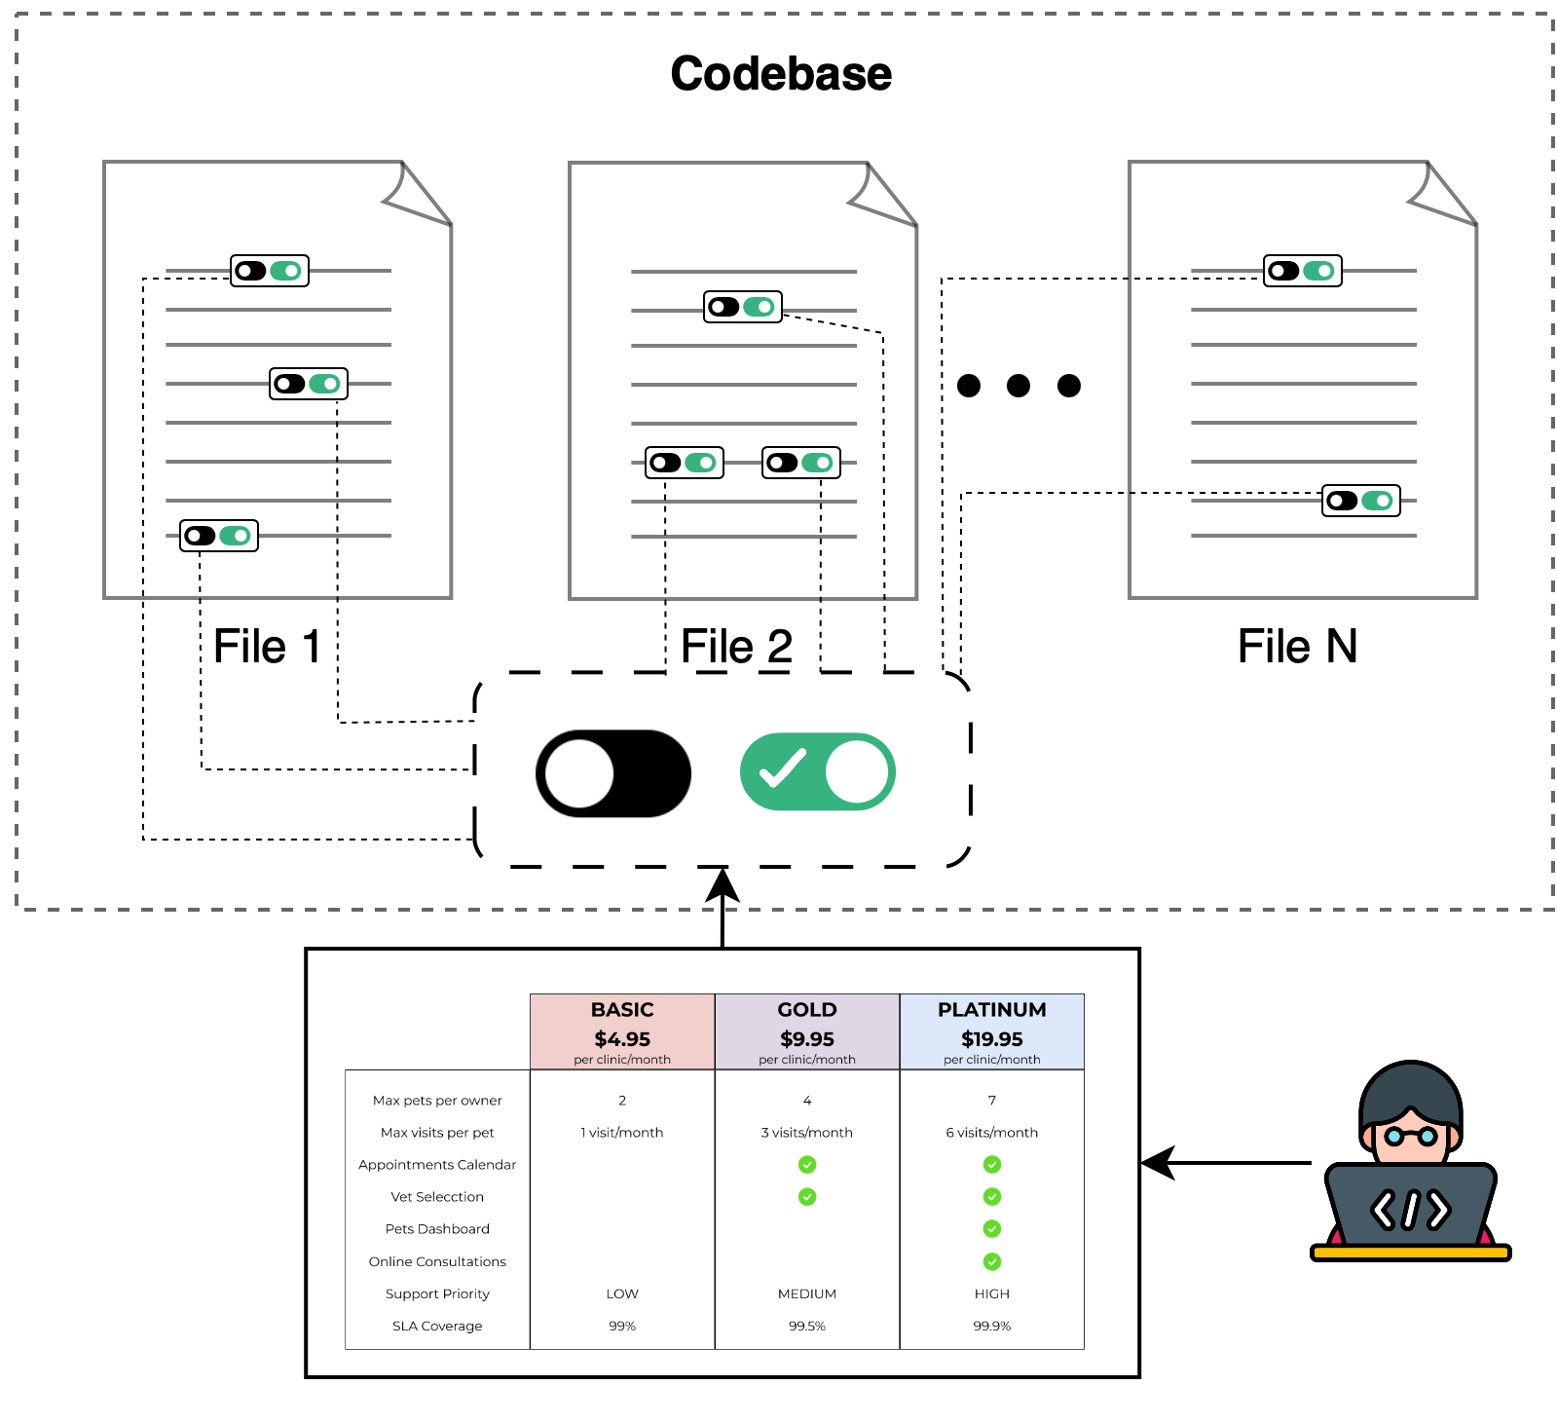
Pricing-driven Development and Operation of SaaS
1. Pricing & Subscription Modeling
2. Pricing Design Methodologies
toggle
Dev
Ops
operate
plan
3. PRICING-DRIVEN SELF-ADAPTATION
release
4. Subscription Compliance Testing
test
monitor
5. Automated Analysis of Pricings
PROVIDER EVENTS (pe_{j})
pe_{1 (new plan)}
pe_{3 (price change)}
23
pe_{j (feature reallocation)}

Slide 7
Pricing-driven Development and Operation of SaaS
1. Pricing & Subscription Modeling
2. Pricing Design Methodologies
toggle
Dev
Ops
operate
plan
3. PRICING-DRIVEN SELF-ADAPTATION
release
4. Subscription Compliance Testing
test
monitor
5. Automated Analysis of Pricings
PROVIDER EVENTS (pe_{j})
pe_{1 (new plan)}
pe_{3 (price change)}
23
pe_{j (feature reallocation)}

