Slide 1
Traditional DevOps life cyle
code
deploy
plan
Dev
Ops
build
release
operate
test
monitor
PROVIDER EVENTS (pe_{j})
pe_{1 (new plan)}
pe_{2 (new feature)}
pe_{3 (price change)}
2
pe_{j (feature reallocation)}

Slide 2
Traditional DevOps life cyle
code
deploy
plan
Dev
Ops
build
release
operate
test
monitor
PROVIDER EVENTS (pe_{j})
pe_{1 (new plan)}
pe_{2 (new feature)}
pe_{3 (price change)}
2
pe_{j (feature reallocation)}

Slide 3
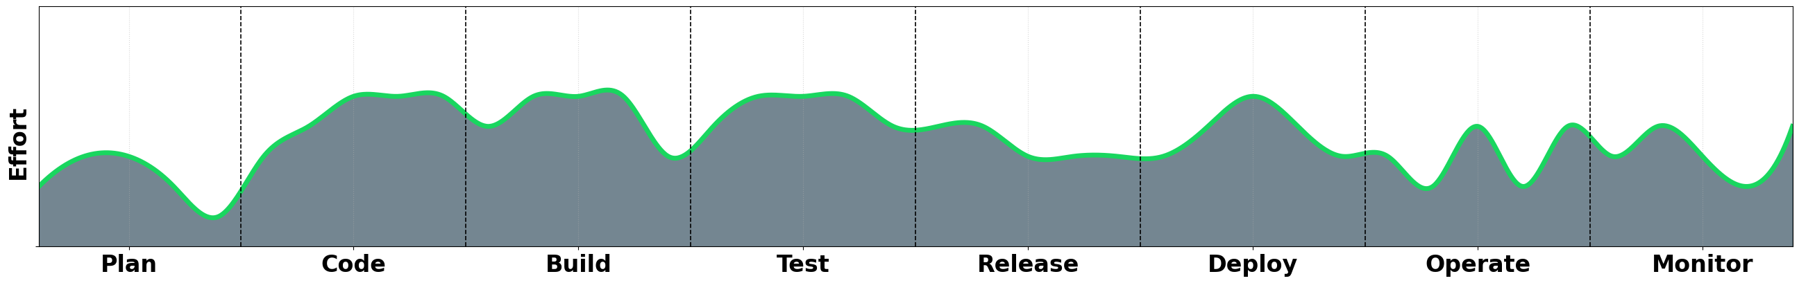
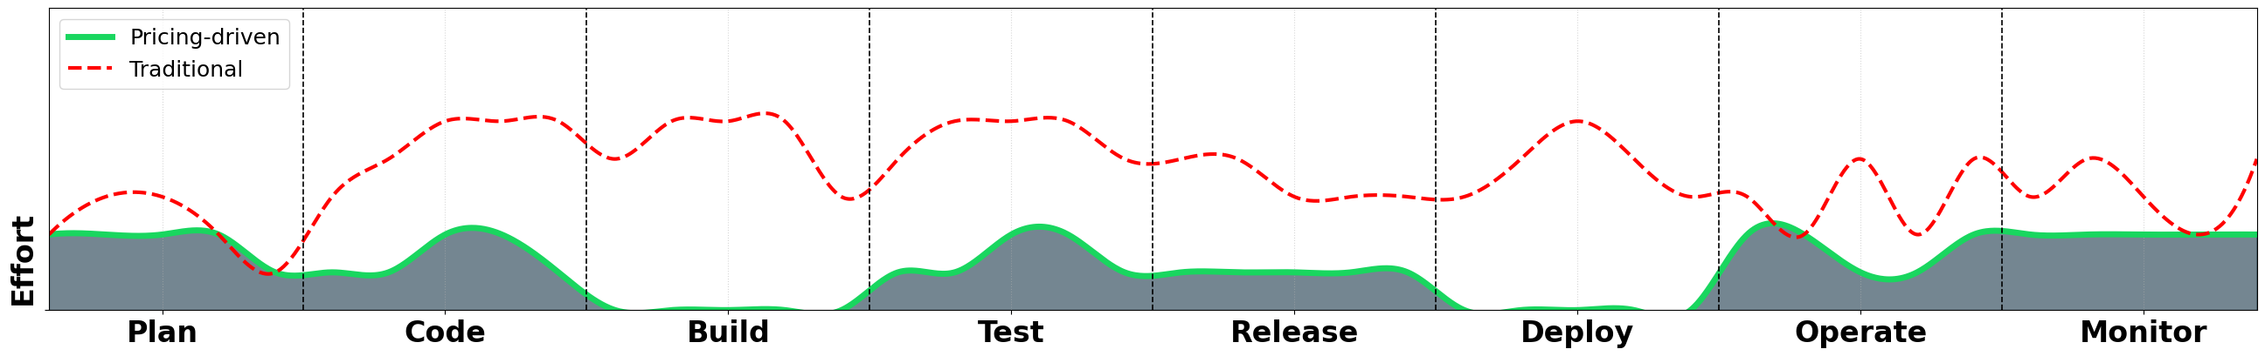
Traditional DevOps life cyle
code
deploy
plan
Dev
Ops
build
release
operate
test
monitor
2

Slide 4


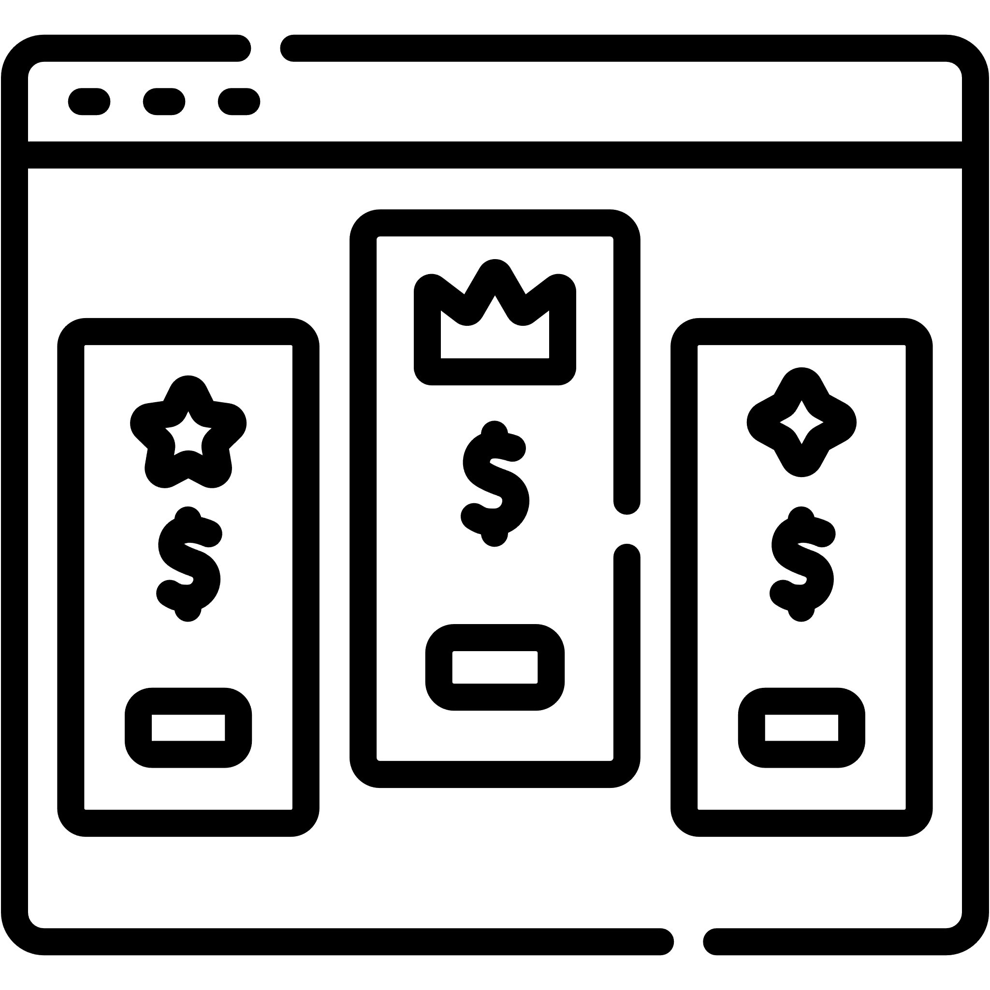





Pricing-driven Development and Operation of SaaS
code
deploy
build
operate
“
Pricing-driven Development and Operation of SaaS is an alternative DevOps cycle aimed at optimizing the management of pricing events–specially those that do not alter service functionalities themselves, but change how such functionalities can be contracted by consumers
toggle
Ops
Dev
operate
plan
release
”
test
monitor
3

Slide 5
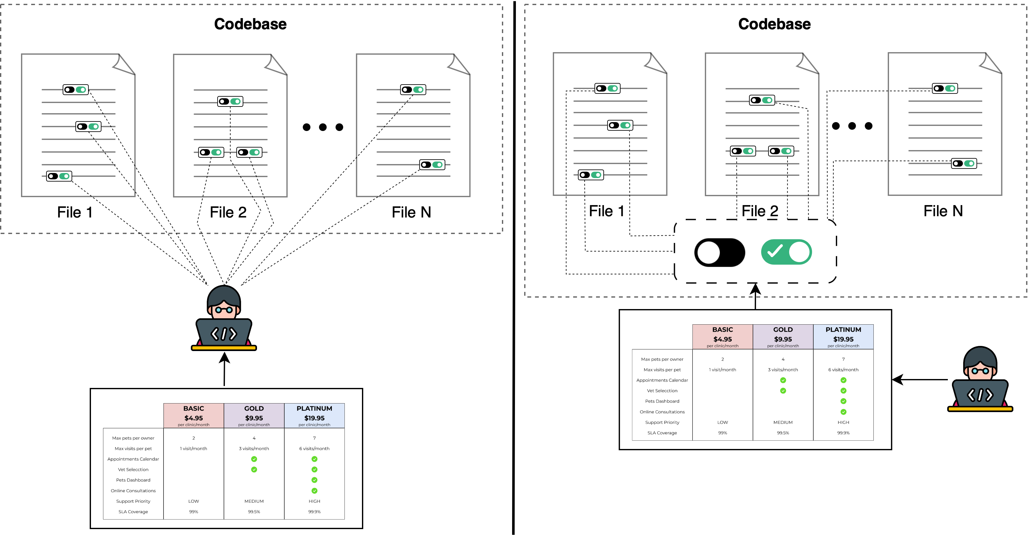
Pricing-driven Development and Operation of SaaS
code
deploy
build
toggle
operate
Dev
Ops
operate
plan
release
test
monitor
3

Slide 6
Pricing-driven Development and Operation of SaaS
code
deploy
build
toggle
operate
Dev
Ops
operate
plan
release
test
monitor
3

Slide 7


Pricing-driven Development and Operation of SaaS
code
deploy
build
toggle
operate
Dev
Ops
operate
plan
release
test
monitor
3

Slide 8
Pricing-driven Development and Operation of SaaS
1. Pricing & Subscription Modeling
2. Pricing Design Methodologies
toggle
Dev
Ops
operate
plan
3. PRICING-DRIVEN SELF-ADAPTATION
release
4. Subscription Compliance Testing
test
monitor
5. Automated Analysis of Pricings
PROVIDER EVENTS (pe_{j})
pe_{1 (new plan)}
pe_{3 (price change)}
4
pe_{j (feature reallocation)}

Slide 9
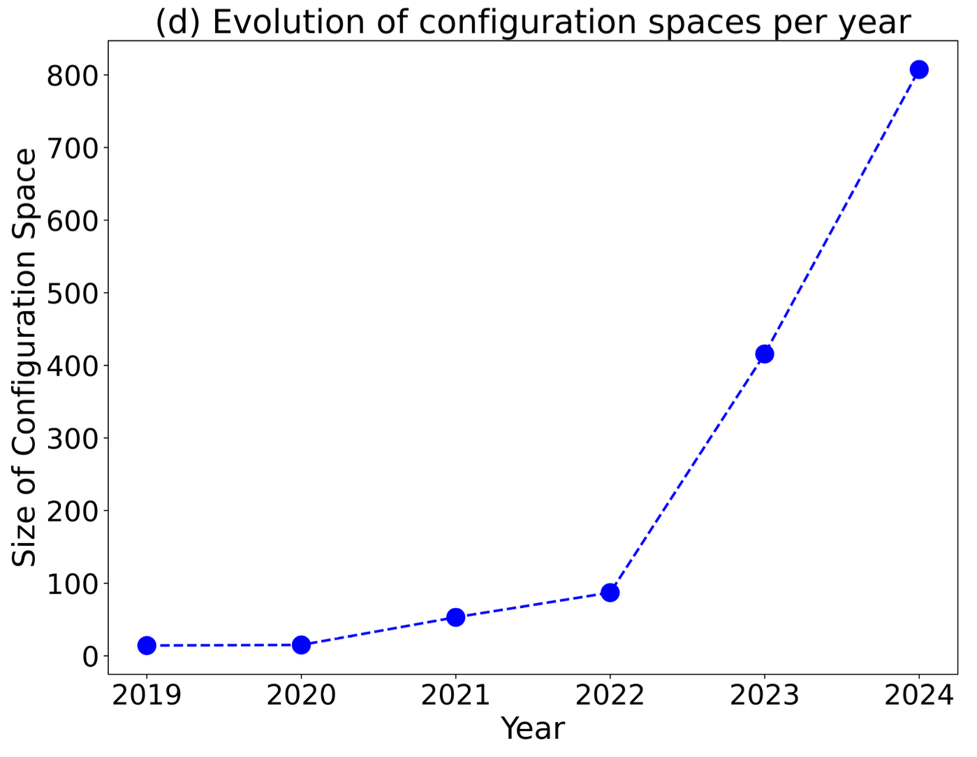




Pricing-driven Development and Operation of SaaS
1. Pricing & Subscription Modeling
2. Pricing Design Methodologies
toggle
Dev
Ops
operate
plan
3. PRICING-DRIVEN SELF-ADAPTATION
release
4. Subscription Compliance Testing
test
monitor
5. Automated Analysis of Pricings
PROVIDER EVENTS (pe_{j})
pe_{1 (new plan)}
pe_{3 (price change)}
4
pe_{j (feature reallocation)}

