Slide 1
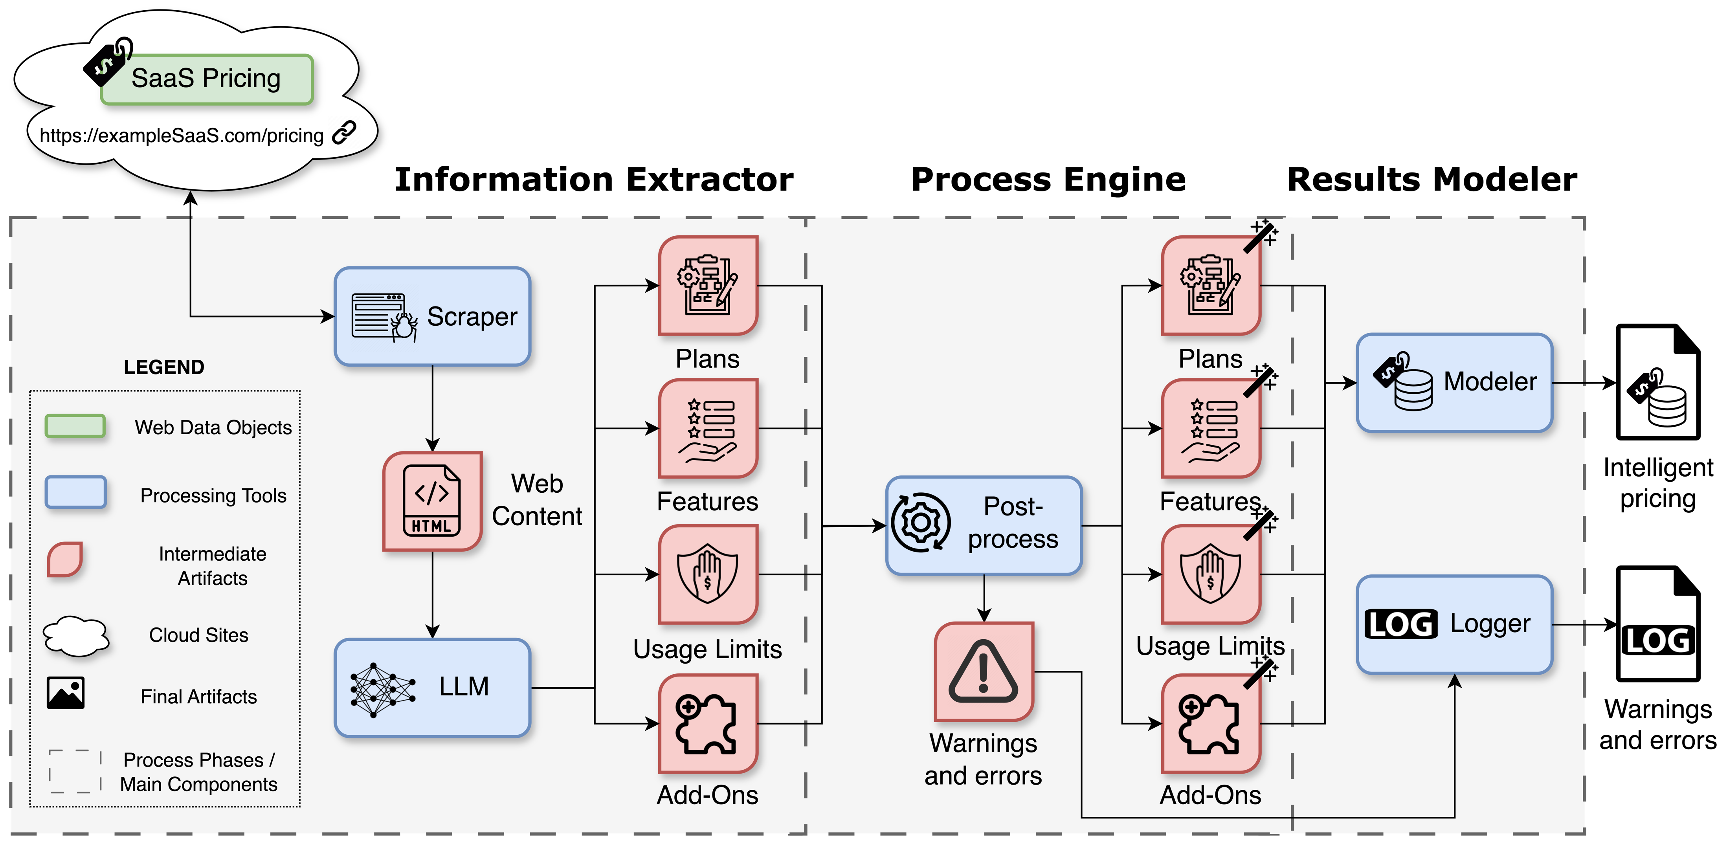

What are we proposing?
7

