Slide 1
Feature Toggles
5

Slide 2
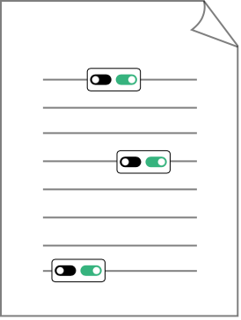
Anatomy of a feature toggle
SaaS Code File
5

Slide 3
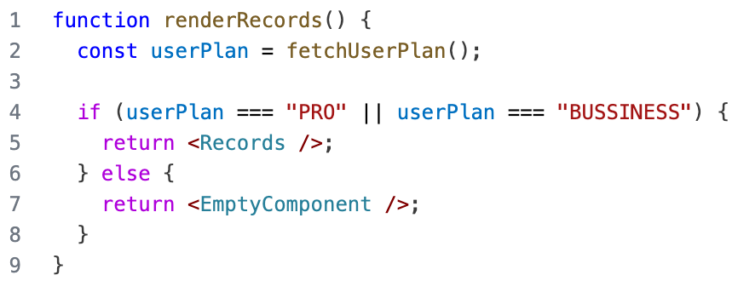
Anatomy of a feature toggle
Context
Rule
Feature
SaaS Code File
5

