Slide 1
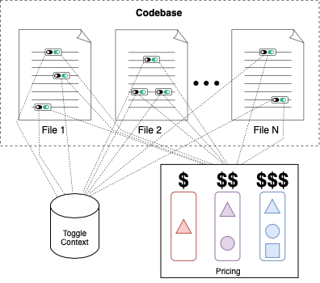
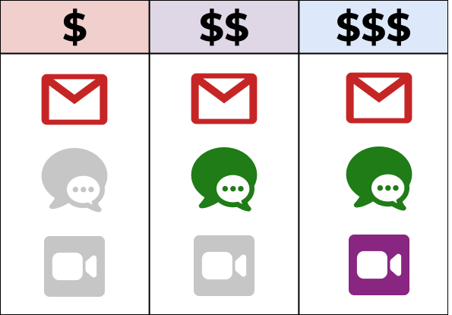
Feature Toggles
7

Slide 2

Feature Toggles
7

Slide 3
Feature Toggles
: Evaluation Space
8
evaluation space size
7

Slide 4
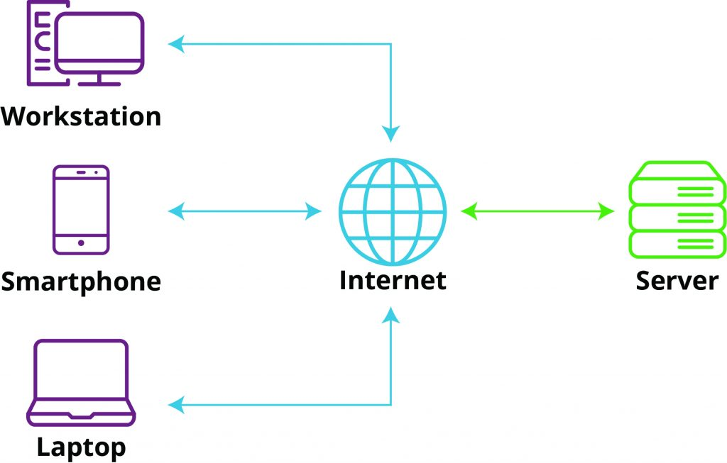
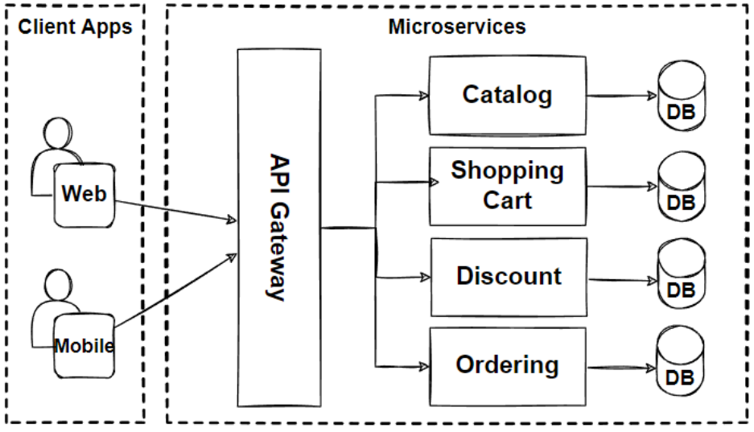
Feature Toggles
: Evaluation Space
8
8+
…
32
7

