Slide 1
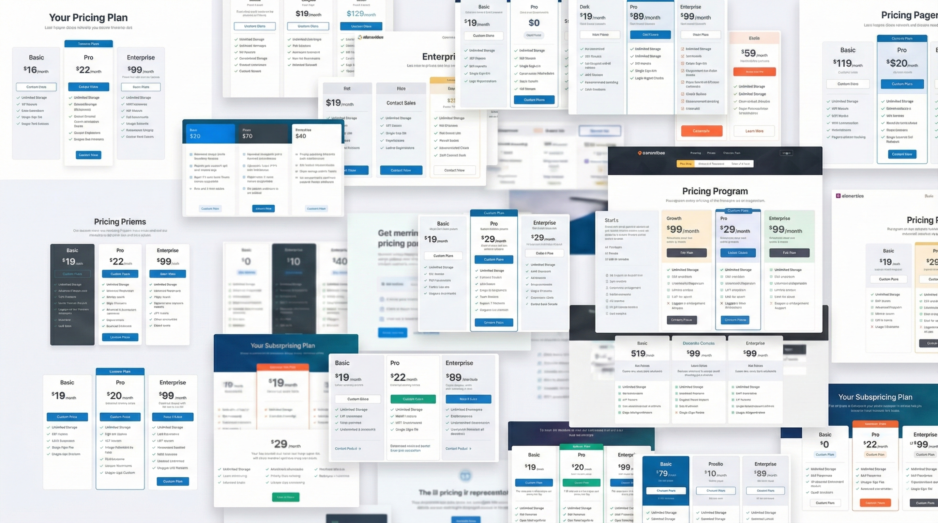
2

Slide 2


OPTIMIZE
Decision-makers
Value-cost
Pricing Intelligence is the discipline that turns pricing data into actionable knowledge.
What is the best subscription option among all these SaaS products for continous integration?
3

Slide 3


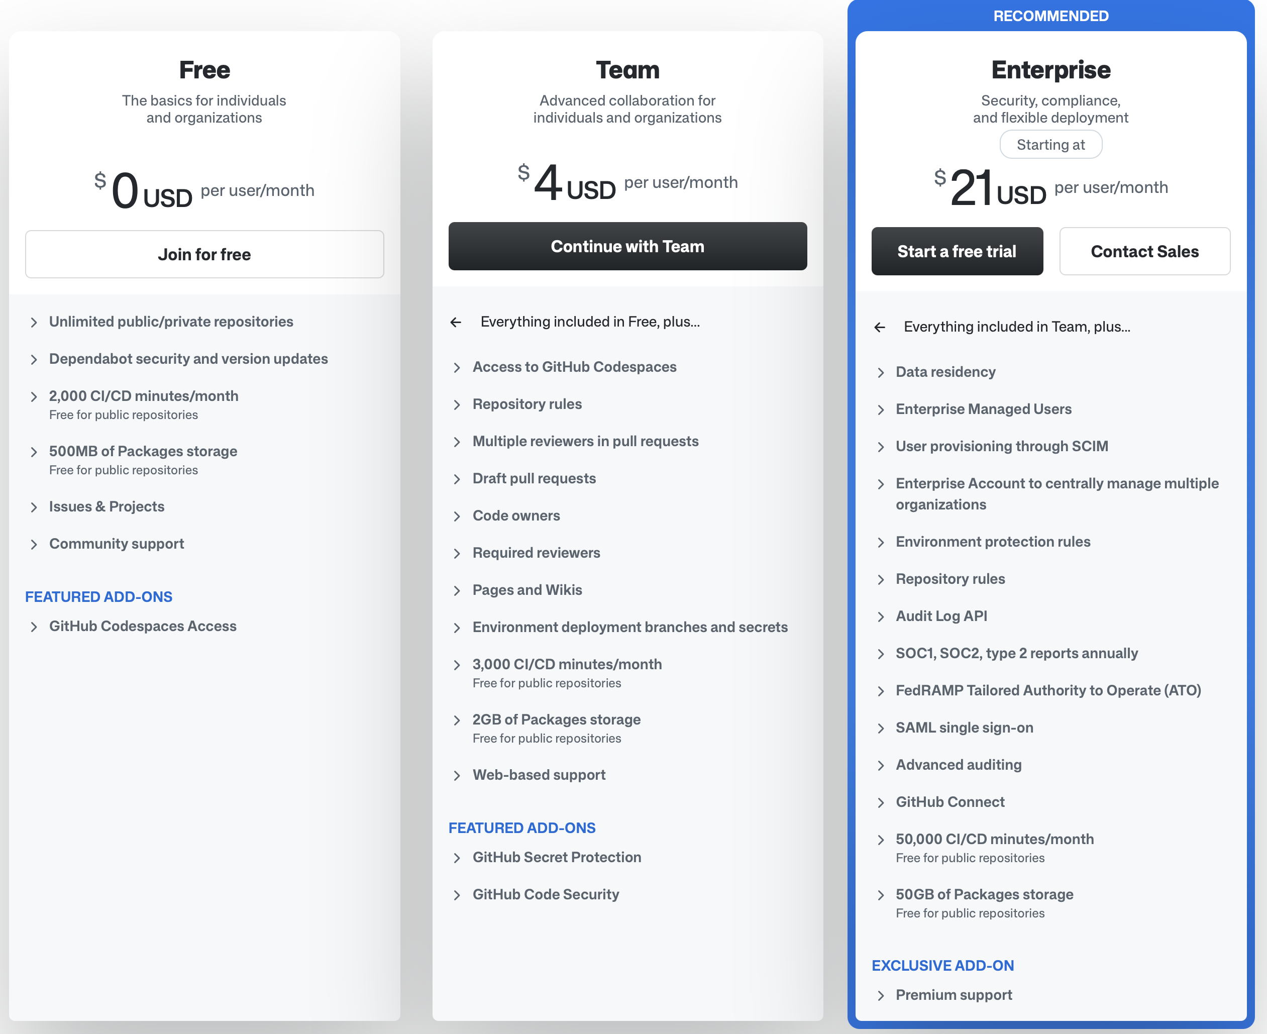
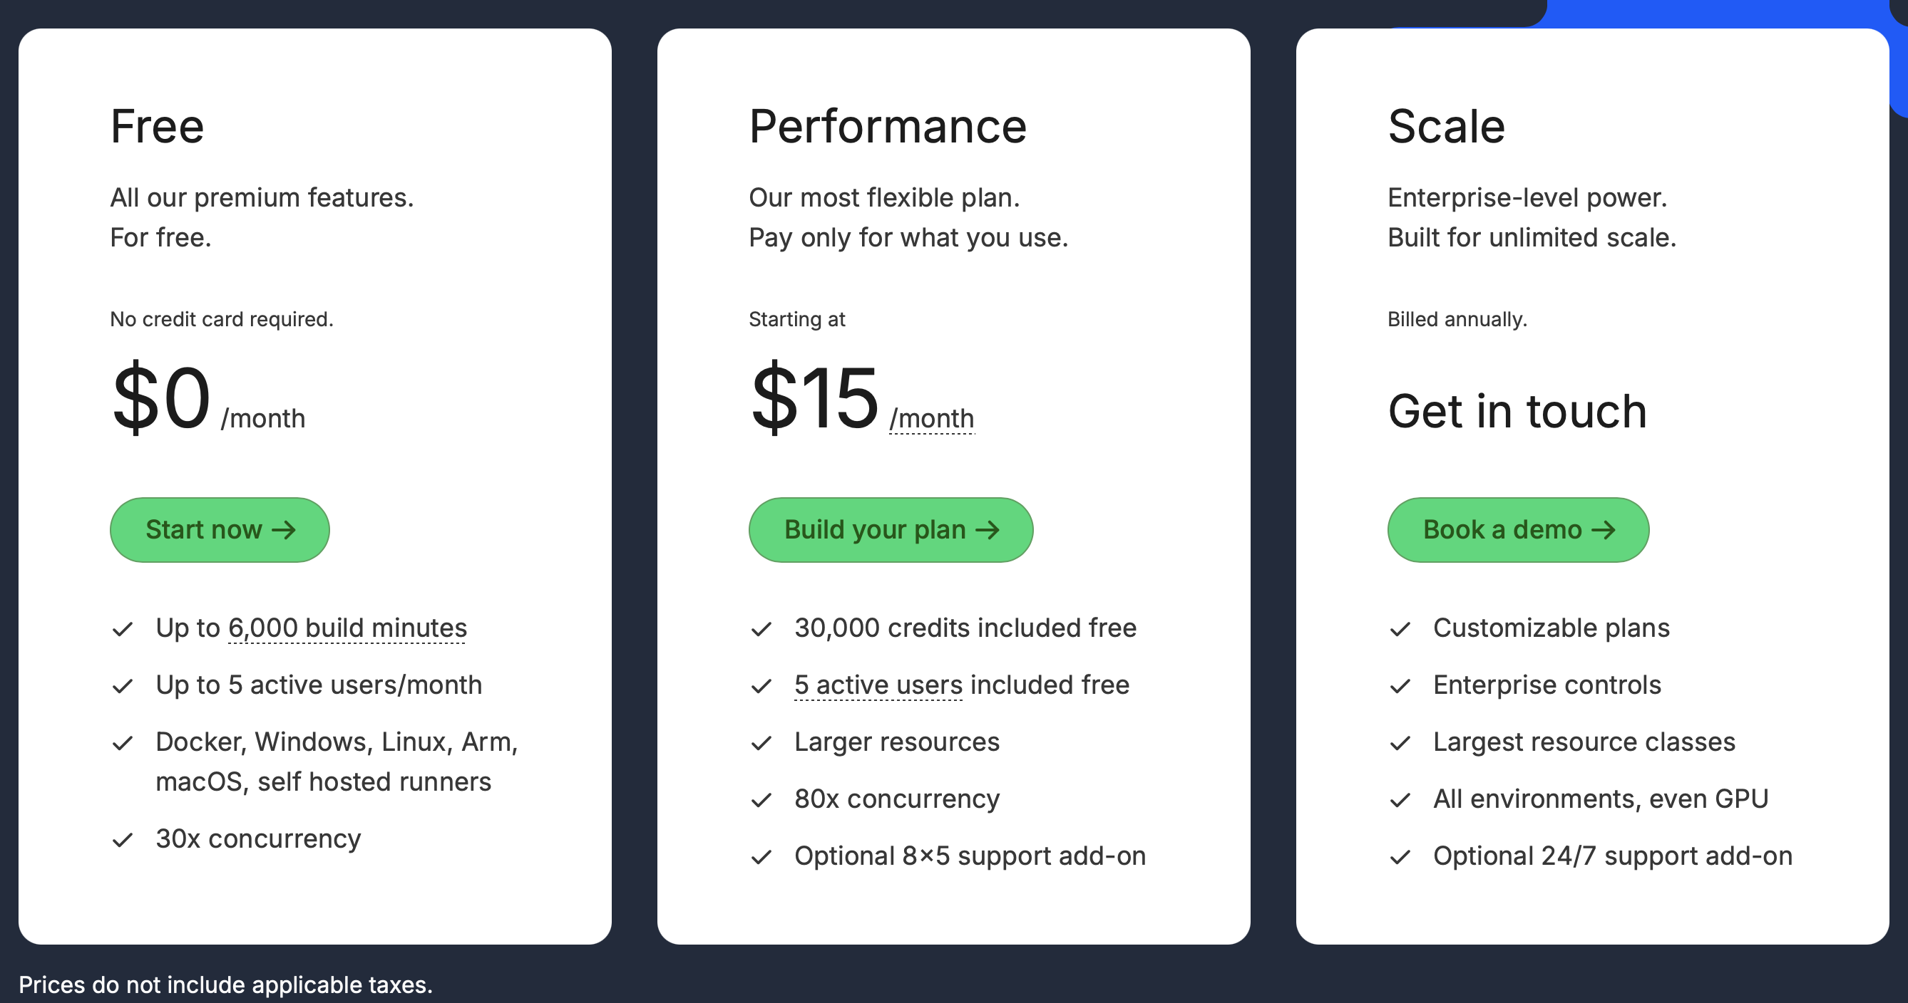
What is the best subscription option among all these SaaS products for continous integration?
3

