Slide 1


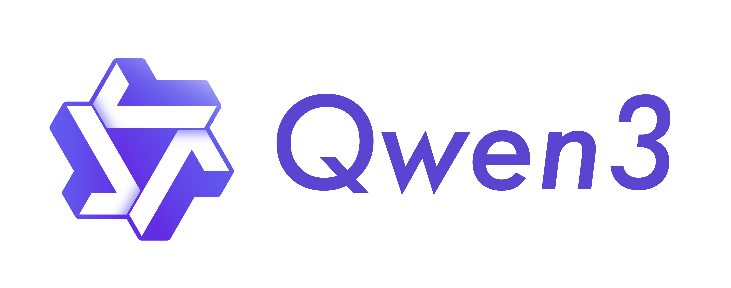
Methodology
11 participants
Manual Review (T1)
Structural Filtering (T2)
56 PI tasks templates
“Which of these SaaS is more customizable: {{SAAS 1}} or {{SAAS 2}}?”
Raw templates (T0)
2 LLMs
14

