Slide 1
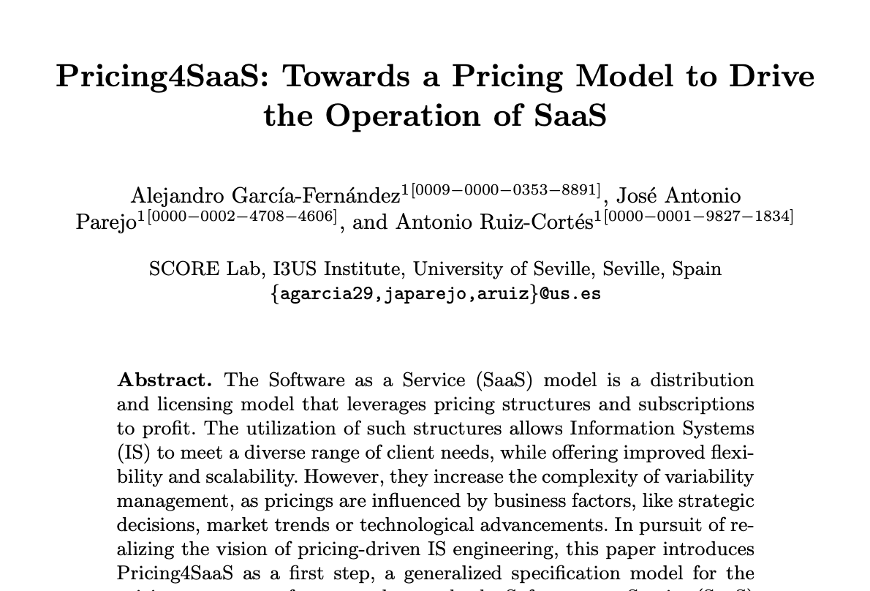










RQ₁: How are pricings’ configuration and evaluation spaces evolving in modern SaaS?
16
Available on webarchive
+4 years of trackable history
162
Clear list of features in
most snapshots
30
30 SaaS
10

Slide 2
RQ₁: How are pricings’ configuration and evaluation spaces evolving in modern SaaS?
16
Available on webarchive
+4 years of trackable history
162
Clear list of features in
most snapshots
30
30 SaaS
10

