Slide 1
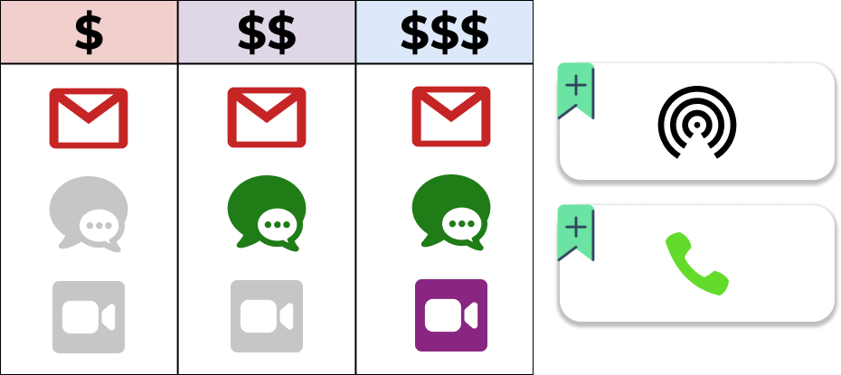












The “Pricification” Process
Identification of features
Essential features
Key features
22

Slide 2
The “Pricification” Process
Identification of features
Generation of pricing structure
22

Slide 3
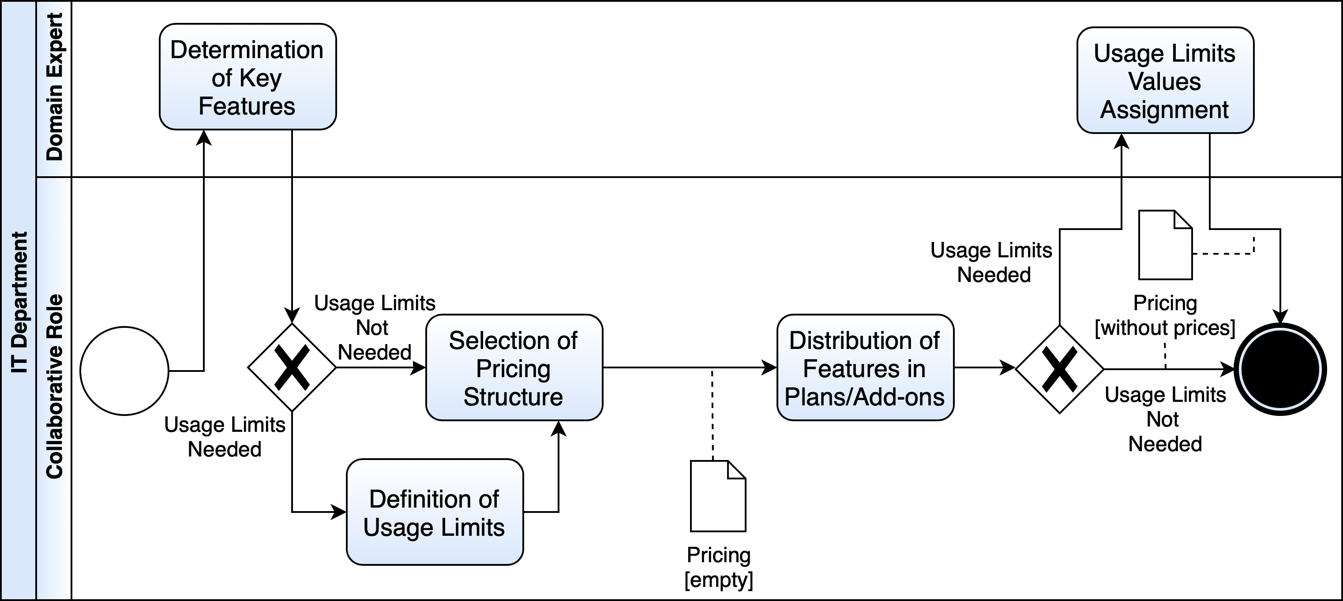
The “Pricification” Process
22

Slide 4
The “Pricification” Process
Identification of features
Set prices
Generation of pricing structure
22

