Slide 1
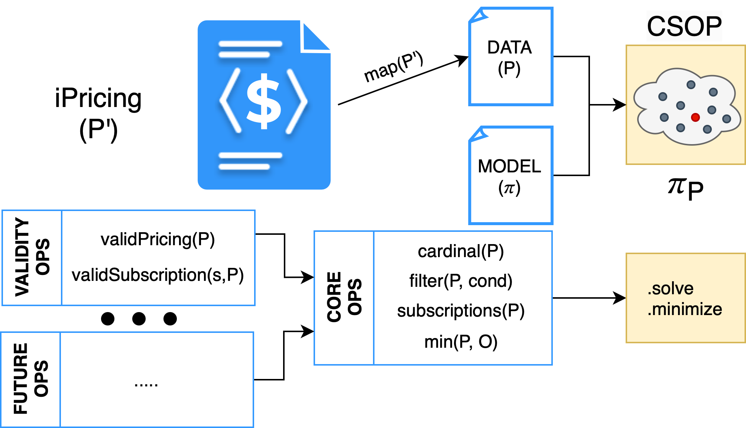
Our Proposal
21

Slide 2
Our Proposal
21

Slide 3


Our Proposal
FILTERED
CARDINALITY
FILTERED
CHEAPEST
SUBSCRIPTION
FILTERED
MOST
EXPENSIVE
SUBSCRIPTION
CARDINALITY
CHEAPEST
SUBSCRIPTION
MOST
EXPENSIVE
SUBSCRIPTION
Operations
On
demand
FILTER
Core
VALID SUBSCRIPTION
VALID PRICING
PRICING MODEL
iPricing
22

