Slide 1




RQ₂: Are current feature toggling tools appropriate for optimizing pricing-driven feature toggling?
keyword
snowballing
5
21
alternativeto.net
“feature toggling tool”
“feature toggling library”
13

Slide 2
RQ₂: Are current feature toggling tools appropriate for optimizing pricing-driven feature toggling?
14

Slide 3


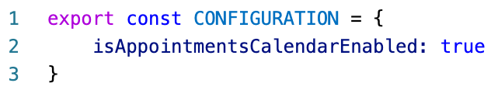
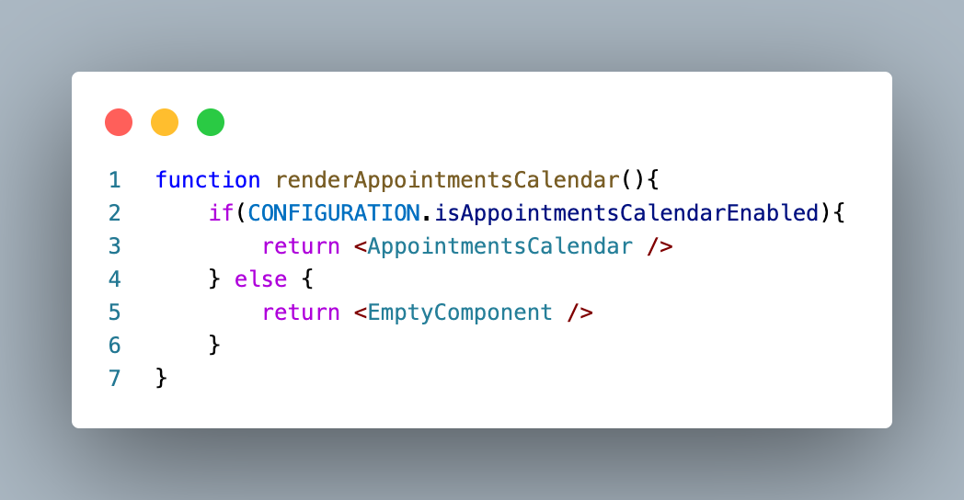
RQ₂: Are current feature toggling tools appropriate for optimizing pricing-driven feature toggling?
L1
.js
14

Slide 4
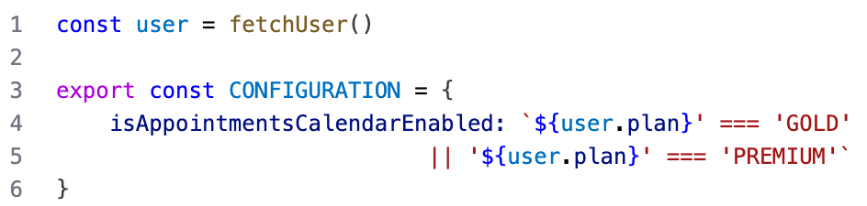
RQ₂: Are current feature toggling tools appropriate for optimizing pricing-driven feature toggling?
L2
L1
.js
14

Slide 5
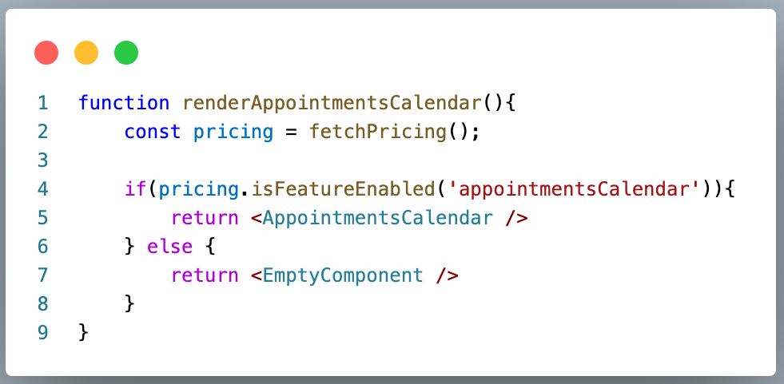
RQ₂: Are current feature toggling tools appropriate for optimizing pricing-driven feature toggling?
L3
L2
L1
.js
14

