Slide 1

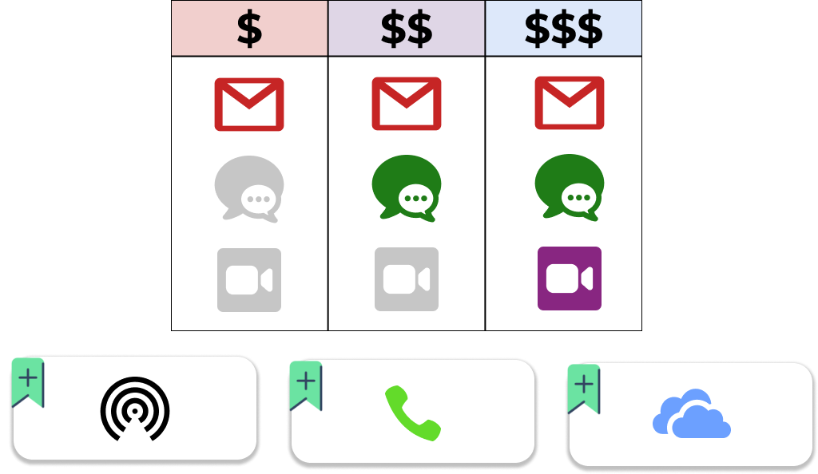

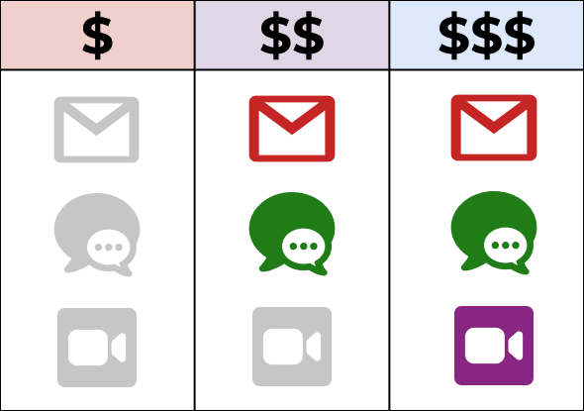
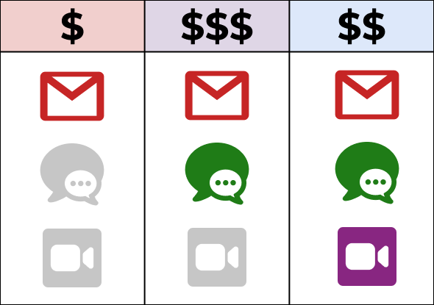

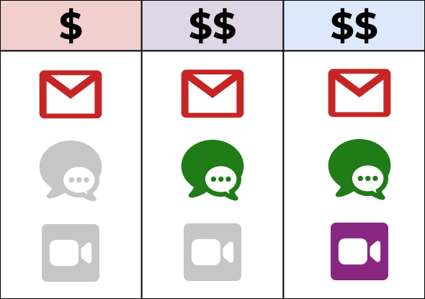








Detection of Pricing Inconsistencies in Benchmark
(Stage two)
65%
Higher Plan – Lower Price
Different Features
Same Prices
Same Features Different Prices
Empty Plans
Dead Features
Non-existent Feature
35%
Non-available Add-on
Dummy Add-on
Cyclic Add-on Dependencies
27

Slide 2
Detection of Pricing Inconsistencies in Benchmark
(Stage two)
Dummy Add-on
Cyclic Add-on Dependencies
28

