Slide 1
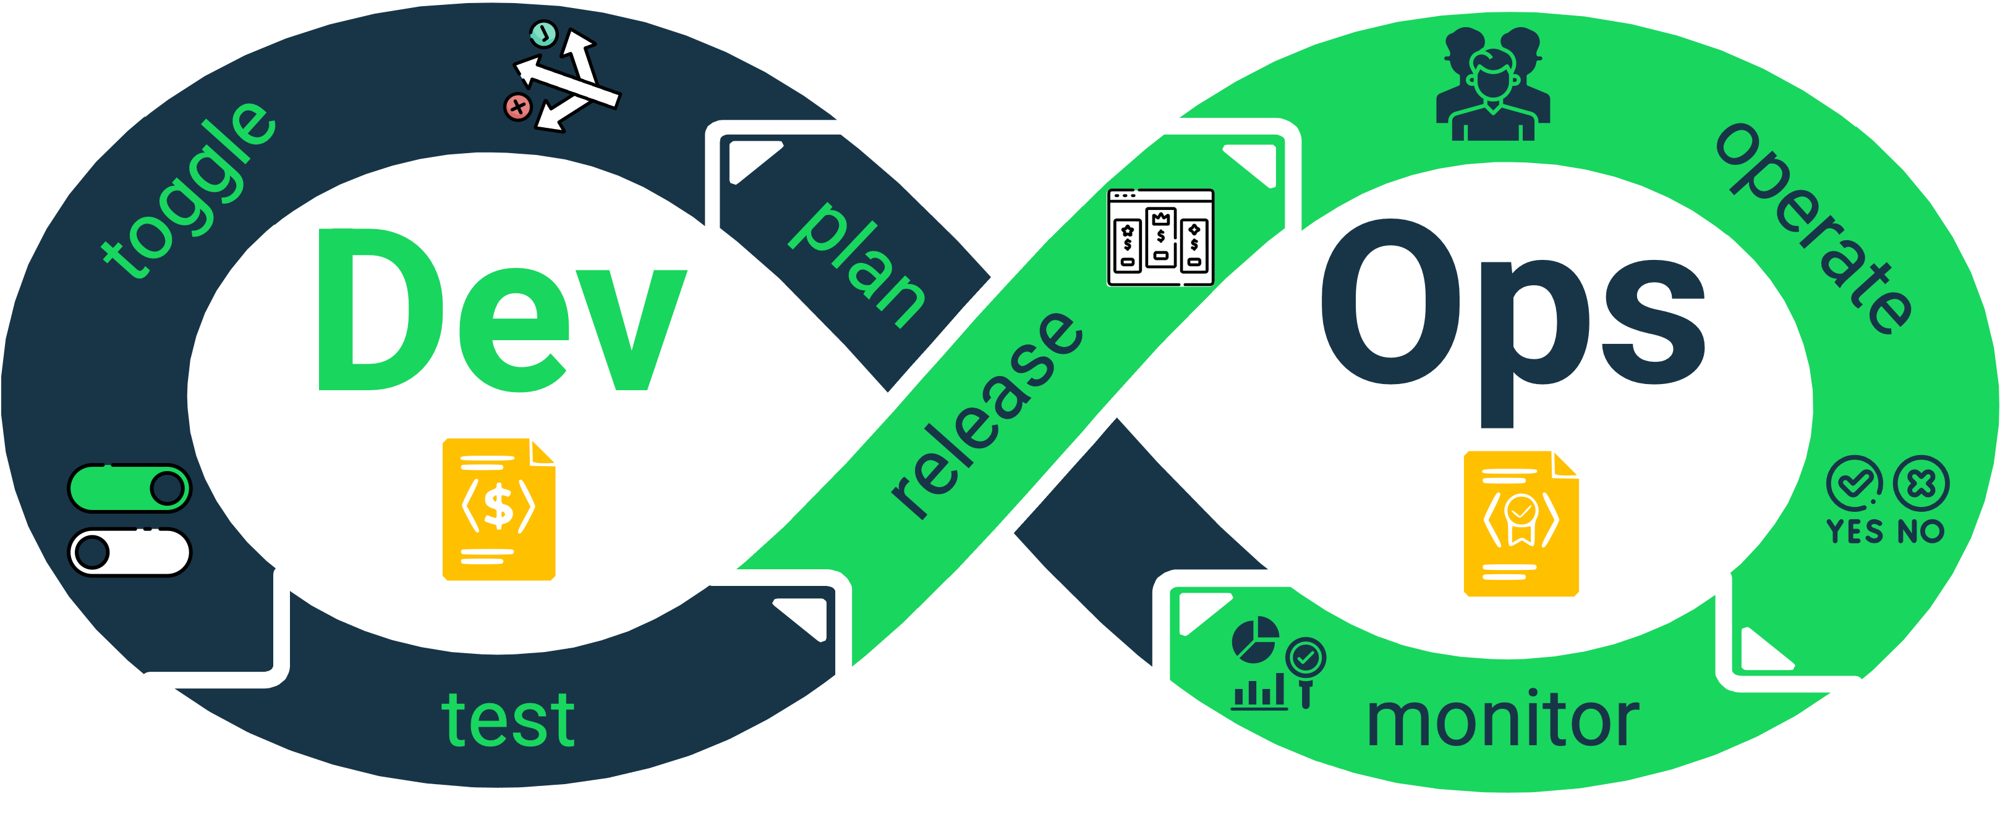
Pricing Intelligence (PI)
Decision-makers
Ask PI tasks:
“Which provider is cheaper for my usage?”
Semantic gap
+
Orchestration gap
What should be executed?
PI tools
Require precise actions, parameters and pricing artifacts.
Pricing Intelligence is the discipline that turns pricing data into actionable knowledge.
10

