Slide 1

Automated Analysis of Pricings in SaaS-based Information Systems
Alejandro García-Fernández, José Antonio Parejo, Pablo Trinidad, Antonio Ruiz-Cortés
Universidad de Sevilla, Seville, Spain
CAISE’25
June 20th, 2025
Notes:
Morning, I’m AGF, and I want to give you a quick overview of our proposal on the automated…

Slide 2

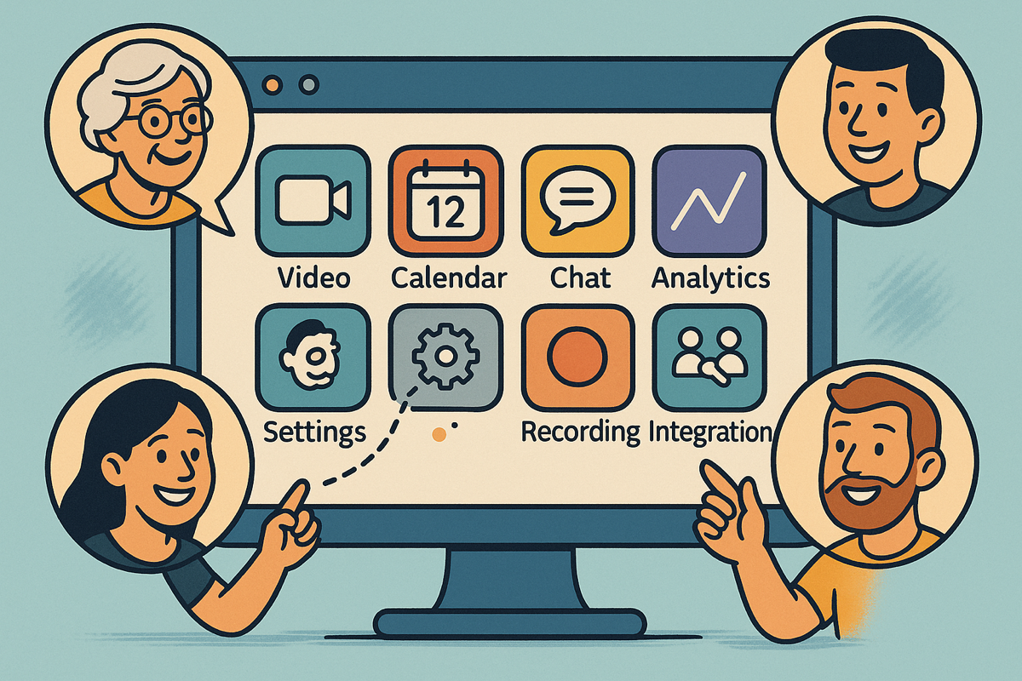
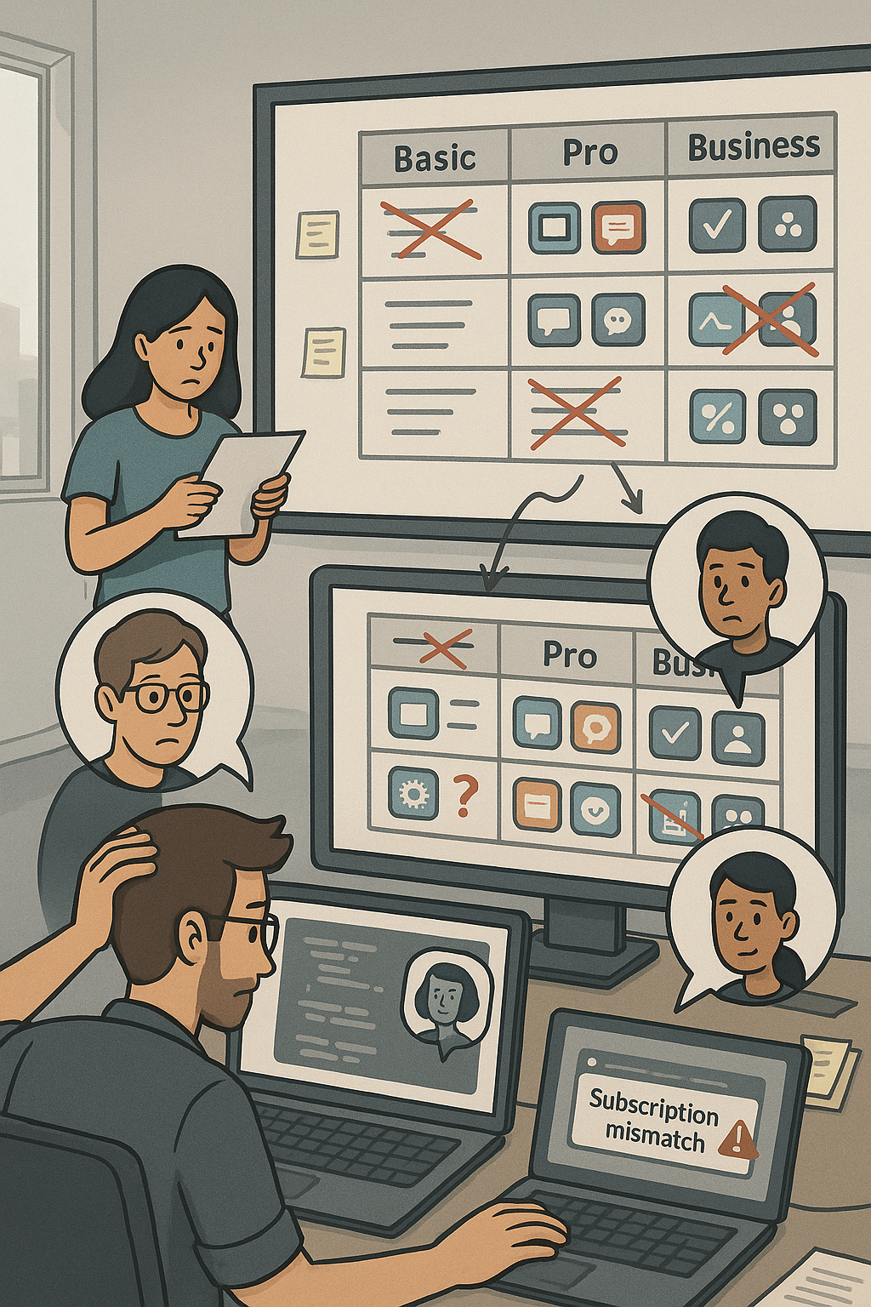



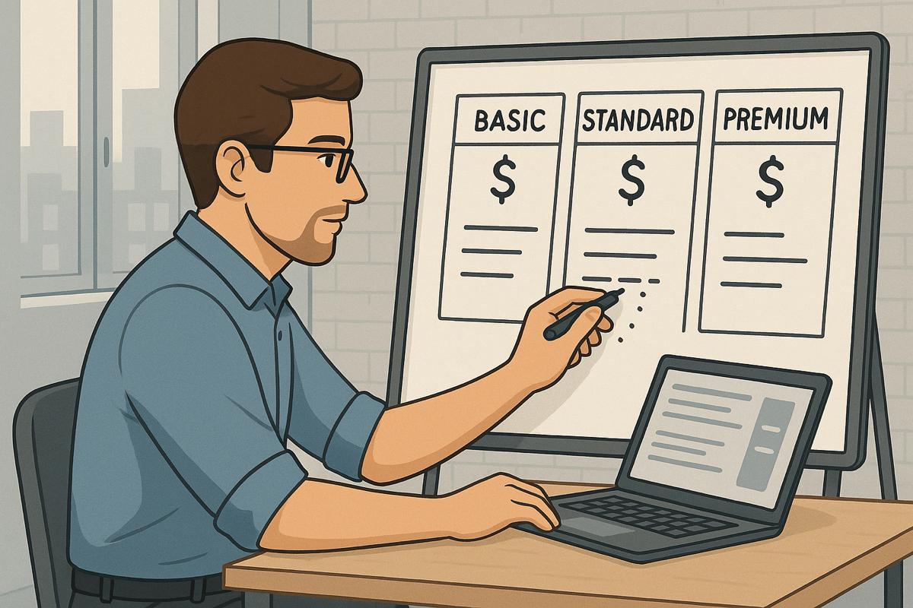
Teams
2
1
3
4
Notes:
But before we Delve into de details, let me tell you the story of John
Wouldn’t it be great for John to have a suite of tolos that can aware him in advance of any errors, warnings, and so on so that he can minimize the amount of these problems in production?

Slide 3




1
1
INTRODUCTION
2
PROPOSAL
3
EVALUATION
4
CONCLUSIONS
2

Slide 4








User-oriented Pricings
García-Fernández, A., Parejo, J. A., & Ruiz-Cortés, A. (2024, May). Pricing4saas: towards a pricing model to drive the operation of saas.
In International Conference on Advanced Information Systems Engineering (pp. 47-54). Cham: Springer Nature Switzerland.
3
Notes:
Pricings include list of features
Features are distributed among plans
Plans determine the subset of features available by paying a certain Price
Plans can also impose strict or relaxed usage limits to some strategic features
Usuarlly, plans are designed to commit the needs of a certain group of users
Add-ons as extensions of plans for features that doesn’t exactly match any group of users defined by plans, or as a way of extending usage limits.
Pricings are structures that include a list of features, that are distributed among a set of plans, which determine the subset features that users will be able to access if they commit to pay the price. Moreover, plans can also impose strict or relaxed usage limits on some features, forcing users to upgrade their plan if they need to consume more resources.

Slide 5

User-oriented Pricings
García-Fernández, A., Parejo, J. A., & Ruiz-Cortés, A. (2024, May). Pricing4saas: towards a pricing model to drive the operation of saas.
In International Conference on Advanced Information Systems Engineering (pp. 47-54). Cham: Springer Nature Switzerland.
3
Notes:
Pricings are structures that include a list of features, that are distributed among a set of plans, which determine the subset features that users will be able to access if they commit to pay the price. Moreover, plans can also impose strict or relaxed usage limits on some features, forcing users to upgrade their plan if they need to consume more resources.

Slide 6




User-oriented Pricings
García-Fernández, A., Parejo, J. A., & Ruiz-Cortés, A. (2024, May). Pricing4saas: towards a pricing model to drive the operation of saas.
In International Conference on Advanced Information Systems Engineering (pp. 47-54). Cham: Springer Nature Switzerland.
3
Notes:
Pricings are structures that include a list of features, that are distributed among a set of plans, which determine the subset features that users will be able to access if they commit to pay the price. Moreover, plans can also impose strict or relaxed usage limits on some features, forcing users to upgrade their plan if they need to consume more resources.

Slide 7
User-oriented Pricings
García-Fernández, A., Parejo, J. A., & Ruiz-Cortés, A. (2024, May). Pricing4saas: towards a pricing model to drive the operation of saas.
In International Conference on Advanced Information Systems Engineering (pp. 47-54). Cham: Springer Nature Switzerland.
3
Notes:
Pricings are structures that include a list of features, that are distributed among a set of plans, which determine the subset features that users will be able to access if they commit to pay the price. Moreover, plans can also impose strict or relaxed usage limits on some features, forcing users to upgrade their plan if they need to consume more resources.

Slide 8



User-oriented Pricings
García-Fernández, A., Parejo, J. A., & Ruiz-Cortés, A. (2024, May). Pricing4saas: towards a pricing model to drive the operation of saas.
In International Conference on Advanced Information Systems Engineering (pp. 47-54). Cham: Springer Nature Switzerland.
3
Notes:
Pricings are structures that include a list of features, that are distributed among a set of plans, which determine the subset features that users will be able to access if they commit to pay the price. Moreover, plans can also impose strict or relaxed usage limits on some features, forcing users to upgrade their plan if they need to consume more resources.

Slide 9



How to Measure the Complexity of a Pricing?
Ⓢ(BASIC)
Ⓢ(BASIC, calls)
ICSOC’24
TSC’25?
Ⓢ(PRO)
Ⓢ(PRO, calls)
Ⓢ(BUSINESS)
Ⓢ(BUSINESS, calls)
8

Slide 10
Configuration
Space
Ⓢ(BASIC)
Ⓢ(BASIC, calls)
TSC’25?
Ⓢ(PRO)
Ⓢ(PRO, calls)
Ⓢ(BUSINESS)
Ⓢ(BUSINESS, calls)
8
Notes:
El pricing es una forma compacta de representar el espacio de configuración del SaaS

Slide 11

Pricings’ Configuration Space
Ⓢ(BASIC)
Ⓢ(GOLD)
Ⓢ(PLAT.)
3

Slide 12
Pricings’ Configuration Space
Ⓢ(BASIC)
Ⓢ(BASIC, calls)
Ⓢ(BASIC, cloud storage)
Ⓢ(BASIC, calls, cloud storage)
Ⓢ(GOLD)
Ⓢ(GOLD, calls)
Ⓢ(GOLD, cloud storage)
Ⓢ(GOLD, calls, cloud storage)
Ⓢ(PLAT.)
CALLS
Ⓢ(PLAT., calls)
Ⓢ(PLAT., cloud storage)
Ⓢ(PLAT., calls, cloud storage)
CLOUD STORAGE
3

Slide 13
Traditional DevOps life cyle
code
deploy
plan
Dev
Ops
build
release
operate
test
monitor
PROVIDER EVENTS (pe_{j})
pe_{1 (new plan)}
pe_{2 (new feature)}
pe_{3 (price change)}
2
pe_{j (feature reallocation)}
Notes:
Todos conocemos el ciclo DevOps original. Sin embargo, para sistemas SaaS que ofrecen planes de precios, éste se vuelve ineficiente y error-prone.
What would you say if I tell you that it becomes very unefficient when applied to SaaS with pricing models integrated?

Slide 14
Traditional DevOps life cyle
code
deploy
plan
Dev
Ops
build
release
operate
test
monitor
PROVIDER EVENTS (pe_{j})
pe_{1 (new plan)}
pe_{2 (new feature)}
pe_{3 (price change)}
2
pe_{j (feature reallocation)}
Notes:
¿Por qué? Porque incluso si el proveedor no desarrolla nuevas funcionalidades, cualquier cambio en el plan de precios —como restringir una feature en un plan existente o introducir un nuevo plan— activa un nuevo ciclo completo de DevOps.

Slide 15
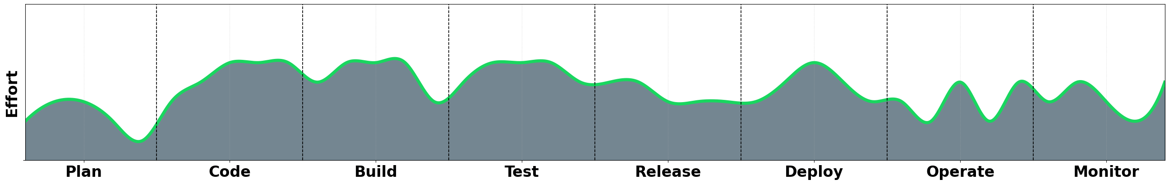
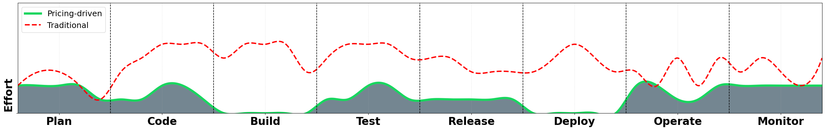
Traditional DevOps life cyle
code
deploy
plan
Dev
Ops
build
release
operate
test
monitor
2
Notes:
¿Por qué? Porque incluso si el proveedor no desarrolla nuevas funcionalidades, cualquier cambio en el plan de precios —como restringir una feature en un plan existente o introducir un nuevo plan— activa un nuevo ciclo completo de DevOps.

Slide 16


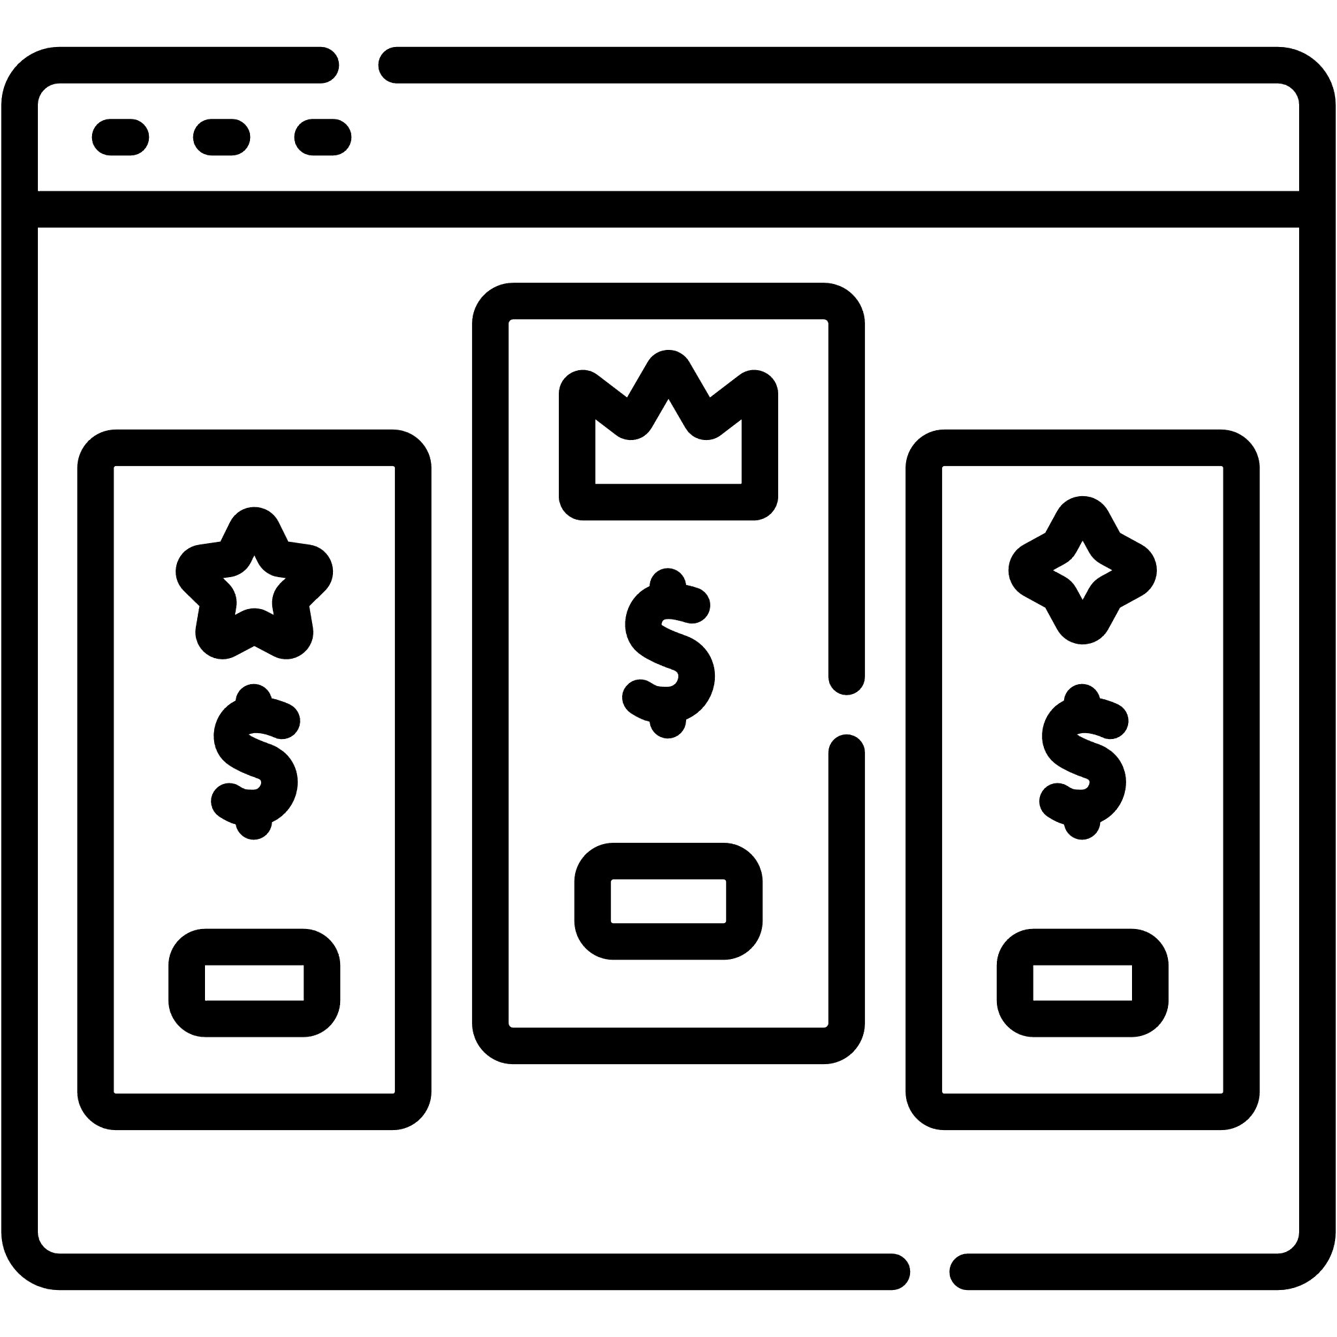

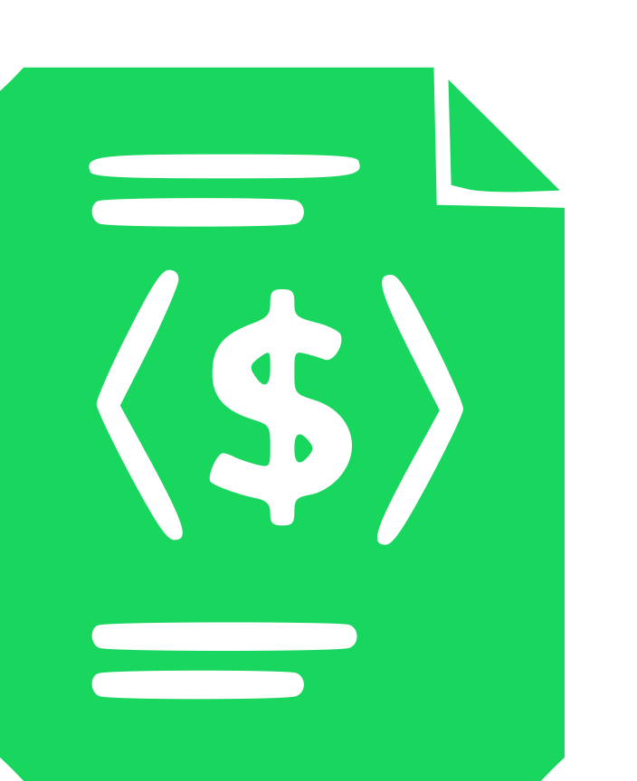



Pricing-driven Development and Operation of SaaS
code
deploy
build
operate
“
Pricing-driven Development and Operation of SaaS is an alternative DevOps cycle aimed at optimizing the management of pricing events–specially those that do not alter service functionalities themselves, but change how such functionalities can be contracted by consumers
toggle
Ops
Dev
operate
plan
release
”
test
monitor
3
Notes:
En este contexto, proponemos en la tesis pricing-driven devops, un ciclo alternativo al original que gestiona este tipo de eventos de forma mucho más eficiente y directa, gracias a que considera tanto los pricings del servicio –así como las subscripciones de los usuarios del mismo– como elementos de primer nivel dentro del sistema.
Como vemos, en esta aproximación las fases “code” y “build” se sustituyen por la fase “toggle”, ya que no es necesario modificar el código del servicio para aplicar los cambios provocados por el evento. Además, la fase “deploy” desaparece, ya que las modificaciones se aplican en caliente, sin necesidad de redesplegar el sistema.
Sin embargo, como es de esperar, lograr este resultado no es tribial. (Aquí exponemos los 5 challenges del pricing-driven devops y a qué fases afecta):

Slide 17
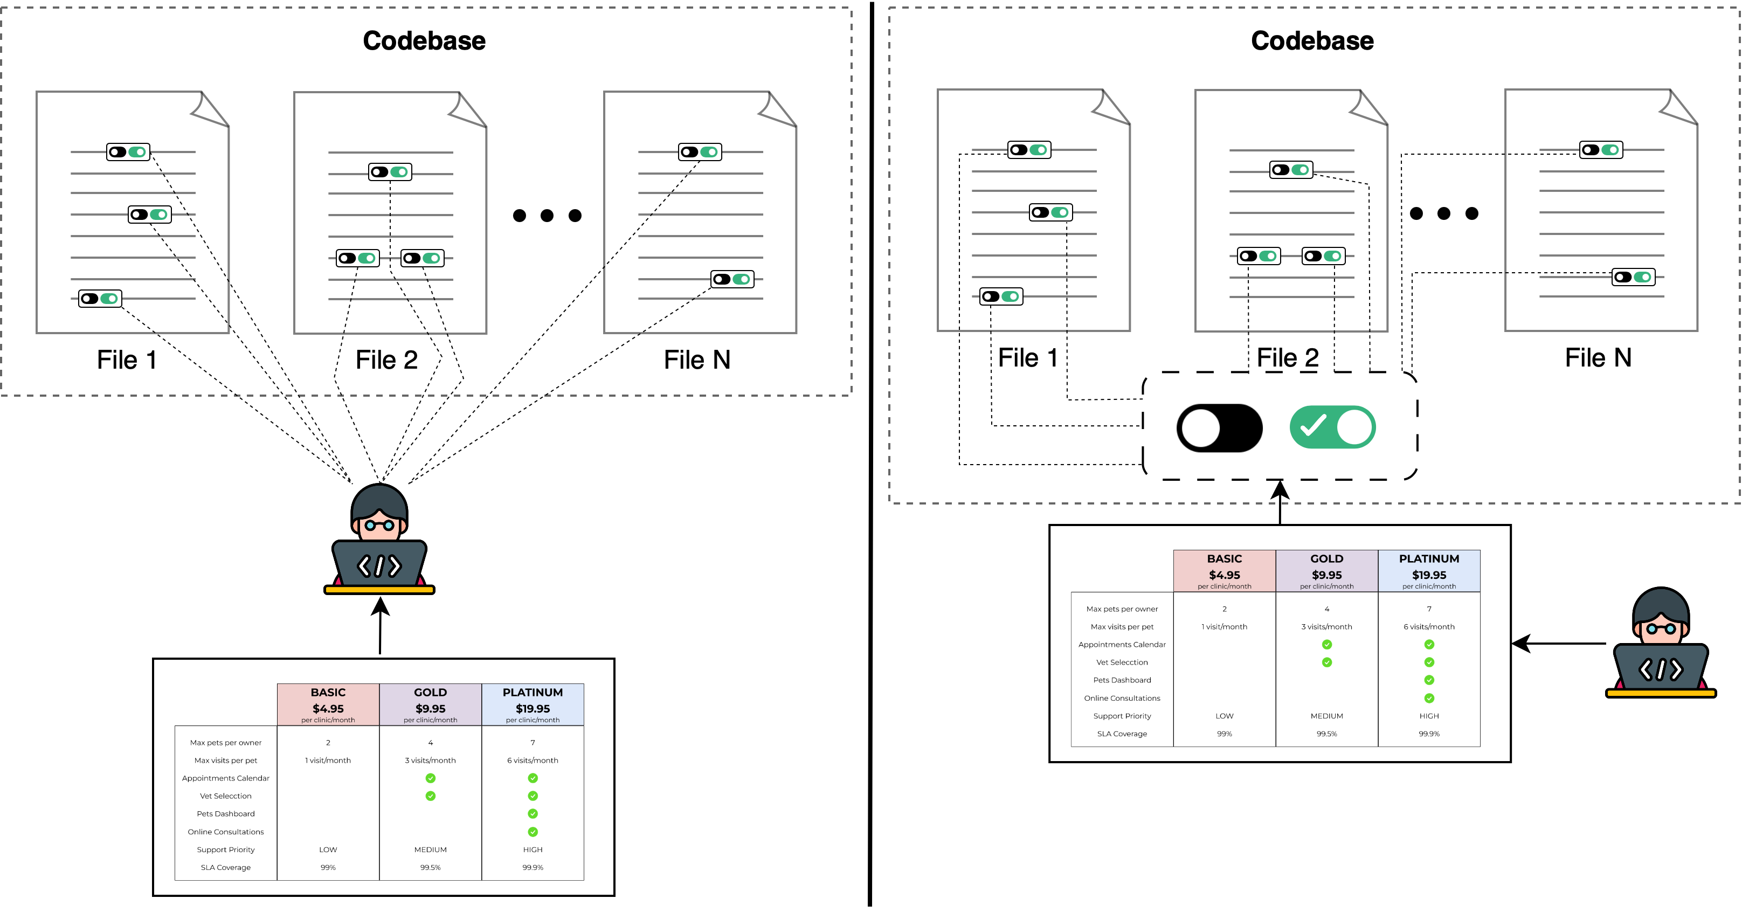
Pricing-driven Development and Operation of SaaS
code
deploy
build
toggle
operate
Dev
Ops
operate
plan
release
test
monitor
3
Notes:
En este contexto, proponemos en la tesis pricing-driven devops, un ciclo alternativo al original que gestiona este tipo de eventos de forma mucho más eficiente y directa, gracias a que considera tanto los pricings del servicio –así como las subscripciones de los usuarios del mismo– como elementos de primer nivel dentro del sistema.
Como vemos, en esta aproximación las fases “code” y “build” se sustituyen por la fase “toggle”, ya que no es necesario modificar el código del servicio para aplicar los cambios provocados por el evento. Además, la fase “deploy” desaparece, ya que las modificaciones se aplican en caliente, sin necesidad de redesplegar el sistema.
Sin embargo, como es de esperar, lograr este resultado no es tribial. (Aquí exponemos los 5 challenges del pricing-driven devops y a qué fases afecta):

Slide 18
Pricing-driven Development and Operation of SaaS
code
deploy
build
toggle
operate
Dev
Ops
operate
plan
release
test
monitor
3
Notes:
En este contexto, proponemos en la tesis pricing-driven devops, un ciclo alternativo al original que gestiona este tipo de eventos de forma mucho más eficiente y directa, gracias a que considera tanto los pricings del servicio –así como las subscripciones de los usuarios del mismo– como elementos de primer nivel dentro del sistema.
Como vemos, en esta aproximación las fases “code” y “build” se sustituyen por la fase “toggle”, ya que no es necesario modificar el código del servicio para aplicar los cambios provocados por el evento. Además, la fase “deploy” desaparece, ya que las modificaciones se aplican en caliente, sin necesidad de redesplegar el sistema.
Sin embargo, como es de esperar, lograr este resultado no es tribial. (Aquí exponemos los 5 challenges del pricing-driven devops y a qué fases afecta):

Slide 19


Pricing-driven Development and Operation of SaaS
code
deploy
build
toggle
operate
Dev
Ops
operate
plan
release
test
monitor
3
Notes:
En este contexto, proponemos en la tesis pricing-driven devops, un ciclo alternativo al original que gestiona este tipo de eventos de forma mucho más eficiente y directa, gracias a que considera tanto los pricings del servicio –así como las subscripciones de los usuarios del mismo– como elementos de primer nivel dentro del sistema.
Como vemos, en esta aproximación las fases “code” y “build” se sustituyen por la fase “toggle”, ya que no es necesario modificar el código del servicio para aplicar los cambios provocados por el evento. Además, la fase “deploy” desaparece, ya que las modificaciones se aplican en caliente, sin necesidad de redesplegar el sistema.
Sin embargo, como es de esperar, lograr este resultado no es tribial. (Aquí exponemos los 5 challenges del pricing-driven devops y a qué fases afecta):

Slide 20
Pricing-driven Development and Operation of SaaS
1. Pricing & Subscription Modeling
2. Pricing Design Methodologies
toggle
Dev
Ops
operate
plan
3. PRICING-DRIVEN SELF-ADAPTATION
release
4. Subscription Compliance Testing
test
monitor
5. Automated Analysis of Pricings
PROVIDER EVENTS (pe_{j})
pe_{1 (new plan)}
pe_{3 (price change)}
4
pe_{j (feature reallocation)}
Notes:
Pricing & Subscription Modeling: Dado que los pricings y las subscripciones son los elementos esenciales que rigen este ciclo de pricing-driven devops –o más específicamente sus versiones orientadas a la máquina (iPricings y iSubscriptions)–, este challenge aborda el desafío de crear un lenguaje lo suficientemente expresivo como para poder representar los pricings de cualquier dominio, así como sus subscripciones.

Slide 21
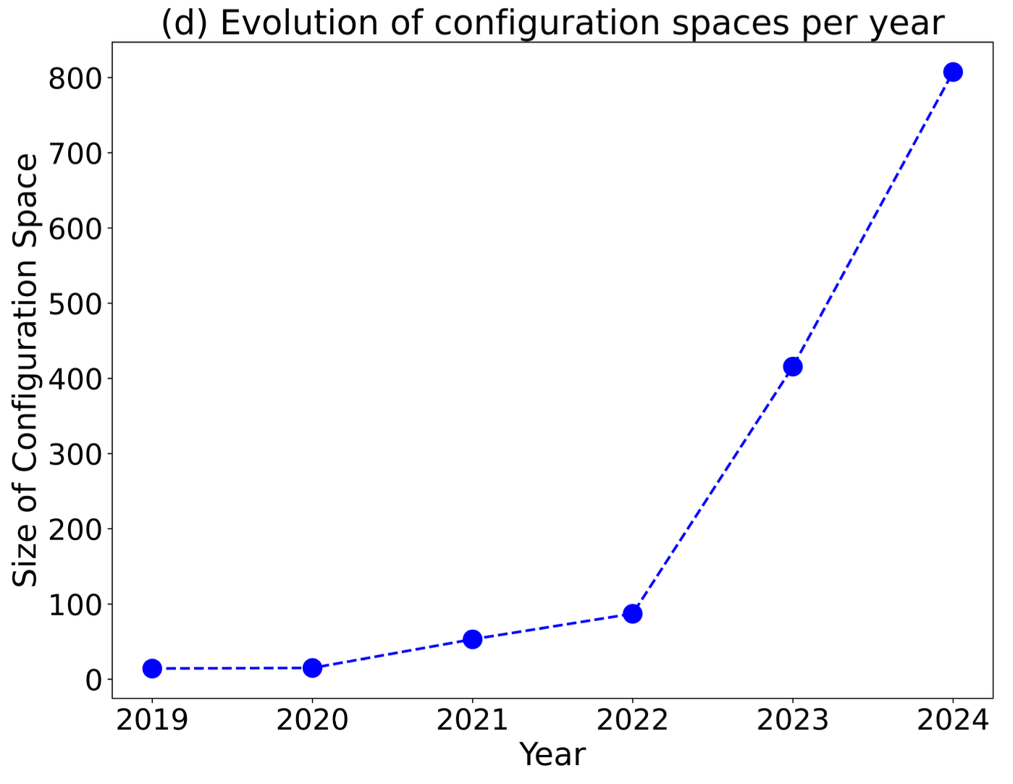



Pricing-driven Development and Operation of SaaS
1. Pricing & Subscription Modeling
2. Pricing Design Methodologies
toggle
Dev
Ops
operate
plan
3. PRICING-DRIVEN SELF-ADAPTATION
release
4. Subscription Compliance Testing
test
monitor
5. Automated Analysis of Pricings
PROVIDER EVENTS (pe_{j})
pe_{1 (new plan)}
pe_{3 (price change)}
4
pe_{j (feature reallocation)}
Notes:
Pricing Design Methodologies: Se enmarca en la fase “plan”, e incluye todas aquellas contribuciones orientadas a definir metodologías para diseñar planes de precios que maximicen el valor percibido de cada configuración del sistema, con el objetivo de reducir las dummy configurations —es decir, aquellas combinaciones poco atractivas o irrelevantes para los usuarios.

Slide 22
Automated Analysis of Pricings
toggle
Ops
Dev
operate
plan
release
test
monitor
PROVIDER EVENTS (pe_{j})
pe_{1 (new plan)}
pe_{3 (price change)}
4
pe_{j (feature reallocation)}

Slide 23
1
1
INTRODUCTION
2
PROPOSAL
3
EVALUATION
4
CONCLUSIONS
5

Slide 24
Our Goals
01
Validate Pricings
6

Slide 25
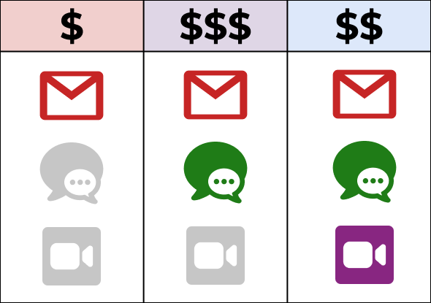
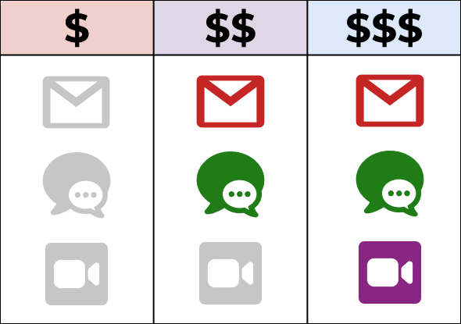



Common Cases of Invalid Pricings
Inconsistent Prices
Empty Plans
Dead Features
7

Slide 26
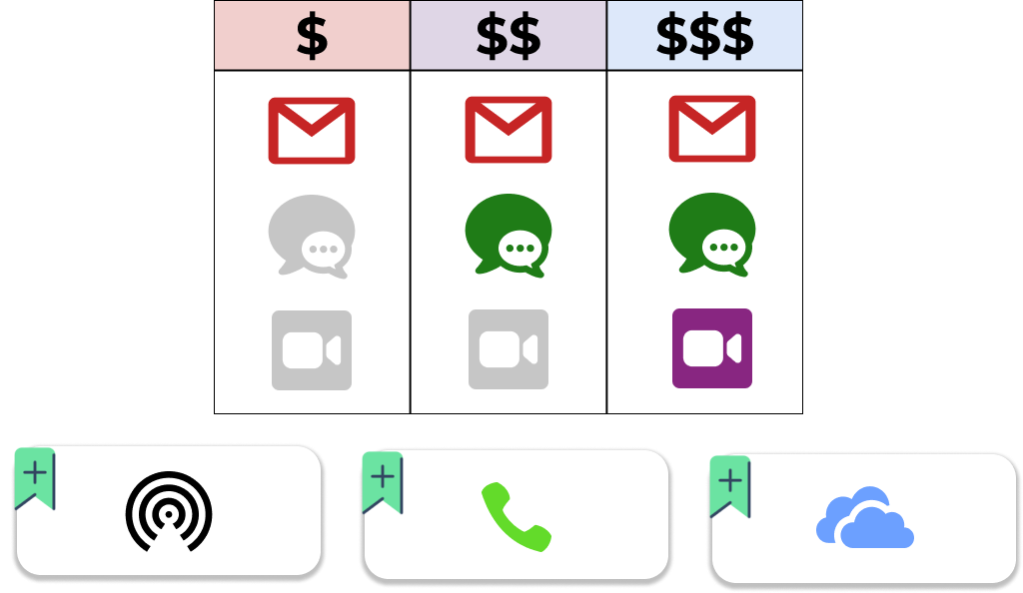

Common Cases of Invalid Pricings
Depends on
8

Slide 27

Complex Cases of Invalid Pricings
Depends on
Excludes
8

Slide 28
Our Goals
02
Validate Subscriptions
01
Validate Pricings
9

Slide 29
Common Cases of Invalid Subscriptions
S
Empty Subscription
10

Slide 30

Common Cases of Invalid Subscriptions
$
S
Add-on not Available
11

Slide 31

Common Cases of Invalid Subscriptions
$$$
S
Required add-on
not contracted
Depends on
11
Notes:
Esta resolución de dependencias y exclusiones es interesante ….

Slide 32
Common Cases of Invalid Subscriptions
$$$
S
Excluded add-on
contracted
Depends on
Excludes
12
Notes:
Esta resolución de dependencias y exclusiones es interesante ….

Slide 33
Common Cases of Invalid Pricing
Depends on
Dead add-on
Excludes
13
Notes:
Esta resolución de dependencias y exclusiones es interesante ….

Slide 34
Our Goals
03
Quantify the Size of the Configuration Space
02
Validate Subscriptions
01
Validate Pricings
14

Slide 35
Our Goals
04
Find the best subscription given a set of requirements
03
Quantify the Size of the Configuration Space
02
Validate Subscriptions
01
Validate Pricings
17

Slide 36




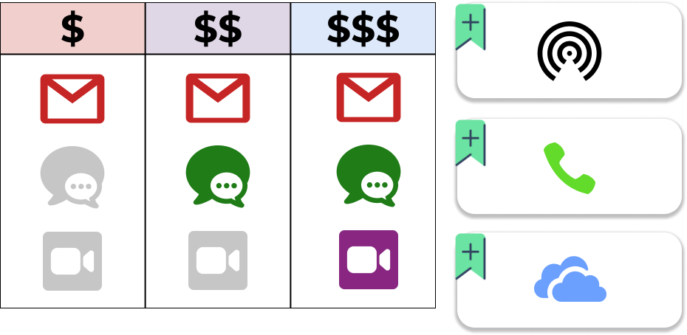
Optimization of Subscriptions
Depends on
Excludes
18

Slide 37
How can we do this?
19

Slide 38
C S O P
20

Slide 39
C S O P
Constraint
Satisfaction
Optimization
Problems
20

Slide 40
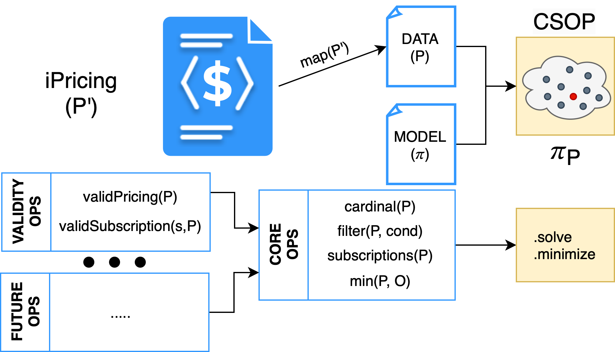
Our Proposal
21

Slide 41
Our Proposal
21

Slide 42


Our Proposal
FILTERED
CARDINALITY
FILTERED
CHEAPEST
SUBSCRIPTION
FILTERED
MOST
EXPENSIVE
SUBSCRIPTION
CARDINALITY
CHEAPEST
SUBSCRIPTION
MOST
EXPENSIVE
SUBSCRIPTION
Operations
On
demand
FILTER
Core
VALID SUBSCRIPTION
VALID PRICING
PRICING MODEL
iPricing
22

Slide 43
1
1
INTRODUCTION
2
PROPOSAL
3
EVALUATION
4
CONCLUSIONS
23

Slide 44


Evaluation Process
Stage 01
Verify validity and
results of
state-of-the-art
dataset
Stage 02
Design a benchmark of
pricing inconsistencies and
evaluate how many our
solution can detect
García-Fernández, A., Parejo, J. A., Cavero, F. J., & Ruiz-Cortés, A. (2024, December). Racing the market: An industry support
analysis for pricing-driven devops in SaaS. In International Conference on Service-Oriented Computing (pp. 260-275).
24

Slide 45







Evaluating Pricing Validity on a State-of-the-art Dataset
(Stage one)
+20% contain errors
30
SaaS
162
pricings
25 linked features mismatches
8 incorrect feature definitions
6
years
24223
configurations
1 future operation date
1 without prices
25

Slide 46

Comparing Configuration Space Metrics with State-of-the-art
(Stage one)
30
SaaS
162
pricings
6
years
24223
configurations
100%
25

Slide 47


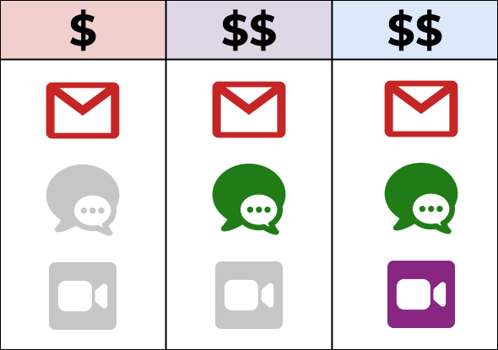
Design of Pricing Inconsistencies Benchmark
(Stage two)
Same Features Different Prices
Subsumed Plans
Empty Plans
Dummy Add-on
Dead Features
Non-available Add-on
Cyclic Add-on Dependencies
Different Features
Same Prices
Non-existent Feature
26

Slide 48


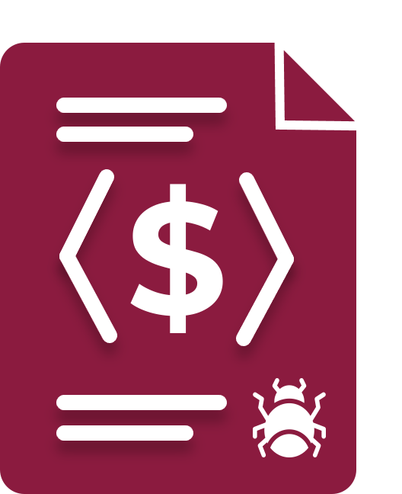

Detection of Pricing Inconsistencies in Benchmark
(Stage two)
65%
Higher Plan – Lower Price
Different Features
Same Prices
Same Features Different Prices
Empty Plans
Dead Features
Non-existent Feature
35%
Non-available Add-on
Dummy Add-on
Cyclic Add-on Dependencies
27

Slide 49
Detection of Pricing Inconsistencies in Benchmark
(Stage two)
Dummy Add-on
Cyclic Add-on Dependencies
28
Notes:
However, the seven undetected inconsistencies involve cases that go beyond the current scope
of this work and open opportunities for future research. For instance, our solution does not
currently address scenarios where one plan is subsumed by another, i.e. when a plan offers the
same features and usage limits as another but at a different price, or when a more expensive plan
provides inferior usage limits compared to a cheaper one. Additionally, detecting “dead elements”
within pricings —such as add-ons that cannot be contracted due to conflicting dependencies
or availability across plans— remains unaddressed. These types of validations require novel
operations and constraints that were not within the domain of this study, leaving them as
promising directions for further exploration

Slide 50
1
1
INTRODUCTION
2
PROPOSAL
3
EVALUATION
4
CONCLUSIONS
29

Slide 51
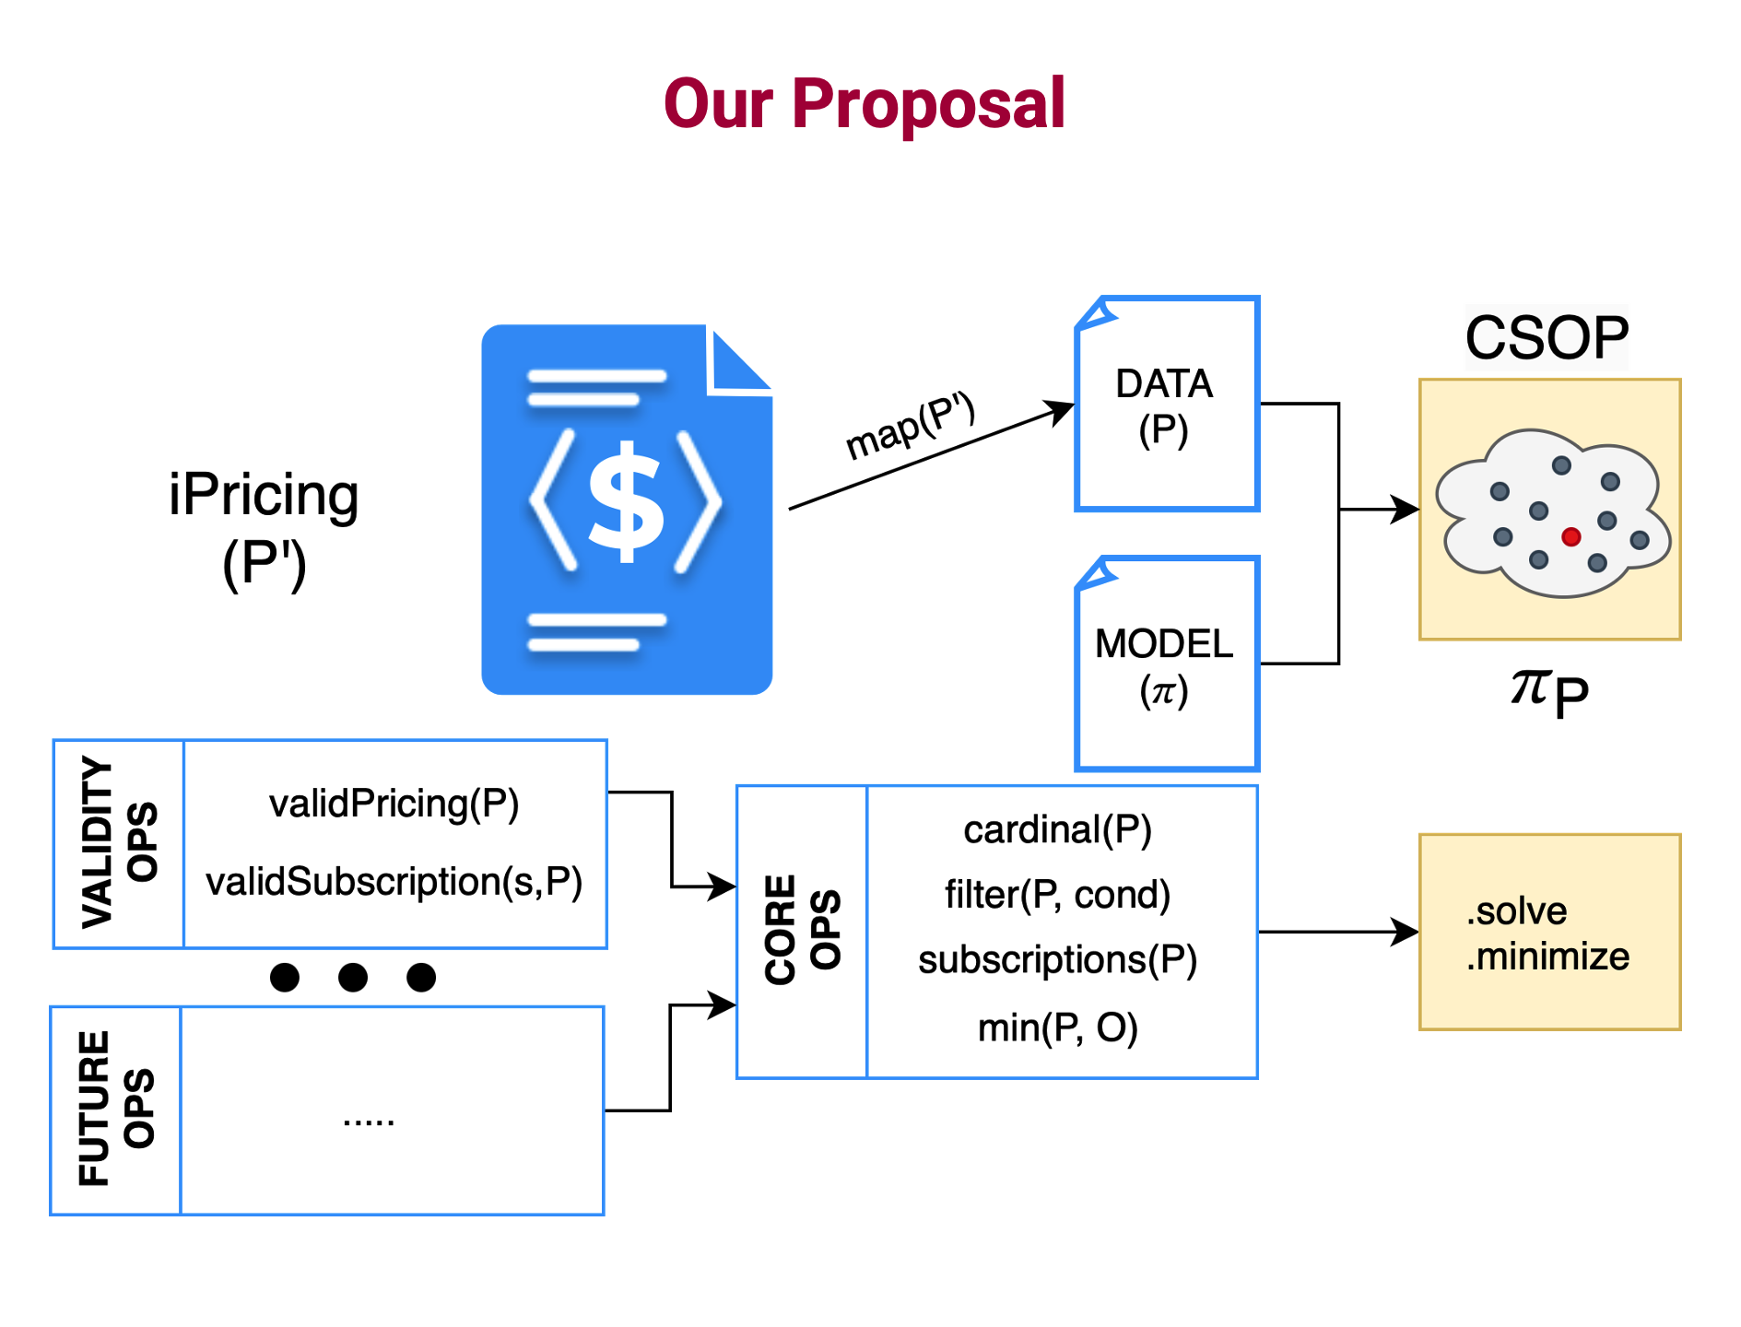
Conclusions
1. A generic, CSOP representation of iPricings.
30

Slide 52
Conclusions
1. A generic, CSOP representation of iPricings.
2. A mapping of iPricings into CSOP datafiles, which combined with the generic model creates a CSOP whose solutions define the iPricing’s configuration space.
30

Slide 53
Conclusions
1. A generic, CSOP representation of iPricings.
2. A mapping of iPricings into CSOP datafiles, which combined with the generic model creates a CSOP whose solutions define the iPricing’s configuration space.
3. An extensible core set of analysis operations.
30

Slide 54
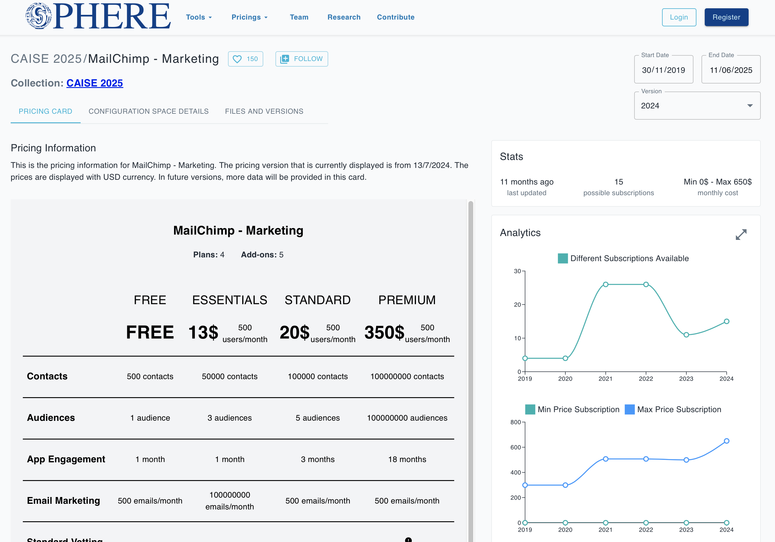
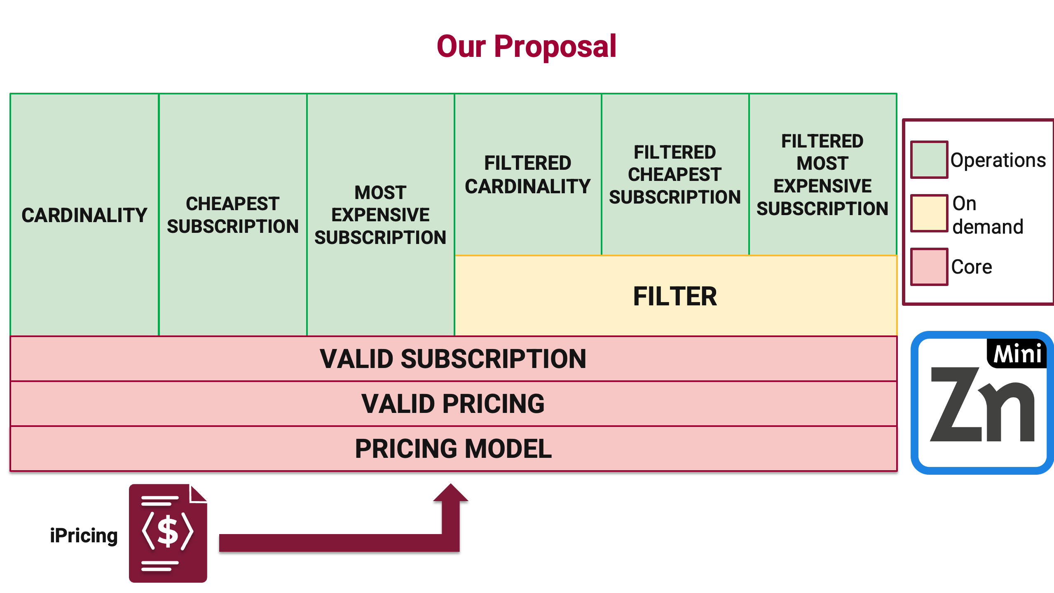
Conclusions
1. A generic, CSOP representation of iPricings.
2. A mapping of iPricings into CSOP datafiles, which combined with the generic model creates a CSOP whose solutions define the iPricing’s configuration space
3. An extensible core set of analysis operations.
4. A tool with a layered architecture that implements the approach using Minizinc as solver.
30

Slide 55
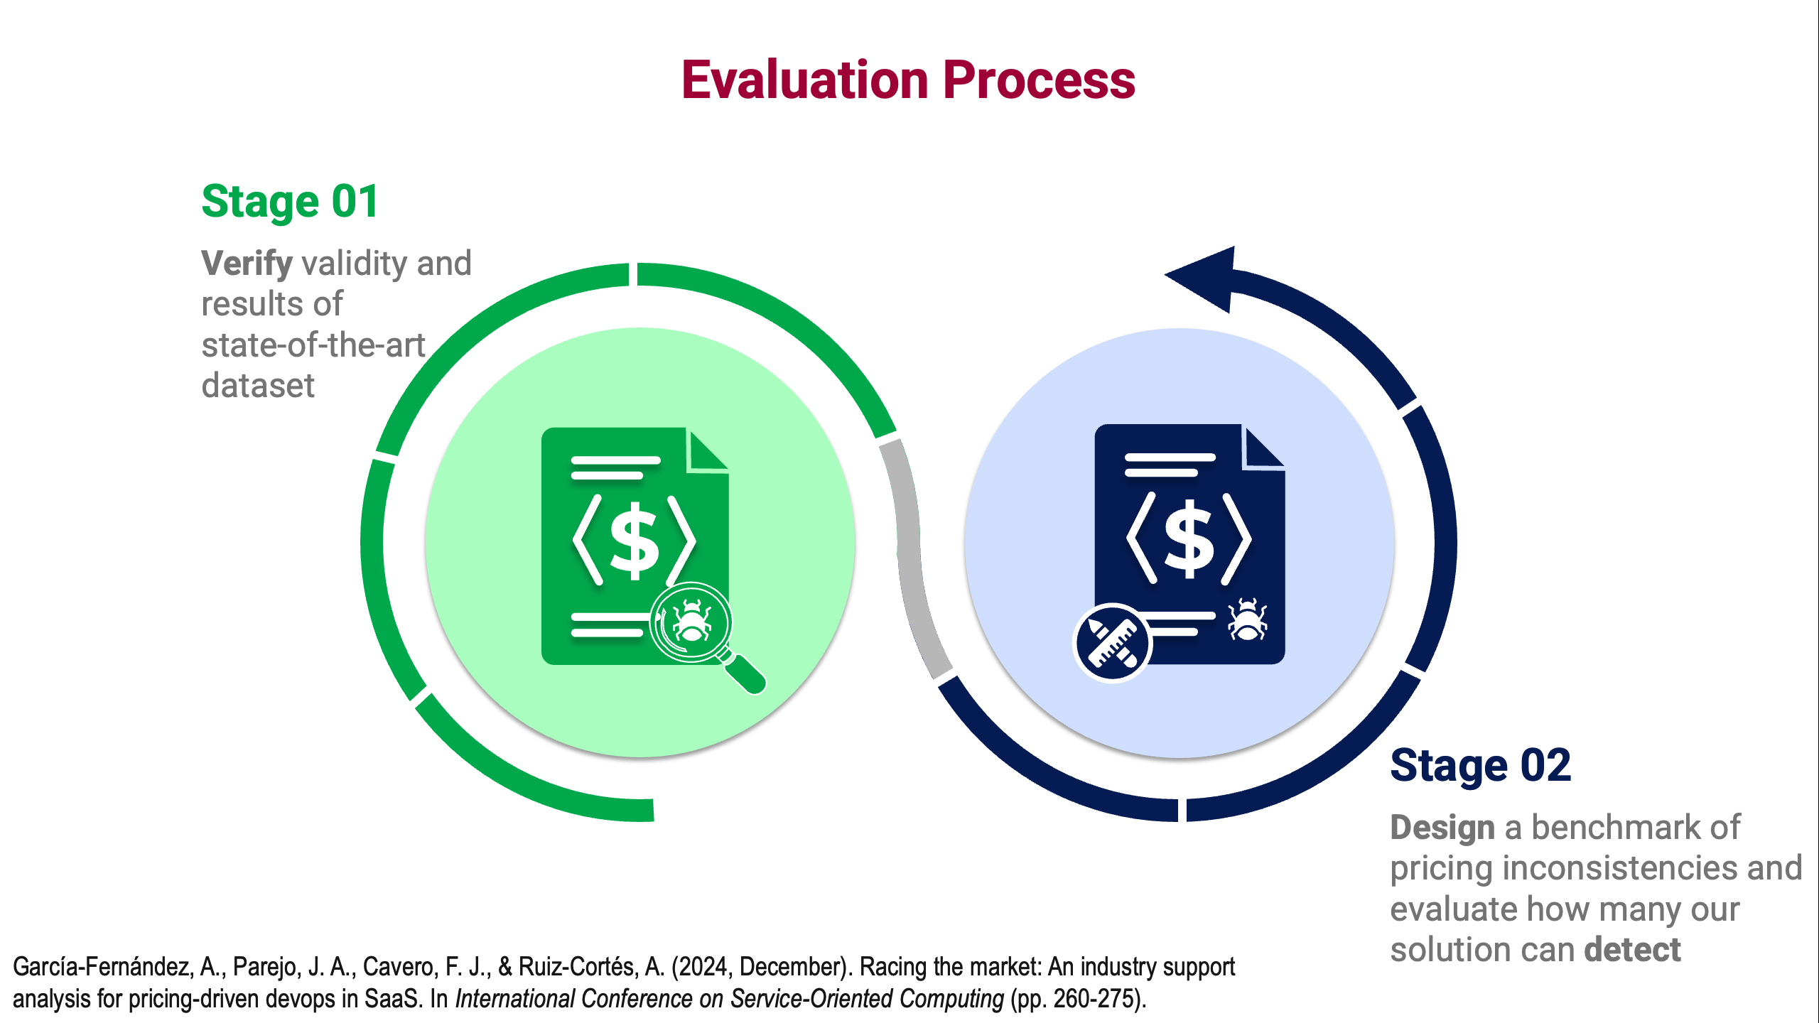
Conclusions
1. A generic, CSOP representation of iPricings.
2. A mapping of iPricings into CSOP datafiles, which combined with the generic model creates a CSOP whose solutions define the iPricing’s configuration space.
3. An extensible core set of analysis operations.
4. A tool with a layered architecture that implements the approach using Minizinc as solver.
5. A benchmark of pricing inconsistencies
that can be used to evaluate future solutions
in automated iPricing validation.
30

Slide 56



Automated Analysis of Pricings in SaaS-based Information Systems
Alejandro García-Fernández
(agarcia29@us.es)
Universidad de Sevilla, Seville, Spain
sphere.score.us.es
June 20th, 2025

