Slide 1



Pricing Intelligence: Rethinking IS Engineering in Volatile SaaS Environments
Francisco Javier Cavero, Alejandro García-Fernández, José Antonio Parejo, Manuel Resinas, Antonio Ruiz-Cortés
SCORE Lab, I3US, Universidad de Sevilla, Seville, Spain
CAiSE’26
10th June 2026

Slide 2
















SaaS Pricings
García-Fernández, A., Parejo, J. A., & Ruiz-Cortés, A. (2024, May). Pricing4saas: towards a pricing model to drive the operation of saas.
In International Conference on Advanced Information Systems Engineering (pp. 47-54). Cham: Springer Nature Switzerland.
2
Notes:
Pricings are structures that include a list of features, that are distributed among a set of plans, which determine the subset features that users will be able to access if they commit to pay the price. Moreover, plans can also impose strict or relaxed usage limits on some features, forcing users to upgrade their plan if they need to consume more resources.
Explain configuration space

Slide 3
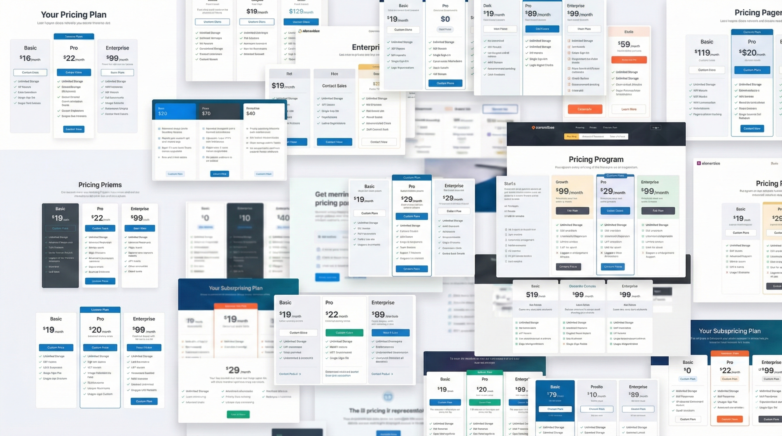
2
Notes:
Pricings are represented in web pricing pages in ad-hoc ways -> No standard notation

Slide 4


OPTIMIZE
Decision-makers
Value-cost
Pricing Intelligence is the discipline that turns pricing data into actionable knowledge.
What is the best subscription option among all these SaaS products for continous integration?
3
Notes:
Pricings are structures that include a list of features, that are distributed among a set of plans, which determine the subset features that users will be able to access if they commit to pay the price. Moreover, plans can also impose strict or relaxed usage limits on some features, forcing users to upgrade their plan if they need to consume more resources.
Explain configuration space

Slide 5


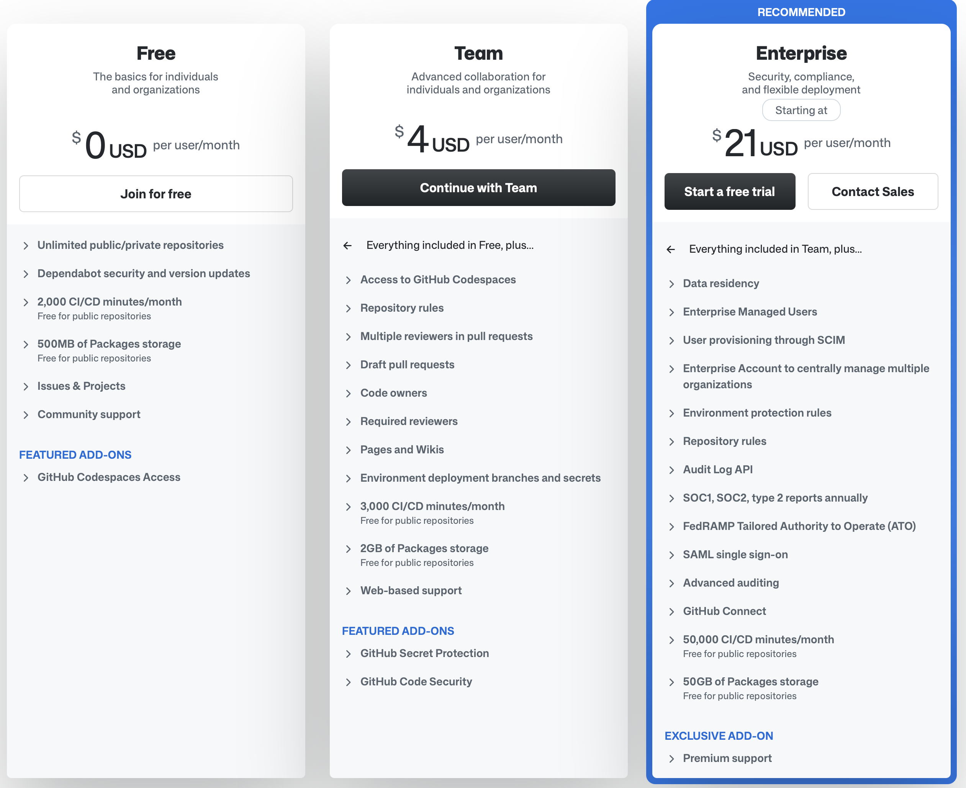
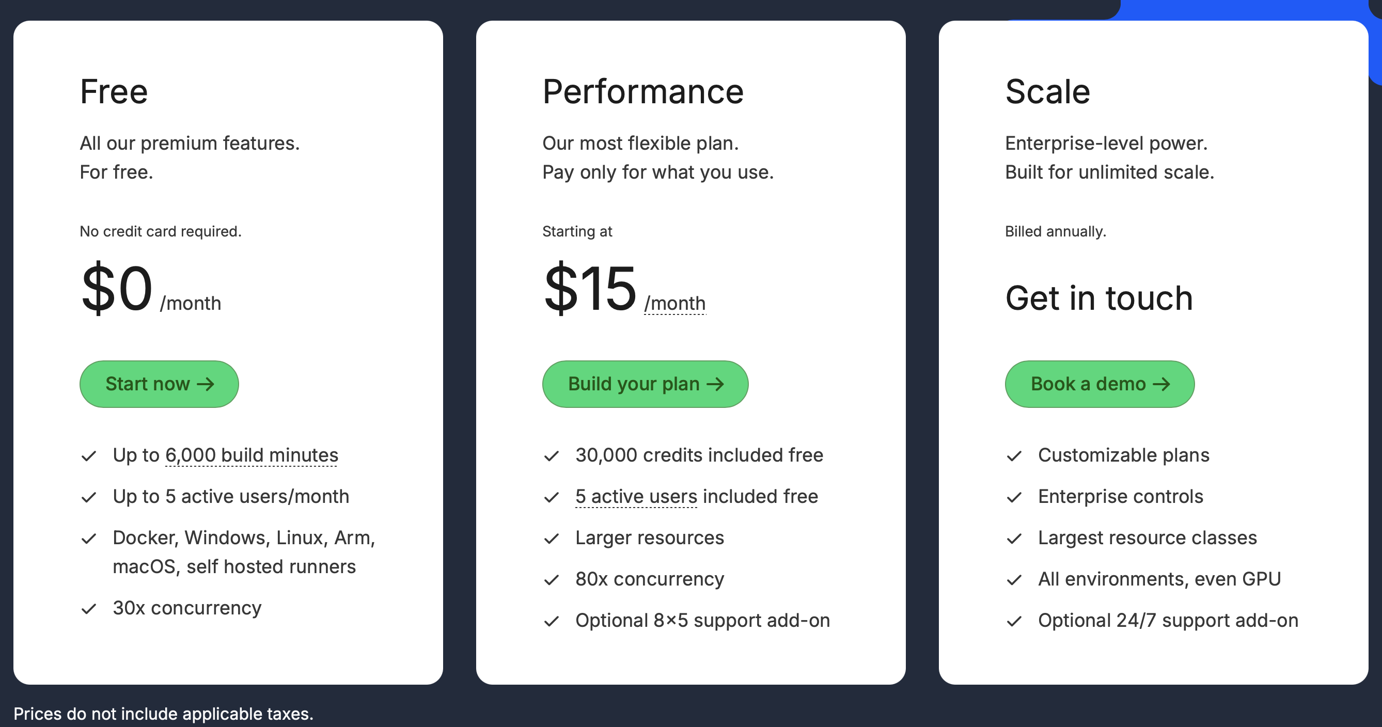
What is the best subscription option among all these SaaS products for continous integration?
3
Notes:
Pricings are structures that include a list of features, that are distributed among a set of plans, which determine the subset features that users will be able to access if they commit to pay the price. Moreover, plans can also impose strict or relaxed usage limits on some features, forcing users to upgrade their plan if they need to consume more resources.
Explain configuration space

Slide 6
SaaS Pricings
García-Fernández, A., Parejo, J. A., & Ruiz-Cortés, A. (2024, May). Pricing4SaaS: Towards a pricing model to drive the operation of SaaS. In International Conference on Advanced Information Systems Engineering (pp. 47-54). Cham: Springer Nature Switzerland.
4
Notes:
Pricings are structures that include a list of features, that are distributed among a set of plans, which determine the subset features that users will be able to access if they commit to pay the price. Moreover, plans can also impose strict or relaxed usage limits on some features, forcing users to upgrade their plan if they need to consume more resources.
Explain configuration space

Slide 7
SaaS Pricings
García-Fernández, A., Parejo, J. A., & Ruiz-Cortés, A. (2024, May). Pricing4SaaS: Towards a pricing model to drive the operation of SaaS. In International Conference on Advanced Information Systems Engineering (pp. 47-54). Cham: Springer Nature Switzerland.
4
Notes:
Pricings are structures that include a list of features, that are distributed among a set of plans, which determine the subset features that users will be able to access if they commit to pay the price. Moreover, plans can also impose strict or relaxed usage limits on some features, forcing users to upgrade their plan if they need to consume more resources.
Explain configuration space

Slide 8
SaaS Pricings
García-Fernández, A., Parejo, J. A., & Ruiz-Cortés, A. (2024, May). Pricing4SaaS: Towards a pricing model to drive the operation of SaaS. In International Conference on Advanced Information Systems Engineering (pp. 47-54). Cham: Springer Nature Switzerland.
4
Notes:
Pricings are structures that include a list of features, that are distributed among a set of plans, which determine the subset features that users will be able to access if they commit to pay the price. Moreover, plans can also impose strict or relaxed usage limits on some features, forcing users to upgrade their plan if they need to consume more resources.
Explain configuration space

Slide 9
SaaS Pricings
García-Fernández, A., Parejo, J. A., & Ruiz-Cortés, A. (2024, May). Pricing4SaaS: Towards a pricing model to drive the operation of SaaS. In International Conference on Advanced Information Systems Engineering (pp. 47-54). Cham: Springer Nature Switzerland.
4
Notes:
Pricings are structures that include a list of features, that are distributed among a set of plans, which determine the subset features that users will be able to access if they commit to pay the price. Moreover, plans can also impose strict or relaxed usage limits on some features, forcing users to upgrade their plan if they need to consume more resources.
Explain configuration space

Slide 10
SaaS Pricings
García-Fernández, A., Parejo, J. A., & Ruiz-Cortés, A. (2024, May). Pricing4SaaS: Towards a pricing model to drive the operation of SaaS. In International Conference on Advanced Information Systems Engineering (pp. 47-54). Cham: Springer Nature Switzerland.
4
Notes:
Pricings are structures that include a list of features, that are distributed among a set of plans, which determine the subset features that users will be able to access if they commit to pay the price. Moreover, plans can also impose strict or relaxed usage limits on some features, forcing users to upgrade their plan if they need to consume more resources.
Explain configuration space

Slide 11

Ⓢ(BASIC)
Ⓢ(BASIC, calls)
Ⓢ(PRO)
Ⓢ(PRO, calls)
Ⓢ(BUSINESS)
Ⓢ(BUSINESS, calls)
4
Notes:
Pricings are structures that include a list of features, that are distributed among a set of plans, which determine the subset features that users will be able to access if they commit to pay the price. Moreover, plans can also impose strict or relaxed usage limits on some features, forcing users to upgrade their plan if they need to consume more resources.
Explain configuration space

Slide 12
Configuration
Space
Ⓢ(BASIC)
Ⓢ(BASIC, calls)
Ⓢ(PRO)
Ⓢ(PRO, calls)
Ⓢ(BUSINESS)
Ⓢ(BUSINESS, calls)
4
Notes:
Pricings are structures that include a list of features, that are distributed among a set of plans, which determine the subset features that users will be able to access if they commit to pay the price. Moreover, plans can also impose strict or relaxed usage limits on some features, forcing users to upgrade their plan if they need to consume more resources.
Explain configuration space

Slide 13

Curse of Customization
Ⓢ(BASIC)
Ⓢ(GOLD)
Ⓢ(PLAT.)
García-Fernández, A., Parejo, J. A., & Ruiz-Cortés, A. (2024, Dec). Racing the Market: An Industry Support Analysis for Pricing-driven DevOps in SaaS.
In International Conference on Service-oriented Computing (pp. 260-275).
5

Slide 14
Curse of Customization
Ⓢ(BASIC)
Ⓢ(BASIC, calls)
Ⓢ(BASIC, cloud storage)
Ⓢ(BASIC, calls, cloud storage)
Ⓢ(GOLD)
Ⓢ(GOLD, calls)
Ⓢ(GOLD, cloud storage)
Ⓢ(GOLD, calls, cloud storage)
Ⓢ(PLAT.)
CALLS
Ⓢ(PLAT., calls)
Ⓢ(PLAT., cloud storage)
Ⓢ(PLAT., calls, cloud storage)
CLOUD STORAGE
5

Slide 15
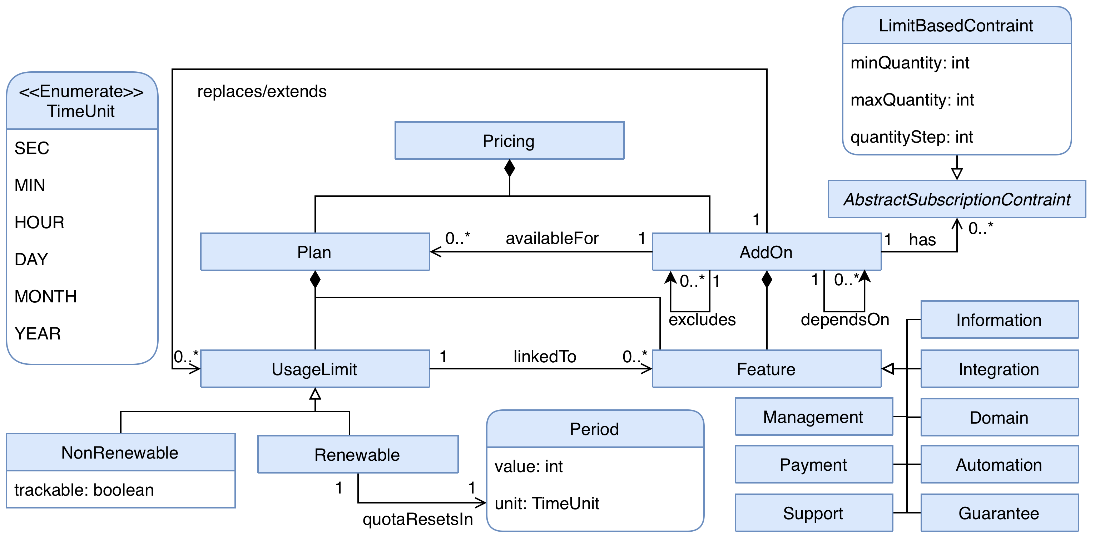
Intelligent Pricing (iPricing)
García-Fernández, A., Parejo, J. A., & Ruiz-Cortés, A. (2025, Dec). iSubscription: Bridging the Gap between Contracts and Runtime Access Control in SaaS.
In International Conference on Service-Oriented Computing (pp. 51-66).
6
Notes:
A strategic, data-driven discipline that integrates these tools, methodologies and processes to optimize both decision-making and the value–cost relationship. PI transforms relevant data into information, and information into actionable knowledge for decision-makers, i.e. human prosumers or automated agents. Analogous to Business Intelligence (BI), which empowers prosumers, to make informed decisions based on data, PI enables them to reason about pricing, extracting actionable insights from their structure and evolution.

Slide 16


Intelligent Pricing (iPricing)
7
Notes:
A strategic, data-driven discipline that integrates these tools, methodologies and processes to optimize both decision-making and the value–cost relationship. PI transforms relevant data into information, and information into actionable knowledge for decision-makers, i.e. human prosumers or automated agents. Analogous to Business Intelligence (BI), which empowers prosumers, to make informed decisions based on data, PI enables them to reason about pricing, extracting actionable insights from their structure and evolution.

Slide 17
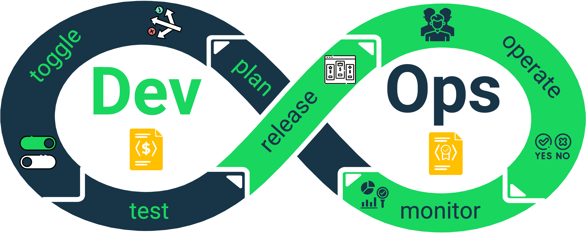
Intelligent Pricing (iPricing)
Input: An URL pointing to a SaaS Pricing Page
Output: A valid iPricing
Input: A valid iPricing
Output: The result of applying one of the available operations
Available operations: Optimal, Filter, Valid
We want to interpret PI tasks and orchestrate heterogeneous tools under a unified analytical process.
8
Notes:
A strategic, data-driven discipline that integrates these tools, methodologies and processes to optimize both decision-making and the value–cost relationship. PI transforms relevant data into information, and information into actionable knowledge for decision-makers, i.e. human prosumers or automated agents. Analogous to Business Intelligence (BI), which empowers prosumers, to make informed decisions based on data, PI enables them to reason about pricing, extracting actionable insights from their structure and evolution.

Slide 18
Pricing Intelligence (PI)
PI task
feeds
answers
Automates modeling from SaaS pricing pages to valid iPricings.
Runs pricing analyses such as optimal, filter and valid configurations.
We want to interpret PI tasks and orchestrate heterogeneous tools under a unified analytical process.
7
Notes:
A strategic, data-driven discipline that integrates these tools, methodologies and processes to optimize both decision-making and the value–cost relationship. PI transforms relevant data into information, and information into actionable knowledge for decision-makers, i.e. human prosumers or automated agents. Analogous to Business Intelligence (BI), which empowers prosumers, to make informed decisions based on data, PI enables them to reason about pricing, extracting actionable insights from their structure and evolution.

Slide 19
Pricing Intelligence (PI)
Decision-makers
OPTIMIZE
Value-cost
9
Notes:
A strategic, data-driven discipline that integrates these tools, methodologies and processes to optimize both decision-making and the value–cost relationship. PI transforms relevant data into information, and information into actionable knowledge for decision-makers, i.e. human prosumers or automated agents. Analogous to Business Intelligence (BI), which empowers prosumers, to make informed decisions based on data, PI enables them to reason about pricing, extracting actionable insights from their structure and evolution.

Slide 20
Pricing Intelligence (PI)
Decision-makers
Ask PI tasks:
“Which provider is cheaper for my usage?”
Semantic gap
+
Orchestration gap
What should be executed?
PI tools
Require precise actions, parameters and pricing artifacts.
Pricing Intelligence is the discipline that turns pricing data into actionable knowledge.
10
Notes:
A strategic, data-driven discipline that integrates these tools, methodologies and processes to optimize both decision-making and the value–cost relationship. PI transforms relevant data into information, and information into actionable knowledge for decision-makers, i.e. human prosumers or automated agents. Analogous to Business Intelligence (BI), which empowers prosumers, to make informed decisions based on data, PI enables them to reason about pricing, extracting actionable insights from their structure and evolution.

Slide 21
Pricing Intelligence Interpretation Process (PIIP)
ACCESIBILITY LAYER
ORCHESTRATION LAYER
CAPABILITY LAYER
11

Slide 22
Capability Layer
ACCESIBILITY LAYER
ORCHESTRATION LAYER
CAPABILITY LAYER
MCP SERVER
11

Slide 23

Holistic Agent for Reasoning on Value and Economic analYsis (H.A.R.V.E.Y.)
ACCESIBILITY LAYER
ORCHESTRATION LAYER
CAPABILITY LAYER
11

Slide 24
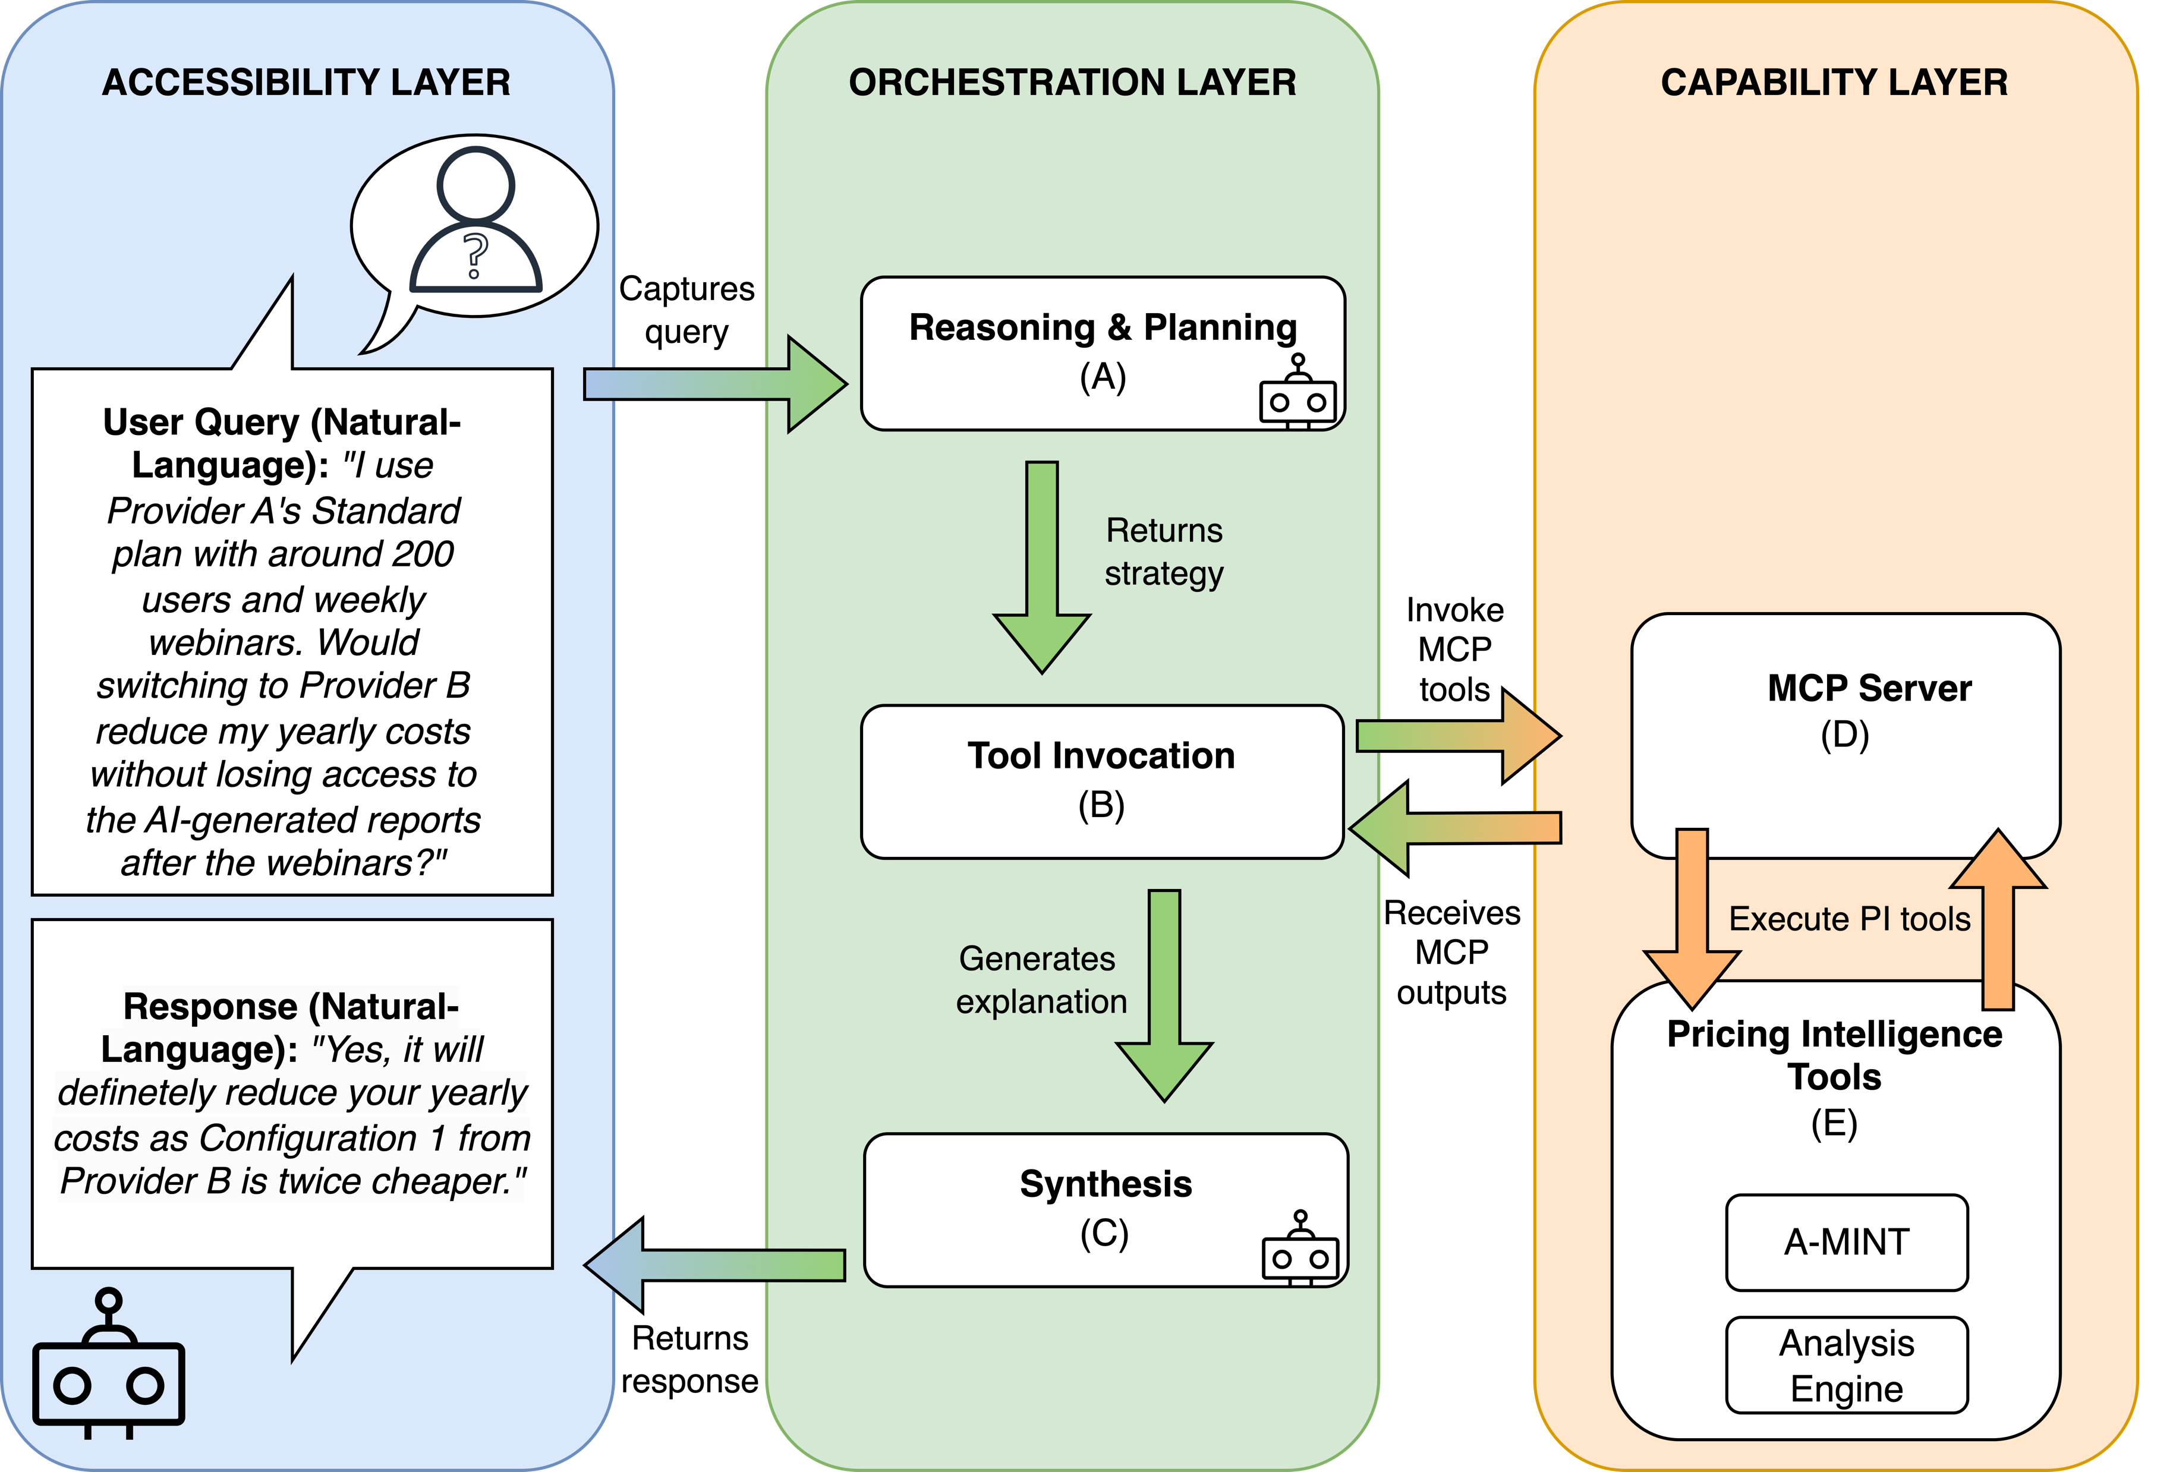
H.A.R.V.E.Y. Architecture
ACCESIBILITY LAYER
ORCHESTRATION LAYER
CAPABILITY LAYER
12

Slide 25
H.A.R.V.E.Y. Architecture
ACCESIBILITY LAYER
ORCHESTRATION LAYER
CAPABILITY LAYER
12

Slide 26
H.A.R.V.E.Y. Architecture
ACCESIBILITY LAYER
ORCHESTRATION LAYER
CAPABILITY LAYER
12

Slide 27
H.A.R.V.E.Y. Architecture
ACCESIBILITY LAYER
ORCHESTRATION LAYER
CAPABILITY LAYER
12

Slide 28
H.A.R.V.E.Y. Architecture
ACCESIBILITY LAYER
ORCHESTRATION LAYER
CAPABILITY LAYER
12

Slide 29
H.A.R.V.E.Y. Architecture
ACCESIBILITY LAYER
ORCHESTRATION LAYER
CAPABILITY LAYER
12

Slide 30
H.A.R.V.E.Y. Architecture
ACCESIBILITY LAYER
ORCHESTRATION LAYER
CAPABILITY LAYER
12

Slide 31
H.A.R.V.E.Y. Architecture
ACCESIBILITY LAYER
ORCHESTRATION LAYER
CAPABILITY LAYER
12

Slide 32
Evaluation
RQ1
To what extent do current PI tools cover the elicited PI tasks?
Tool coverage
Characterizes the current scope of PI support and exposes open needs.
RQ2
Can HARVEY generate the correct actions and parameters?
Strategy generation
Measures structural correctness with weighted precision, recall and F1.
RQ3
When action and parameter match, are the values correct?
Value assignment
Isolates grounding errors from upstream strategy-selection errors.
13

Slide 33



Methodology
30 Answerable PI task templates
11 participants
Manual Review (T1)
Structural Filtering (T2)
Answerability Assesment
(T3)
Raw templates (T0)
150 PI tasks
26 Non-Answerable PI task templates
2 LLMs
13

Slide 34
Methodology
11 participants
Manual Review (T1)
Structural Filtering (T2)
56 PI tasks templates
“Which of these SaaS is more customizable: {{SAAS 1}} or {{SAAS 2}}?”
Raw templates (T0)
2 LLMs
14

Slide 35
Current Coverage of PI Needs
Interpretation
54%
Not only a HARVEY limitation
An empirical map of PI support
Shows where new analytical primitives are needed
coverage
30 answerable templates
26 non-answerable templates
56 curated templates
Open gaps
Comparative
What-if
Predictive
Coverage = |AT| / |T2|
Subscription
Cost-aware
These categories become the research agenda for the next PI tools.
15

Slide 36

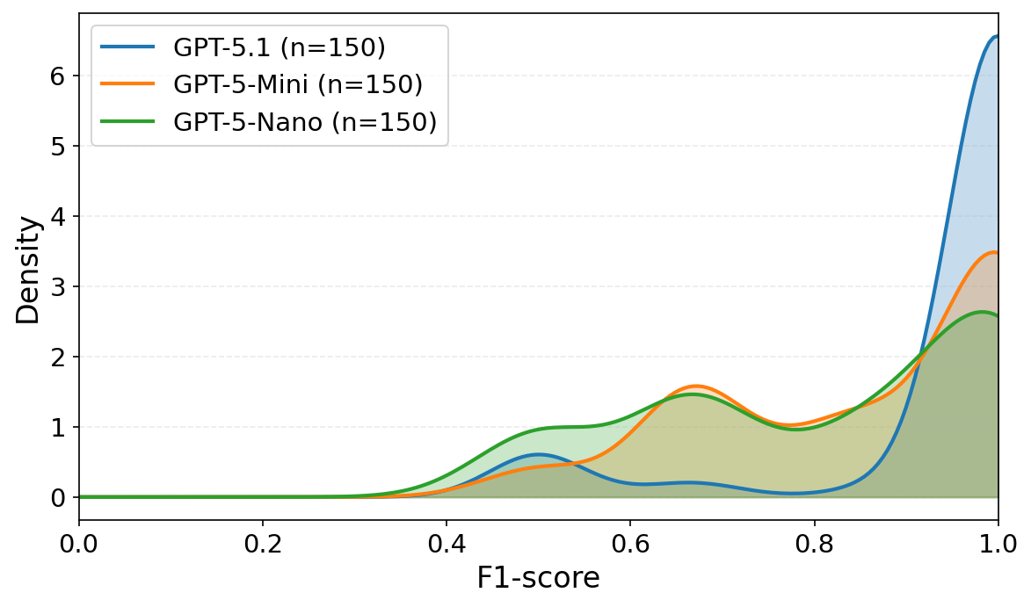



Strategy and Value Accuracy
gpt-5.1
gpt-5-mini
gpt-5-nano
15

Slide 37
Strategy and Value Accuracy
Model
Median weighted F1
Value accuracy
GPT-5.1
1.00
100%
GPT-5-Mini
0.97
100%
GPT-5-Nano
0.86
100%
RQ2: Can HARVEY generate the correct actions and parameters?
RQ3: When action and parameter match, are the values correct?
HARVEY remains reliable across LLM sizes, with stronger models closer to perfect strategy generation.
Matched parameters are instantiated correctly: median value-level accuracy is 100%.
16

Slide 38
Strategy and Value Accuracy
Model
Median weighted F1
Value accuracy
GPT-5.1
1.00
100%
GPT-5-Mini
0.97
100%
GPT-5-Nano
0.86
100%
Can HARVEY generate the correct actions and parameters?
RQ2 finding
HARVEY remains reliable across LLM sizes, with stronger models closer to perfect strategy generation.
16

Slide 39
Strategy and Value Accuracy
Model
Median weighted F1
Value accuracy
GPT-5.1
1.00
100%
GPT-5-Mini
0.97
100%
GPT-5-Nano
0.86
100%
When action and parameter match, are the values correct?
RQ3 finding
Matched parameters are instantiated correctly: median value-level accuracy is 100%.
16

Slide 40

17

Slide 41
“What are the similarities and diﬀerences between these two service oﬀerings for a company with more than 200 users?”
Comparative
Analysis
17

Slide 42
“Which would be the optimal configuration for my needs if the analytics add-on was removed?”
Comparative
Analysis
”What-if”
Analyses
17

Slide 43
“Based on previous changes, how likely is this provider to reduce its API usage limits in the next six months?”
”What-if”
Analyses
Predictive
Reasoning
Comparative
Analysis
17

Slide 44
“How are our current users distributed across the available pricing configurations, and which subscriptions are underutilized?”
Predictive
Reasoning
Subscription
Analytics
”What-if”
Analyses
Comparative
Analysis
17

Slide 45
“Does our pricing maximizes subscription revenue while keeping operational costs under control for 10,000 monthly API calls?”
Subscription
Analytics
Cost-aware
Reasoning
$
Predictive
Reasoning
Comparative
Analysis
”What-if”
Analyses
17

Slide 46
Cost-aware
Reasoning
Comparative
Analysis
$
Subscription
Analytics
”What-if”
Analyses
Predictive
Reasoning
17

Slide 47
Cost-aware
Reasoning
Comparative
Analysis
$
MCP SERVER
Subscription
Analytics
”What-if”
Analyses
Predictive
Reasoning
18

Slide 48
Conclusions
OPTIMIZE
Decision-makers
Value-cost
ACCESIBILITY LAYER
ORCHESTRATION LAYER
CAPABILITY LAYER
19

Slide 49



Pricing Intelligence: Rethinking IS Engineering in Volatile SaaS Environments
Francisco Javier Cavero López, Alejandro García-Fernández, José Antonio Parejo, Manuel Resinas, Antonio Ruiz-Cortés
(fcavero@us.es)
SCORE Lab, I3US, Universidad de Sevilla, Seville, Spain
QACO
CAiSE’26
10th June 2026
PACO

