Slide 1



From Static to Intelligent:
Evolving SaaS Pricing with LLMs
Francisco Javier Cavero
Juan C. Alonso
Antonio Ruiz-Cortés
SCORE Lab, I3US Institute, Universidad de Sevilla
Seville, Spain
SOC4AI · ICSOC’24
December 3rd, 2024 · Tunis, Tunisia

Slide 2











What is a pricing?
2
Notes:
El pricing estructura que

Slide 3

What is a pricing?
2
Notes:
El pricing estructura que

Slide 4
What is a pricing?
2
Notes:
El pricing estructura que

Slide 5




What is a pricing?
2
Notes:
El pricing estructura que

Slide 6
What is a pricing?
2
Notes:
El pricing estructura que

Slide 7



What is a pricing?
2
Notes:
El pricing estructura que

Slide 8


What is a pricing?
2
Notes:
El pricing estructura que

Slide 9


What is a pricing?
2
Notes:
El pricing estructura que

Slide 10


What is a pricing?
2
Notes:
El pricing estructura que

Slide 11
What is a pricing?
2
Notes:
El pricing estructura que

Slide 12
What is a pricing?
2
Notes:
El pricing estructura que

Slide 13
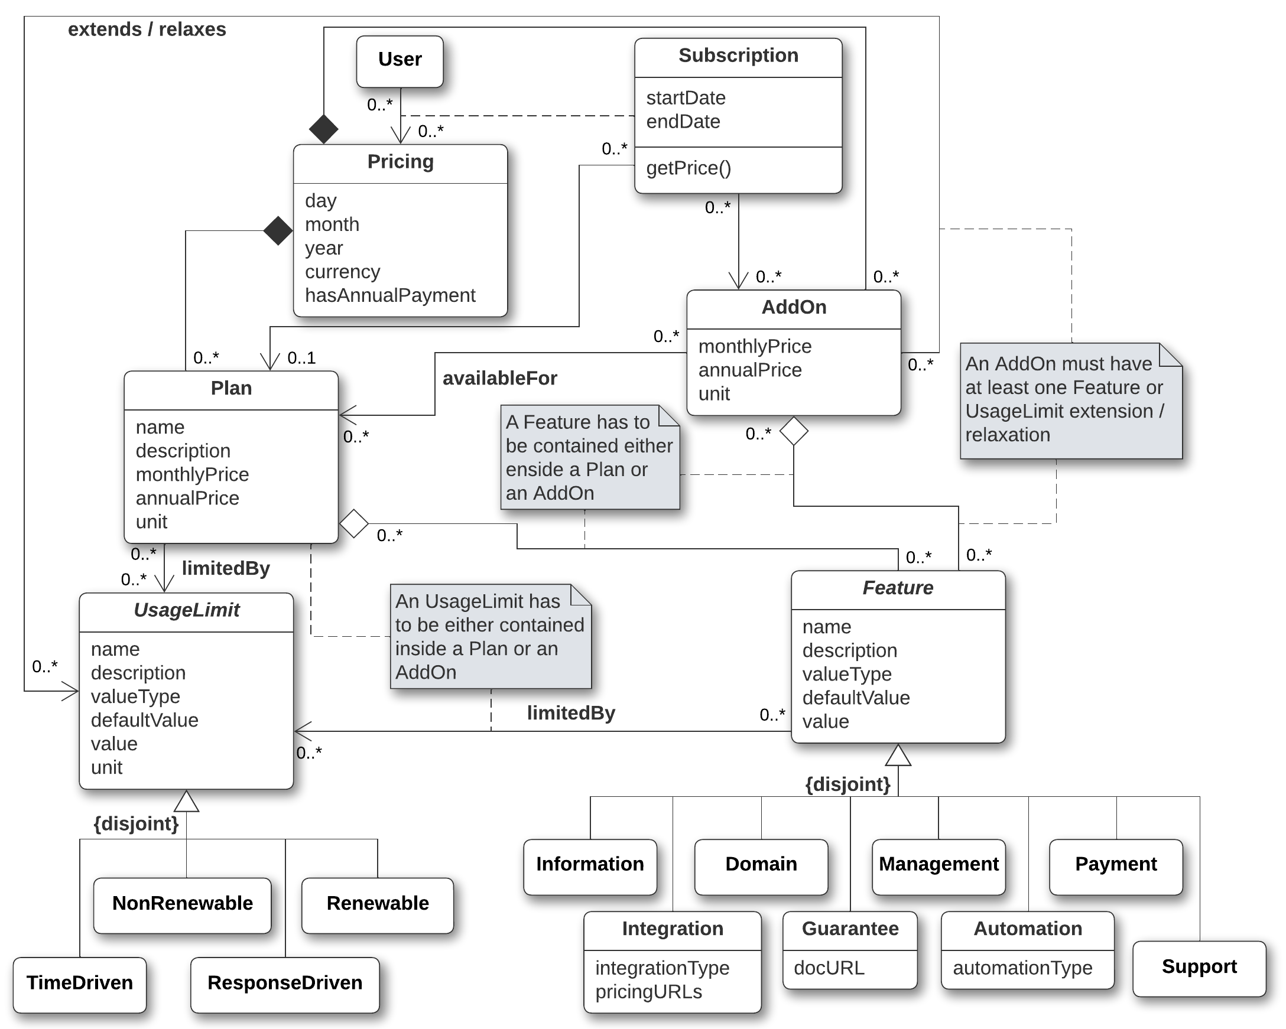
What is Pricing4SaaS?
García-Fernández, A., Parejo, J. A., Ruiz-Cortés, A. (2024). Pricing4SaaS: Towards a pricing model to drive the operation of SaaS. In International Conference on Advanced Information Systems Engineering (pp. 47-54). Cham: Springer Nature Switzerland.
3

Slide 14
What is Pricing4SaaS?
García-Fernández, A., Parejo, J. A., Ruiz-Cortés, A. (2024). Pricing4SaaS: Towards a pricing model to drive the operation of SaaS. In International Conference on Advanced Information Systems Engineering (pp. 47-54). Cham: Springer Nature Switzerland.
3

Slide 15
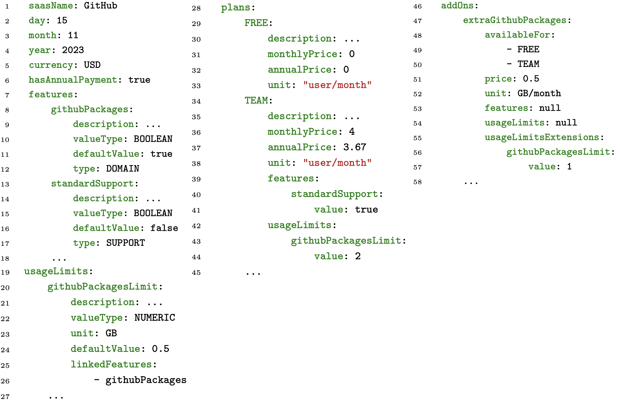
What is Pricing2Yaml?
García-Fernández, A., Parejo, J. A., Ruiz-Cortés, A. (2024). Pricing4SaaS: Towards a pricing model to drive the operation of SaaS. In International Conference on Advanced Information Systems Engineering (pp. 47-54). Cham: Springer Nature Switzerland.
4

Slide 16
What is Pricing2Yaml?
García-Fernández, A., Parejo, J. A., Ruiz-Cortés, A. (2024). Pricing4SaaS: Towards a pricing model to drive the operation of SaaS. In International Conference on Advanced Information Systems Engineering (pp. 47-54). Cham: Springer Nature Switzerland.
4

Slide 17
What is an iPricing?
Dynamic and Machine-Readable Structure
Alignment with SaaS Business Objectives
Integration of Automation and Autonomy
Foundation on Pricing4SaaS
5

Slide 18
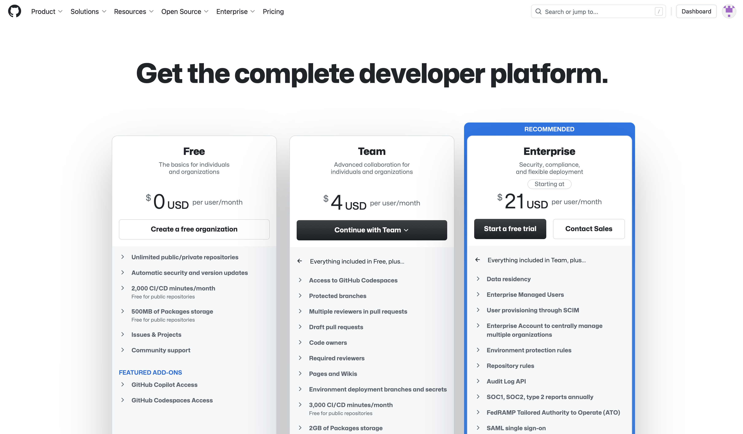

LLMs
6

Slide 19
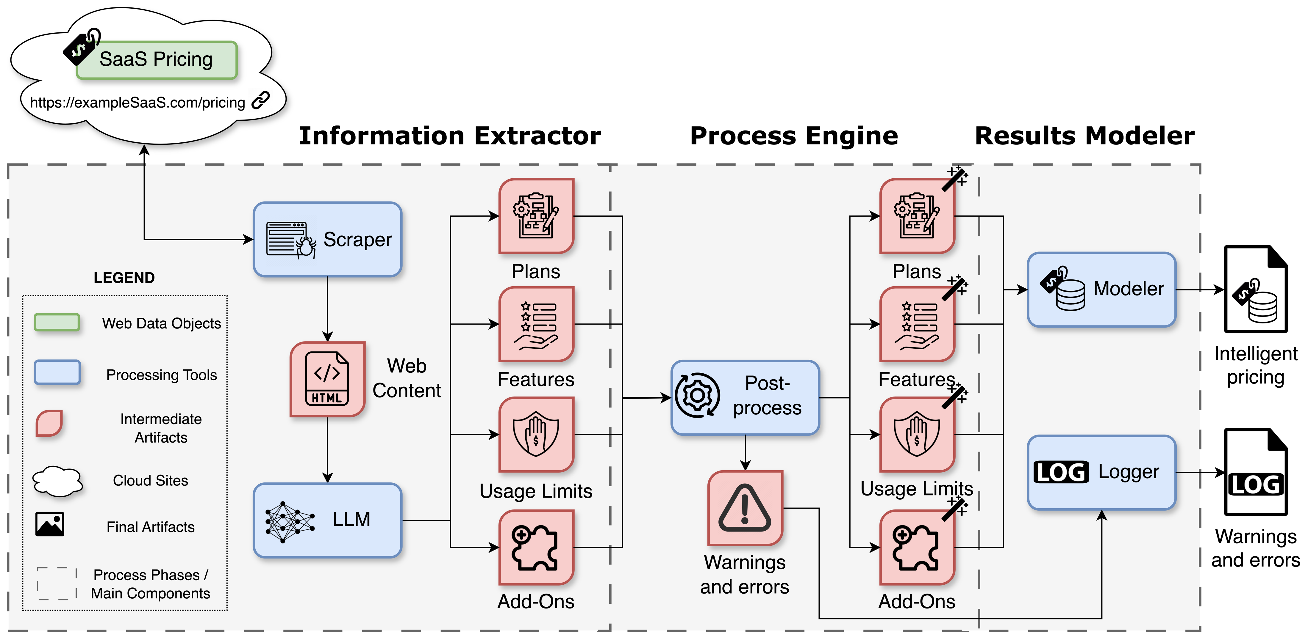
What are we proposing?
7

Slide 24

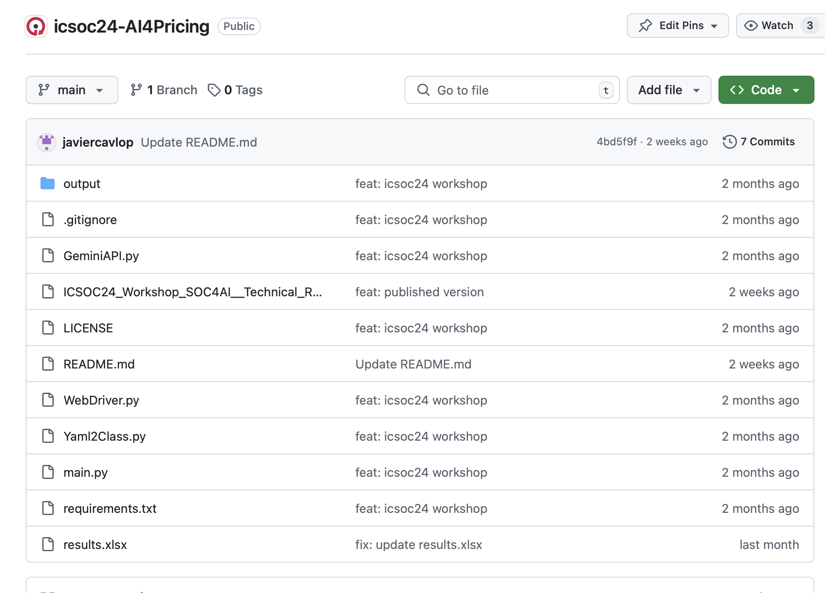

What is AI4Pricing?
8

Slide 25
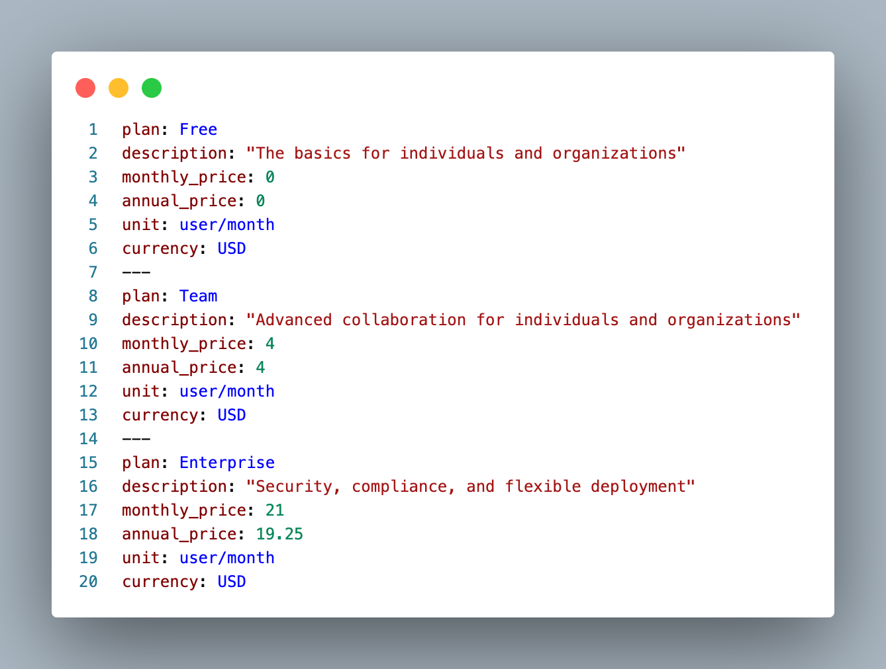
9

Slide 26
9

Slide 27
9

Slide 28
How did we evaluate it?
Point-based system
1
3
TP
FN
Element should be extracted (it was)
Element should be extracted (it was not)
Accuracy
Precision
Recall
2
4
FP
TN
Element should
not be extracted (it was)
Element should not be extracted (it was not)
10

Slide 29














How did we evaluate it?
Ground Truth
True Positives
11

Slide 30


How did we evaluate it?
Ground Truth
False Positives
11

Slide 31
How did we evaluate it?
Ground Truth
False Negatives
11

Slide 32

How did we evaluate it?
Ground Truth
True Negatives
11

Slide 33
How did we evaluate it?
Ground Truth
Half Points
0.5 TP & 0.5 FN
0.5 TP & 0.5 FP
11

Slide 34
What are the results?
- SaaS: GitHub, Jira, Clockify, Microsoft Office…
30 SaaS
- Extracted: Plans
- HTML tag (<table />): Yes
15 SaaS
- Extracted: Features, Usage Limits, Add-Ons
12

Slide 35
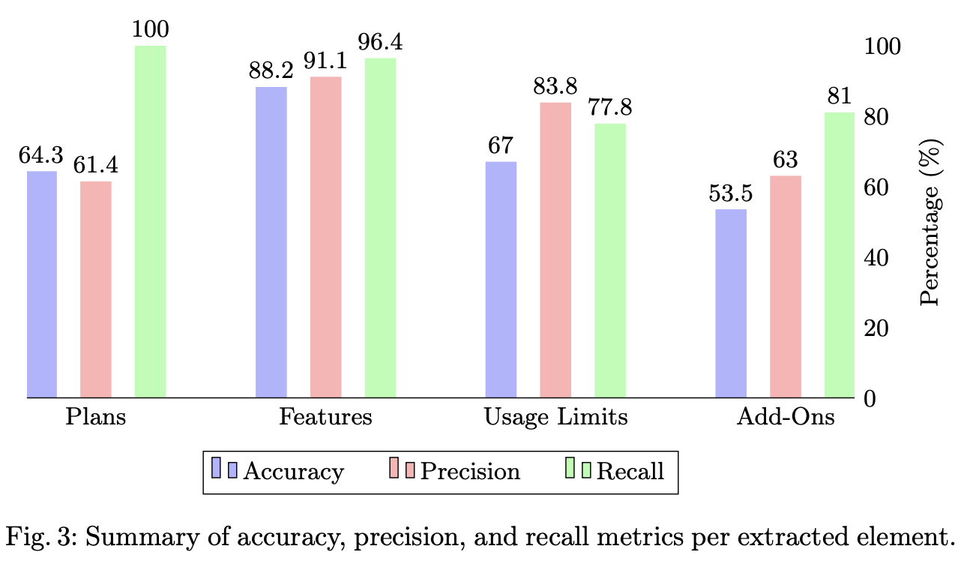
What are the results?
13

Slide 36
What are the results?
13

Slide 37
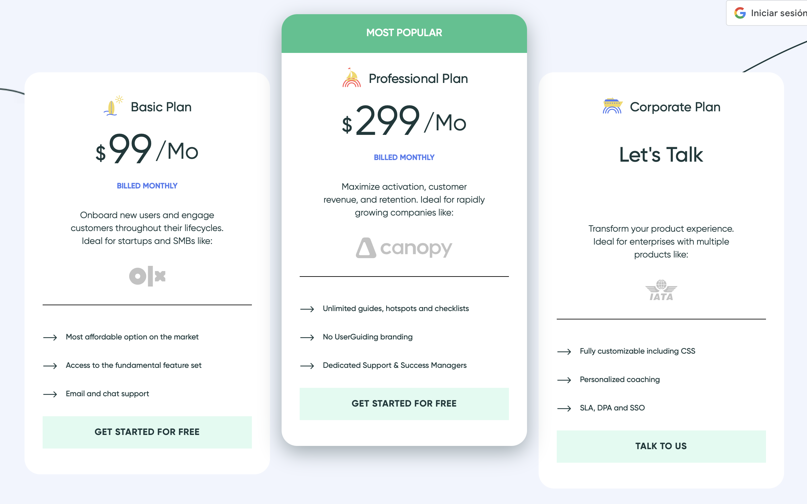
What would be the ideal extraction?
14

Slide 38
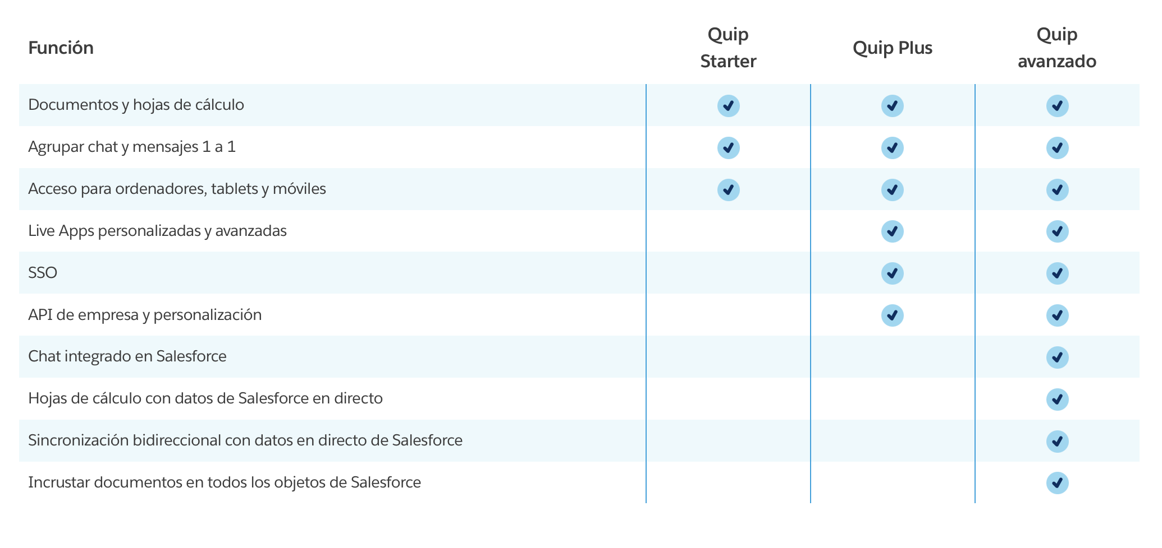
What would be the ideal extraction?
14

Slide 39
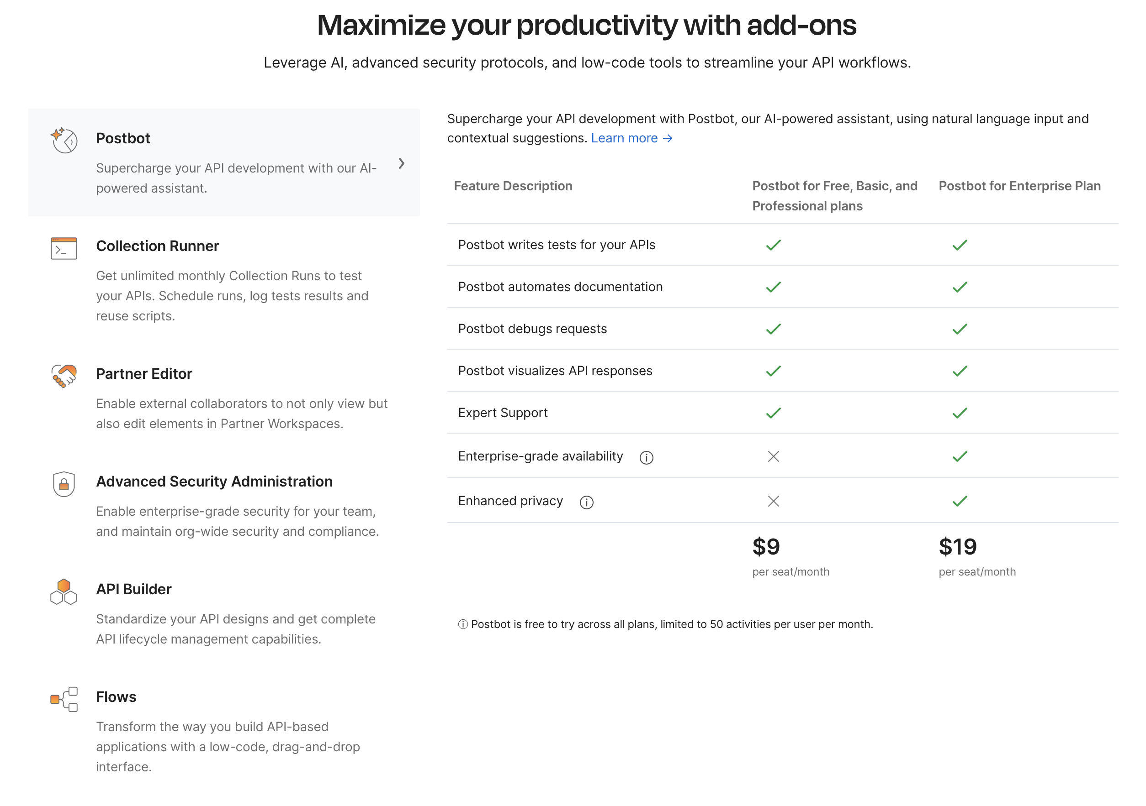
What would be the ideal extraction?
14

Slide 40
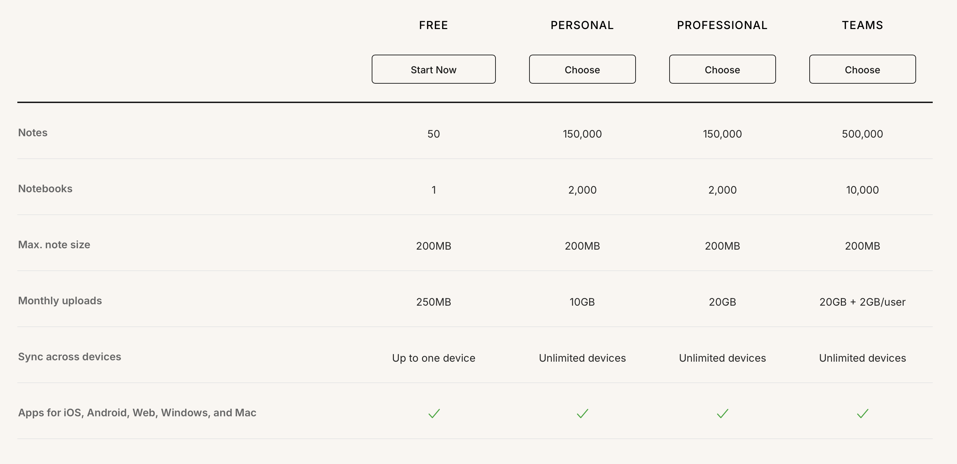
What would be the ideal extraction?
14

Slide 41
What would be the ideal extraction?
14

Slide 42
14

Slide 43
What challenges arise?
Advanced Models
Internal
LLM Agent
A
D
Prompt Engineering
1
Multimodal LLM
B
E
2
Advanced Functions
External
Knowledge Graphs
C
F
15

Slide 44
What are the conclusions?
Demonstrated Feasibility and Performance
Impact on the SaaS Ecosystem
Future Directions
16

Slide 45


Thanks!
Questions?
Francisco Javier Cavero López
fcavero@us.es

